Slide 1
Linear Circuits 1
ECET 250E
Week 6 | Chapter 7: First-Order Circuits
Camosun College
Electronics & Computer Engineering Technology
Mozhgan Bacon, PhD, P.Eng.
Fall 2026
Based on Fundamentals of Electric Circuits, 2026 Release — C.K. Alexander, M.N.O. Sadiku & S.J. Fredette (McGraw Hill)

Slide 2
Overview
This chapter examines R C and L C circuits’ reaction to switched sources.
The circuits are referred to as first order circuits.
Three special functions, the unit step, unit impulse, and unit ramp function are also introduced.
Both source free and switched sources are examined.

Slide 3
First Order Circuits
A first order circuit is characterized by a first order differential equation.
There are two types of first order circuits:
Resistive capacitive, called R C.
Resistive inductive, called R L.
There are also two ways to excite the circuits:
Initial conditions.
Independent sources.

Slide 4
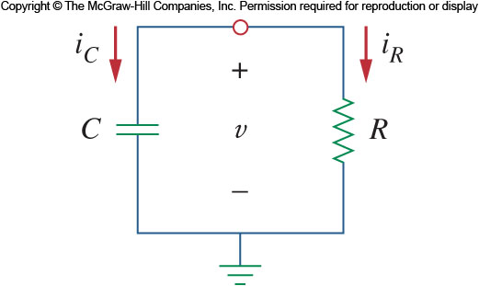
Source Free R C Circuit
A source free R C circuit occurs when its d c source is suddenly disconnected.
The energy stored in the capacitor is released to the resistors.
Consider a series combination of a resistor and a initially charged capacitor as shown:

Slide 5
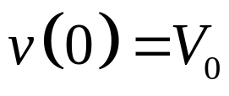
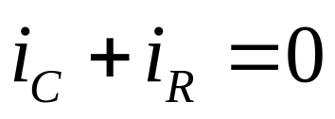
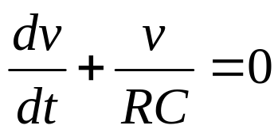
Source Free R C Circuit
Since the capacitor was initially charged, we can assume at t=0 the initial voltages is:
Applying K C L at the top node:
Or
This is a first order differential equation.

Slide 6
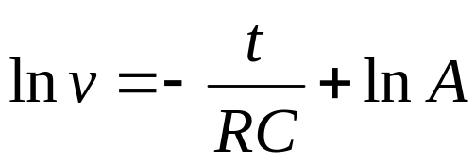
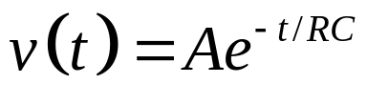
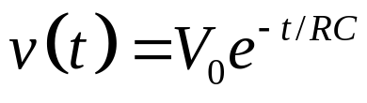
Source Free R C Circuit 3
Rearranging the equation and solving both sides yields(integrating both sides):
Where A is the integration constant.
Taking powers of e produces Taking powers of e produces.
With the initial conditions:

Slide 7
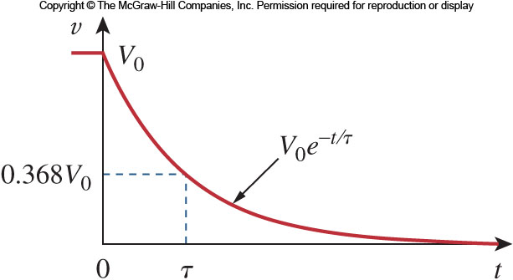
Natural Response
The result shows that the voltage response of the R C circuit is an exponential decay of the initial voltage.
Since this is the response of the circuit without any external applied voltage or current, the response is called the natural response.

Slide 8


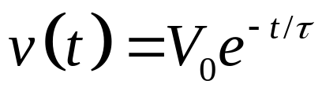
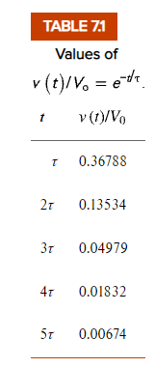
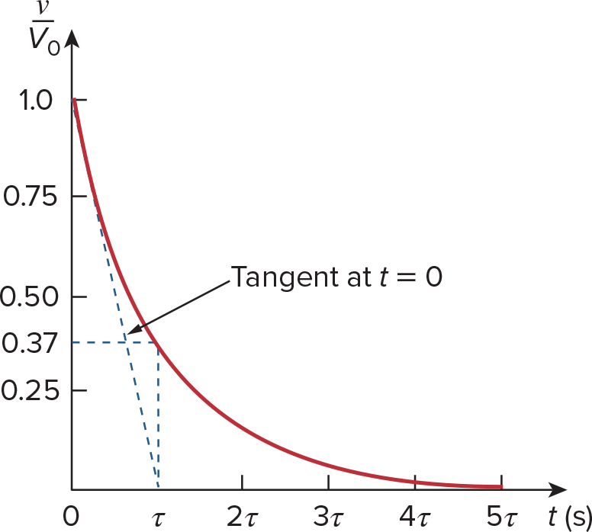
Time Constant
The speed at which the voltage decays can be characterized by how long it takes the voltage to
drop to
of the initial voltage.
This is called the time constant and is represented by τ.
By selecting
as the reference voltage:
The voltage can thus be expressed as:
Graphical determination of the time constant τ from the response curve.

Slide 9
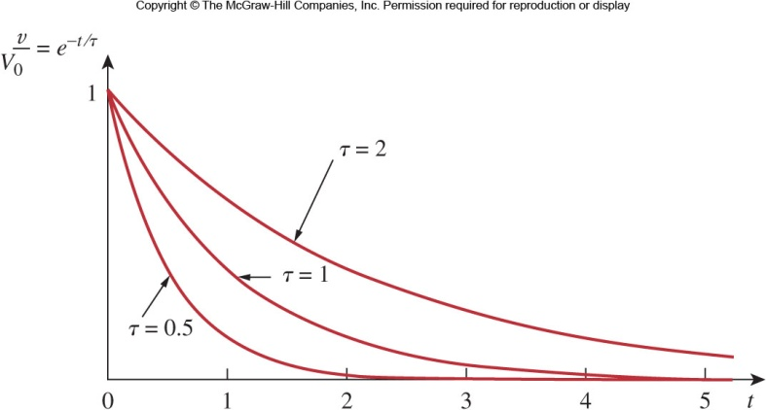
Time Constant 2
After five time constants the voltage on the capacitor is less than one percent.
After five time constants a capacitor is considered to be either fully discharged or charged.
A circuit with a small time constant has a fast response and vice versa.
Plot of v/V0=e^(−t/τ) for various values of the time constant.

Slide 10
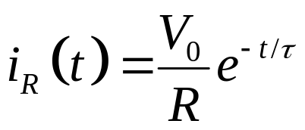
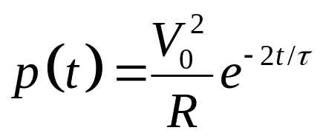
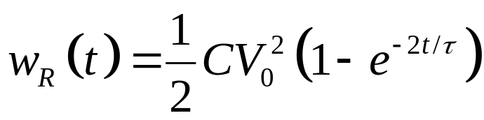
R C Discharge
With the voltage known, we can find the current:
The power dissipated in the resistor is:
The energy absorbed by the resistor is:

Slide 11
Source Free R C Circuit Summary
The key to working with this type of situation is:
Start with the initial voltage across the capacitor and the time constant.
With these two items, the voltage as a function of time can be known.
From the voltage, the current can be known by using the resistance and Ohm’s law.
The resistance of the circuit is often the Thevenin equivalent resistance.

Slide 12
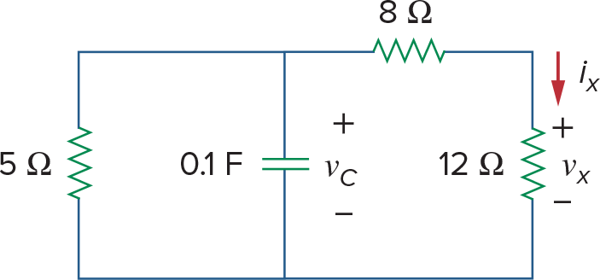
Figure 7.5
For Example 7.1.

Slide 14
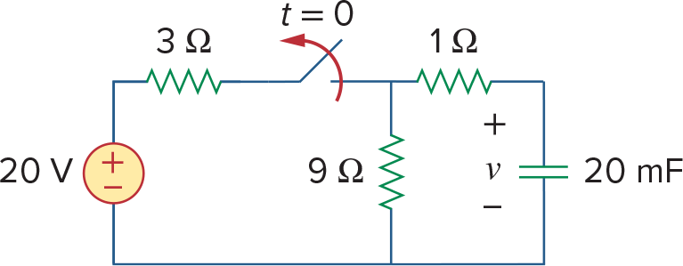
The switch in the circuit in Fig. 7.8 has been closed for a long time, and it is opened at t = 0. Find v(t) for t ≥ 0. Calculate the initial energy stored in the capacitor.
Figure 7.8
For Example 7.2.

Slide 16
Source Free R L Circuit 1
Now lets consider the series connection of a resistor and inductor.
In this case, the value of interest is the current through the inductor.
Since the current cannot change instantaneously, we can determine its value as a function of time.
Once again, we will start with an initial current passing through the inductor.

Slide 17
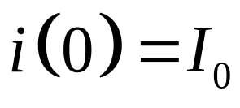
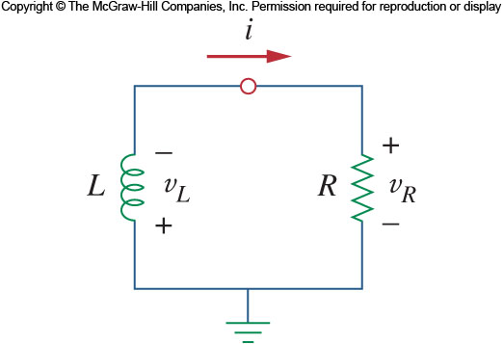
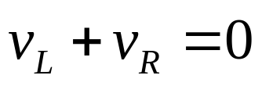
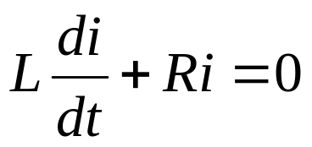
Source Free R L Circuit 2
We will take the initial current to be:
Applying K V L around the loop:
Or:

Slide 18
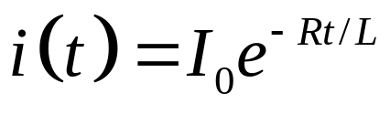
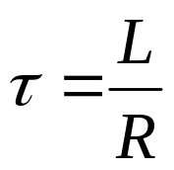
Source Free R L Circuit 3
After integration:
Once again, the natural response is an exponentially decaying current.
The time constant in this case is:
The same principles as the R C circuit apply here.

Slide 19
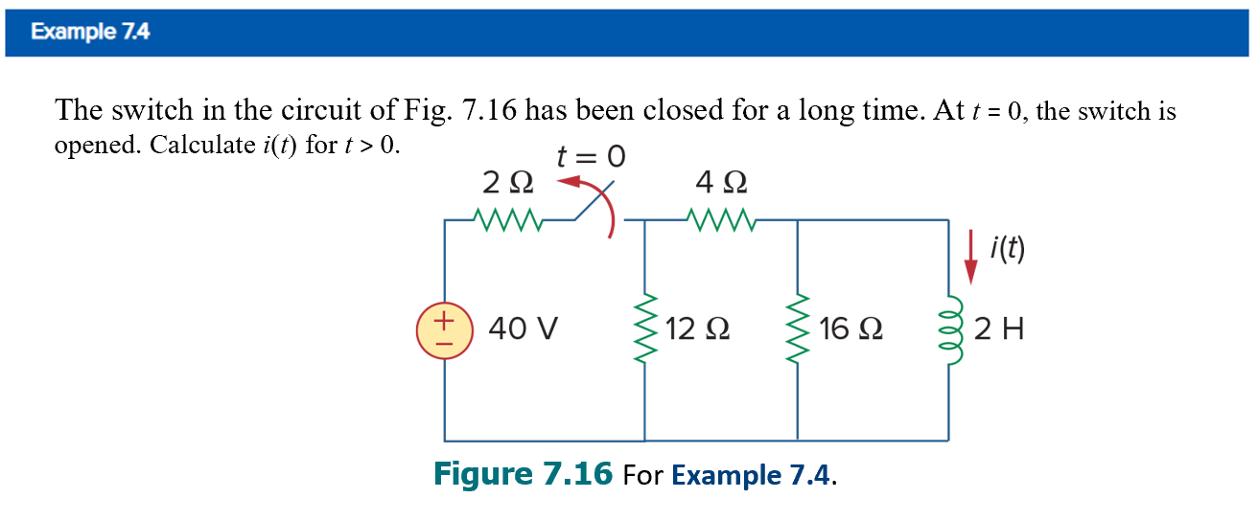
Figure 7.16 For Example 7.4.

Slide 20
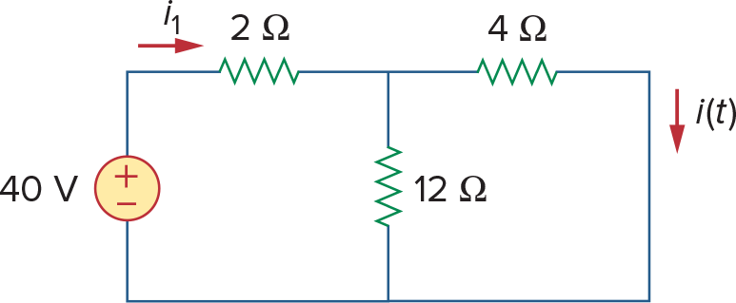
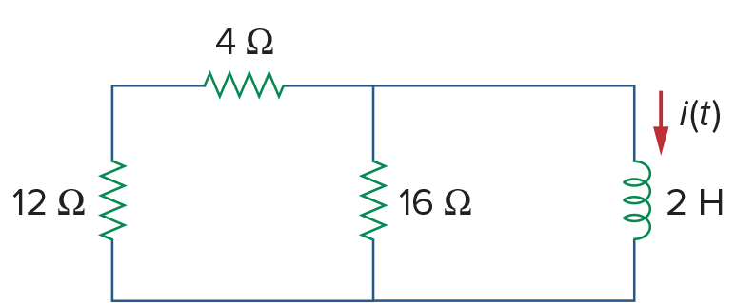
(a)
(b)

Slide 21
Singularity Functions
Before we consider the response of a circuit to an external voltage, we need to cover some important mathematical functions.
Singularity functions serve as good approximations to switching on or off a voltage.
The three most common singularity functions are the unit step, unit impulse, and unit ramp.

Slide 22
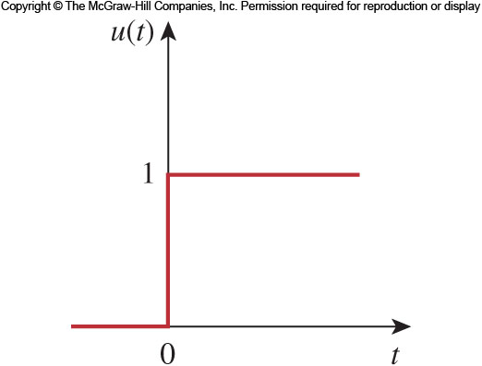
The Unit Step 1
A step function is one that maintains a constant value before a certain time and then changes to another constant afterwards.
The prototypical form is zero before t=0 and one afterwards.
See the graph for an illustration.

Slide 23
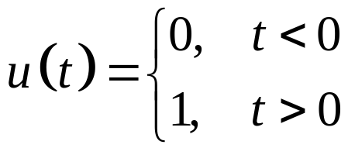
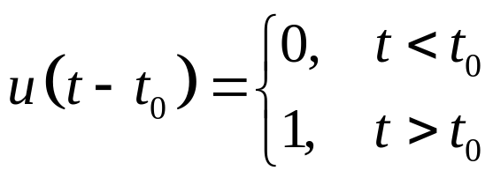
The Unit Step 2
Mathematically, the unit step is expressed as:
The switching time may be shifted to t=t₀ by:
Note that this results in a delay in the switch.
The unit step function is written as u(t)

Slide 24
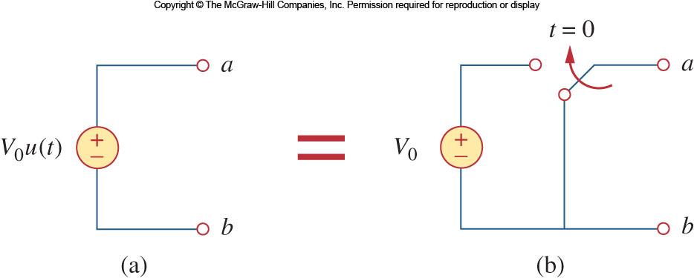
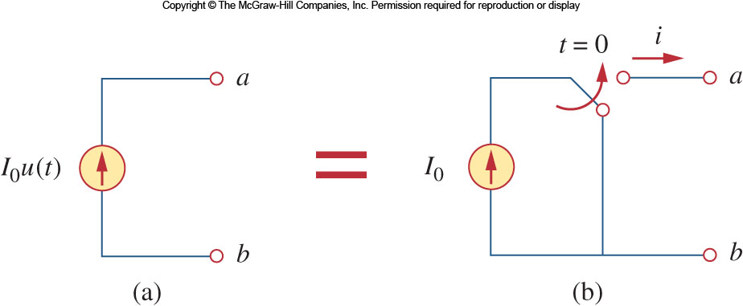
Equivalent Circuit
The unit step function has an equivalent circuit to represent when it is used to switch on a source.
The equivalent circuits for a voltage and current source are shown.

Slide 25
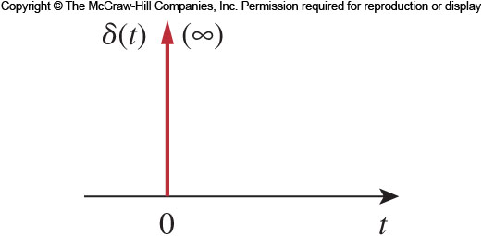
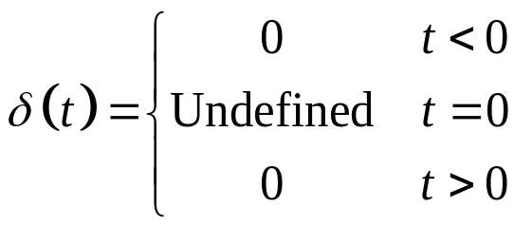
The Unit Impulse Function
The derivative of the unit step function is the unit impulse function.
This is expressed as:
Voltages of this form can occur during switching operations.
The unit impulse function—also known as the delta function

Slide 26
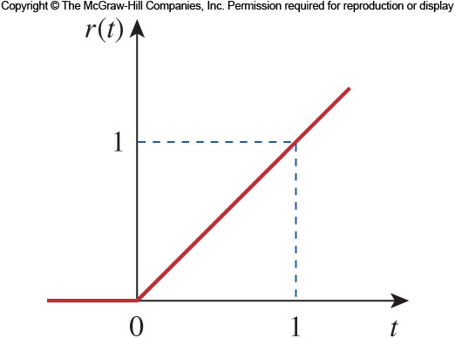
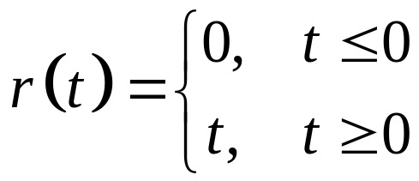
The Unit Ramp Function
Integration of the unit step function results in the unit ramp function:
Much like the other functions, the onset of the ramp may be adjusted.

Slide 27
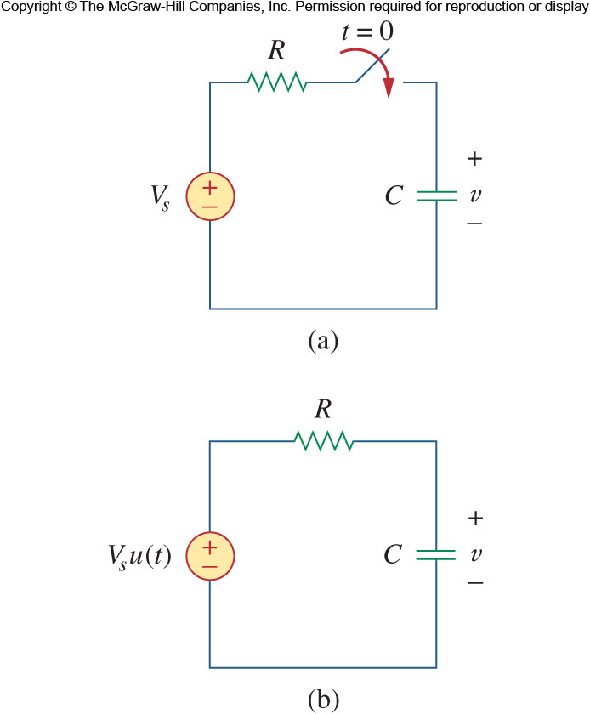
Step Response of R C Circuit 1
When a D C source is suddenly applied to a R C circuit, the source can be modeled as a step function.
The circuit response is known as the step response.
Let’s consider the circuit shown here.
We can find the voltage on the capacitor as a function of time.

Slide 28
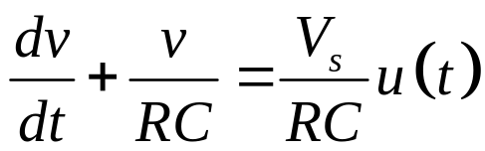
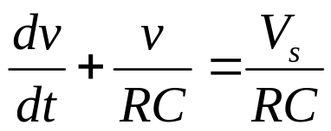
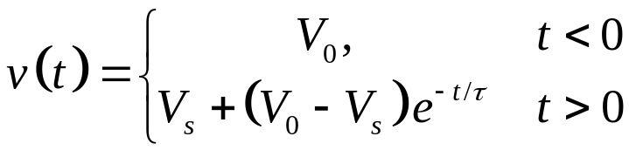
Step Response of R C Circuit 2
We assume an initial voltage of V₀ on the capacitor.
Applying K C L:
For t>0 this becomes:
Integrating both sides and introducing initial conditions finally yields:

Slide 29
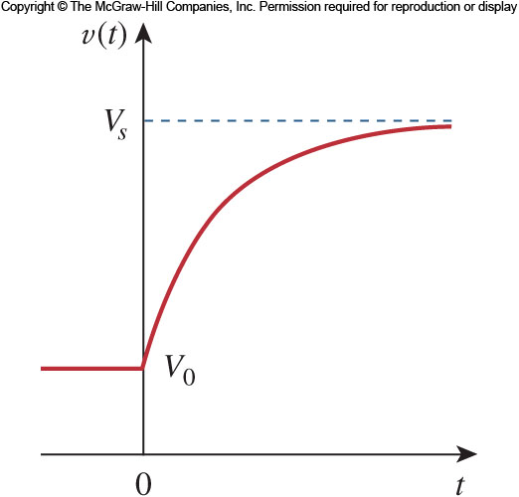
Step Response of R C Circuit 3
This is known as the complete response, or total response.
We can consider the response to be broken into two separate responses:
The natural response of the capacitor or inductor due to the energy stored in it.
The second part is the forced response.

Slide 30
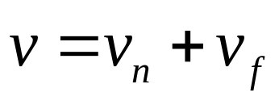
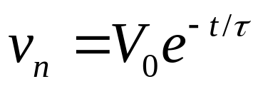
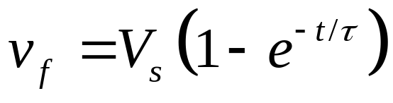
Forced Response
The complete response can be written as:
Where the nature response is:
And the forced response is:
Note that the eventual response of the circuit is to reach V_{s} after the natural response decays to zero.

Slide 31
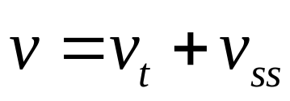
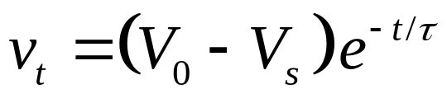
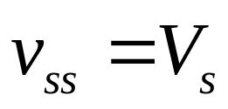
Another Perspective
Another way to look at the response is to break it up into the transient response and the steady state response:
Where the transient is:
And the steady state is:

Slide 32
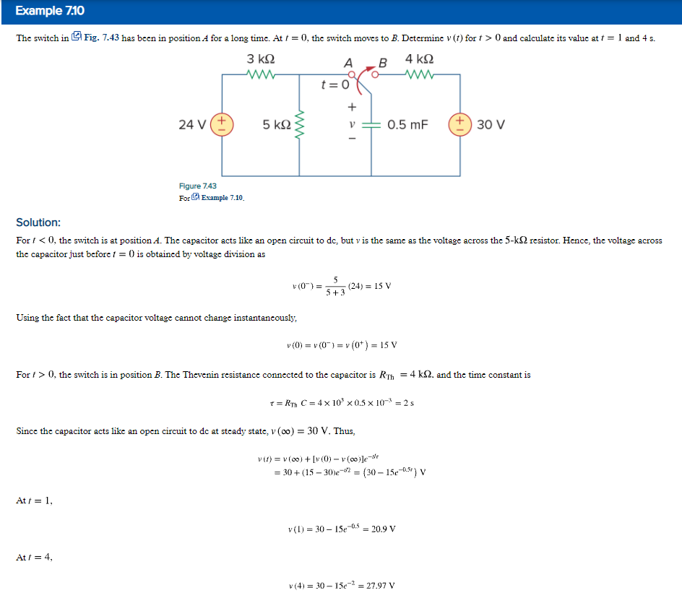

Slide 33
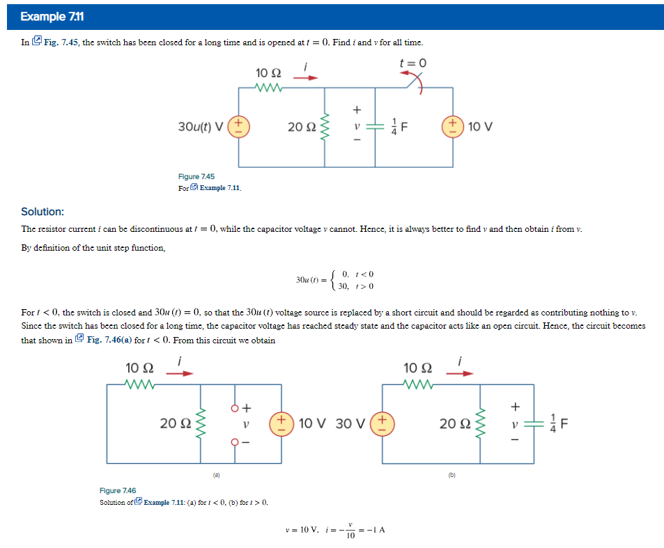

Slide 34
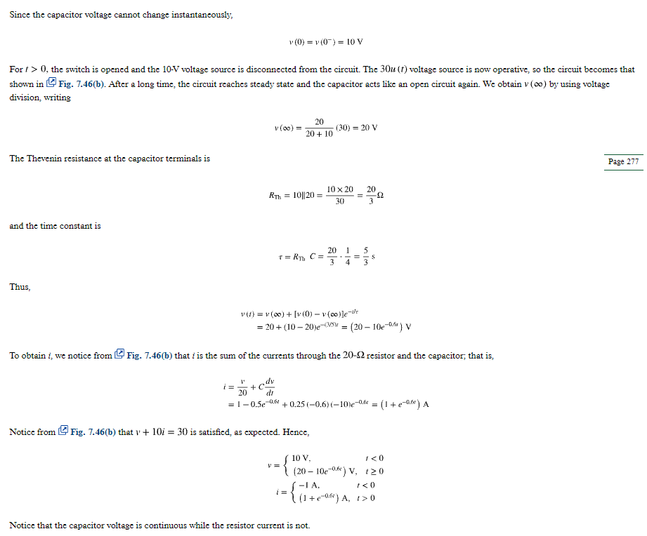

Slide 35
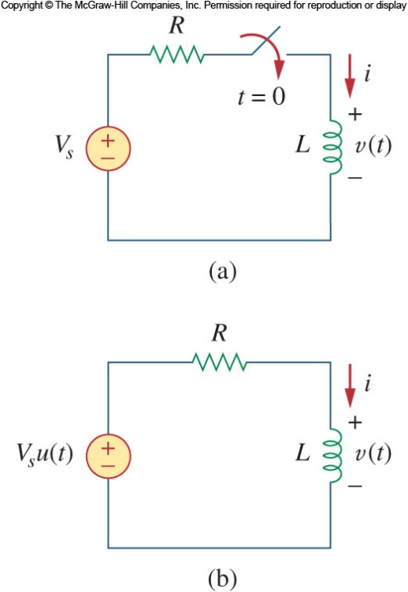

Step Response of R L Circuit 1
Now we can look at the step response of a R L circuit.
We will use the transient and steady state response approach.
We know that the transient response will be an exponential:

Slide 36



Step Response of R L Circuit 2
After a sufficiently long time, the current will reach he steady state:
This yields an overall response of:
To determine the value of A we need to keep in mind that the current cannot change instantaneously.

Slide 37



Step Response of R L Circuit 3
Thus we can use the t=0 time to establish A.
The complete response of the circuit is thus:
Without an initial current, the circuit response is shown here.

Slide 38


Slide 40



Because learning changes everything.®
www.mheducation.com
© McGraw Hill LLC.

