Slide 1
Digital Health and the Building of Effective Integrated Care Systems
Panel Debate 1: Scaling Up Digital Health
Dr Nick Goodwin, PhD
CEO, International Foundation for Integrated Care

Slide 2


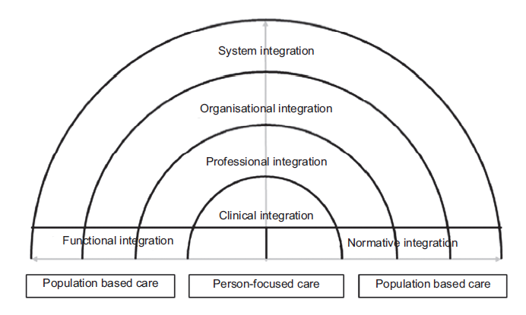
Understanding Integrated Care: The Essential Role of Digital Health
Governance, accountability,
performance assessment,
financial incentives
Monitoring, evaluation and
quality improvement
Business planning
Case finding
Risk stratification tools
Shared e-health records
Inter-professional communication
Decision-support systems
Care assessments
Care in the Home Environment
Assisted living
Smart Homes
Home adaptations
Supporting self-care
Telehealth
Telecare
Health literacy
Valentijn P et al (2015) Towards an international taxonomy of integrated primary care: a Delphi consensus approach. BMC Fam Pract, 16(1):64-015-0278-x

Slide 3
Appreciating the Implementation Challenges
The reality looks more like this:
Available at: http://carewell-project.eu/fileadmin/carewell/deliverables/d8.6_v2.0_carewell_guidelines_for_deployment_printable_version.pdf

Slide 4
The Need for “Simultaneous Innovation”
Five Key ‘Laws’ for Digital Health Adoption
Keep it simple for patients and carers to use, and for professionals to adopt
Tailor the service to the specific needs of the end user; consider how they might best use and accept new technology
Enhance human contact by better connecting patients to family, friends and care professionals; users must feel safe, secure and empowered
Embed an IT infrastructure to act as the bedrock of better care through integrated information systems
Build relationships and networks to influence behaviours, build alliances, and overcome the significant mismatch of motives that exist between patients, carers, professionals, commissioners and industry.

