Slide 1
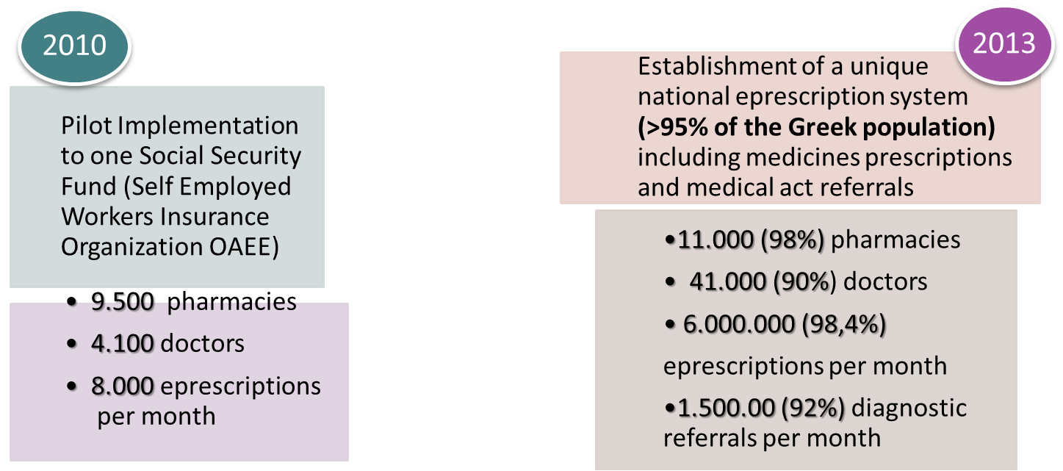
“LEAPFROG” WITH ICT :
The Greek ePrescription System

Slide 2
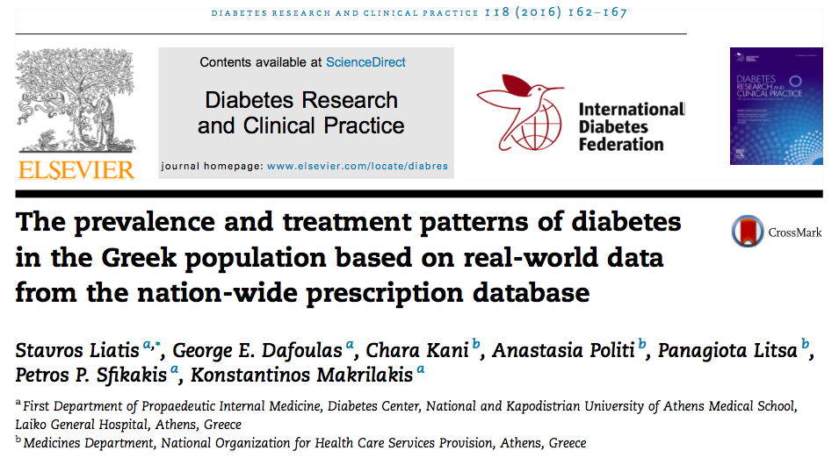
Real world data analytics and Population Health:
The use case of the National e-prescription of Greece

Slide 3
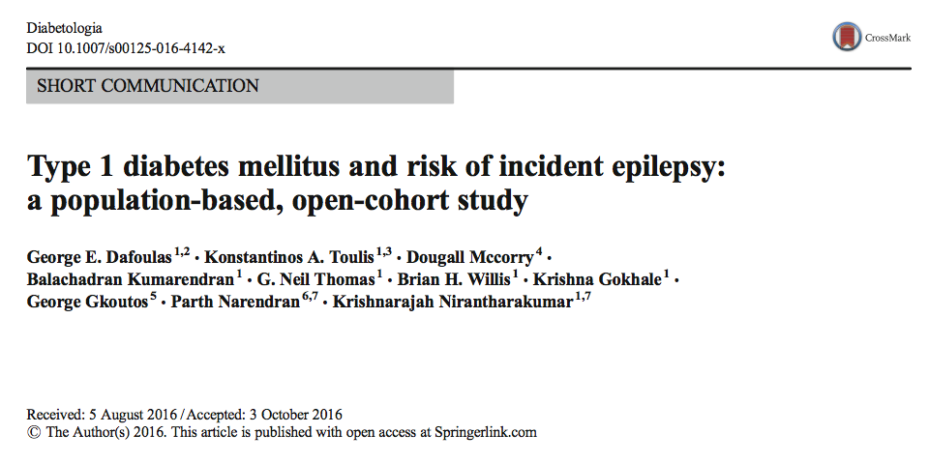
Real World Data Evidence in Health Research:
The use case of PPP of THIN Database in UK

Slide 4
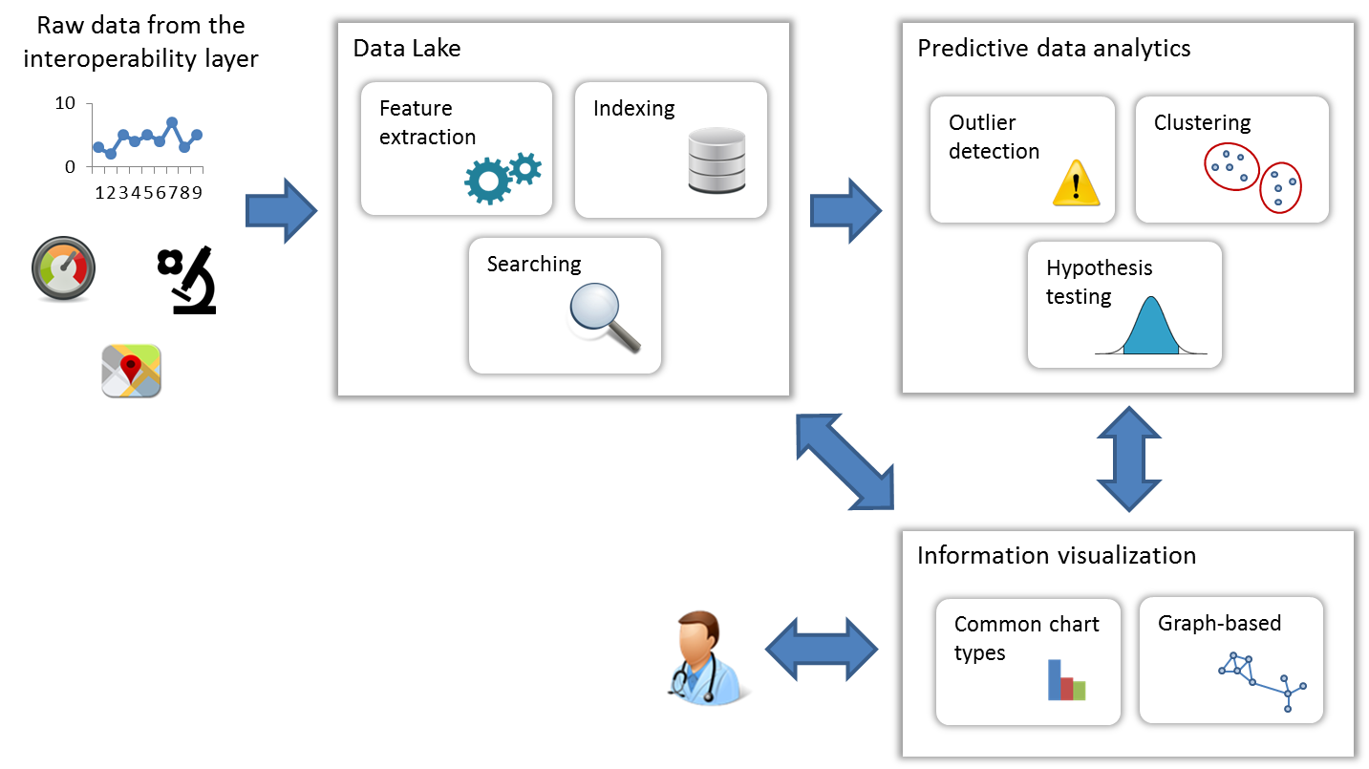
The “Data tide” of IoT era in Health and Care services
ACTIVAGE – Tools for
data analytics of IoT
e-health and e-care
services

Slide 5

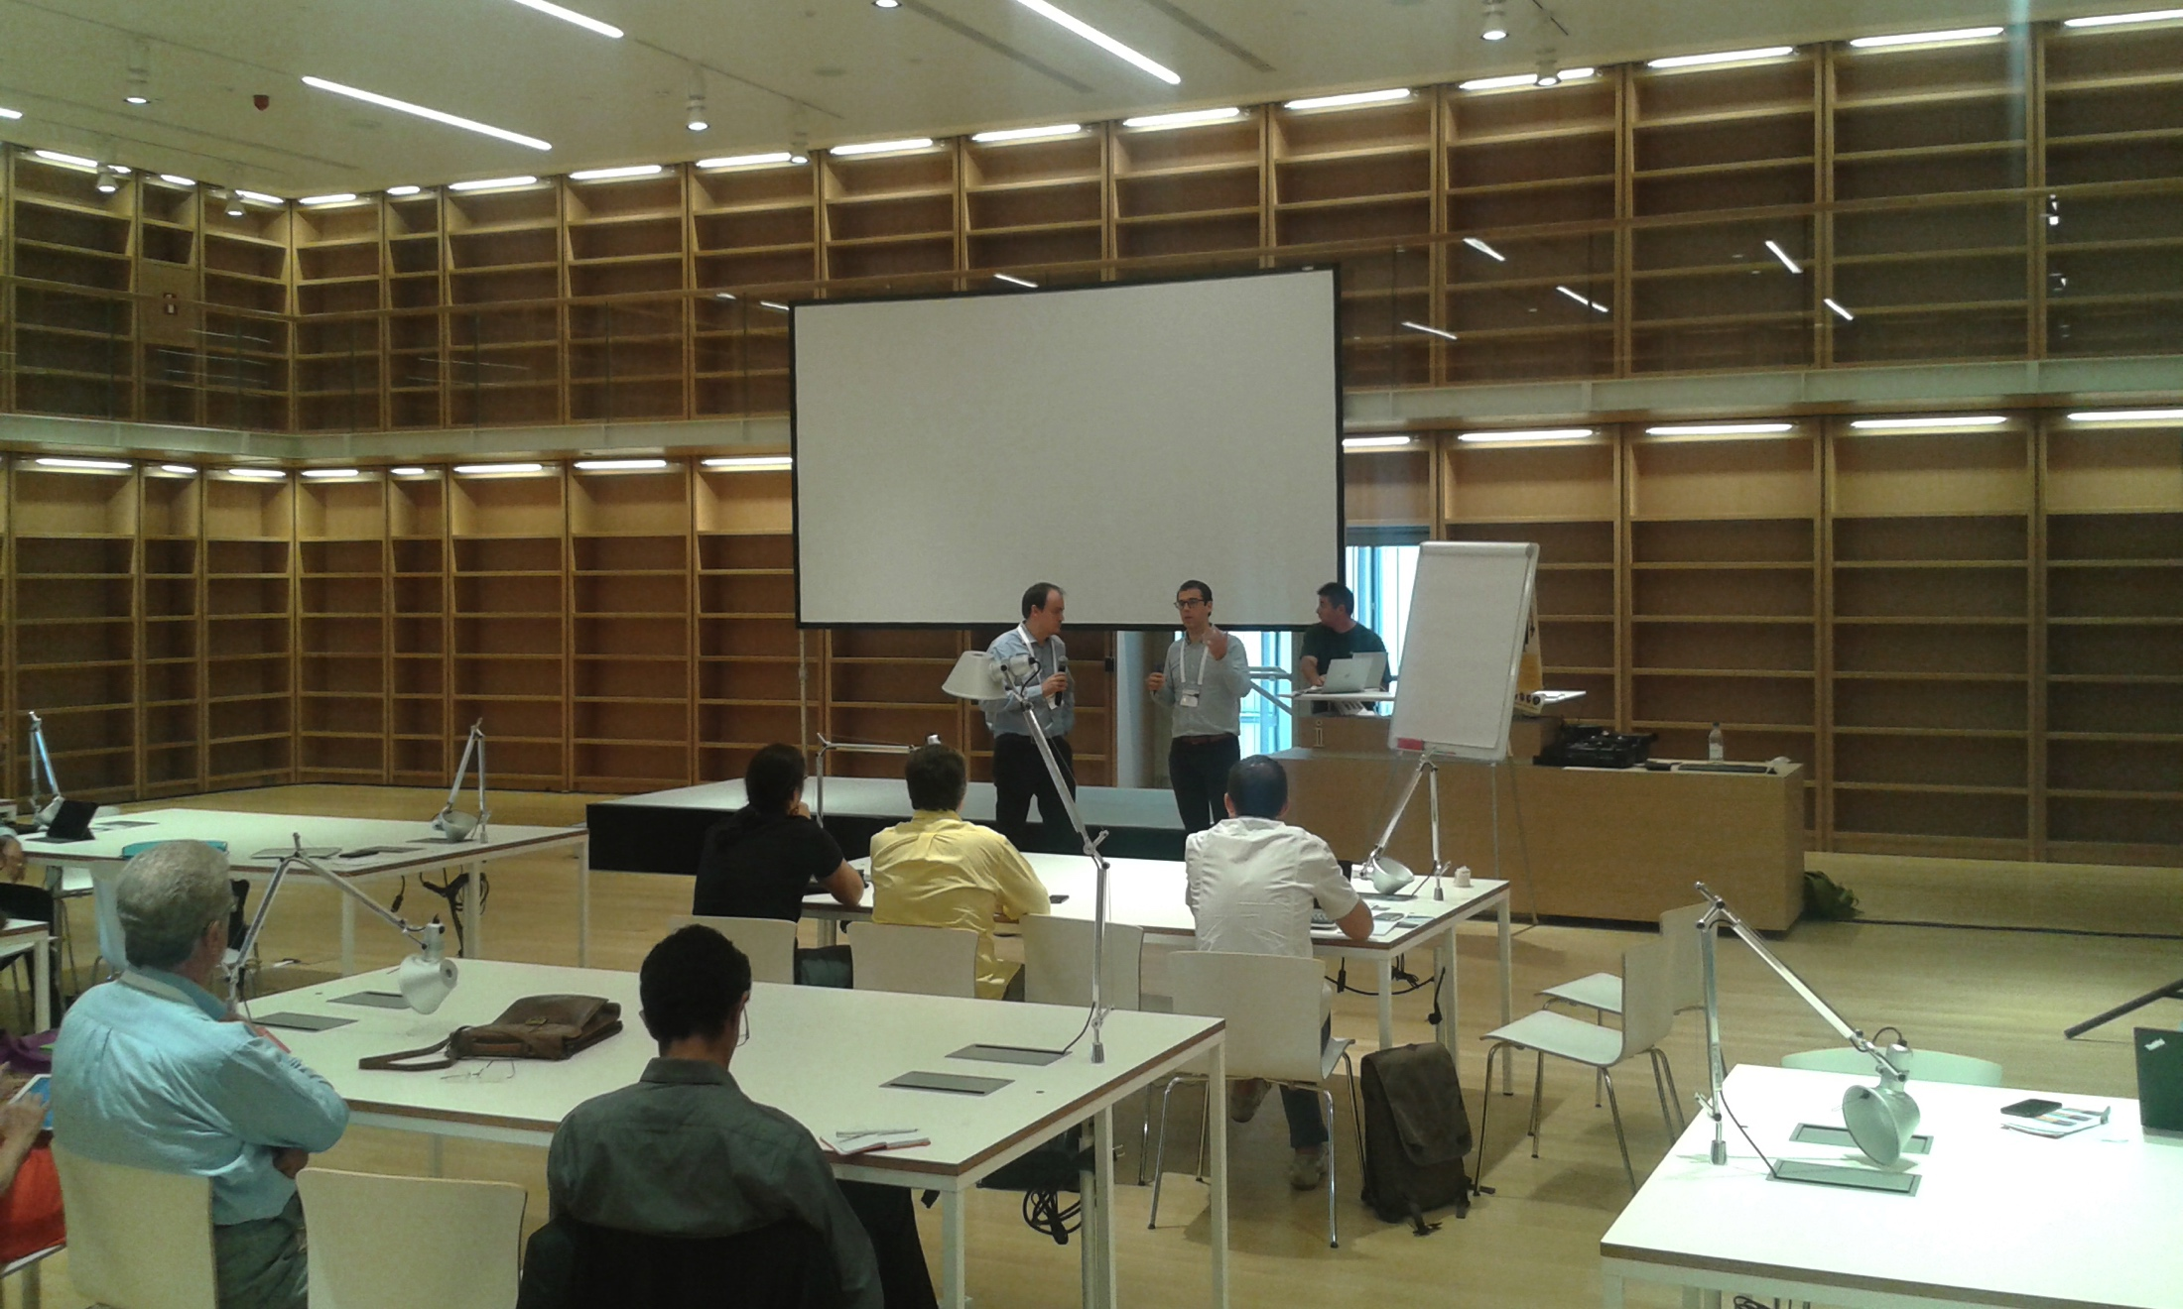

“DATATHONS” IN EVIDENCE-BASED MEDICINE: APPLYING OPEN SCIENCE PRINCIPLES
IN HEALTH CARE SERVICES AND RESEARCH

