Slide 1
Panel 3 – Unleashing Intelligence for IC and Population Health
The role of Artificial Intelligence in making the shift to Value Based Healthcare
David Brackman
COCIR Lead member in Digital Health and Global Product Manager Advanced Visualization Products & Solutions – Philips Healthcare

Slide 2

Value Based Healthcare
Michael E. Porter introduced value based Healthcare back in 2006

Slide 3

Moving from Volume Based Healthcare towards Value Based Healthcare
Today:
Not adding value for the patient
Using wrong parameters to measure outcomes
Focus on:
Adding value for the patient
Lowering costs not primary goal
Competition based on outcomes
Transparency for costs & outcomes
  Efficiency of medication?
  Efficiency of certain diagnostic tools?

Slide 4
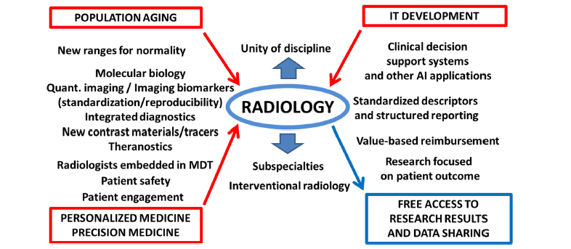
Future trends in Radiology
Sardanelli European Radiology Experimental (2017) 1:1

Slide 5
Use of Artificial Intelligence in Radiology
Artificial Intelligence can support the radiologist in the shift from a modality specific approach towards organ and diseases focussed approach
It will provide access to unique and authentic clinical data for clinical trails, there is no way to influence data
Develop precision medicine: collaboration between patiënts and medical specialists and medical domain experts
Clinical care pathways approach example Genomics = > radiomics + radiogenomics
Access to data on a Regional, National or International level to make algoritms more intelligent

Slide 6
Challenges
Artificial Intelligence (Machine Learning, Deep Learning,…) is a getting a buzz word, everything is called Artificial Intelligence ?
Who controls the data? Ones personal data is collected and stored in the cloud, the person who generated the data loses control of it
Integration of Radiology departments within the clinical care pathways to deliver value based Healthcare
We need labelled, accessible & actionable data on all levels of these clinical care pathways
Standardization and validation of data models between industry partners but also cross hospitals, communities,…
Some physicians will need to develop clinical data scientists capabilities to collect relevant data
We need Time
  To develop, adapt & validate these algorithms
  All actors involved into this field need to adapt towards Security, privacy and accuracy

Slide 7
Conclusion
Artificial Intelligence can support Radiologists to deliver accurate and timely diagnose by:
Automation
Integration
Quantification
Support decision making of the patient specific treatment plan
Communication with patients, referrals, specialists but also during Multi disciplinary clinical team meetings

Slide 8
Thank you for your attention!
www.cocir.org

