Slide 1


Executive vice president
Erik Jylling
Danish Regions
Managing Data Protection and Cybersecurity in healthcare

Slide 2
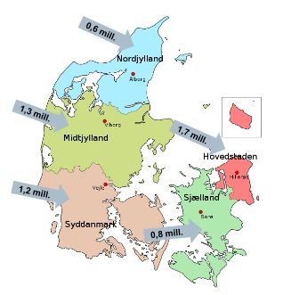
Structure of the Danish healthcare sector
The Danish public health insurance gives everybody in Denmark an equal and free access to health services
Denmark is divided into 5 regions and 98 municipalities
The 5 regions are responsible for:
The provision of hospital services
Psychiatric services
General practitioners and specialists
The 98 municipalities are responsible for:
Homenursing
Public health
School health services and child dental treatment
Prevention and rehabilitation
Elderly care
The state is responsible for:
The state holds the overall regulatory and supervisory functions in health and elderly care

Slide 3
General data protection regulation (GDPR)
Data-driven health care has to go hand-in-hand with privacy
Trust and transparency are crucial

Slide 4
Challenges - GDPR
Predictive medicine and prevention – at what point are we actually treating the patient ?
Value-based healthcare – in many cases we need outcome data years after treatment to evaluate results of a specific treatment
Consent and transparency - impact on data quality and completeness ?

Slide 5
Cybersecurity in healthcare
Protection against cyber attacks is a challenge for the entire healthcare sector (and the entire society)
Better cooperation between all sectors (state, regions and municipalities) is important to prevent attacks
Danish context: New National Cyber and Information Security Strategy in March 2018 (expected) – the health care sector is identified as having critical importance
Implementation of EU directive on the security of Networks and Information Systems (NIS Directive)

Slide 6
Challenges - cybersecurity
Cybersecurity and protection against cyber crime is expensive and difficult to demonstrate value of additional investments - when are investments sufficient?
Threats are constantly changing
Health care professionals need access to data

Slide 7

Thank you for your attention WWW.REGIONER.DK

