Slide 1


Whose consent is it really?
Petra Wilson

Slide 2


Whose consent is it really?
Patients have a right to access data about them
Patients have a right to obtain portable copies of that data
Patients have the right to demand data deletion - the right to be forgotten (but not for research - art 17 (30 (d))
Limited consent - foreseen in rec. 33 but unclear
BUT …..
No right to decide who has access
No right to limit access
No engagement after signature
Need to re-consent for changes to usage
In the case of research – national derogations may be enacted = fragmentation

Slide 3

‘Consenting’ the patient

Slide 4

Dynamic Consent
What – is dynamic consent
a new approach to engaging individuals about the use of their personal information, for research or care.
It is ‘dynamic’ because it allows interactions over time; it enables people to alter their consent choices in real time as their circumstances change and to have confidence that these changed choices will take effect.
How can it be done?
An interactive personalised interface that allows participants to engage as much or as little as they choose and to alter their consent choices in real time.
consent preferences travel securely with their data so that third parties know the scope of the consent that applies.
Available preferences can be adapted to suit the capabilities and needs of institutions, researchers and participants.

Slide 5




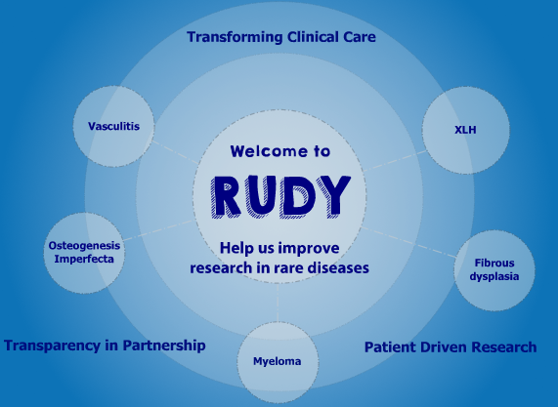

…. and we already have lots of working models
String of Pearls

Slide 6
