Slide 1
Error Potentials post-hoc Analysis
Potential Abstract for BCI conference (Due Jan 4)
5 subjects analysed
All RJB
Multiple target counts
Summary
in 4 of 5 subjects, multiple electrodes show notable differences in the HG range when comparing successful trials to unsuccessful trials.
Electrodes no spatial pattern across subjects
These differences typically occur at the end of the feedback period.
Additional analyses (to do)
Determination of electrodes exhibiting significant differences from a pixel-cluster-based metric (a la fMRI)
Classification of missed trials (plan LDA classification using 4-fold validation, comparison of classification performance based on number of electrodes used in classifier)
Real-time detection of error signal (looking for suggestions on this, but it seems like an important step if we want to make the pitch toward abstract task structures)

Slide 2
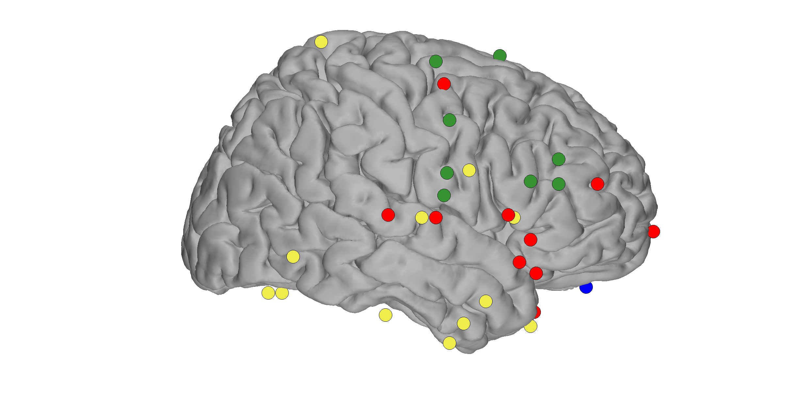
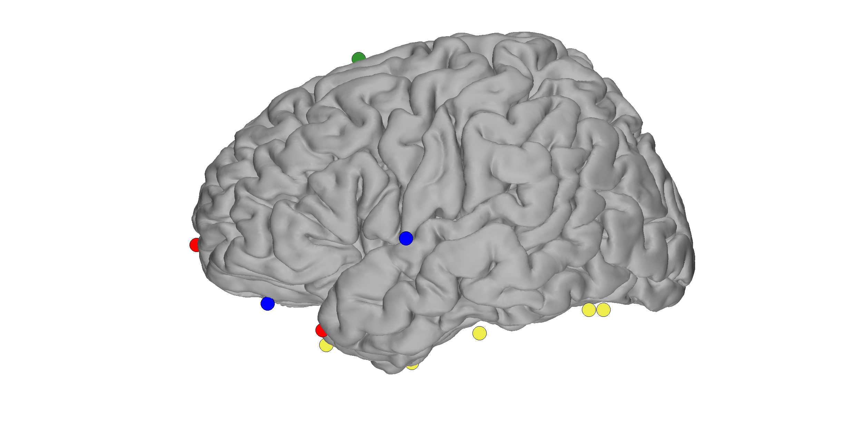
Spatial Distribution of Electrodes
S1 (left hemi)
S2 (right)
S3 (right)
S4 (right)

Slide 3
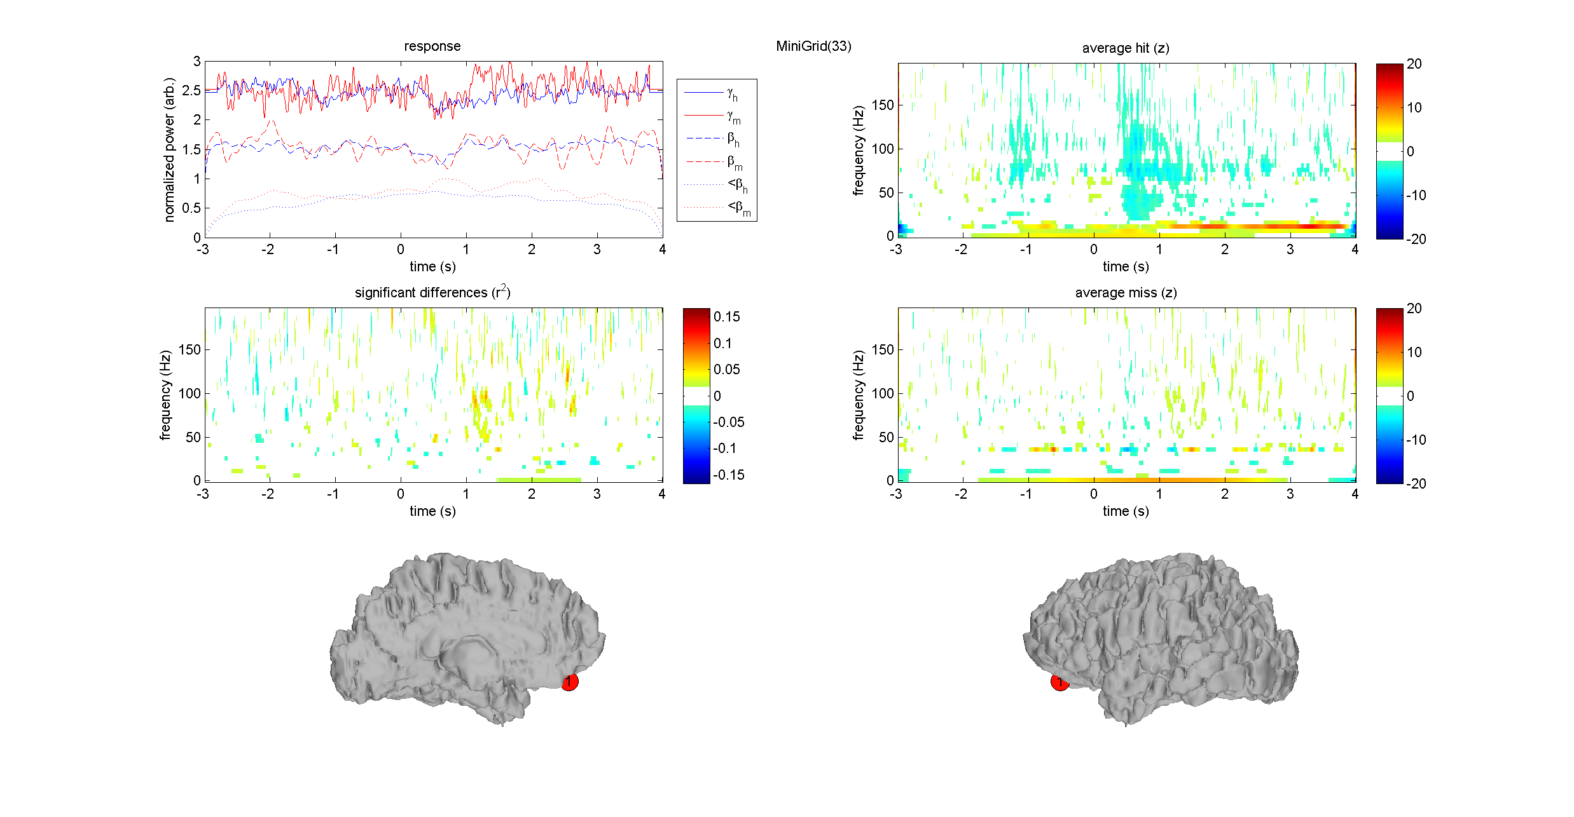
Examples – S1

Slide 4
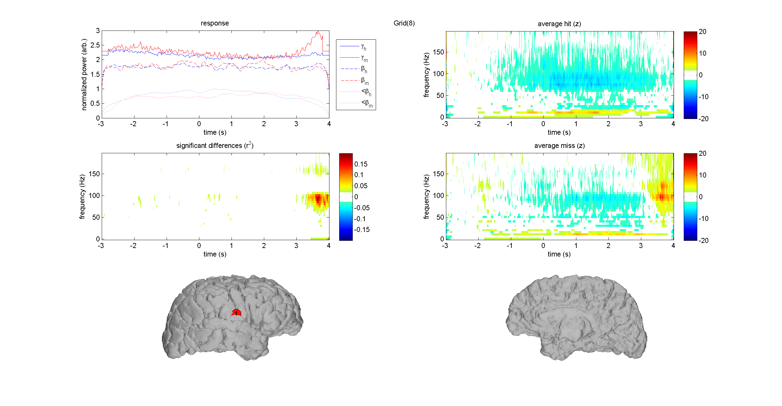
Examples – S2

Slide 5
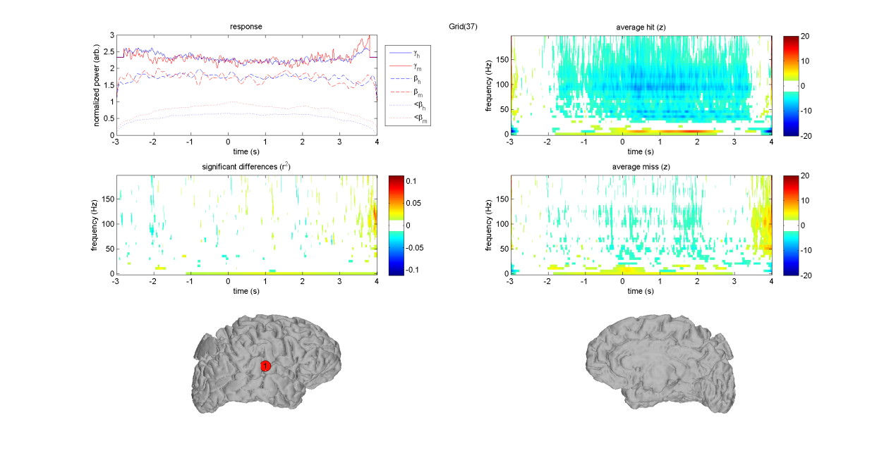
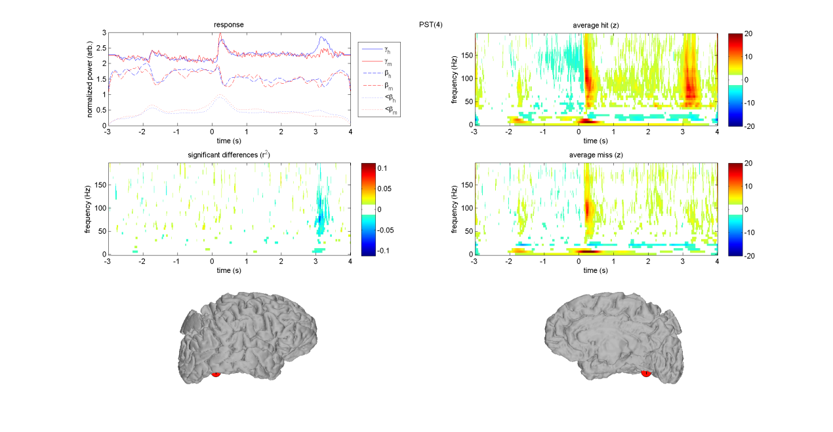
Examples – S3

Slide 6
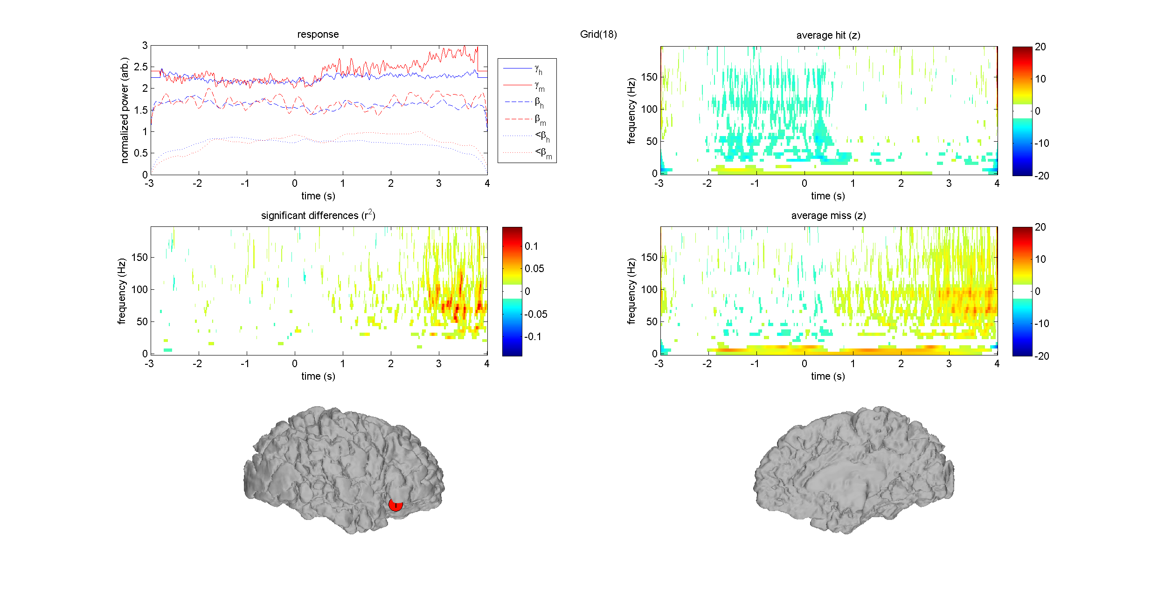
Examples – S4

