Slide 1
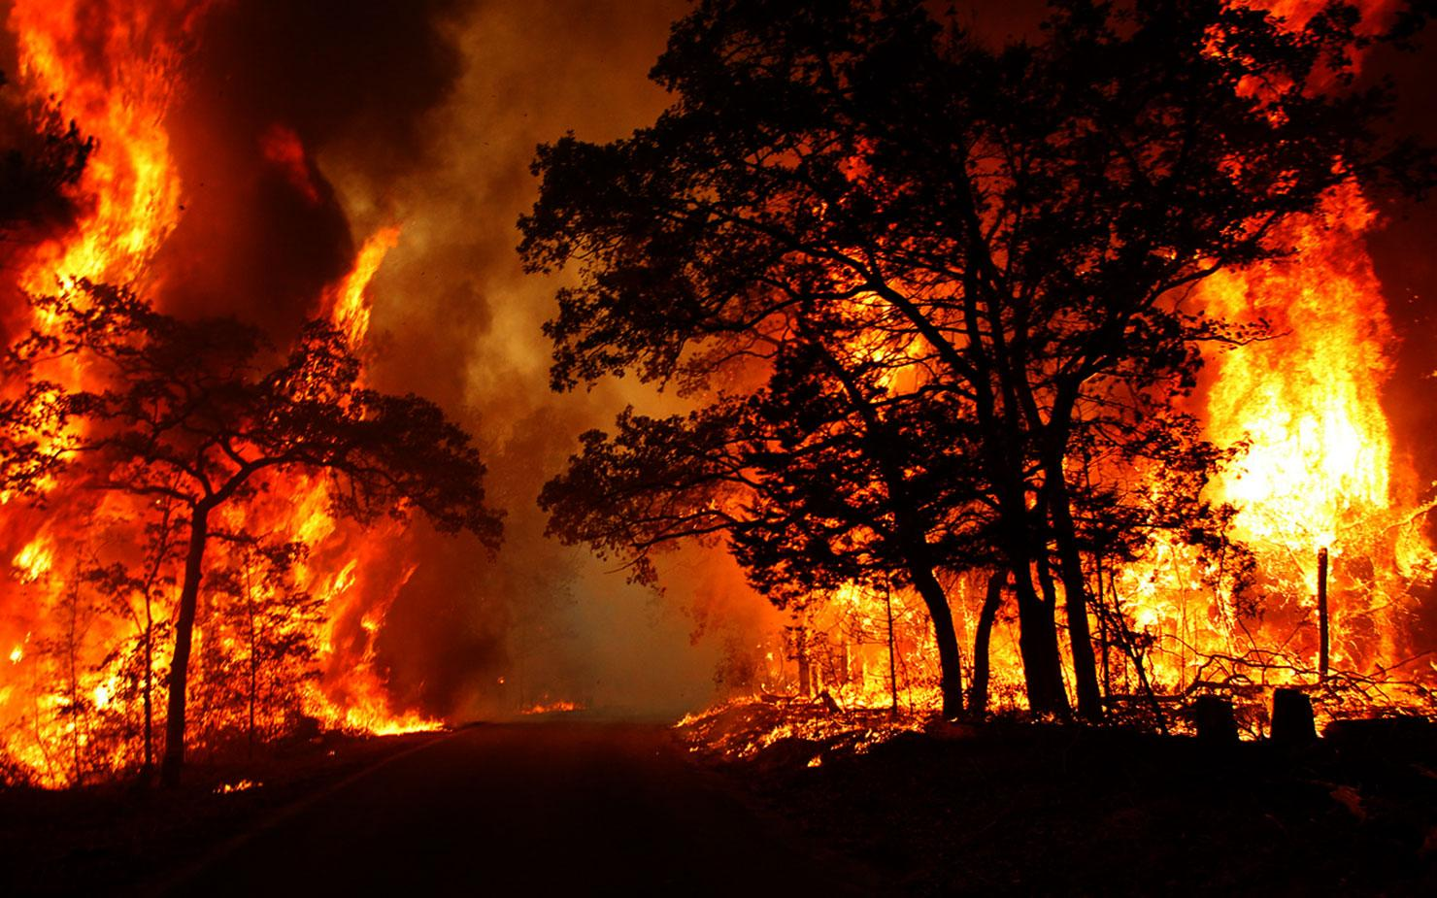
Portuguese Forest Fires
A Data Science Project
by David Watts

Slide 2
Context
Damage
Response
Prediction
Forest Fires are responsible for over 3,000 deaths and $12 billion annually in the US alone.
Responding appropriately with dedicated resources in a timely fashion is crucial for minimizing loss.
Through data science, we may be able to gain predictive power and improve response, driving down accrued damage.

Slide 3
Problem Statement
Given meteorological, fire science, and spatio/temporal data, can we predict the area of a forest fire’s damage at its outset?

Slide 4
The Data
X, Y coordinates
Day of Week, Month of Year
Meteorological measurements at time of fire:
Temperature
Relative Humidity
Wind Speed
Rainfall over last 30 minutes
FWIC Metrics
FFMC
DMC
DC
ISI

Slide 5
FWIC Metrics
Wind Speed
Relative Humidity
Rainfall and Temperature
FFMC - Last 16 hours
Surface level conditions
DMC - Last 12 Days
Mid-depth conditions
ISI
Fire spread conditions
DC - Last 52 Days
Deepest burnable layer

Slide 6
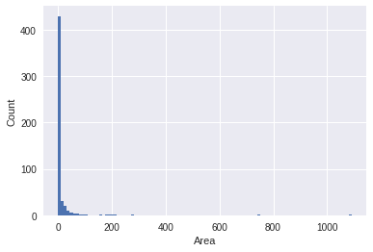
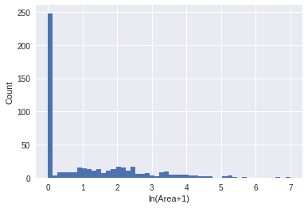
Area, Transformed
Better!

Slide 7
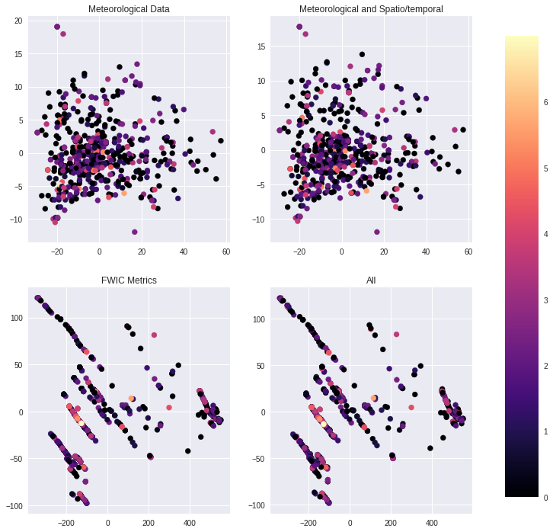
Principle Component Analysis by Features

Slide 8
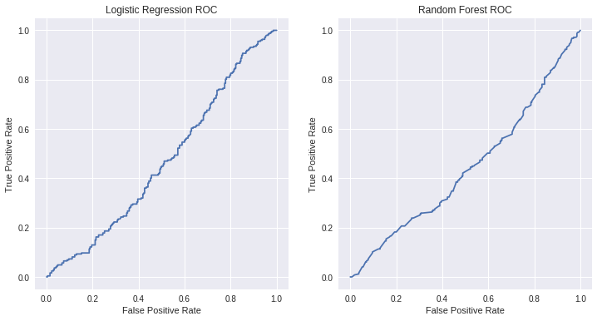
Can we even tell the difference between area==0 and area!=0 ?

Slide 9
Machine Learning Models
Linear Regression
Standard Least Squares
Shrinkage Methods:
Ridge Regression
Lasso (LARS)
Elastic Net
Support Vector Regression
Kernels:
Linear
Radial Basis
Gradient Boosting Regression
Random Forests with added learning power
Challenge 2c

Slide 10
MAE Results
Technique | MAE (30 trial avg)
Mean distance from the mean | 18.57
Linear Regression | 13.01
Ridge Regression | 12.99
Elastic Net | 12.99
Lasso Lars | 12.99
Technique | MAE (30 trial avg)
SVR Linear | 12.85
GBR | 12.71
SVR Rbf | 12.70
Hybrid | 12.69

Slide 11
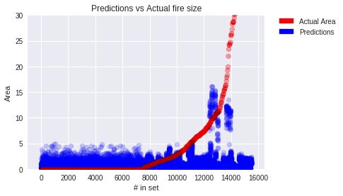
Prediction Accuracy

Slide 12
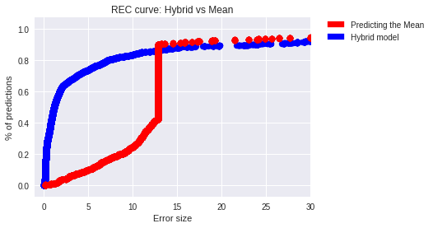
Regression Error Characteristic

Slide 13
Recommendations
Existing model is lacking is predictive power…
Change output variable
Perhaps use likelihood of a fire starting
Heatmap showing locations most at risk
Add features to the data relying on Fire Science subject matter expertise. E.g.,
Fire fighting measures
Controlled burn history/state of the forest
Geographical features, such as gradient,

Slide 14
Thank you!
Data acquired from UCI Machine Learning Repository, http://archive.ics.uci.edu/ml/datasets/Forest+Fires
Citation:
CitP. Cortez and A. Morais. A Data Mining Approach to Predict Forest Fires using Meteorological Data. In J. Neves, M. F. Santos and J. Machado Eds., New Trends in Artificial Intelligence, Proceedings of the 13th EPIA 2007 - Portuguese Conference on Artificial Intelligence, December, Guimarães, Portugal, pp. 512-523, 2007. APPIA, ISBN-13 978-989-95618-0-9. Available at:
http://www.dsi.uminho.pt/~pcortez/fires.pdf

