Slide 1
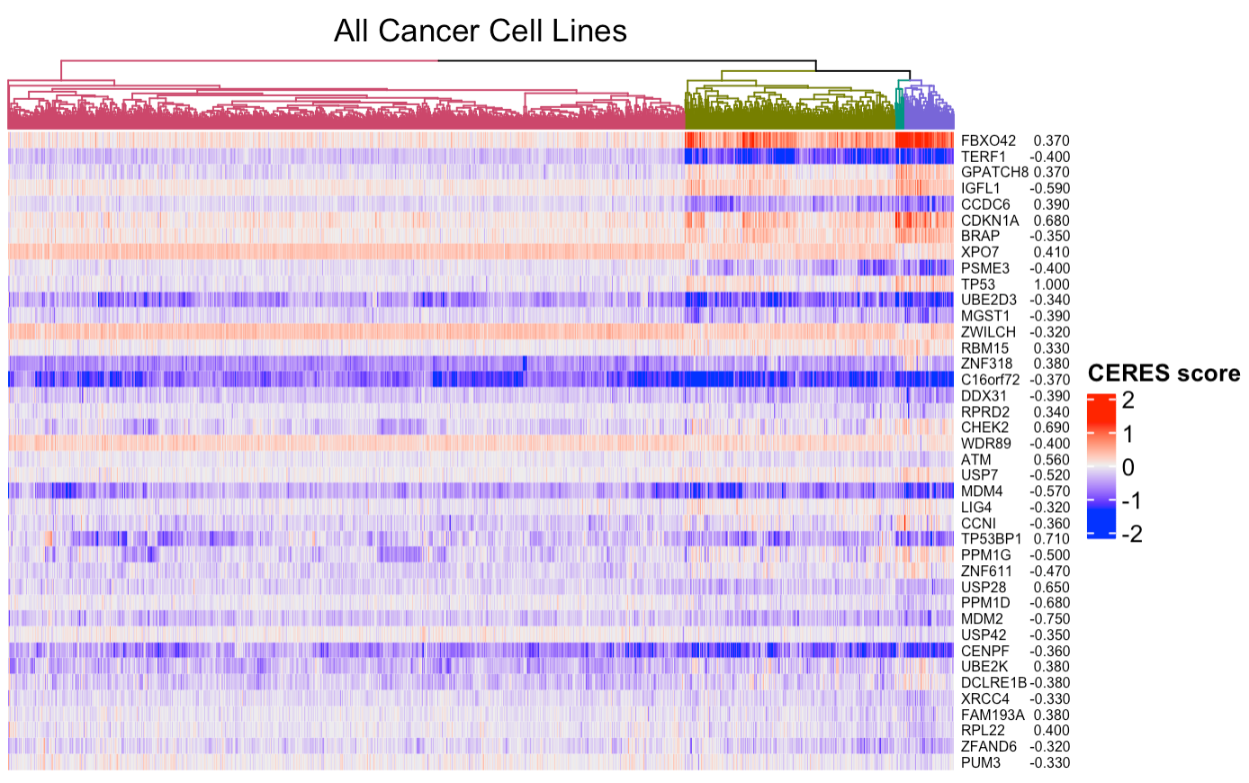
Distinctive Clustering.
Computed most negative and positive correlations (40).
Next step of analysis, Investigating the clusters.

Slide 2
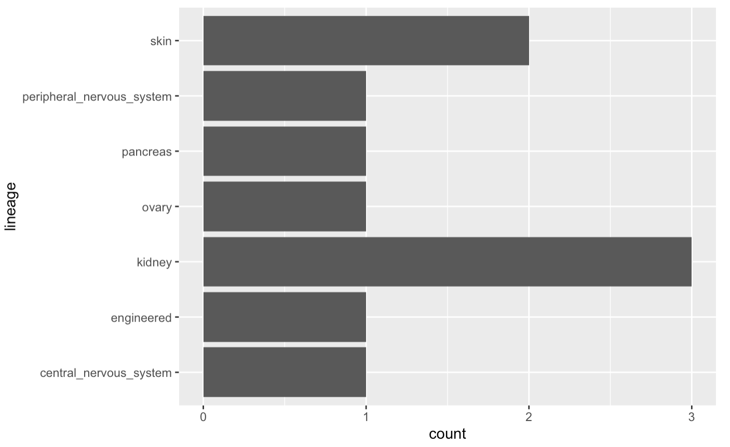
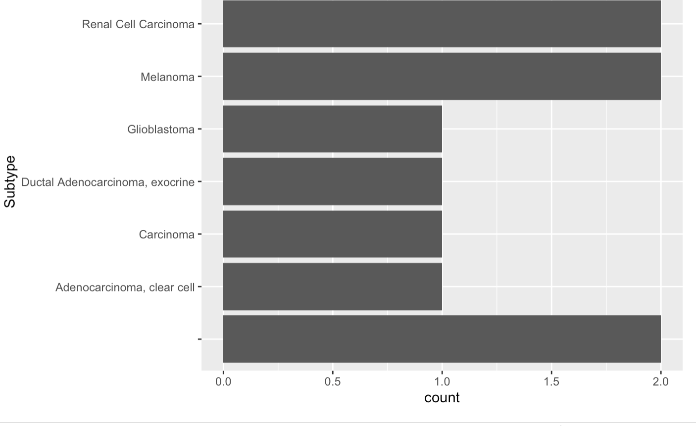
First cluster analysis was on ‘Cluster 4’ – The smallest cluster from the heatmap from slide 1. Figures created with ggplot on R. Kidney Lineage was the most significant count from cluster 4.

Slide 3
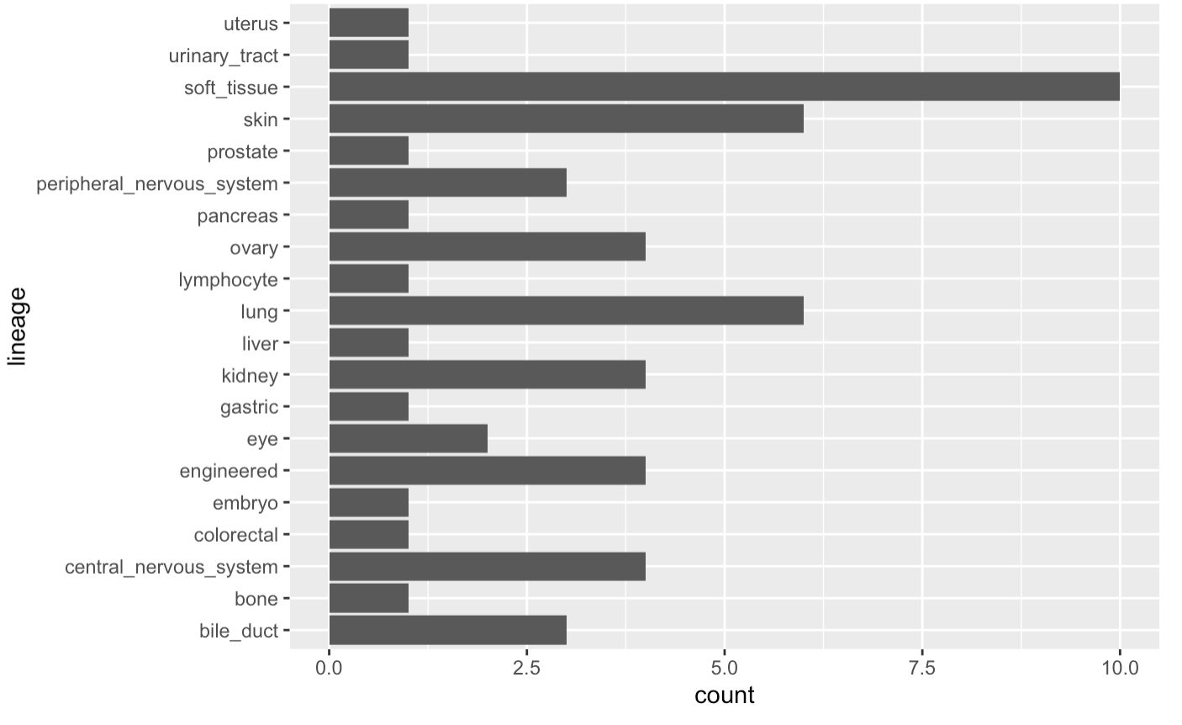
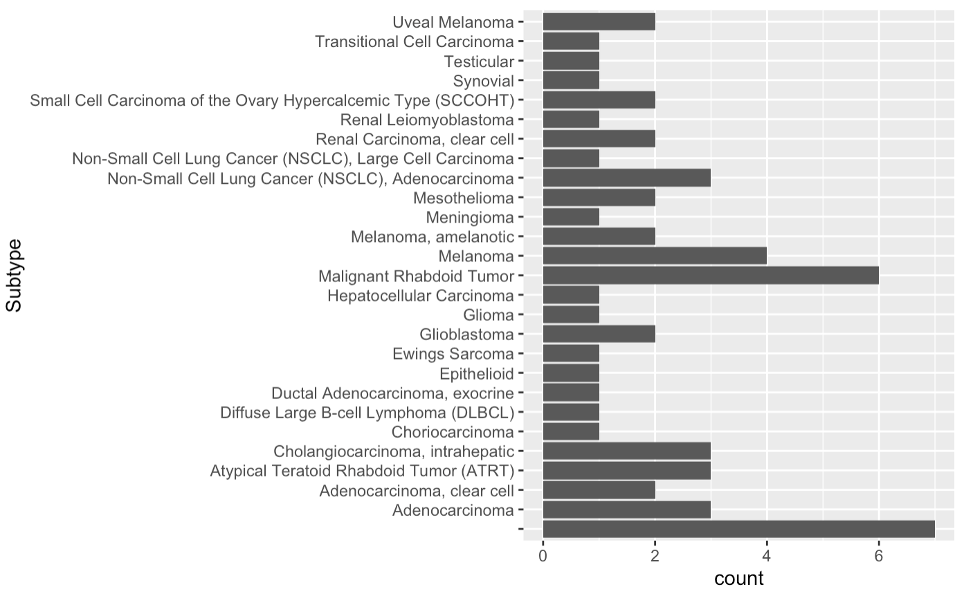
Second cluster analysis was on ‘Cluster 2’ – The smallest cluster from the heatmap from slide 1. Figures created with ggplot on R. Soft tissue Lineage was the most significant count with Malignant Rhabdoid Tumor being the most significant subtype (Primarily a kidney tumor) – Interesting result.

Slide 4
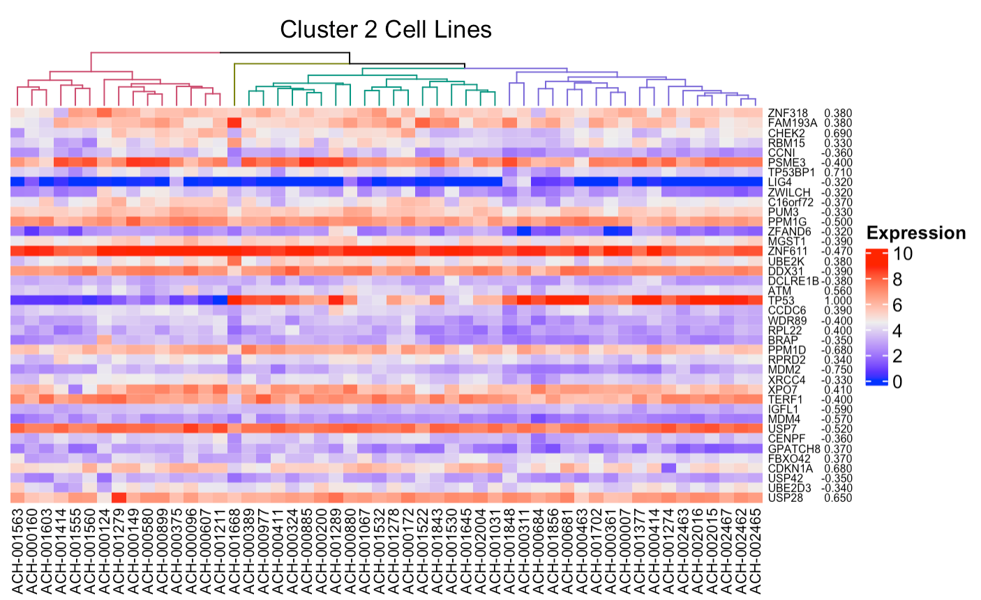
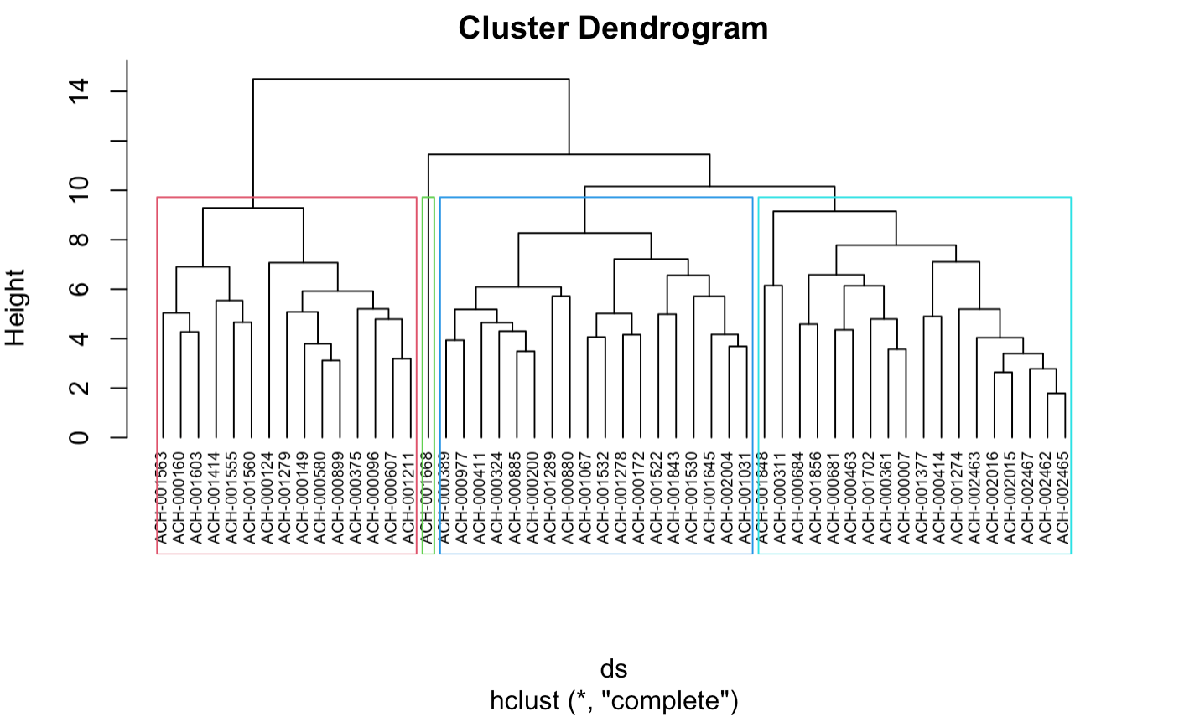
Further cluster analysis on ‘Cluster 2’ – Heatmap of Expression data just for the DepMap_IDs that are within cluster 2. Kept same row order and the same genes ‘most correlated (Neg and pos)’ to TP53.
Interesting observation – TP53 expression levels differ within the cell lines, with a distinct cluster of high expression of TP53 and a distinct cluster of low expression of TP53.

Slide 5
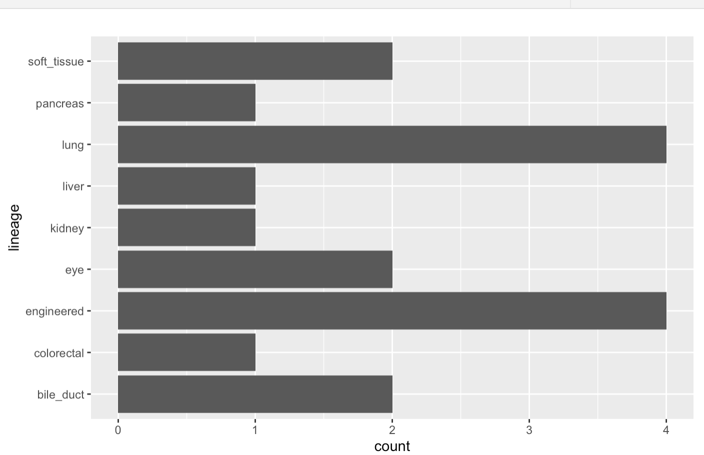
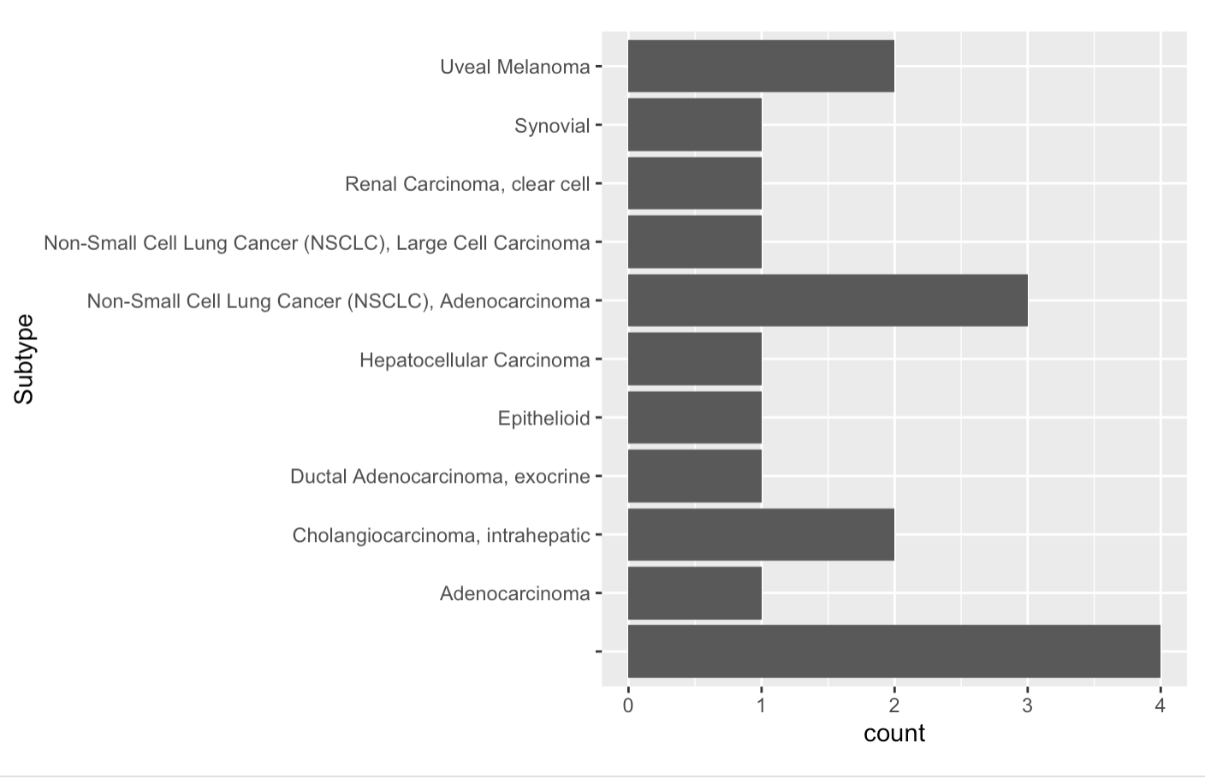
Further cluster analysis on ‘Cluster 2’. Checking the lineages where TP53 shows high expression (High expression of TP53 is shown in cluster 2 (right hand side) of the heatmap in the previous slide.
Lung lineage and NSCLC Adenocarcinoma subtype being most significant in count. This is where TP53 is highly expressed.

Slide 6
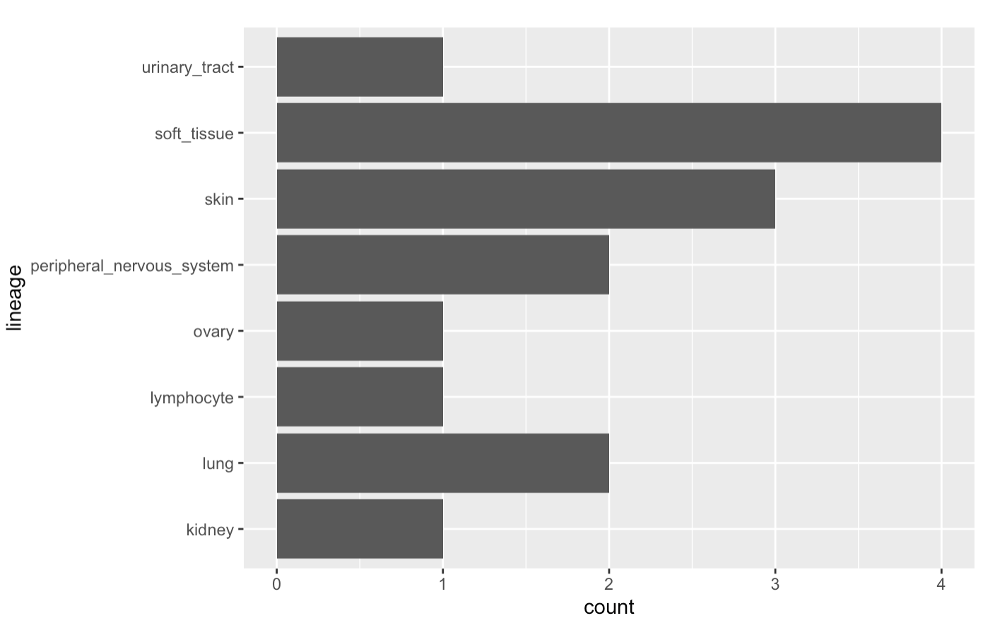
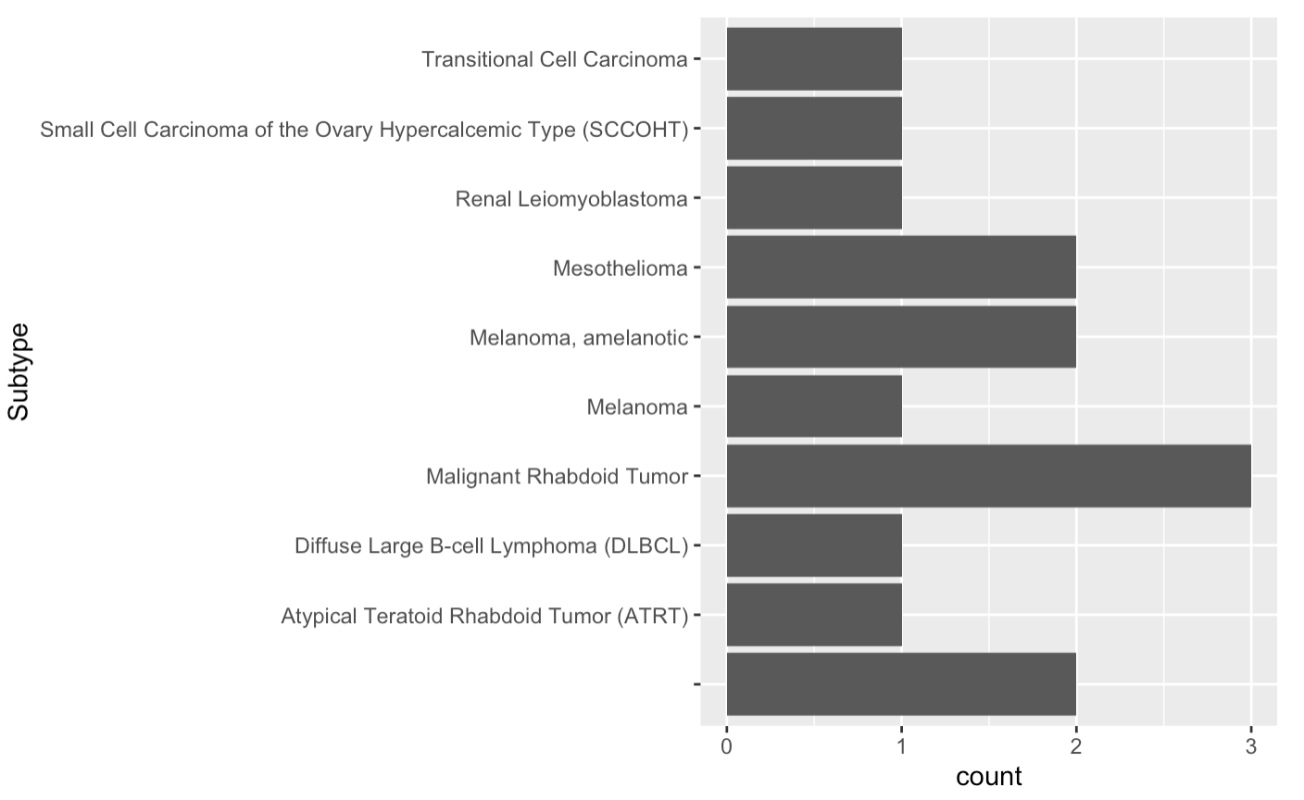
Further cluster analysis on ‘Cluster 2’. Checking the lineages where TP53 shows low expression (low expression of TP53 is shown in cluster 2 (left hand side) of the heatmap in slide 4.
Soft tissue lineage and Malignant Rhabdoid Tumor most significant in count. These results are similar to those found in the first analysis on cluster 2 with CRISPR gene essentiality data. This could potentially show a link between expression and essentiality clustering?

Slide 7
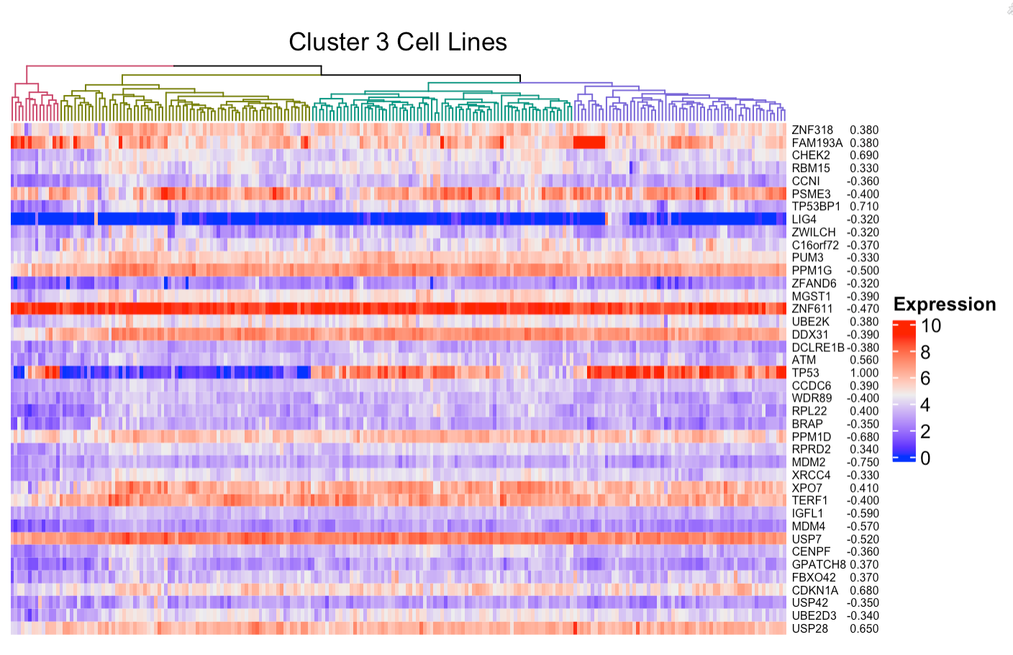
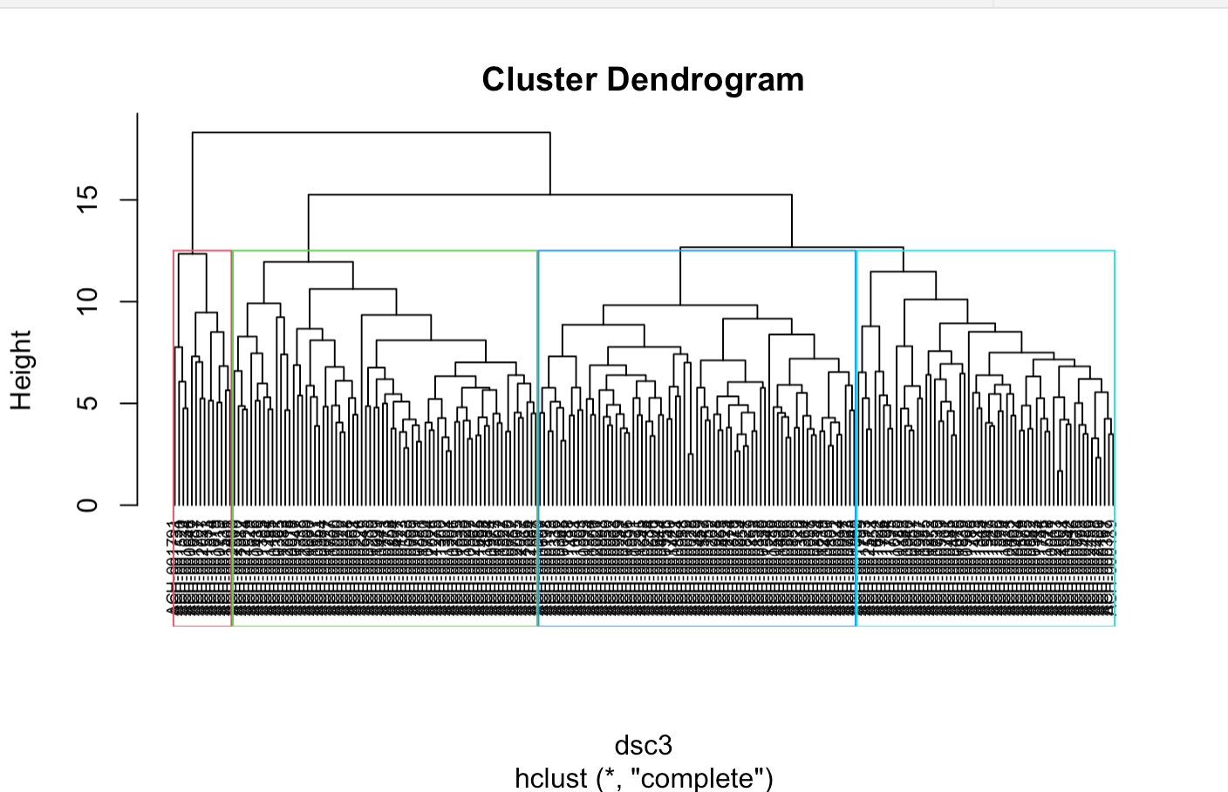
Third cluster analysis was on ‘Cluster 3’ –A cluster from the heatmap from slide 1. The Heatmap is generated by expression data, with the same most correlated genes to TP53 (same row order).
A similar pattern is seen here with expression of TP53 as in Cluster 2 cell lines.
In one cluster (within Cluster 3 cell lines) it is highly expressed.
In one cluster (within Cluster 3 cell lines) TP53 has low mRNA expression.

Slide 8
Summary of Current analysis
All Cancer cell lines Gene essentiality (CRISPR) heatmap with Hclust and top 40 most correlated genes (pos and neg) to TP53.
First Cluster analysis: The smallest cluster within the heatmap:
Identified most significant lineage = Kidney.
Second Cluster analysis: ‘Cluster 2’ within the heatmap:
Identified significant lineages = Soft Tissue, Skin, Lung
Identified significant subtype = Malignant Rhabdoid Tumor.
Plotted an expression heatmap with the same top 40 most correlated genes to TP53 (same row order). Preformed Hclust on the new expression heatmap. This showed a distinct cluster of high TP53 expression and a distinct cluster of low TP53 expression.
Preformed cluster analysis on the high TP53 expression cluster – Lineage = Lung and Subtype = NSCLC Adenocarcinoma
Preformed cluster analysis on the low TP53 expression cluster – Lineage = Soft tissue lineage and Subtype = Malignant Rhabdoid Tumor. (Similar results to Cluster 2 gene essentiality data)
Third Cluster analysis from Heatmap 1 (CRISPR):
Found similar pattern of distinct clusters of high TP53 expression and low TP53 expression.

