Slide 1
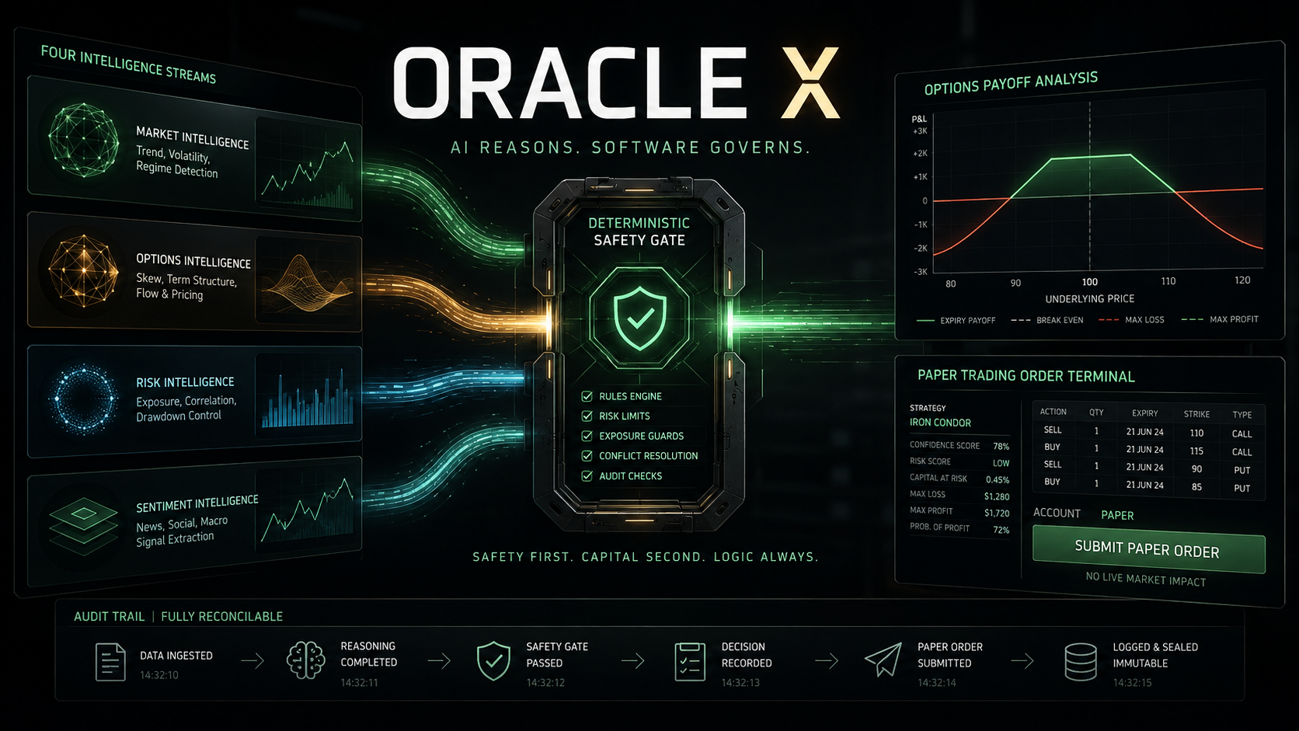
Notes:
[Sources]
- OpenAI-generated ORACLE X project cover, created 2026-09-04.
[/Sources]

Slide 2
THE ARCHITECTURAL BET
Models build the case. Software controls the trade.
One model should never own both reasoning and execution.
ATHENA
HADES
HERMES
MORPHEUS
>
>
>
Thesis
Challenge
Options
Stress
Advisory intelligence
Deterministic authority
QUANT
GOVERNOR
GUARD
ALPACA
>
>
>
Exact values
Hard limits
Final check
Paper order
Notes:
[Sources]
- ORACLE X AGENTS.md and docs/ARCHITECTURE.md.
- Implemented workflow in backend/app/workflow.py.
[/Sources]

Slide 3
FAIL-CLOSED BY CONSTRUCTION
A model cannot talk its way around a failed gate.
AI MAY
SOFTWARE MUST
+ Interpret evidence
01 Recalculate price, spread and max loss
+ Challenge assumptions
02 Enforce paper mode and kill switch
+ Recommend a strategy
03 Expire approvals and freeze strategy
+ Explain deterministic results
04 Reserve idempotency before submission
05 Append every decision to replay
No broker credentials. No order tools.
Notes:
[Sources]
- ORACLE X trust-boundary and Risk Governor contracts.
- Verified implementation in backend/app/config.py, workflow.py and store.py.
[/Sources]

Slide 4
WHY DID THIS TRADE HAPPEN?
Every decision leaves a reconstructable trail.
1
2
3
4
5
6
7
8
EVIDENCE
ATHENA
HADES
HERMES
MORPHEUS
RISK
GUARD
ORDER
18
events in the verified demo replay
Append-only storage rejects update and delete attempts.
Notes:
[Sources]
- Verified browser run and tests/test_workflow.py.
- Replay endpoint: GET /api/runs/{run_id}/replay.
[/Sources]

Slide 5
SUBMISSION BUILD
A working options committee,
not a trading chatbot.
READY TO JUDGE
+ Four typed agent contracts
+ Real sponsor adapters
7 / 7
18
0
+ Deterministic Risk Governor
+ Final Execution Guard
SAFETY TESTS
REPLAY EVENTS
LIVE ENDPOINTS
+ Paper-only order boundary
+ Responsive War Room
ORACLE X
AI reasons. Software governs.
Notes:
[Sources]
- Test result: 7 passed on 2026-09-04.
- ORACLE X repository implementation and local browser verification.
[/Sources]

