Slide 1
Scalable AI
(the codewars pacman story)

Slide 2
What is pacman?
https://www.youtube.com/watch?v=E4rVgZ3FFYE

Slide 3
The task
Make pacman AI to collect beans
Make ghost AI to catch pacman ASAP

Slide 4

Our results
4th place

Slide 5
The AI algorithm
Scoring system

Slide 6
Simple example
Calculate persons credit score

Slide 7
Simple example
Calculate persons credit score
Person does not have a job

Slide 8
Simple example
Calculate persons credit score
Person does not have a job -100 points

Slide 9
Simple example
Calculate persons credit score
Person does not have a job -100 points
Person had problems with other creditors

Slide 10
Simple example
Calculate persons credit score
Person does not have a job -100 points
Person had problems with other creditors -200 points

Slide 11
Simple example
Calculate persons credit score
Person does not have a job -100 points
Person had problems with other creditors -200 points
Person owns a successful company

Slide 12
Simple example
Calculate persons credit score
Person does not have a job -100 points
Person had problems with other creditors -200 points
Person owns a successful company +1000 points

Slide 13
Simple example
Calculate persons credit score
Person does not have a job -100 points
Person had problems with other creditors -200 points
Person owns a successful company +1000 points
Person is a drunkard

Slide 14
Simple example
Calculate persons credit score
Person does not have a job -100 points
Person had problems with other creditors -200 points
Person owns a successful company +1000 points
Person is a drunkard -50 points

Slide 15
Simple example
Calculate persons credit score
Person does not have a job -100 points
Person had problems with other creditors -200 points
Person owns a successful company +1000 points
Person is a drunkard -50 points
Person likes apple products

Slide 16
Simple example
Calculate persons credit score
Person does not have a job -100 points
Person had problems with other creditors -200 points
Person owns a successful company +1000 points
Person is a drunkard -50 points
Person likes apple products -100 points

Slide 17
Simple example
Calculate persons credit score
Person does not have a job -100 points
Person had problems with other creditors -200 points
Person owns a successful company +1000 points
Person is a drunkard -50 points
Person likes apple products -100 points
Grand total: 550 points

Slide 18
In similar way neural networks work

Slide 19
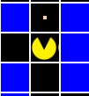
How this relates to pacman?

Slide 20
How this relates to pacman?
Direction scoring

Slide 21
How this relates to pacman?
At any point in this game pacman has four directions to go to

Slide 22
How this relates to pacman?
At any point in this game pacman has four directions to go to
We scored four directions in our algorithm

Slide 23
Features
How to avoid walls?

Slide 24
Features
How to avoid walls?
Assign negative scores to a tile
0 points
0 points
-1000 points
0 points

Slide 25
Features
How to collect beans?
Assign assign positive scores to a bean
100 points
0 points
0 points
(note: if wall had a bean we wouldn't go to it because going to wall outweighs the bean)
0 points

Slide 26
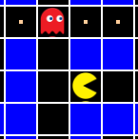
Features
How not to be caught by a ghost?
Calculate paths and see if ghost is on it
A wall
-300 points
0 points
Even though there are beans on path ghost outweighs the beans
0 points

Slide 27
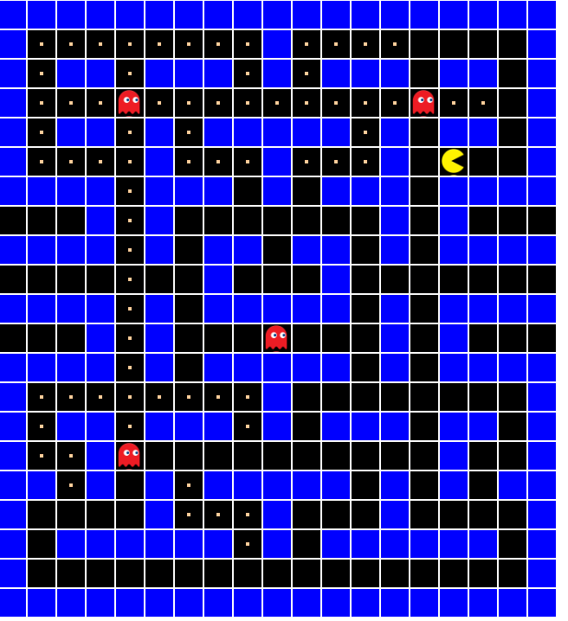
Features
How to determine where are more beans?
Calculate beans by partitioning areas
10 points
5 points

Slide 28
Features
How to determine where are more beans?
Calculate beans by partitioning areas
10 points
5 points

Slide 29
Features
Not to keep looping in same tiles
Remember 16 tiles with their coordinates
and assign negative score weight multiplied by times traversed that tile in 16 turns

Slide 30
Features
Other features are just spinoffs of the ones already mentioned
(like, don't go to ghost works same way as not going to the pacman)

Slide 31
The grand logic algorithm

Slide 32
The grand logic algorithm
(sort-by second > (map-indexed vector scores))

Slide 33
The grand logic algorithm
(sort-by second > (map-indexed vector scores))
Just sort the scores and see which path has the highest

Slide 34
Reusability
Pacman and Ghosts have the same code

Slide 35
How to implement ghosts?
Ghosts are implemented exactly the same just weights are different.

Slide 36
Functions for pacman and ghosts logic
(defn score-turn-for-pacman [original pacman-prev-positions]
(score-turn-for-subject
original
(first (pacman-pos original))
pacman-prev-positions))
(defn score-turn-ghosts [original ghost-positions]
(mapv
#(score-turn-for-subject
original % [])
ghost-positions))

Slide 37
Scalability
Add as many features as you want and just sum them to the rest of the scores
Feature development can be parallelized
Mix and match features for infinite combinations and possiblities
Zero fear of changing weights (even in realtime)

Slide 38
Conclusions
This is a nice way to implement AI
Don't mix up x and y in vector :(

Slide 39
Quick demo
https://github.com/davidkazlauskas/pacmanai
Clone, cd into dir and run 'lein figwheel'

