Slide 1
Risk Concepts & Risk Assessment 11.1 – 11.3
David Kelly
EM_564
6/14/2022

Slide 2
Risk concepts (11.1)
What is a risk?
A function of the uniqueness of a project and the experience of the project team.
Risk involves 2 concepts
Likelihood that a troublesome event will occur
The impact of the event if it does occur
Greater risk can mean greater rewards, savings, or benefits.
Risk management generally focuses on negative consequences.

Slide 3
Risk identification (11.2)
Manage things that you aware of. Identify risks and predict their consequences.
Risk in projects – aka “Risk of failure” – you might fall short in – schedule, budget, or technical performance.
Use project chronology to look at the phases and stages in the cycles.
Feasibility, contract negotiation, system concept
Type of work or technical function
Product reliability and maintainability
Production risks for manufacturing or availability of raw materials
Notes:
The next several pages are about Risk Identification
Chronology – Id risks in each such as hurdles and problems that can halt the project or lead to future failure.

Slide 4
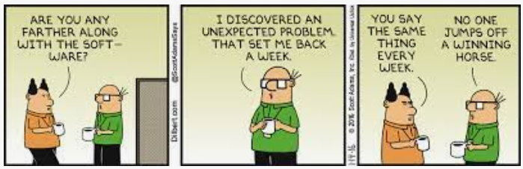
Risk identification
Factors contributing to high risk
Using an untried approach
Develop a new system and advancing technology at the same time
Developing and testing new equipment, system, or procedures
Operating in an unstable or variable environment
Notes:
Develop a new system and advance technology – Experience this at my previous job. Let’s put the new app on the latest IPAD, learn IOS development and deployment.
Dilbert: With risk management, we are trying to minimize the Unexpected problem

Slide 5
Risk Sources
Internal
Market Risk
Assumptions Risk
Technical Risk
Maturity – How knowledgeable is the project team?
Complexity – How many steps, elements or components are in the process?
Quality – How producible, reliable and testable is the end-item or process?
Concurrency or dependency – How many dependent activities overlap?
Other risks – health, safety, and environmental
External
Sources that project managers and teams have limited or no control over
Notes:
Market risk - Failures in customer needs, identifying changes required, identifying competitors products.
External Government regulations
Competitors actions
Interest rates
Senior management
Suppliers
Labor availability
Adverse impacts of climate change
Stakeholders

Slide 6
Identification Techniques
Project analogy
Taking note of earlier projects to identify risks in upcoming projects
Keeping good records, document lessons learned
Identify projects that were similar in significant ways
WBS – Work packages analyzed for technical hurdles
Process flowcharts – analyze flows between project tasks
Failure mode and effects analysis methods
FMEA – Identify conditions leading to systems that fail
HAZOP – hazard and operability study method.
Project networks – integration of subsystems and components
Notes:
WBS - problem with managers, customers, suppliers, equipment or resource availability.

Slide 7
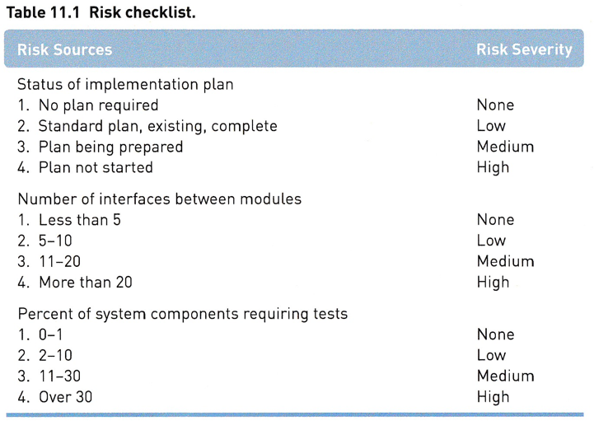
Identification Techniques
Checklists
Can pertain to the
project as a whole or specific
phases, work packages or
tasks.
Notes:
Checklist shows 3 example categories of sources and the risk severity
Checklists help to ensure the important risk sources won’t be overlooked.

Slide 8
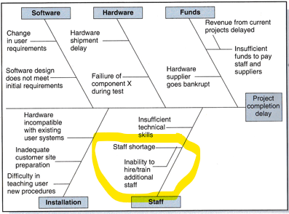
Identification Techniques
Cause-effect diagrams
Via Brainstorming
Delphi technique – Anonymous group survey approach for combining the opinions of several people to come to a consensus.
Notes:
Cause and affect – Cause is inability to hire/train additional staff the effect was Staff shortage.
Delph - Info is collected and reviewed. Each person could change their opinion until the group reaches a consensus

Slide 9
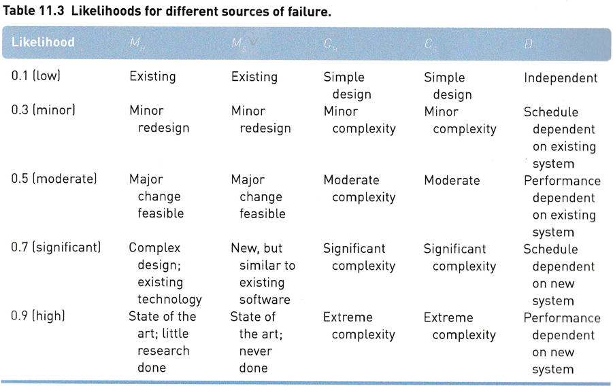
Risk Assessment (11.3)
Risk likelihood
Probability
that a risk factor
will materialize
Composite Likelihood
Factor (CLF)
CLF = (W1)M_{H} + (W2)C_{H} + (W3)M_{S} + (W4)C_{S} + (W5)D
Notes:
We have another checklist for potential sources of failure in software and hardware Immaturity and complexity
TYPO in book
Composite likelihood factor – CLF
MH – immaturity of hardware
MS – immaturity of software
CH – Complexity of hardware
CS – Complexity of software
D – Dependency of external factors

Slide 10
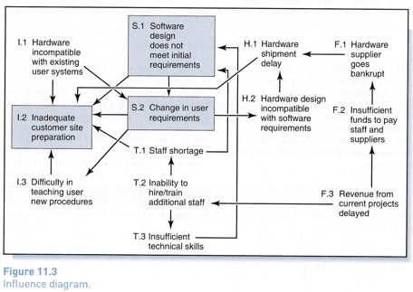
Risk Assessment
Influence Diagram – Shows interdependencies
Notes:
The risks with the most connections have the most likelihood of failure.

Slide 11
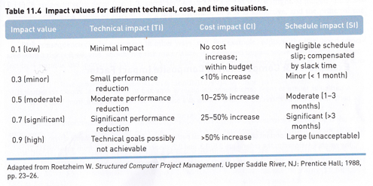
Risk Assessment
Risk Impact – Composite input factor (CIF)
CIF = (W1)TI + (W2)CI + (W3)SI
Notes:
Composite input factor

Slide 12
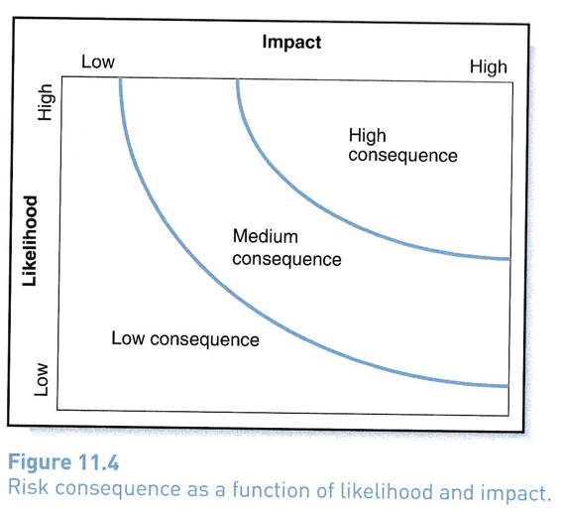
Risk Consequence
Combined consideration
of both likelihood and impact
RCR = (CLF) x (CIF)
Notes:
Composite likelihood factor
Composite Impact factor

Slide 13
PERT
Helps account for risks in project scheduling
Estimates additional time needed to handle risks in making the dates
Uses 3 time estimates for each project activity
a – optimistic
m – most likely
b – pessimistic
Activities with no risk – a, m, and b are identical.
More risk is seen by a larger spread between a and b.
Notes:
Composite likelihood factor
Composite Impact factor

Slide 14
Risk Priority
Risk Registry – page 372.
Risk Source of condition
Function area impacted
Risk impact (CIF)
Risk Likelihood (CLF)
Consequence Rate (RCR) – Ordered by highest first
Effect on project if risk source materializes
Action to solve the issue
Climate change
How sensitive is your project to CC?
Flood, heat, drought
Not all projects affected
Notes:
Based on risk consequences in the last section we have the Risk registry

Slide 15
Managing Risk by Steve Hendershot -Project Management Institute, Inc.
In the pod cast Managing Risk, Steve Hendershot interviews David Hilson - PHD. (Paraphrased)
Steve asks David: The world has a lot of unknowns in it which makes it difficult to predict what is going to happen next. An example would be the recent pandemic and also emerging technologies. What does risk identification and analysis look like when we have no previous examples?
David Hilson: Risks are unknown. They have yet to happen, they may never happen but some uncertainties we don’t care about. It will more than likely rain tomorrow. We only care about what will affect our projects.

Slide 16
Summary
If you apply these techniques you should be able to
Identify your risks
Compute how likely they might happen (CLF)
Compute their impact on your project (CIF)
Compute the risk consequence (RCR)
Take a risk, but a calculated one.
In the end it should lead you to having fewer unexpected problems.

Slide 17
Questions
Which of these are risk identification techniques?
A. WBS – Work packages scrutinized for technical hurdles, problem with managers, customers, suppliers, equipment or resource availability.
B. FEMA –Federal Emergency Management Agency method.
C. HAZOP – Hazard and operability study method.
D. All of the above
E. A and C
Notes:
FMEA – Identify conditions leading to system failure

Slide 18
Engagement
How would you handle this situation?
1. Your engineering manager pushes new technology at all costs and expects you to support that effort. The current system is outdated and desperately needs to be updated.
2. The business product manager just wants to get changes made to the web site as they have done for years. Instead of 1 week to get the work done, it requires 2-3 weeks to build new tech and then make the changes. Customers just have to wait for important changes.
How would you address this situation in terms of risk management?
To your manager?
To the product manager?
Notes:
FMEA – Identify conditions leading to system failure

Slide 19
Academic Integrity Statement
I commit myself to Washington State University's high standards to uphold academic honesty and scholarly values as established by the WSU's Standards of Conduct. I affirm that I have not given or received any unauthorized assistance on this assignment/examination, that the work product presented here is the work of the author(s) [all team members listed], and that all materials from other sources (including books, articles, Internet, or other media), whether quoted or paraphrased, have been properly cited.
David Kelly

Slide 20
References
Nicholas, J. M., & Steyn, H. (2021). Project Management for Engineering, Business and Technology (6th ed.). Routledge.
Hendershot, Steve. (2020, May 6). Managing risk | projectified - PMI. Managing Risk. Retrieved June 13, 2022, from https://www.pmi.org/learning/training-development/projectified-podcast/podcasts/managing-risk

