Slide 1
TMA AUTOMOTIVE SOFTWARE CENTER
SMART LIGHT

Slide 2
INTRODUCTION
SPRINT 1: SMART LIGHT
🌏
MEMBER
Mentor
Pham Nguyen Minh Khoi
1
Nguyen Phan Thao Nhi
Le Xuan Huy
4
Phan Le Quang Chien
3
2
Phan Van Hieu

Slide 3
Overview
Problem
What is our system?
Smart Light
What does it has?
How dose it work?
Demo

Slide 4
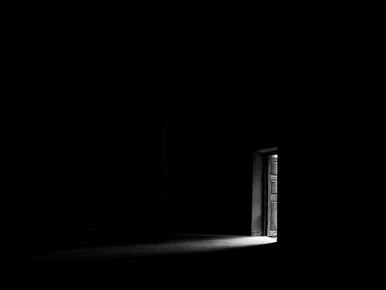

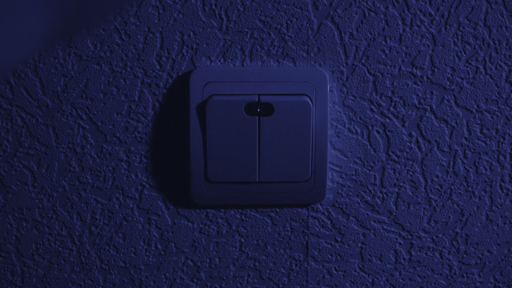
I. PROBLEM
Have you ever come home and groping for the switch to turn on the lights in the dark?

Slide 5


I. PROBLEM
Realize that you have not turned off the lights but can not do anything because you are in the company
It is annoying and inconvenient if we keep control the electrical equipment in the traditional way
Need a system that make the control easier

Slide 6

II. WHAT IS OUR SYSTEM?
1. SMART LIGHT
Is a light that can turn on/turn off by reading people’s gesture.

Slide 7
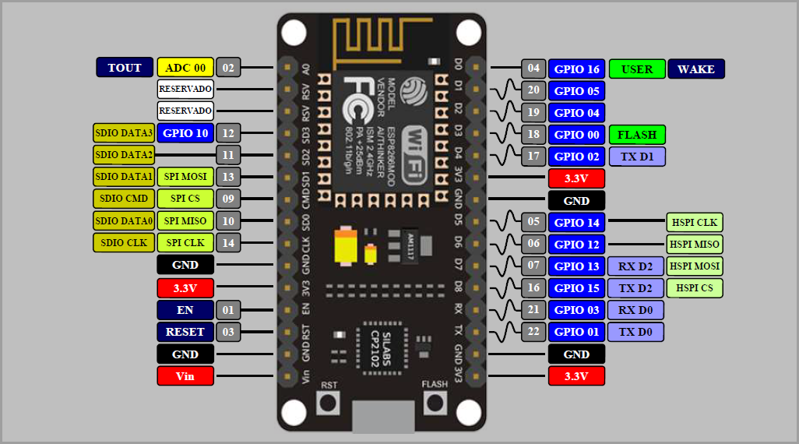
II. WHAT IS OUR SYSTEM?
2. WHAT DOES IT HAS?
Esp8266 NodeMCU

Slide 8
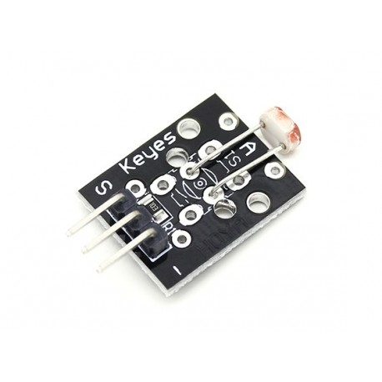
II. WHAT IS OUR SYSTEM?
2. WHAT DOES IT HAS?
Photoresistor Module

Slide 9
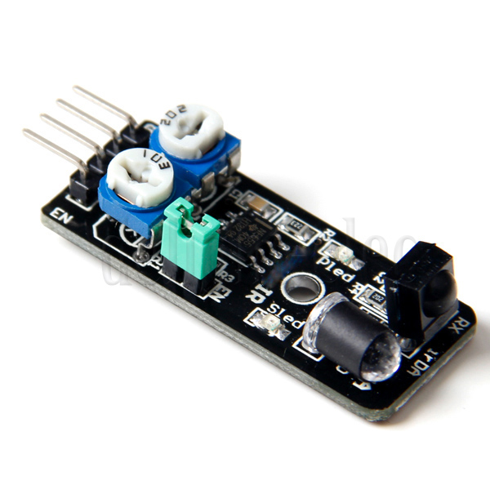
II. WHAT IS OUR SYSTEM?
2. WHAT DOES IT HAS?
Avoidance Module

Slide 10
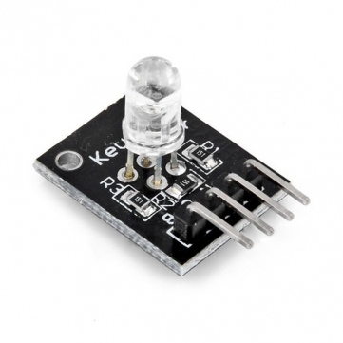
II. WHAT IS OUR SYSTEM?
2. WHAT DOES IT HAS?
RGB LED Module

Slide 11
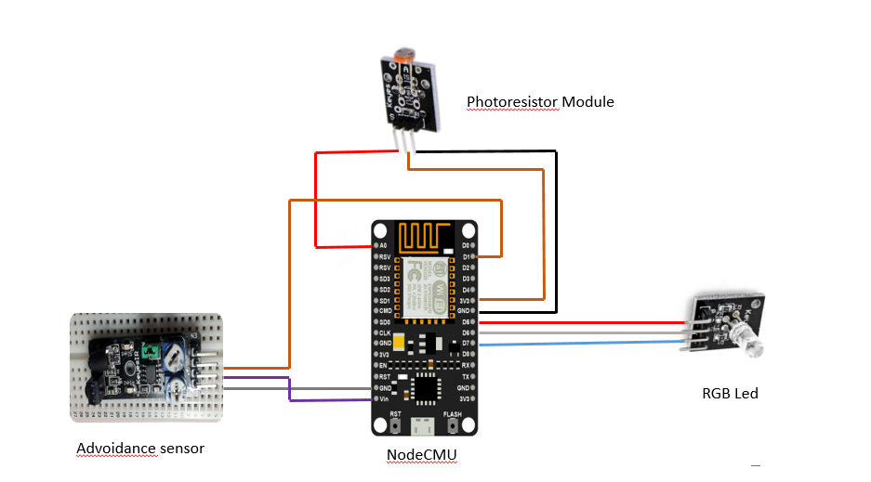
II. WHAT IS OUR SYSTEM?
3. HOW DOES IT WORK?
ELECTRIC CIRCUIT

Slide 12
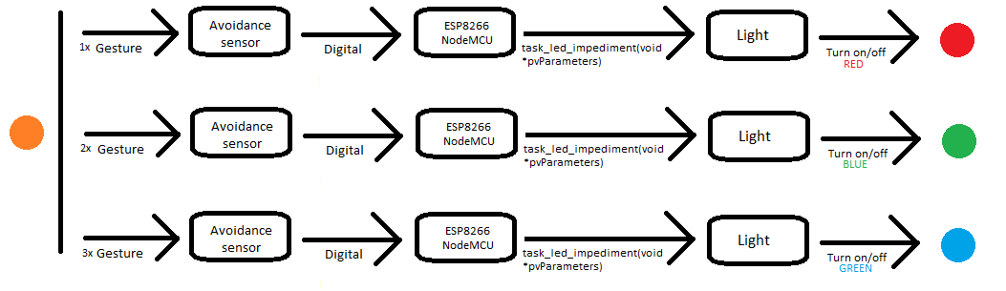
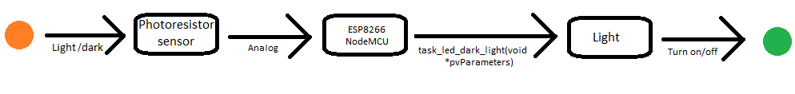
II. WHAT IS OUR SYSTEM?
4. OPERATION

Slide 13

III. DEMO

Slide 14
Thank You!

