Slide 1
SEIR_MC Model
As of Sep 27 2021

Slide 2
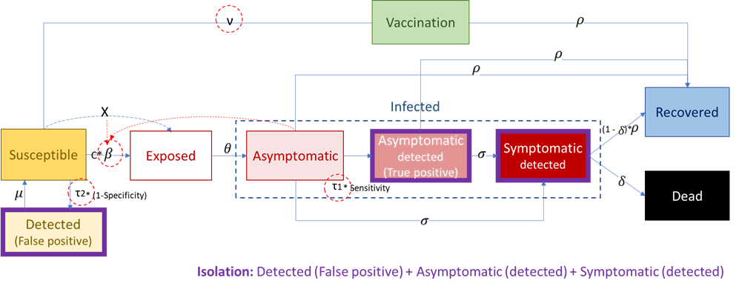
SEIR_MC모델

Slide 3
Model input data
Age contact matrix
초기조건 | 0-19 세 연령 | 20-39세 연령 | 40-59세 연령 | 60세이상 연령 | 비고
Total population (N=51,822,000) | 8,809,740 | 13,991,940 | 17101260 | 11,919,060 | 한국 전체 인구수
Uninfected | 8808740 | 13990940 | 15096260 | 8917060 | Total pop-Asymptomatic
Vaccinated | 0 | 0 | 2,000,000 | 3,000,000 | 7월말 누적완전백신접종 수
Exposed | 1000 | 1000 | 5000 | 2000 | 확진자수로부터 가정된 값
Asymptomatic | 1000 | 1000 | 5000 | 2000 | 확진자수로부터 가정된 값
Test positive (confirmatory testing) | 500 | 500 | 2000 | 1000 | 7월말 확진자수
False positive (mass screening) | 0 | 0 | 0 | 0
Symptomatic | 100 | 100 | 200 | 200 | 확진자수로부터 가정된 값
Recovered | 10000 | 20000 | 80000 | 150000 | 7월말 누적 확진자수
Dead | 0 | 0 | 0 | 0 | 7월말 누적 사망률
모델 지표
Rt | 1.36 |  |  |  | 7월초 계산된 수치
Beta | 0.1 |  |  |  | Rt값으로부터 추정된 수치
Mass screening testing rate (among uninfected population) | 0.00001
Confirmatory testing rate (among infected/asymptomatic population) | 0.2
Vaccination rate | 0
Incubation rate | 0.4
Sensitivity | 0.95
Specificity | 0.998
Progression rate | 0.035
Recovery rate | 0.07
Case fatality (among symptomatic population) | 0.0006
 | 0~11 | 12~18 | 19~59 | 60+
0~11 | 4 | 3 | 2 | 2
12~18 | 3 | 3 | 2 | 2
19~59 | 2 | 2 | 3 | 2
60+ | 2 | 2 | 2 | 3

Slide 4
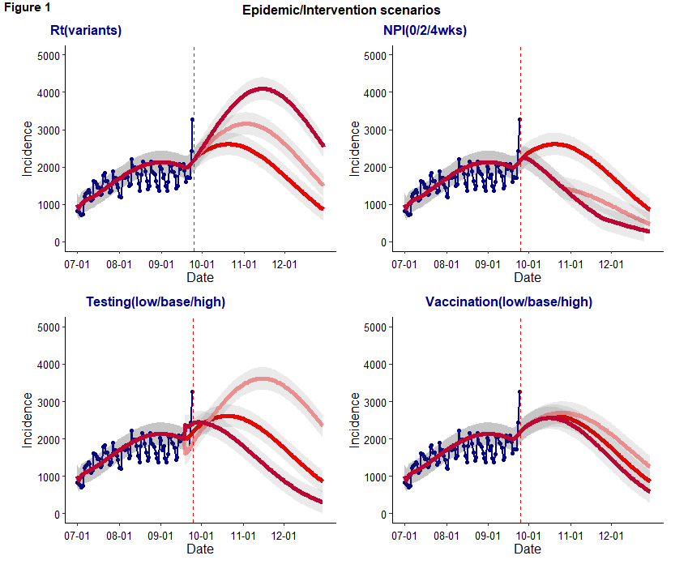
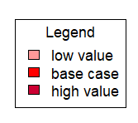
When we consider independent impact of each parameter (Rt/NPI/Testing/Vaccination), testing and Rt are more sensitive to the incidence compared to NPI and vaccination due in part to a large number of exposed/asymptomatic population.
4/8 wks NPI may avert the incidence about 30-40% compared to the base case and contribute to reduce the incidence even after a lift of the NPI.
Low testing rate results in a high peak in November due to the greater number of undetected asymptomatic patients; high testing rate results in a immediate peak at the point of intervention as it captures and isolate greater number of undetected asymptomatic patients who may contribute to the on-going infections.
Vaccination has relatively marginal impact as the percent change is based on the large number of susceptible population; Its impact to incidence makes some difference in a couple of weeks later due to the time associated with incubation and progression.

Slide 5
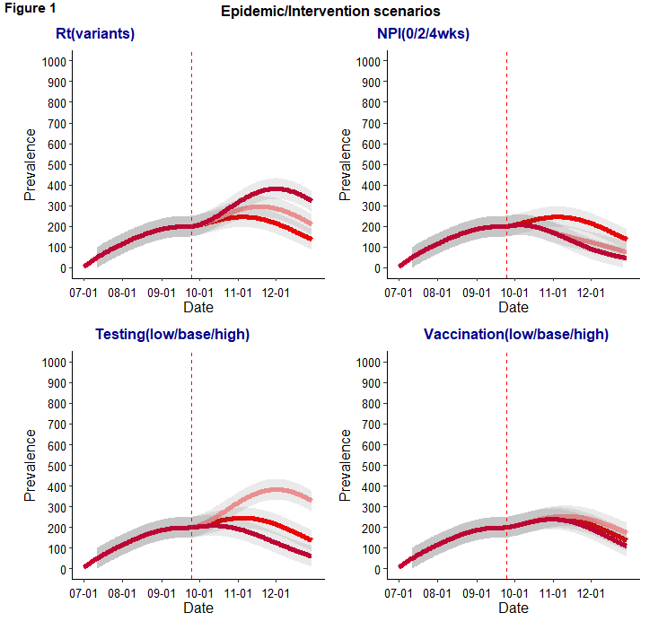
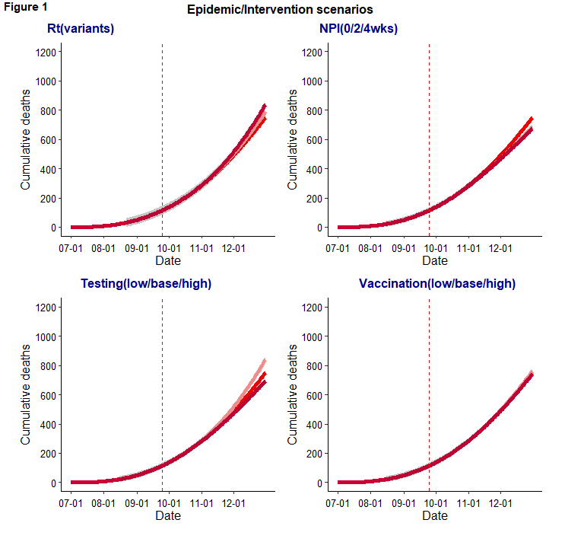
Prevalence of hospitalized patients projection
Cumulative deaths projection

Slide 6
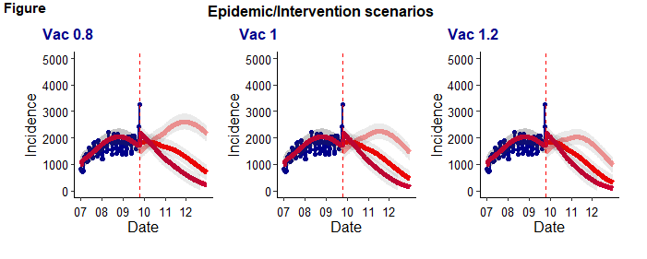
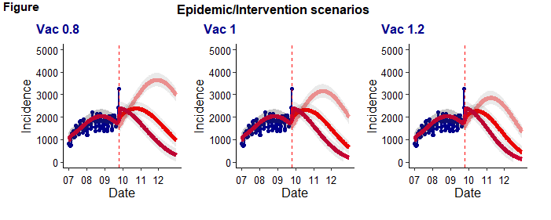
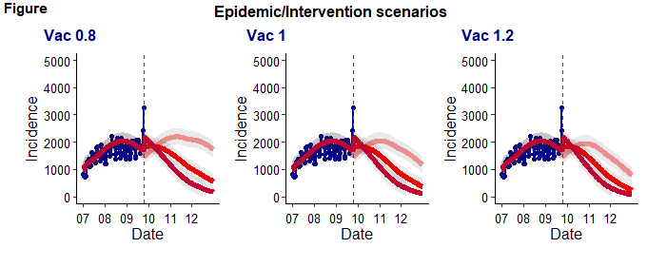
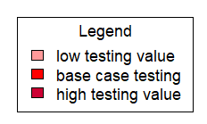
Rt1
4 wks NPI
No NPI
8 wks NPI

Slide 7
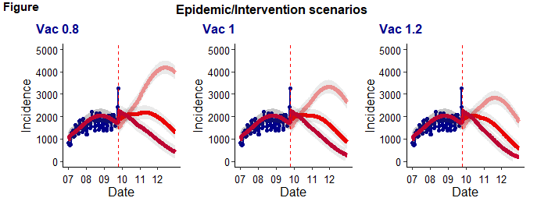
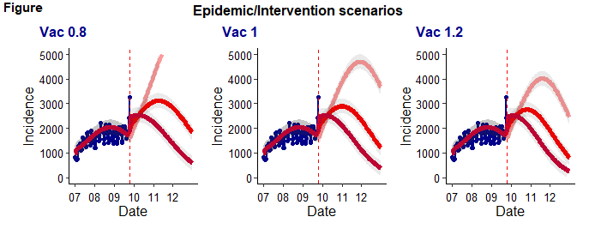
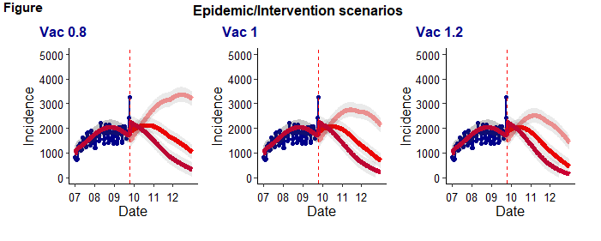
Rt1.05
4 wks NPI
No NPI
8 wks NPI
When vaccination rate is higher (>1), testing rate is less sensitive between 4wks NPI and 8 wks NPI; This suggests maintaining/increasing vaccination rate is important to reduce necessary duration of NPI to control the epidemic.
With 20% higher testing rate and >4wks NPI, incidence may decrease <1000 by December.

Slide 8
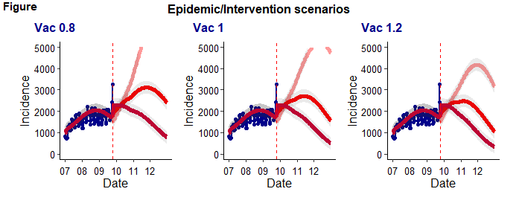
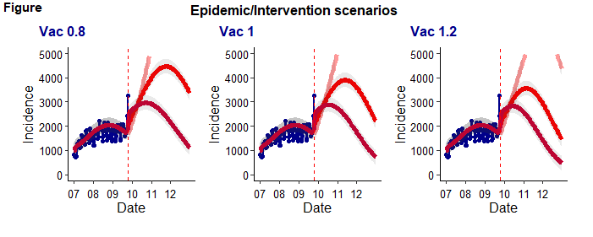
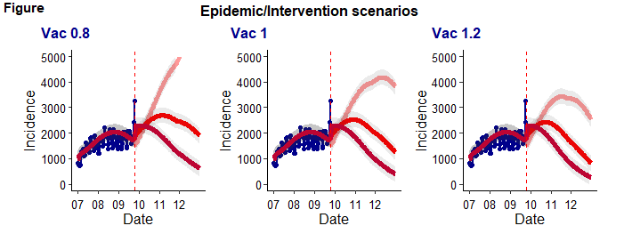
Rt1.1
4 wks NPI
No NPI
8 wks NPI
20% lower testing rate is more sensitive to incidence than 20% higher testing rate (especially when Rt is high); This suggests that maintaining testing capacity and efficiency is important to control the epidemic.

Slide 9
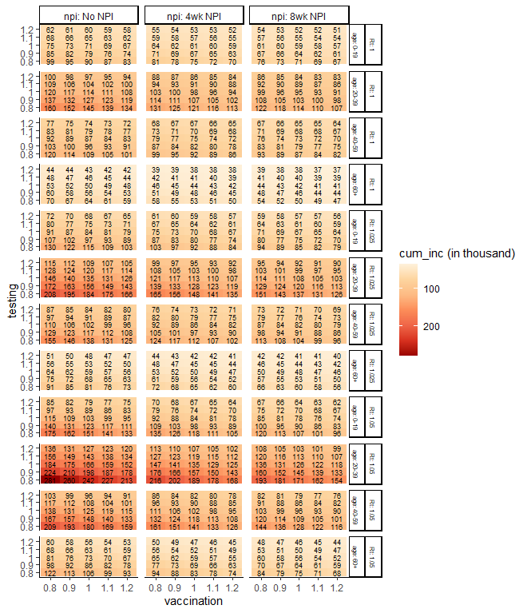
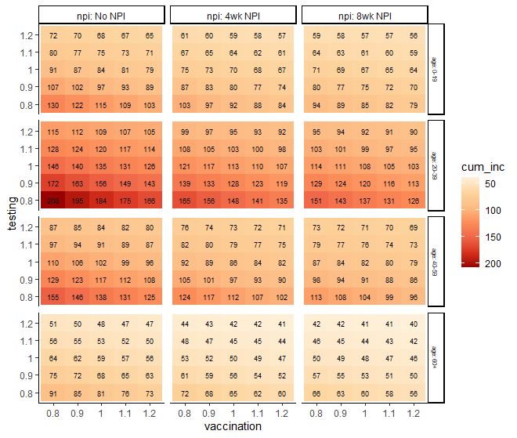
Given the population size and contact pattern, age 20-39 group shows the greatest health impact than other age groups
When Rt increases in a moderate level, cumulative cases may decrease 16% (from 135 to 113) by 1 month NPI and 20% (from 135 to 108) by 2 months NPI when vaccination and testing rates are constant.
Increasing testing 20% and vaccination 10% may achieve similar cumulative incidence (107,000) of base case scenario with 2 months NPI; In other words, investing in increasing testing (upto 20%) and vaccination (upto 10%) may be able to mitigate socioeconomic challenges by reducing the duration (2months) of NPI.

Slide 10
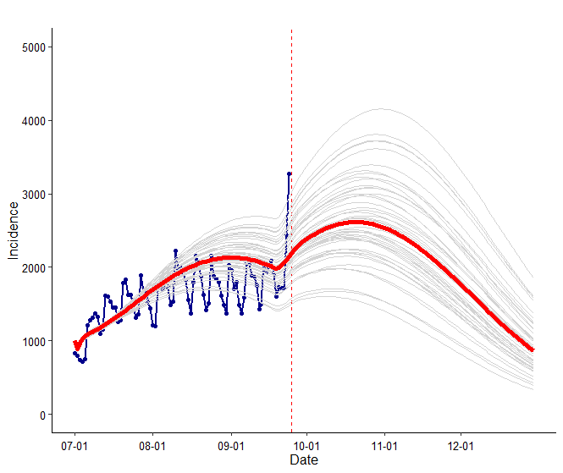
Uncertainty intervals

Slide 11
TBD: 연령별 그래프 appendix에 첨부

