Slide 1
SEIR_MC Model
As of Oct 11 2021

Slide 2
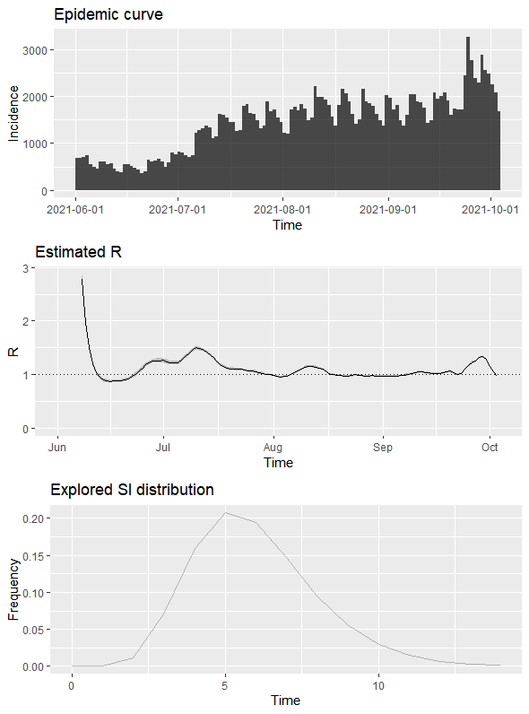
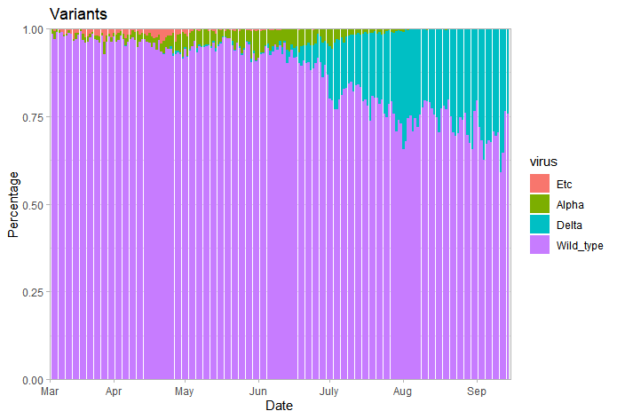
Real World Data Input 1:
Daily Incidence and variants types

Slide 3
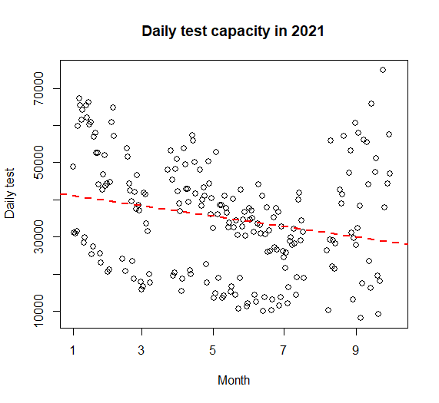
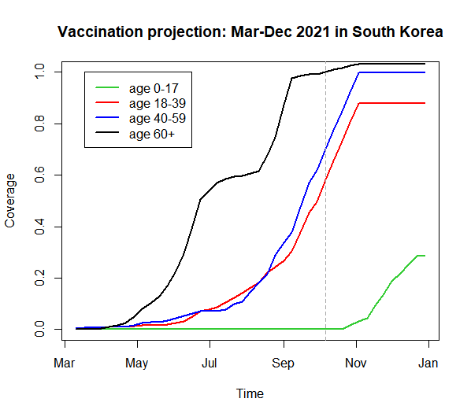
Real World Data Input 2: Daily testing and vaccination

Slide 4
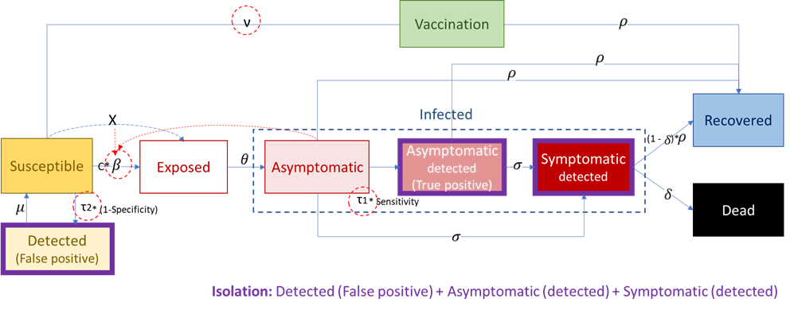
SEIR_MC모델
Infectious

Slide 5
Model input data
초기조건 | 0-19 세 연령 | 20-39세 연령 | 40-59세 연령 | 60세이상 연령 | 비고
Total population (N=51,822,000) | 8,809,740 | 13,991,940 | 17101260 | 11,919,060 | 한국 전체 인구수
Uninfected | 8808740 | 13990940 | 15096260 | 8917060 | Total pop-Asymptomatic
Vaccinated | 724 | 1,257,656 | 1,360,168 | 7,290,718 | 6월말 누적완전백신접종 수
Exposed | 1000 | 2000 | 2000 | 2000 | 확진자수로부터 가정된 값
Asymptomatic | 1000 | 2000 | 2000 | 2000 | 확진자수로부터 가정된 값
Test positive (confirmatory testing) | 100 | 1000 | 1000 | 1000 | 6월말 확진자 유병률
Symptomatic | 300 | 800 | 800 | 800 | 확진자수로부터 가정된 값
Recovered | 10000 | 20000 | 80000 | 150000 | 6월말 누적 확진자수+자연치유
Dead | 0 | 500 | 1000 | 1000 | 6월말 누적 사망률
모델 지표
Rt | 1.1-1.3 |  |  |  | EpiEstim: 6-9월 확진사수와 세대기간으로 계산된 수치
Testing rate | 0.11 |  |  |  | 관측치와 가정 (among uninfected/ exposed/ asymptomatic population)
Vaccination rate | Real world data |  |  |  | 관측치
Incubation rate | 0.4 |  |  |  | 잠복기간 (3-4일)
Sensitivity | 0.95 |  |  |  | 선별/확진 검사
Specificity | 0.998 |  |  |  | 선별/확진 검사
Progression rate | 0.035 |  |  |  | 증상 발현율 / 일
Recovery rate | 0.07 |  |  |  | 14일 회복기간
Case fatality | 0.0006 |  |  |  | 유증상 환자중 사망율 / 일
Age contact matrix
 | 0~19 | 20~39 | 40~59 | 60+
0~19 | 4 | 3 | 2 | 2
20~39 | 3 | 3 | 2 | 2
40~59 | 2 | 2 | 3 | 2
60+ | 2 | 2 | 2 | 3
Source: Mossong J, Hens N, Jit M, Beutels P, Auranen K, et al. (2008)
Social contacts and mixing patterns relevant to the spread of infectious
diseases. PLoS Med 5(3) e74. doi:10.1371/journal.pmed.0050074

Slide 6
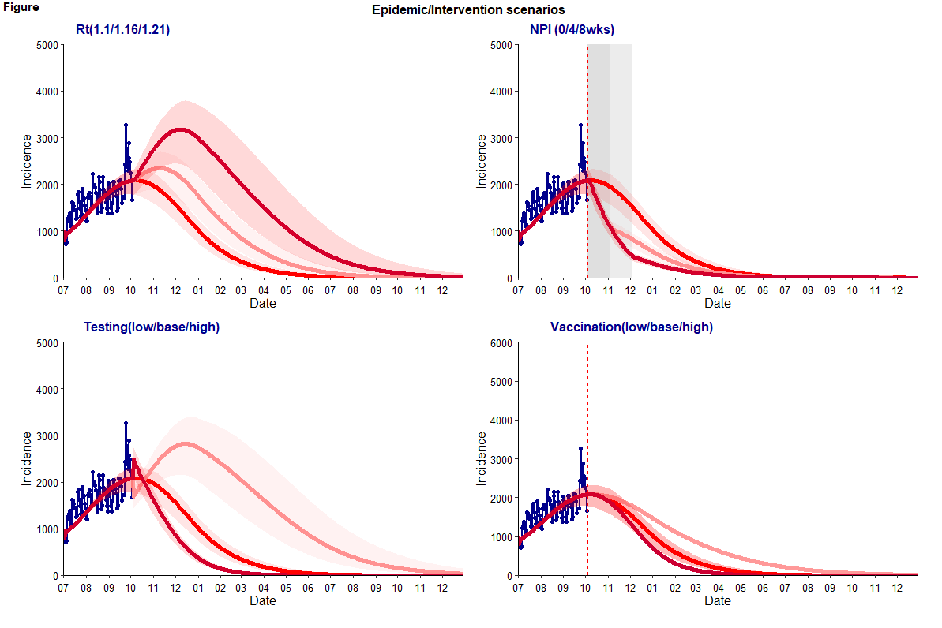
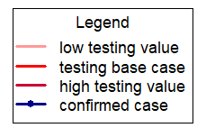

Slide 7
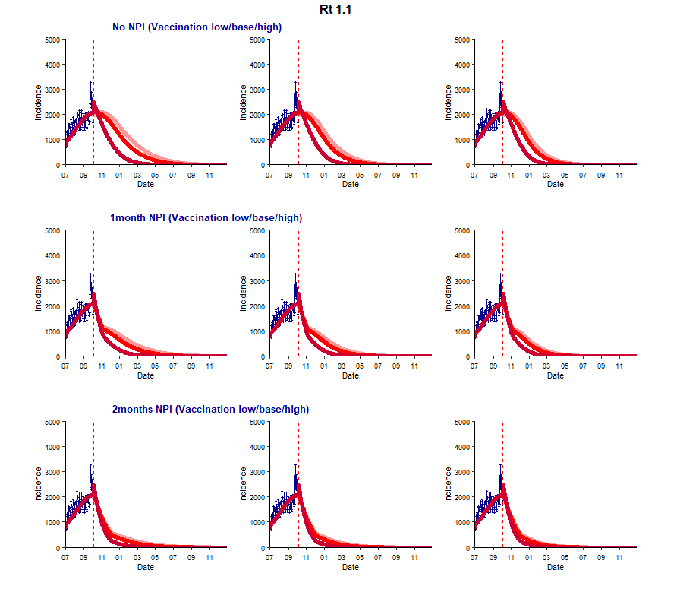
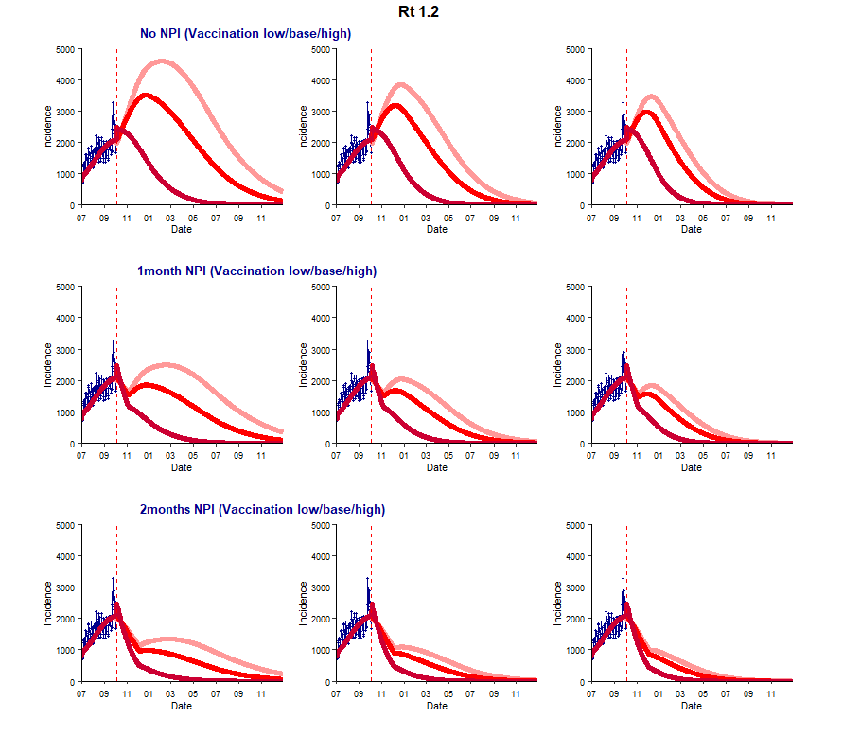

Slide 8
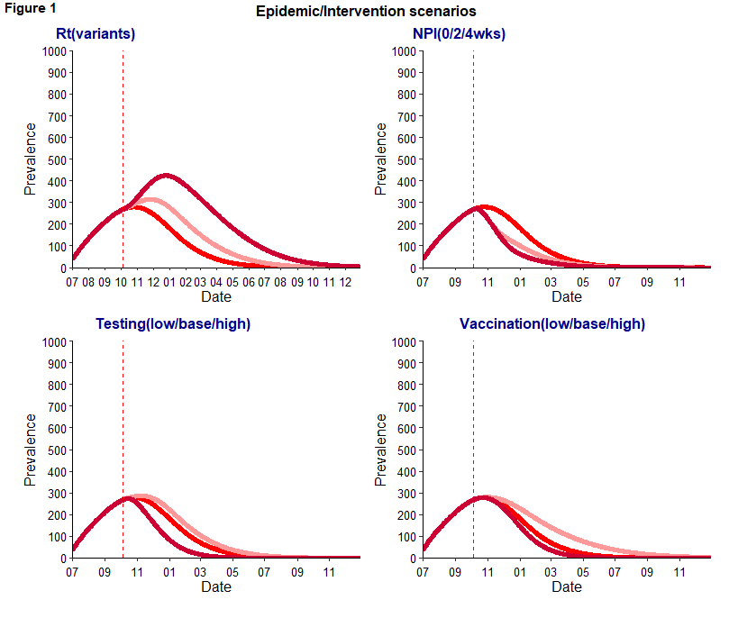
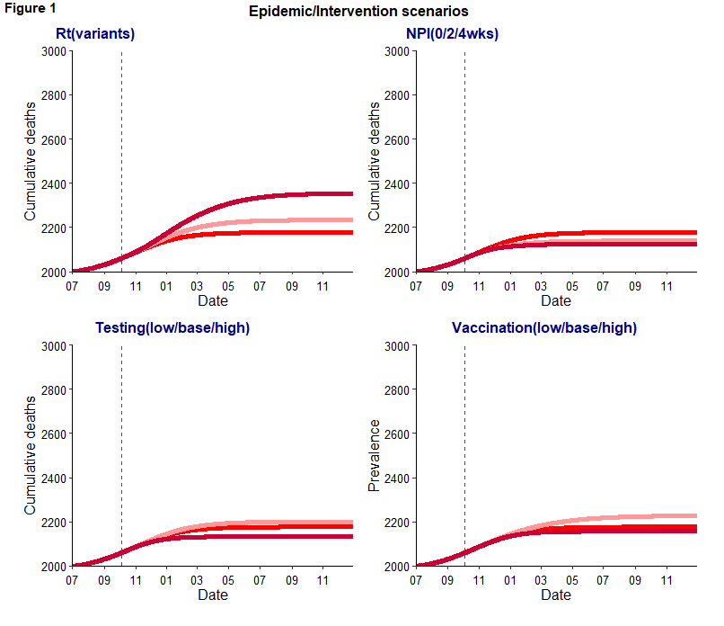
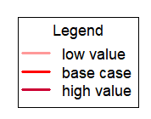

Slide 9
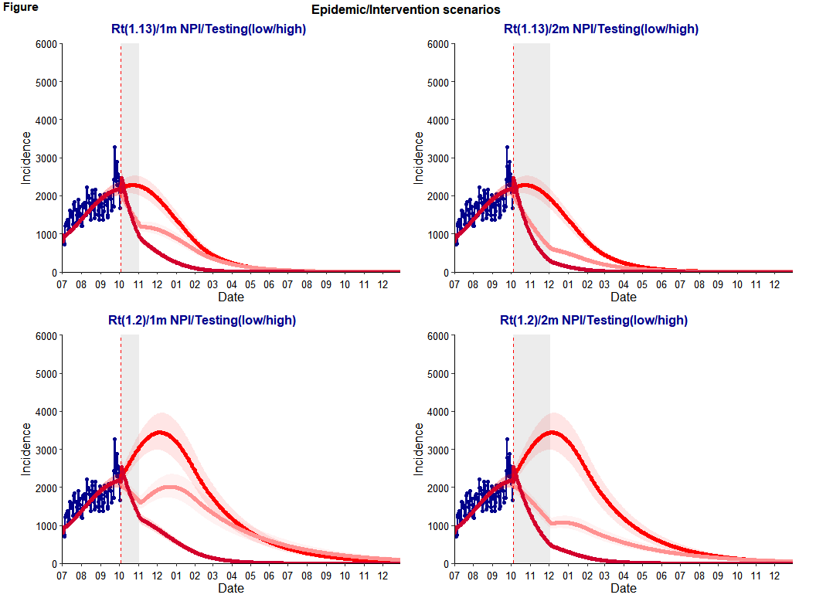

Slide 10
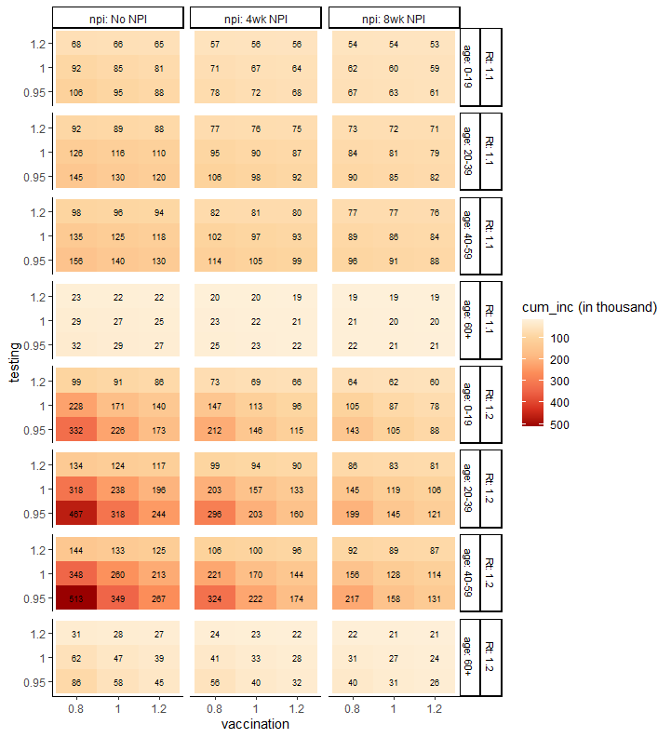
Vaccination : 20% decrease (low) or increase (high) of the expected vaccination rate from Oct, 2021-Dec, 2022
Testing: 5% decrease (low) -20% increase (high) of the expected testing rate from Oct 2021-Dec 2022
Heatmap represents cumulative incidence from July 2021 to Dec 2022 (18months)
Given the population size and contact pattern, age 20-59 group shows the greatest health impact than other age groups
If Rt increases from 1.1 to 1.21, cumulative cases may decrease 34% (from 238,000 to 157,000) by 1 month NPI and 50% (from 238,000 to 119,000) by 2 months NPI when vaccination and testing rates are constant.
Increasing testing 20% and vaccination 20% may achieve similar cumulative incidence (117,000) of base case scenario with 2 months NPI (119,000); In other words, investing in increasing testing and vaccination (upto 20%) may be able to mitigate socioeconomic challenges by reducing the duration (2months) of NPI.

