Slide 1
SEIR_MC Model
As of Oct 11 2021

Slide 2
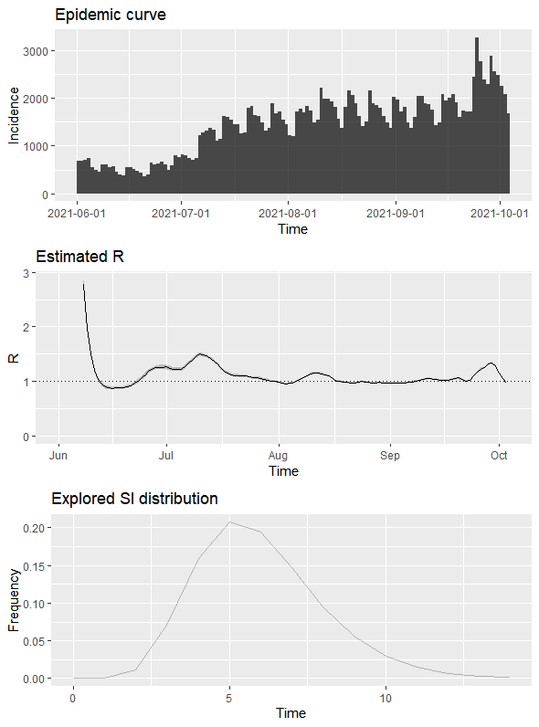
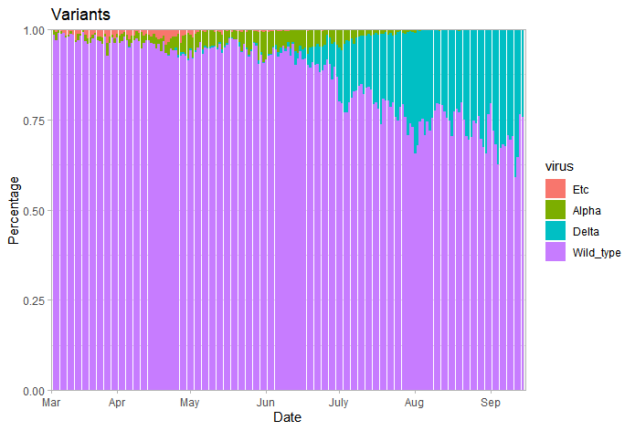
Real World Data Input 1:
Daily Incidence and variants types

Slide 3
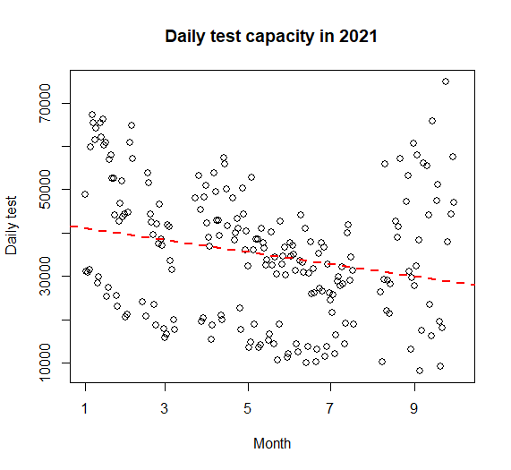
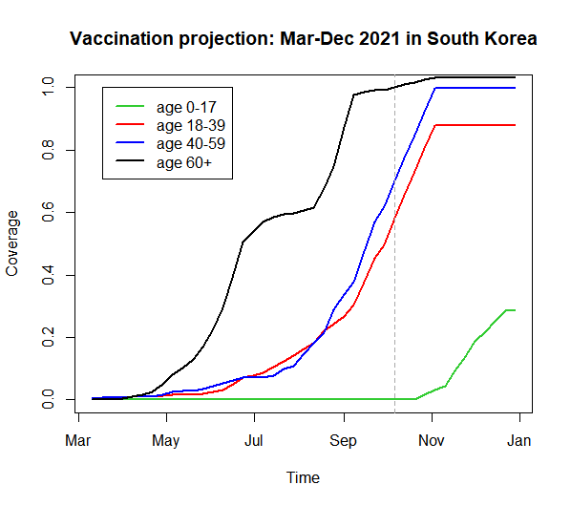
Real World Data Input 2: Daily testing and vaccination

Slide 4
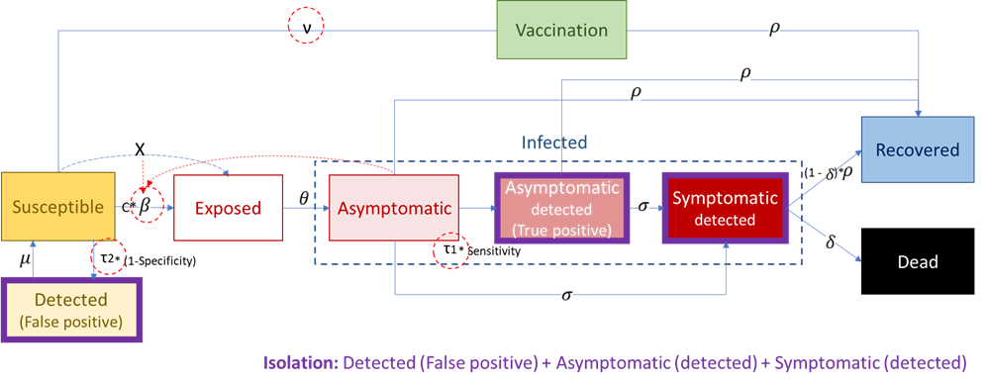
SEIR_MC모델
Infectious

Slide 5
Model input data
초기조건 | 0-19 세 연령 | 20-39세 연령 | 40-59세 연령 | 60세이상 연령 | 비고
Total population (N=51,822,000) | 8,809,740 | 13,991,940 | 17101260 | 11,919,060 | 한국 전체 인구수
Uninfected | 8808740 | 13990940 | 15096260 | 8917060 | Total pop-Asymptomatic
Vaccinated | 724 | 1,257,656 | 1,360,168 | 7,290,718 | 6월말 누적완전백신접종 수
Exposed | 1000 | 2000 | 2000 | 2000 | 확진자수로부터 가정된 값
Asymptomatic | 1000 | 2000 | 2000 | 2000 | 확진자수로부터 가정된 값
Test positive (confirmatory testing) | 100 | 1000 | 1000 | 1000 | 6월말 확진자 유병률
Symptomatic | 300 | 800 | 800 | 800 | 확진자수로부터 가정된 값
Recovered | 10000 | 20000 | 80000 | 150000 | 6월말 누적 확진자수+자연치유
Dead | 0 | 500 | 1000 | 1000 | 6월말 누적 사망률
모델 지표
Rt | 1.1-1.3 |  |  |  | EpiEstim: 6-9월 확진사수와 세대기간으로 계산된 수치
Testing rate | 0.11 |  |  |  | 관측치와 가정 (among uninfected/ exposed/ asymptomatic population)
Vaccination rate | Real world data |  |  |  | 관측치
Incubation rate | 0.4 |  |  |  | 잠복기간 (3-4일)
Sensitivity | 0.95 |  |  |  | 선별/확진 검사
Specificity | 0.998 |  |  |  | 선별/확진 검사
Progression rate | 0.035 |  |  |  | 증상 발현율 / 일
Recovery rate | 0.07 |  |  |  | 14일 회복기간
Case fatality | 0.0006 |  |  |  | 유증상 환자중 사망율 / 일
Age contact matrix
 | 0~19 | 20~39 | 40~59 | 60+
0~19 | 4 | 3 | 2 | 2
20~39 | 3 | 3 | 2 | 2
40~59 | 2 | 2 | 3 | 2
60+ | 2 | 2 | 2 | 3
Source: Mossong J, Hens N, Jit M, Beutels P, Auranen K, et al. (2008)
Social contacts and mixing patterns relevant to the spread of infectious
diseases. PLoS Med 5(3) e74. doi:10.1371/journal.pmed.0050074

Slide 6
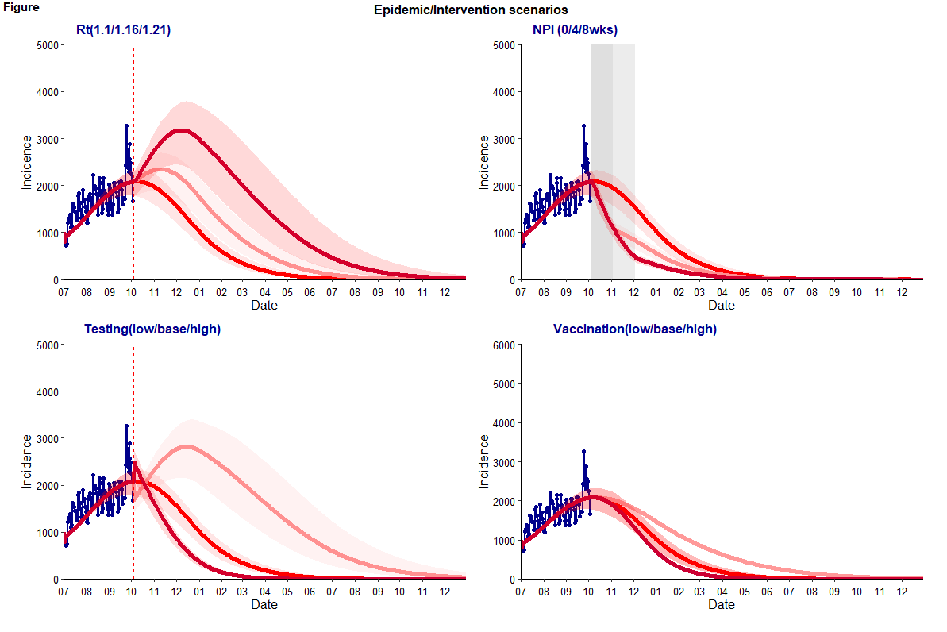
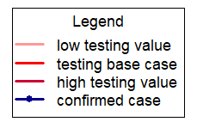

Slide 7
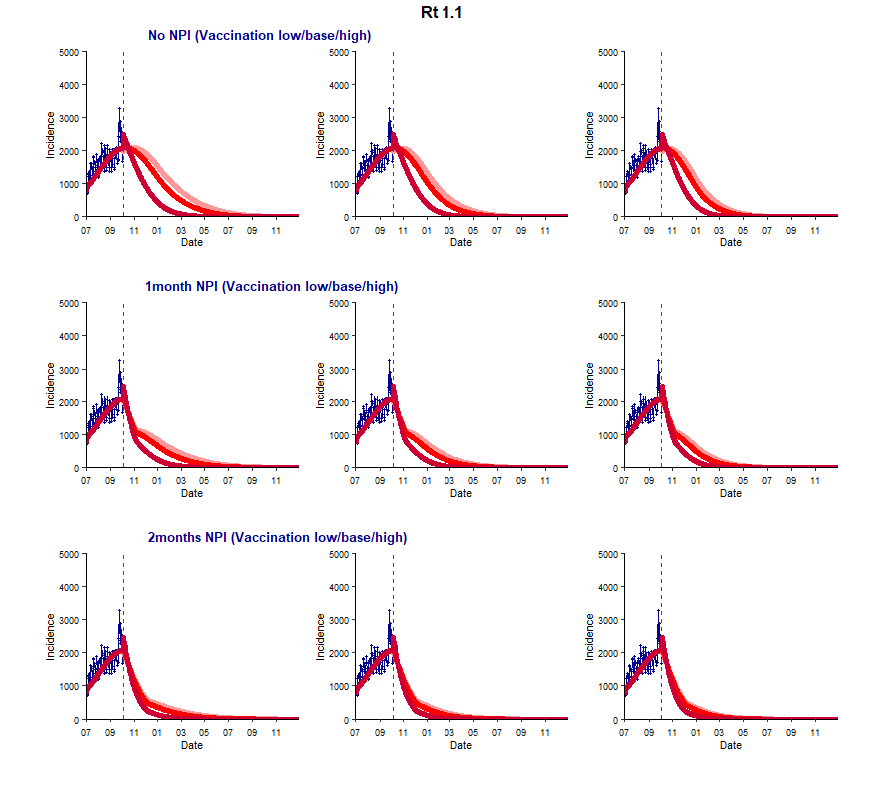
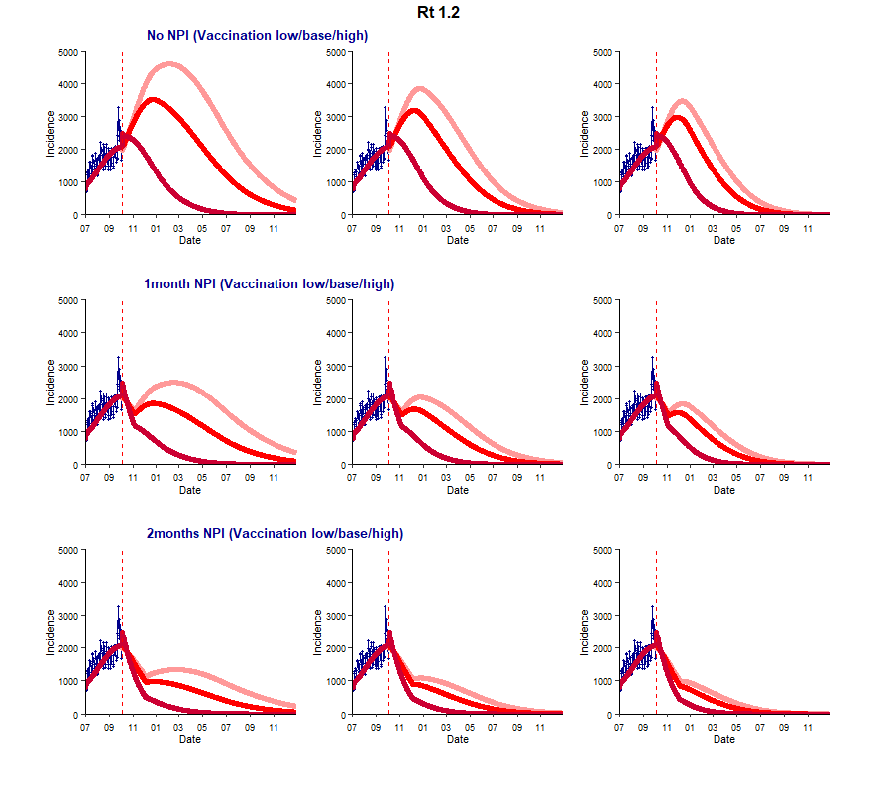

Slide 8
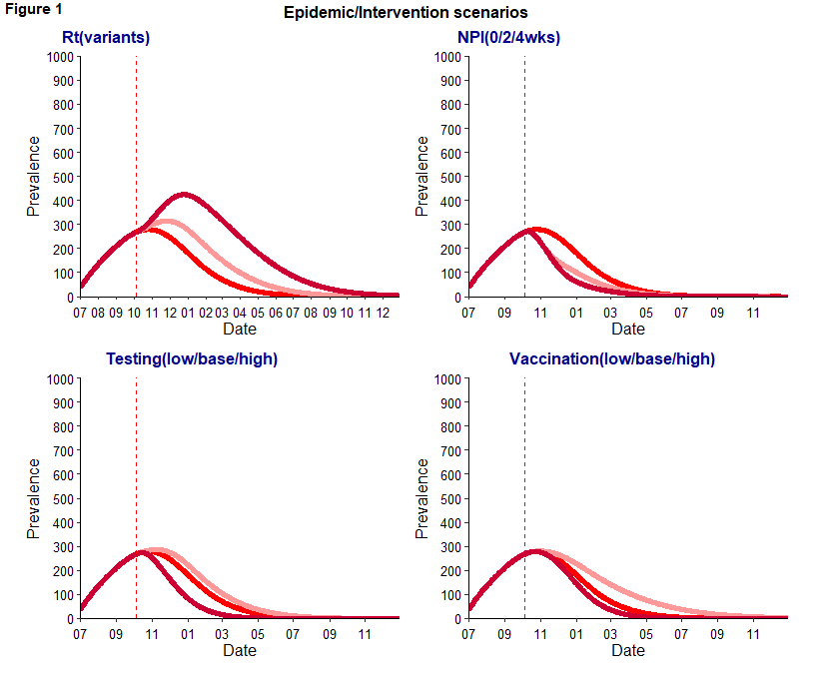
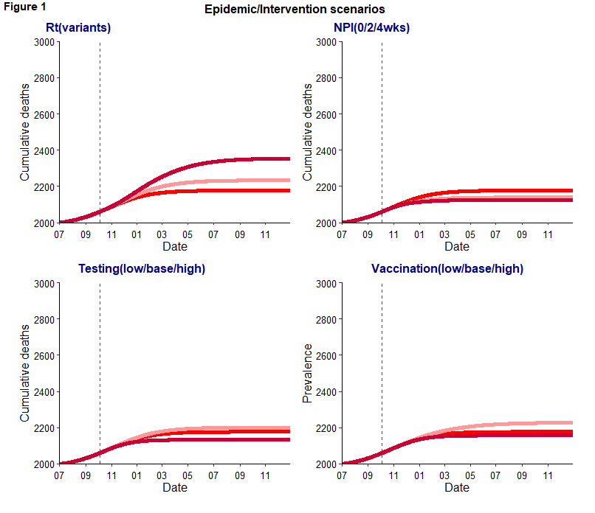
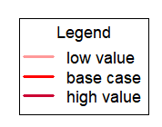

Slide 9
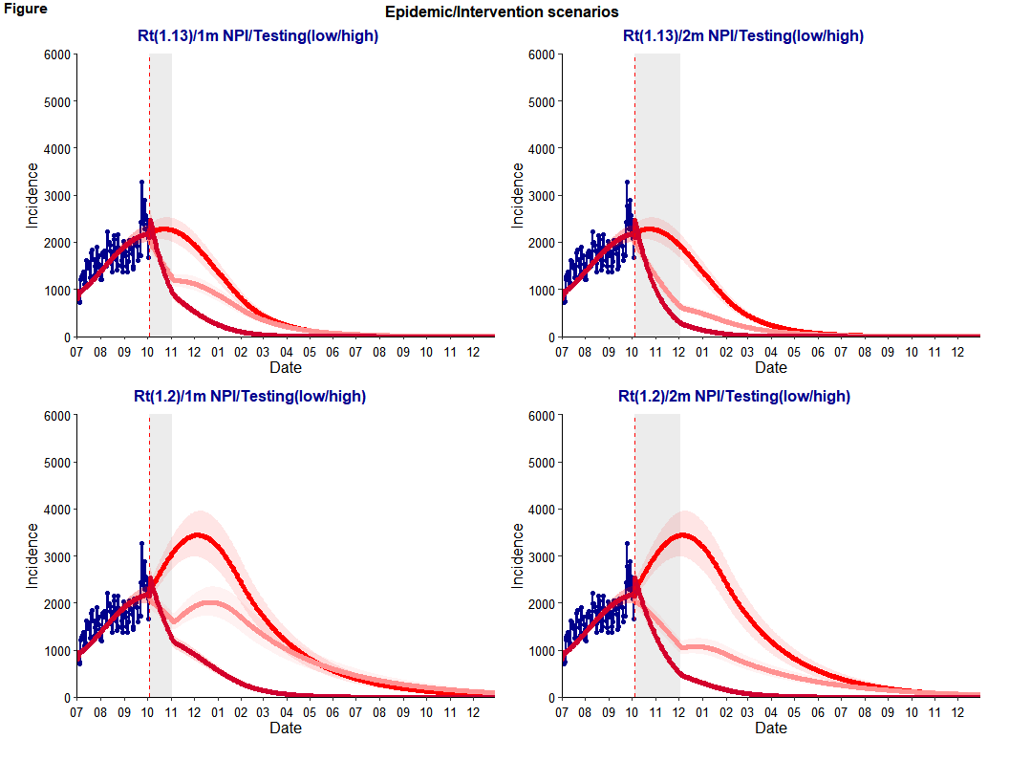

Slide 10
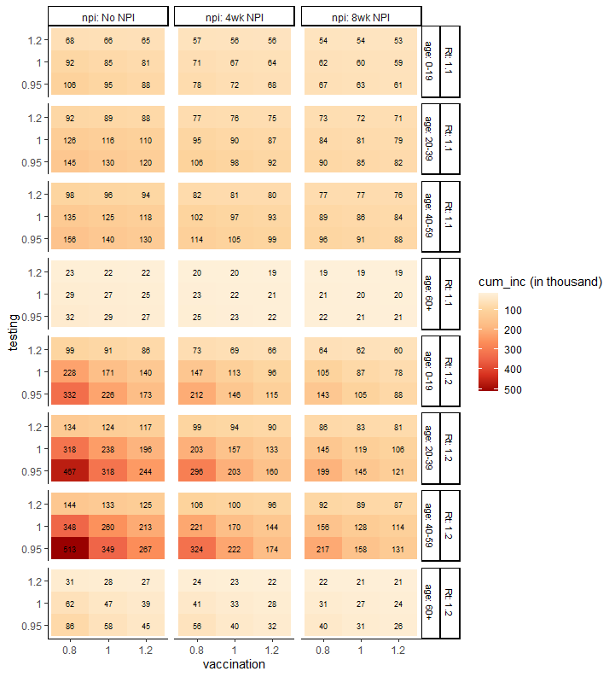
Vaccination : 20% decrease (low) or increase (high) of the expected vaccination rate from Oct, 2021-Dec, 2022
Testing: 5% decrease (low) -20% increase (high) of the expected testing rate from Oct 2021-Dec 2022
Heatmap represents cumulative incidence from July 2021 to Dec 2022 (18months)
Given the population size and contact pattern, age 20-59 group shows the greatest health impact than other age groups
If Rt increases from 1.1 to 1.21, cumulative cases may decrease 34% (from 238,000 to 157,000) by 1 month NPI and 50% (from 238,000 to 119,000) by 2 months NPI when vaccination and testing rates are constant.
Increasing testing 20% and vaccination 20% may achieve similar cumulative incidence (117,000) of base case scenario with 2 months NPI (119,000); In other words, investing in increasing testing and vaccination (upto 20%) may be able to mitigate socioeconomic challenges by reducing the duration (2months) of NPI.

Slide 11
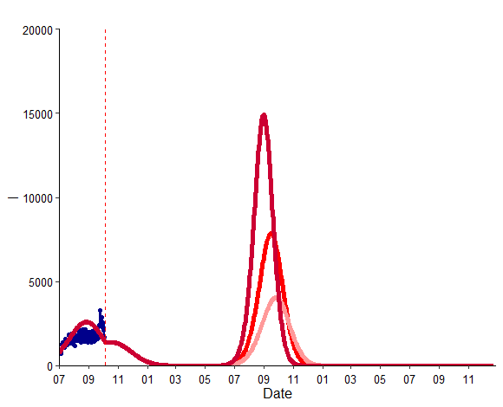
Result
With no NPI after April 2022, epidemic curves may be observed in July-November 2022. The peak may be observed earlier and higher if Rt increases upto (range 3-4) due to infections among unvaccinated populations. (The timing and peak however may be varied by the vaccination uptake coverage/effectiveness, transmissibility of Delta and effect of NPI)
Condition: Vaccination coverage
Fitting (observed age specific vaccination uptake rate from Mar – Sep 2021)
From Oct to Dec 2021: age 0-19 (x1.5); age 20-39 (50%); age 40-59 (50%); age 60+ (10%)
From Jan to Jun 2022: age 0-19 (x1); age 20-39 (17%); age 40-59 (10%); age 60+ (3%)
From July to Dec 2023: age 0-19 (80%); age 20-39 (0%); age 40-59 (0%); age 60+ (0%)
Calibration:
Number of total recovered population (including natural recovery before/after testing and vaccination) as 63% by Dec 2021, and 82% by Dec 2023 (~42 million)
Number of vaccination coverage as 61% by Dec 2021, and upto 80% by Dec 2023 (~40 million)
Scenarios
As of Oct 2021: estimated average Rt as 1.1 under NPI
Oct 2021-Apr 2022: estimated Rt as 0.82 with NPI (assuming transmissibility increases 1.7 times with Delta from Oct 2021 and NPI reduces 20% Rt from Oct 2021 to April 2022)
Apr 2022-Dec 2023 with no NPI :Rt increase 3-4 (i.e. Transmissibility increase 4.3-4.8 times) after April 2022, epidemic curves may be observed as shown the figure based on sensitivity analysis: 3.5 (low)/3.7 (base)/3.9 (high). In other words, if Rt is managed to be below 3 after April 2022, epidemic curve may be continued to be flatten.

Slide 12
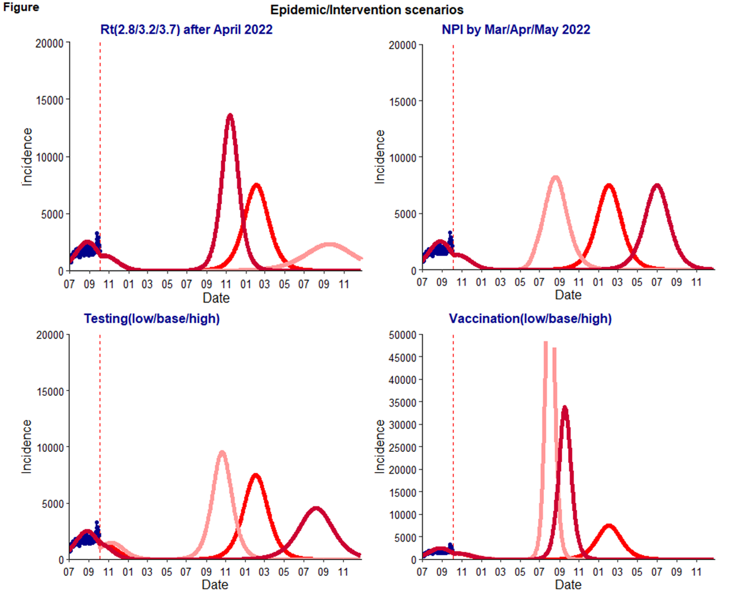
All scenarios were applied by NPI from Oct 2021 to April 2022 with expected impact of reducing Rt 20%.
Epidemic peak may be observed at 15000 in Nov 2022 under Rt 3.7; at 8000 in Feb 2023 under Rt 3.2; at 3000 under Rt 2.8 in Sep 2023.
Epidemic peak may be observed at 8000 in Aug 2022 with NPI until March 2022, Feb 2023 with NPI until April 2022, or July 2023 with NPI until May 2022.
Low testing (-20%) after Oct 2021 may result epidemic peak (+20%) to be observed in early (Oct 2022) while high testing (+20%) may result epidemic peak (-20%) in August 2023.
Reduced vaccination (80-90% of projection rate from Oct 2021; resulting 68-72% effective vaccine coverage by Dec 2023) may result high epidemic peak (>50,000 or 3,5000 in Aug-Sep 2023), compared to the base case vaccination scenario (~10,000 cases Feb 2023 with 75% effective vaccine coverage by Dec 2023)

Slide 13
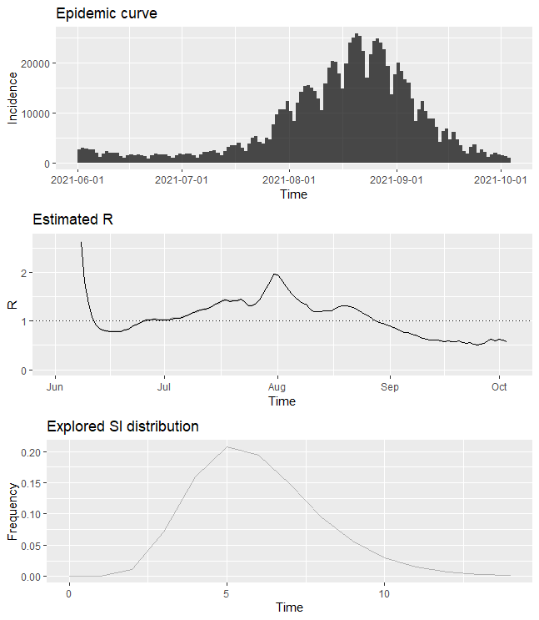
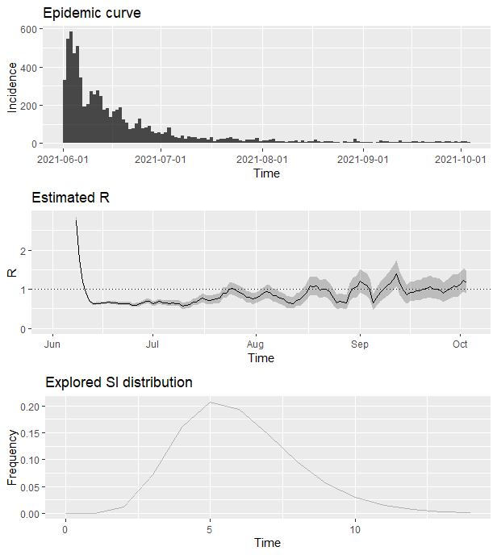
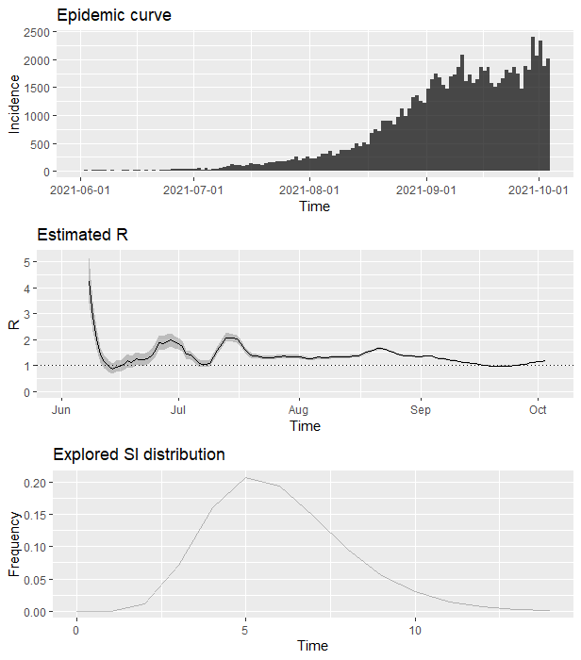
Japan
Taiwan
Australia

Slide 14
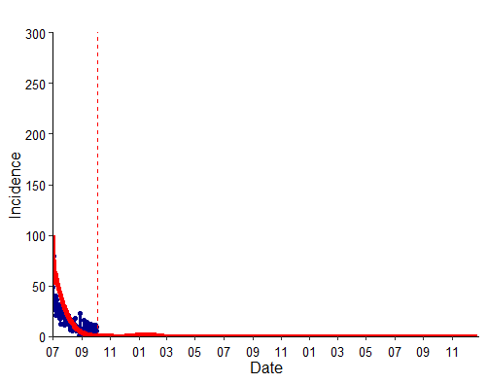
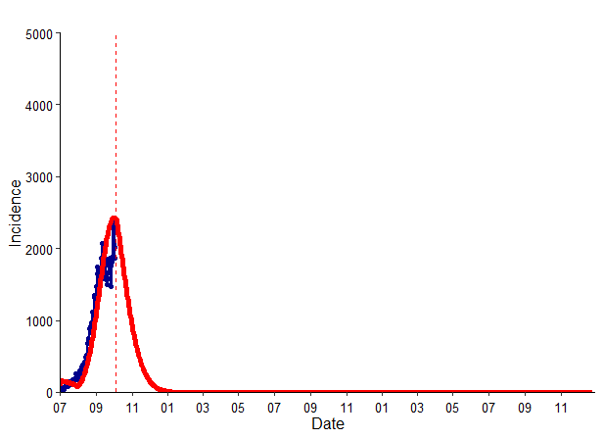
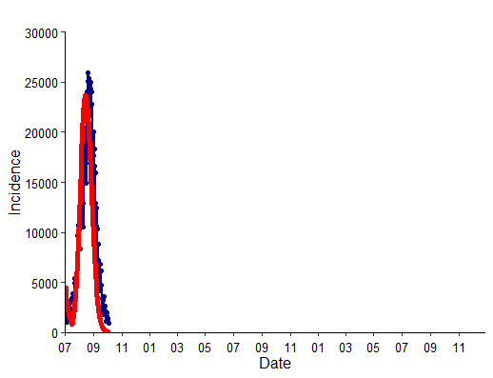
Japan
Taiwan
Australia

