Slide 1
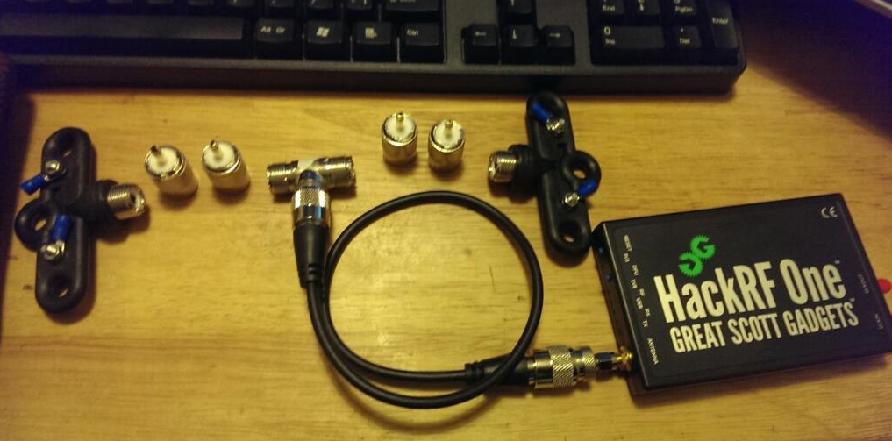
Observing Jovian DAM Emissions with a SDR Telescope

Slide 2
SDR what makes it interesting?
Availability of cheap receivers such as the DVB-T HDTV tuners and transceivers such as the HackRF has lead to explosion in popularity of SDR and allows amateur enthusiasts access to the airwaves
SDR allows the manipulation of radio communication signals from within software. Eg: Can listen to several different frequencies at once
I've been fascinated by Astronomy and Space in general for as long as I can remember. Jupiter is an interesting target for observation either visually or through a radio telescope, and after reading about the DAM emissions and strange interactions with its satellite Io I've been wanting to hear them for myself!

Slide 3
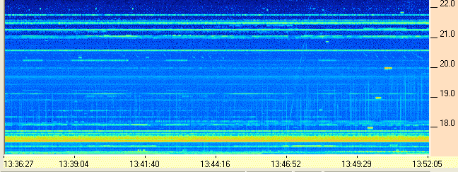
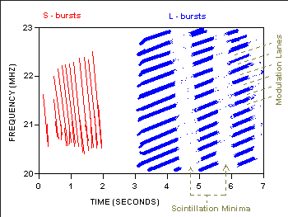
DAM Emissions
Jupiter emits radio waves in the decametric (DAM) range (10 – 100 m wavelengths or 4 – 40MHz frequencies)

Slide 4
Aims
Build an antenna which can pick up DAM Emissions
Develop SDR Filter for interference emissions from natural and human sources
Develop SDR solution to identify interesting Jovian DAM emissions
Design automated listening station, and aggregation, DSP backend for multiple listening sites

Slide 5
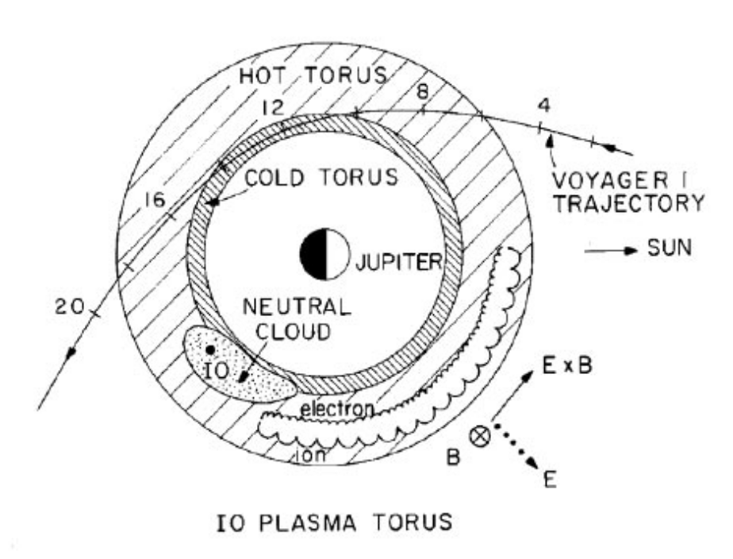
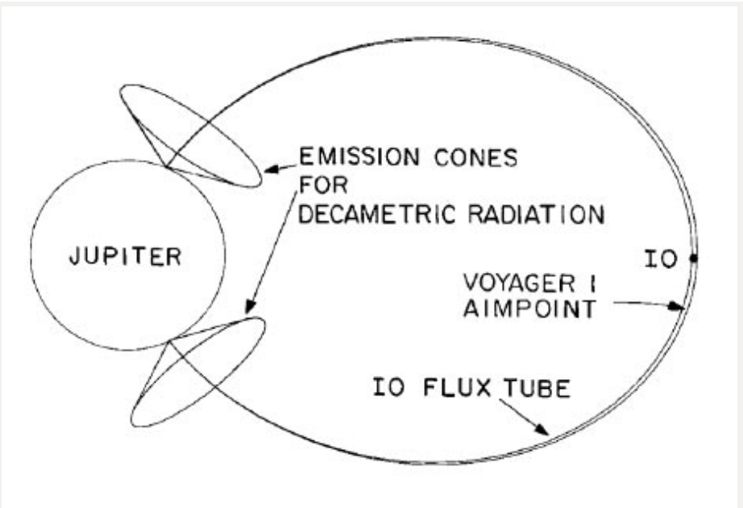
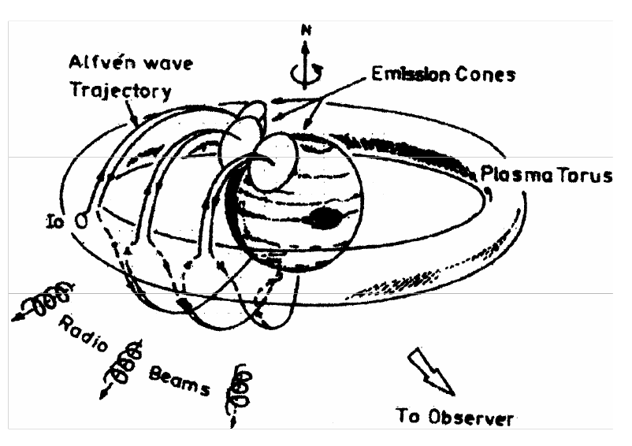
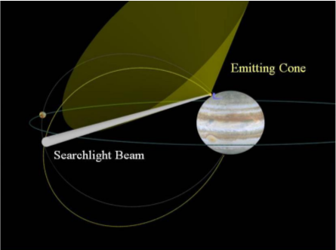
DAM Emissions, where do they come from?

Slide 6
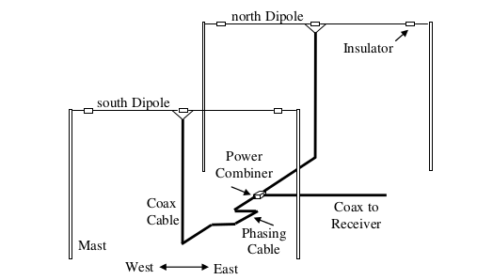
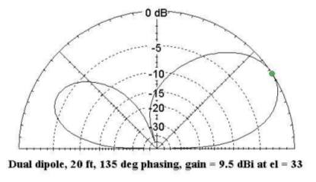
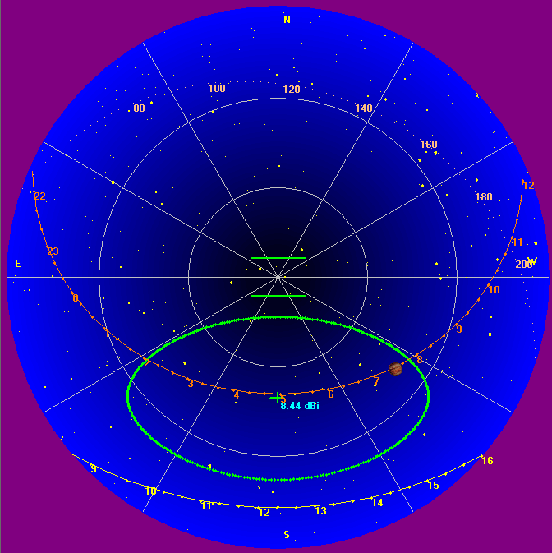
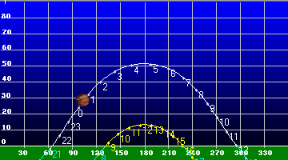
How can the DAM emissions be Observed?

Slide 7
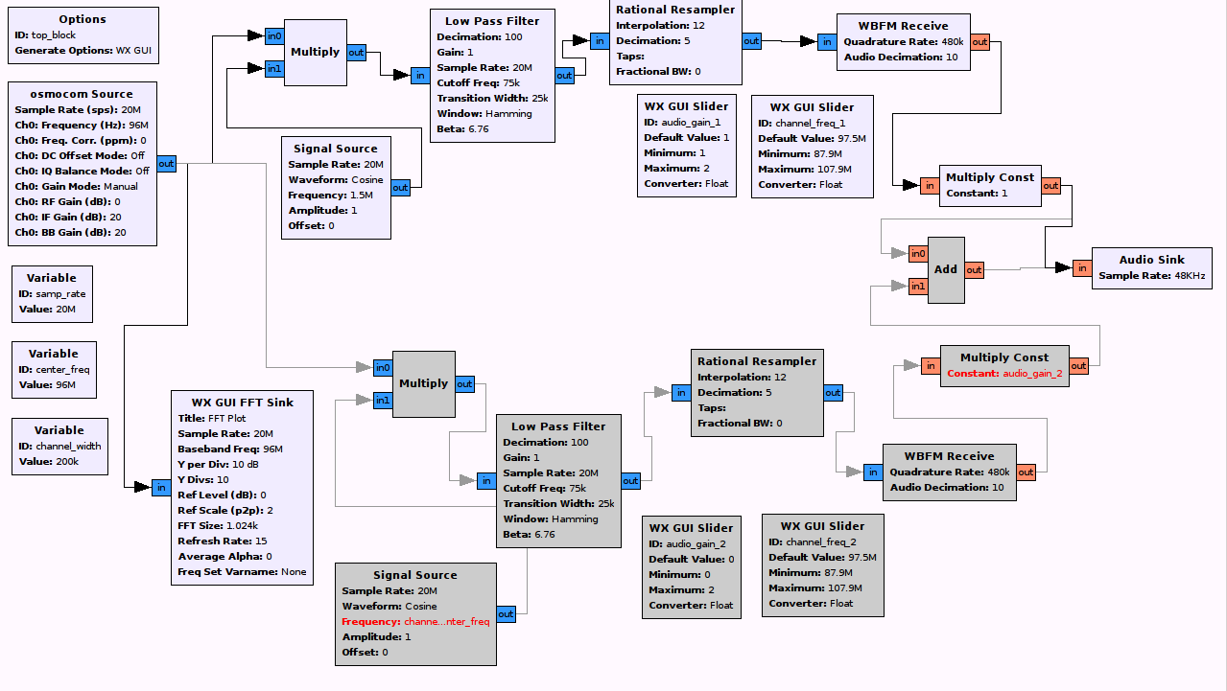
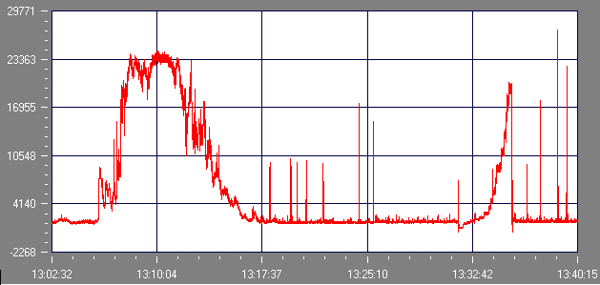
How can SDR be leveraged to process signals observed?

Slide 8
Hypothesis
What IOT technologies would lend themselves to develop a scalable self sufficient listening platform for radio communication
Is it possible to develop an Opensource SDR data processing solution to detect interesting DAM events such as S-Bursts, L-Bursts or N-Bursts
Can an Opensource SDR solution in be developed to process the observation data to flag or filter natural or human created interference

Slide 9
Methodology
Build antenna: Dual Dipole antenna as described in the NASA Radio Jove project
Perform site survey with a spectrum analyser to determine if the Antenna is suitable to capture DAM emissions either from Jupiter or the Sun
Develop an automated system to Collect data from the antennae
Develop a SDR solution to perform digital signal processing on the captured data

Slide 10
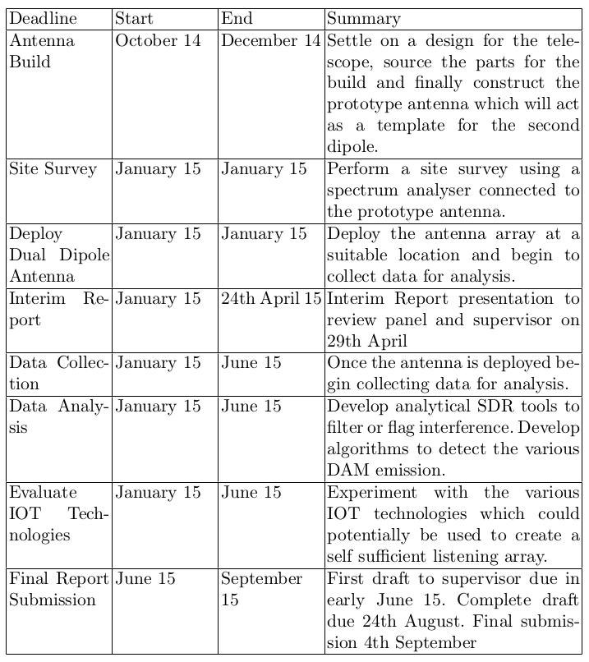
Project Plan

Slide 11
Conclusions
While it is still early in the process, there are a number of limitations of the study already identified
Solution geared towards a telescope listening site with a Latitude of 53.3 Degrees N
An embedded computer such as the Raspberry Pi, Beaglebone Black or Intel Gallileo is unlikely to be powerful enough to perform serious signal processing on site.
Might require more powerful system such as an Intel Atom or i3/i5/i7 system due to intensive USB transfer rates at high bandwidths with the transceiver

