Slide 1
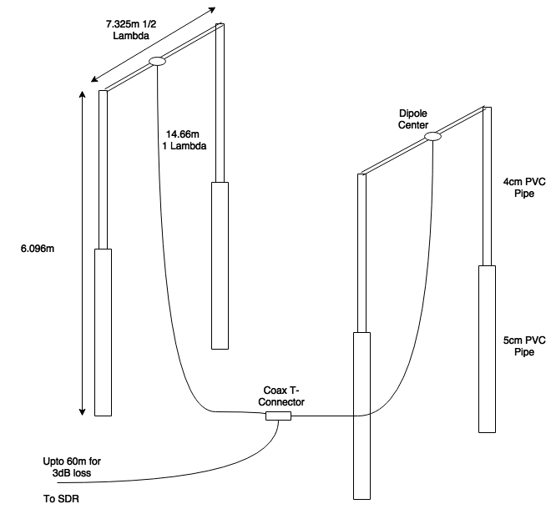
Observing Jovian DAM Emissions with a SDR Telescope

Slide 2
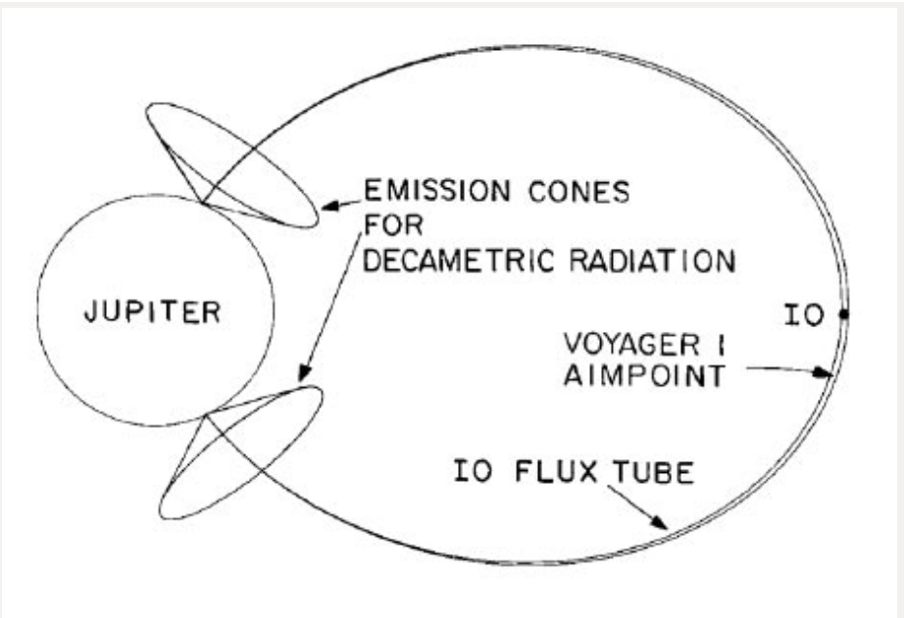
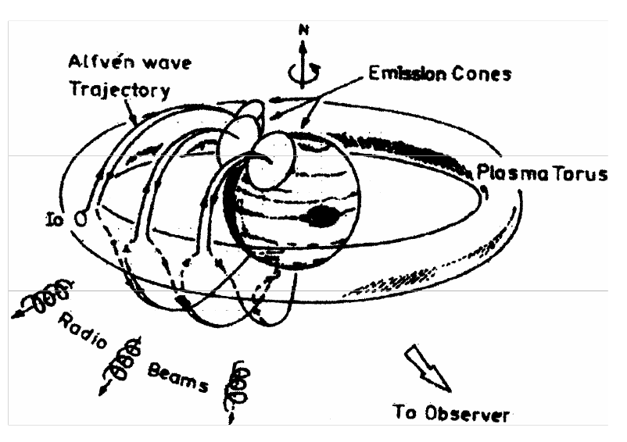
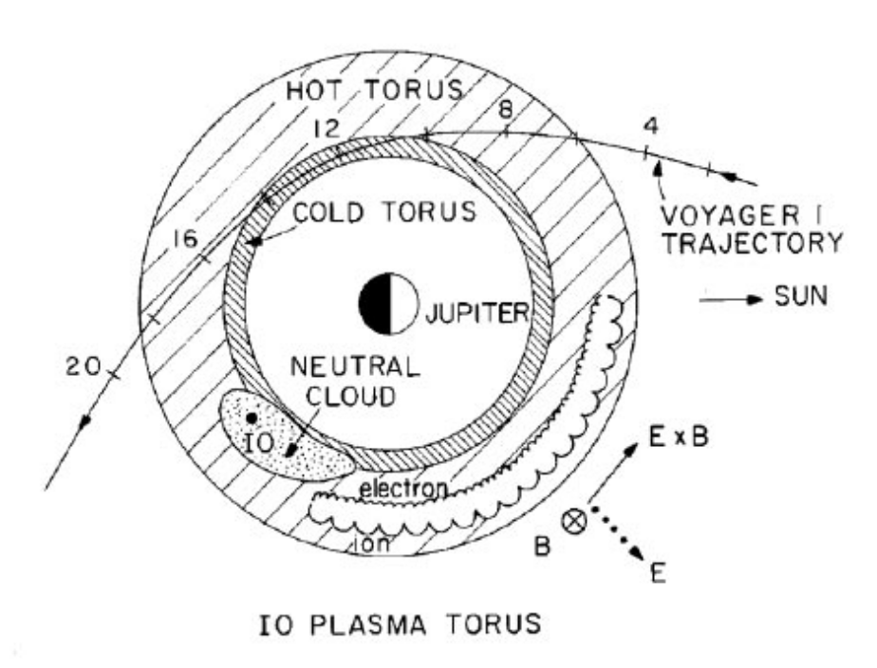
Jovian DAM Emissions
The planet Jupiter emits strongly in the radio spectrum in the 10-100m wavelength range

Slide 3
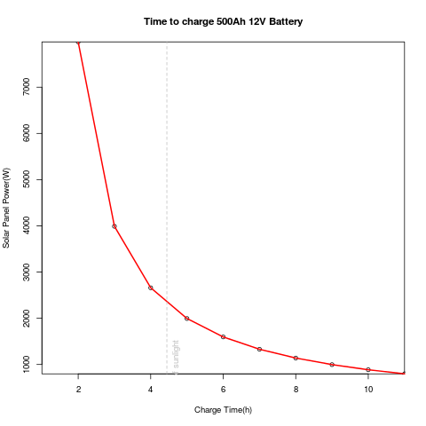
RQ1
What current Internet of Things (IoT) technologies would best suit the development of a software defined radio signal listening station and how cheaply can it be created?
How feasible is it to use renewably generated energy such as solar to power the SDRT system?

Slide 4

RQ1
What current Internet of Things (IoT) technologies would best suit the development of a software defined radio signal listening station and how cheaply can it be created?
How feasible is it to use renewably generated energy such as solar to power the SDRT system?
Can a low powered computing platform such as the Raspberry Pi host the SDRT system?

Slide 5



RQ1
What current Internet of Things (IoT) technologies would best suit the development of a software defined radio signal listening station and how cheaply can it be created?
How feasible is it to use renewably generated energy such as solar to power the SDRT system?
Can a low powered computing platform such as the Raspberry Pi host the SDRT system?
How feasible are wireless technologies such as Bluetooth, Wifi or Zigbee to stream data?

Slide 6
RQ1
What current Internet of Things (IoT) technologies would best suit the development of a software defined radio signal listening station and how cheaply can it be created?
How feasible is it to use renewably generated energy such as solar to power the SDRT system? €2,500
Can a low powered computing platform such as the Raspberry Pi host the SDRT system? No, Intel Atom minimum
How feasible are wireless technologies such as Bluetooth, Wifi or Zigbee to stream data? Wifi or better is required eg: Ethernet

Slide 7
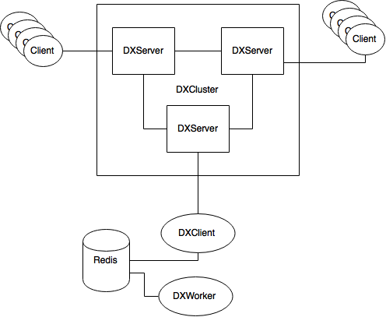
RQ2
What processes or algorithms need to be developed to filter or flag known instances of human interference from radio signal observations?
Flag transmission signals identified by amateur radio enthusiasts from a local DXSpider server in recorded data.

Slide 8
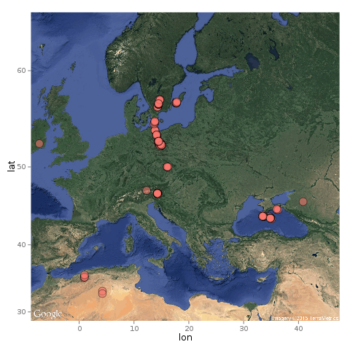
RQ2
What processes or algorithms need to be developed to filter or flag known instances of human interference from radio signal observations?
Flag transmission signals identified by amateur radio enthusiasts from a local DXSpider server in recorded data.
Flag instances of natural radio interference such as lightning from the Blitzortung server in recorded data.

Slide 9
RQ2
What processes or algorithms need to be developed to filter or flag known instances of human interference from radio signal observations?
Flag transmission signals identified by amateur radio enthusiasts from a local DXSpider server in recorded data. Client captures and filters data outside Europe and outside monitored range
Flag instances of natural radio interference such as lightning from the Blitzortung server in recorded data. Client captures data and filters lightning strikes > 1000km

Slide 10
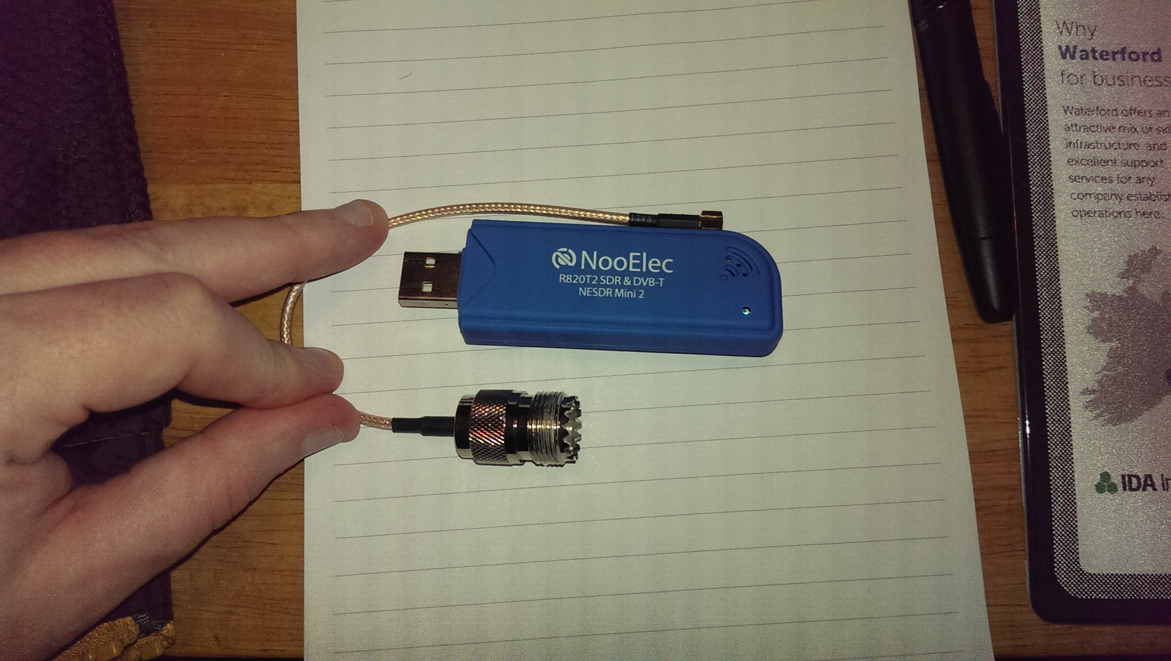
RQ3
What SDR tools, processes and or algorithms need to be developed to identify instances of the three main DAM emission types?
Generating spectrograms using the RTL2832 DAB SDR

Slide 11
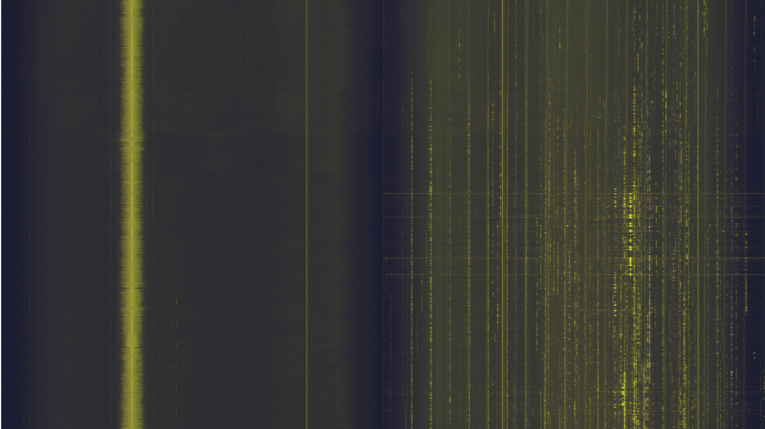
RQ3
What SDR tools, processes and or algorithms need to be developed to identify instances of the three main DAM emission types?
Generating spectrograms using the RTL2832 DAB SDR

Slide 12
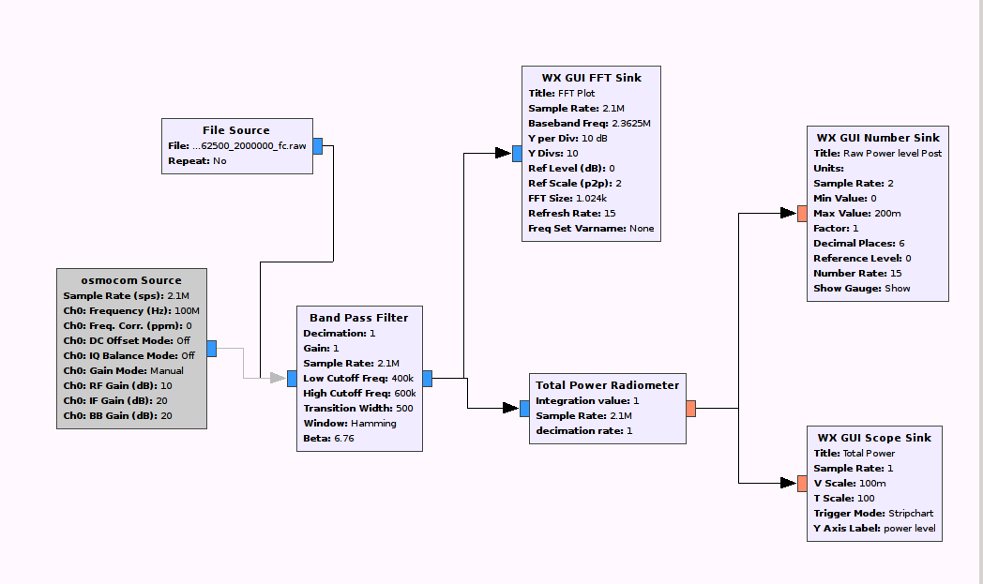
RQ3
What SDR tools, processes and or algorithms need to be developed to identify instances of the three main DAM emission types?
Generating spectrograms using the RTL2832 DAB SDR
Implementing a HackRF Compatible Flow-Graph in GNURadio

Slide 13
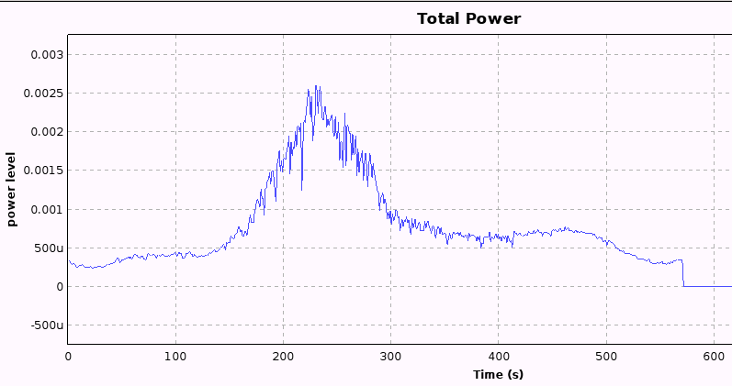
RQ3
What SDR tools, processes and or algorithms need to be developed to identify instances of the three main DAM emission types?
Generating spectrograms using the RTL2832 DAB SDR
rtl_power utility records data in csv, heatmap.py generates spectrogram
Implementing a HackRF Compatible Flow-Graph in GNURadio
GNURadio flow-graph to generate signal temperature intensity plot from live or prerecorded data

Slide 14
Conclusions
Human signals and natural signals overlay on spectrogram
Complete spectrogram generator for HackRF
Calibrate SDRT for accurate power measurements
Machine learning neural network for identification of DAM emissions using captured data

