Slide 1

UNIVERSITY OF DAR ES SALAAM
Department of Computer Science and Engineering
Discrete Structure
(IS 143)
Presentation on Sets Theory

Slide 2
Group Members
Student name: SHIMBO, Hadija Abdulrahmani
Programme: Computer Science
Registration no: 2025-04-10727
Gender: Female.
Student name: ALLY, Ally Awadh
Programme: Computer Science
Registration no: 2025-04-00303
Gender: Male
Student name: IDDI, Abdul Mtugani
Programme: Computer Science
Registration no: 2025-04-02451
Gender: Male
Student name: SULEIMANI, Abdulrahmani ahmada
Programme: Computer Science
Registration no: 2025-04-11026
Gender: Male

Slide 3
Contents
Historical Background of Set Theory in Computer Science
Sets and Their Properties
Set Operations
How Venn Diagrams are used in Set Theory
Relation between Set Theory, Boolean Algebra,Propositional Logic and their applications in computer science.
How Structural Induction is used to prove properties of sets and recursive data structures.
Applications of Sets in Computer Science and Engineering

Slide 4
Contents...
Examples of data types suitable for sets in computer programming
Advantages of Sets on their application in Computer Science
Disdvantages of Sets on their application in Computer Science
Limitations of Set Theory in Computer Science and Engineering

Slide 5
Georg Cantor: The Father of Set Theory Historical Background of Set Theory in Computer Science 1918) The Father of Set Theory (1874–1897)
A German mathematician called Georg cantor who single-handedly created Set Theory between 1874 and 1897.
Key Contributions
Defined the concept of a set as a collection of distinct objects.
Proved that infinite sets have different sizes (cardinalities)
Introduced the concept of 1-to-1 correspondence
Proved the real numbers are uncountable (Cantor's diagonal argument)
Defined transfinite numbers and cardinal arithmetic

Slide 6
Russell's Paradox and the Crisis of Set Theory
In 1901, philosopher Bertrand Russell discovered a fundamental problem in Cantor's naive set theory.
Russell's Paradox stated that;
Consider the set R of all sets that do NOT contain themselves as members.
Does R contain itself? If YES, it shouldn't. If NO, it should.Contradiction!

Slide 7
The Resolution
Zermelo-Fraenkel (ZF) Axioms
Ernst Zermelo (1908) and Abraham Fraenkel restructured set theory with strict axioms, eliminating paradoxes by restricting how sets can be formed.
Type Theory (Russell/Whitehead)
Russell's own response , he hierarchies of types prevent a set from referring to itself.

Slide 8
Zermelo-Fraenkel Axiomatic Set Theory
ZF set theory (with the Axiom of Choice = ZFC) is the standard foundation for all modern mathematics and CS.
Extensionality
Empty set
Pairing
Union
Power set
Infinity
Regularity

Slide 9
Set Theory enters Computer Science
Set Theory became central to Computer Science in the 20th century through multiple pathways:
1930s , Alan Turing & Kurt Gödel.
Gödel's incompleteness theorems used sets of formal statements. Turing's model of computation was built on set-theoretic foundations.
1940s, john Von Neumann.
Designed computer architecture based on sets of instructions and data. Also contributed to axiomatic set theory.

Slide 10
1950s, Database theory.
Edgar Codd (IBM) founded relational database theory using sets — every database table IS a set of tuples.
1960s, Programming Languages.
Type systems in programming languages are based on set theory. A data type defines the SET of valid values a variable can hold.
1970s ,Formal Verification.
CS researchers used sets and logic to formally prove programs correct, building on Cantor and Zermelo's foundations.

Slide 11
Sets and Their Properties
What is a Set?
Definition:
A set is a well-defined, unordered collection of distinct objects. These objects are called the elements or members of the set.
Key Properties of a Set.
1.Well-defined.
Every object either belongs to the set or it doesn't — no ambiguity. Example: 'Even integers less than 10' is well-defined; 'tall people' is NOT.

Slide 12
2.Unordered.
{1, 2, 3} = {3, 1, 2} = {2, 3, 1}. The order of elements does not matter in a set.
3.Distinct.
No element appears more than once. {1, 1, 2, 3} is the same as {1, 2, 3} because duplicates are ignored.
4.Any object
A set can contain numbers, letters, people, other sets, or even nothing: {a, 2, Fred, New Jersey} is a valid set.

Slide 13
Set Notation and Representation
Sets can be written in three main ways.
i.Roster(Tabular) method.
List all elements between curly braces.
Examples: A = {1, 2, 3, 4, 5} B = {a, e, i, o, u} C = {1, 2, 3, ..., 99}
ii.Set-Builder notation.
Describe elements by their properties.
Examples: O = {x | x is odd and x < 10} Q+ = {x ∈ R | x = p/q, for positive integers p, q}

Slide 14
iii. 3. Interval Notation (for numeric sets).
Examples: [1, 5] = {x | 1 ≤ x ≤ 5} (0, ∞) = {x | x > 0}
Important Number Sets in Mathematics.
N : Natural Numbers {0, 1, 2, 3, ...}.
Z: Integers {..., -2, -1, 0, 1, 2, ...}.
Z+ : Positive Integers {1, 2, 3, ...}.
Q: Rational Numbers {p/q | p, q ∈ Z, q ≠ 0}.
R: Real Numbers all rational and irrational numbers.
C : Complex Numbers {a + bi | a, b ∈ R}

Slide 15
Types of sets
Empty Set (∅)
A set with NO elements. |∅| = 0.
Example: {x | x is a month with 6 Sundays} = ∅
ii. Singleton set
A set with exactly ONE element.
Example: {0}, {∅}, {42}

Slide 16
iii. Finite set.
A set with a countable, limited number of elements.
Example: {1, 2, 3, 4, 5}, |A| = 5
iv.Infinite set
A set with unlimited elements.
Example: N = {0, 1, 2, 3, ...}

Slide 17
v.Equal sets.
Two sets are equal if they have exactly the same elements.
Example.
{1,2,3} = {3,2,1} , these two sets are equal regardless their order, meaning does NOT matter.
vi.Universal set.
The set containing ALL objects under consideration in a given context.
All other sets are subsets of Universal (U).

Slide 18
Subset (A ⊆ B)
A is a subset of B if every element of A is also in B.
∀x(x ∈ A → x ∈ B)
Example: {1,2} ⊆ {1,2,3,4}.
Superset (B ⊇ A)
B is a superset of A if A ⊆ B.
B contains all elements of A.
Example: {1,2,3} ⊇ {1,2}

Slide 19
Proper Subset (A ⊂ B)
A is a proper subset of B if A ⊆ B AND A ≠ B.(B has at least one element not in A).
Example: {1,2} ⊂ {1,2,3}.

Slide 20
Power set P(S).
The power set of S is the set of ALL subsets of S, including the empty set and S itself.
If |S| = n, then |P(S)| = 2ⁿ
Example:
S = {a, b}
P(S) = { ∅, {a}, {b}, {a,b} }
|P(S)| = 2² = 4
S = {1,2,3}
P(S) = { ∅, {1},{2},{3},{1,2},{1,3},{2,3},{1,2,3} }
|P(S)| = 2³ = 8

Slide 21
Cardinality|A|.
The cardinality of a set is the number of elements it contains.
Finite sets:
|{a, b, c}| = 3
|∅| = 0
Infinite sets:
|N| = ℵ₀ (aleph-null)
|R| = c (uncountable)
NB:
|A ∪ B| = |A| + |B| - |A ∩ B|
(Inclusion-Exclusion Principle).

Slide 22
Uncountable Set.
A set is uncountable if its elements CANNOT be listed — too many to count, even with infinite time.
Example: R (real numbers), proven by Cantor's diagonal argument
|R| = c (cardinality of the continuum, larger than ℵ₀)

Slide 23
Set Operations
Set operations combine or relate sets to produce new sets.
i.Union of sets (U).
A ∪ B = {x | x ∈ A OR x ∈ B}
The union contains every element that belongs to at least one of the sets.
Examples.
{1,3,5} ∪ {1,2,3} = {1,2,3,5}.
{a,b,c} ∪ {d,e,f} = {a,b,c,d,e,f}.
{1,2} ∪ ∅ = {1,2}.
|A ∪ B| = |A| + |B| - |A ∩ B|
(Inclusion-Exclusion Principle)

Slide 24
ii.Difference(A-B).
A − B = {x | x ∈ A AND x ∉ B}
Elements in A but NOT in B.
{1,3,5} − {1,2,3} = {5}
{1,2,3} − {1,3,5} = {2}

Slide 25
iii. Intersection (∩).
A ∩ B = {x | x ∈ A AND x ∈ B}
The intersection contains only elements belonging to BOTH sets simultaneously.
Examples:
{1,3,5} ∩ {1,2,3} = {1,3}
{a,b,c} ∩ {d,e,f} = ∅ (disjoint sets)
{1,2,3} ∩ {1,2,3} = {1,2,3}.
Disjoint Sets:
If A ∩ B = ∅, then A and B share no common elements.

Slide 26
iv. Complement Ā
Ā = {x ∈ U | x ∉ A}
All elements NOT in A relative to universal set U.
U = {1..10}, A = {1,2,3}
Ā = {4,5,6,7,8,9,10}

Slide 27
All elements NOT in A (relative to U)
v. Cartesian Product (A×B).
Definition: The Cartesian Product A × B is the set of ALL ordered pairs (a, b) where a ∈ A and b ∈ B.
A × B = {(a,b) | a ∈ A and b ∈ B} and |A × B| = |A| × |B|
Example:
A = {1, 2} B = {a, b, c}
A × B = {(1,a), (1,b), (1,c), (2,a), (2,b), (2,c)}
B × A = {(a,1), (a,2), (b,1), (b,2), (c,1), (c,2)} Note: A × B ≠ B × A

Slide 28
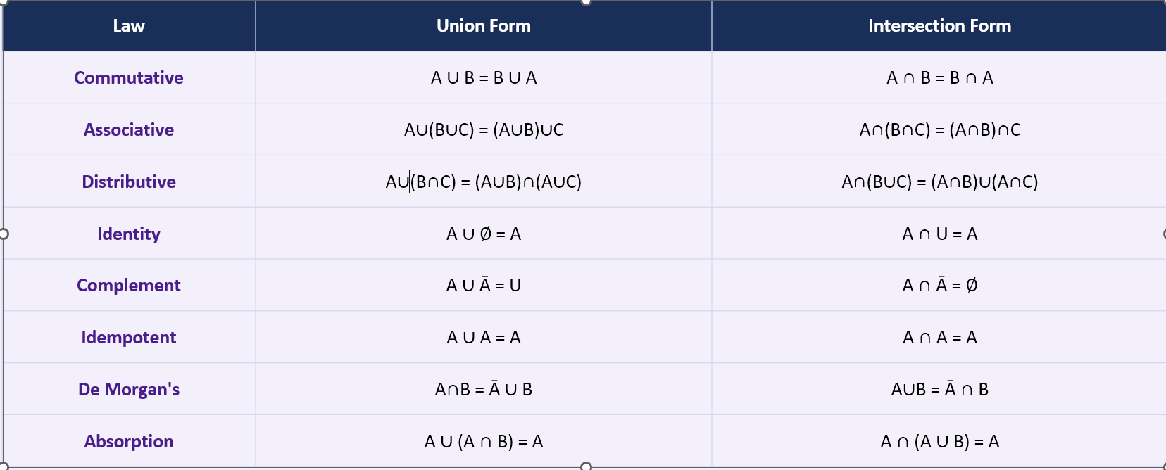
Set identities and Laws

Slide 29
How Venn Diagrams are used in Set Theory
What are venn diagrams?
Definition: Venn diagrams, introduced by English mathematician John Venn in 1881, graphically represent sets as circles or ovals within a rectangle that represents the universal set U.

Slide 30
Components of a venn diagram.
Rectangle (U)
Represents the Universal Set — all objects under consideration in the current context.
Circles or ovals
Each circle represents a set. Elements inside the circle belong to that set.

Slide 31
Overlapping areas
The overlap between circles represents the INTERSECTION of two or more sets.
Points or labels
Individual elements can be placed inside regions to show their set membership precisely.

Slide 32

Two fundamental Venn diagram configurations
Single Set (Set of Vowels).
U = English Alphabet
V
a e i
o u

Slide 33
Subset A ⊆ B.
u
B
A

Slide 34
Union AUB
A
B

Slide 35
Intersection A ∩ B (shaded)
A
B

Slide 36
Difference A − B (shaded)
A − B = part of A only (NOT the overlap)

Slide 37
Complement Ā (shaded)
Ā = everything outside A (within U)
A

Slide 38
Venn diagram:Three sets
Three-set Venn diagrams have 8 distinct regions.
A
B
C

Slide 39
Relation between Set Theory, BooleanAlgebra,Propositional Logic and their applications in computer science.
The three –way connection.
General overview.
Set Theory, Propositional Logic, and Boolean Algebra are three different faces of the SAME underlying mathematical structure:
Set Theory
∈, ∪, ∩, ̄, ⊆
Deals with collections of objects. Provides the language for describing data structures, relations, and functions.

Slide 40
Propositional Logic
∧, ∨, ¬, →, ↔
Deals with True/False statements and their combinations. Provides the foundation for program logic and proofs.
Boolean Algebra
·, +, ¯, 0, 1
Deals with binary values (0/1). Provides the mathematics for digital circuits and computer hardware

Slide 41
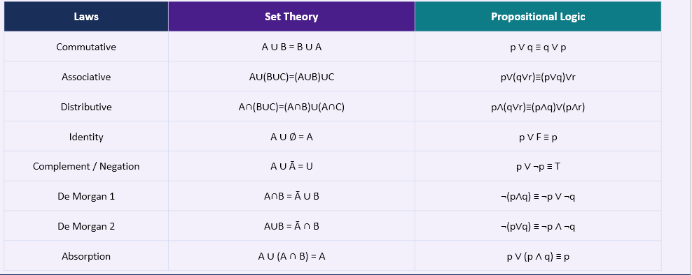
Set Theory vs Propositional Logic — Parallel Laws

Slide 42
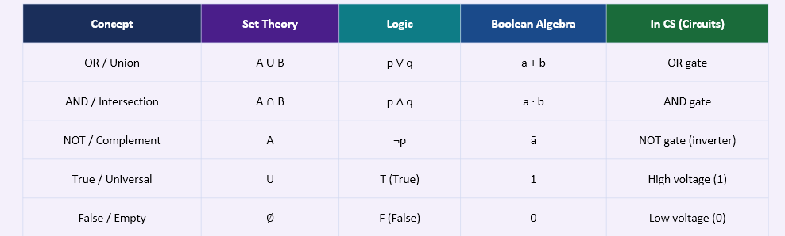
Boolean Algebra and Its Relationship to Set Theory
Boolean Algebra, formalized by George Boole (1815–1864), is a mathematical structure that captures the laws governing BOTH set operations and logical connectives.

Slide 43
Zero-One Matrices and Boolean Operations
Zero-one matrices use Boolean arithmetic to represent discrete structures like relations and graphs:
Boolean operations on matrices
in (A ∨ B): aij ∨ bij
Each element: 1 if either matrix has 1
Meet (A ∧ B): aij ∧ bij

Slide 44
Each element: 1 only if BOTH matrices have 1
Boolean Product (A ⊙ B):
cij = (ai1∧b1j) ∨ (ai2∧b2j) ∨ ...
Like matrix multiplication but ∧ replaces × and ∨ replaces +
Used to: find transitive closure of relations, compute reachability in graphs, analyze paths in networks

Slide 45
Example
A = |1 0| B = |0 1|
|0 1| |1 1|
Join (A ∨ B):
|1∨0 0∨1| |1 1|
|0∨1 1∨1| = |1 1|

Slide 46
Meet (A ∧ B):
|1∧0 0∧1| |0 0|
|0∧1 1∧1| = |0 1|
CS Use: A = connectivity matrix.
A∨B = combined reachability.
A∧B = shared direct connections.

Slide 47
Applications in CS: Logic Gates and Circuits
A logic circuit is a direct physical implementation of Boolean algebra, which parallels Set Theory laws.
i. AND Gate
A · B = 1 only when BOTH inputs are 1
Set equivalent: A ∩ B
Logic: p ∧ q
Use: Validates multiple conditions simultaneously

Slide 48
ii.OR Gate
A + B = 1 when AT LEAST ONE input is 1
Set equivalent: A ∪ B
Logic: p ∨ q
Use: Combines alternative conditions

Slide 49
iii.NOT Gate.
Ā = inverts the input (0→1, 1→0)
Set equivalent: complement Ā
Logic: ¬p
Use: Negates conditions in control logic

Slide 50
iv.NAND Gate.
Ā · B = NOT (A AND B)
Set: complement of intersection
Most fundamental gate, any circuit can be built from NAND gates alone.

Slide 51
v.NOR Gate.
A + B = NOT (A OR B)
Set: complement of union
Also universal , any circuit can be built from NOR gates alone.
vi.XOR Gate
A ⊕ B = (A ∪ B) − (A ∩ B)
Set: symmetric difference
Use: parity checking, binary addition, cryptography

Slide 52
How Structural Induction is used to prove properties of sets and recursive data structures.
Mathematical Induction is a proof technique used to prove statements about ALL natural numbers or members of a well-ordered set.
General review about Mathematical
It has two steps
Step 1:Base case
Prove the statement P(n) is TRUE for the smallest value (usually n = 0 or n = 1).
This anchors the proof gives us a starting point.

Slide 53
Step 2: Inductive step
Here we assume P(k) is true (the inductive hypothesis). Then we prove that P(k+1) must also be true.
This creates a domino effect for all values above the base case

Slide 54
Structural induction
A generalization of mathematical induction used to prove properties of recursively defined structures (sets, trees, lists, grammars) rather than just integers.
Two steps:
i.Basis step
Prove the property holds for all BASE cases of the recursive definition.
(These are the simplest/smallest elements of the structure ,the building blocks.)

Slide 55
ii.Recursive step
We prove that if the property holds for all PARTS of a composite structure, then it holds for the WHOLE structure.
(Using the recursive construction rules of the definition.)
Proving Properties of Sets Using Induction
Example: Prove that |P(S)| = 2ⁿ for any set S with |S| = n

Slide 56
Proof:
Base Case (n = 0)
When |S| = 0, S = ∅.
The only subset of ∅ is ∅ itself.
So P(∅) = {∅}, and |P(∅)| = 1 = 2⁰. ✓
Inductive Hypothesis
Assume the statement is true for n = k.
For any set S with |S| = k, |P(S)| = 2ᵏ

Slide 57
Inductive Step (n=k+1)
Let S be a set with k+1 elements. Pick any element x ∈ S. Let T = S - {x}, so |T| = k.
By hypothesis: |P(T)| = 2ᵏ.
Every subset of S either (a) contains x — giving 2ᵏ subsets, or (b) does not contain x — giving 2ᵏ subsets.
Total: |P(S)| = 2ᵏ + 2ᵏ = 2·2ᵏ = 2^(k+1) ✓

Slide 58
Recursive Data Structures
Many fundamental CS data structures are defined recursively and can be proved using structural induction.
Linked List.
Base: empty list []
Recursive; a node with value + pointer to another list.
Property provable ; traversal visits every node exactly once.

Slide 59
Binary Tree
Base: empty tree (leaf/null)
Recursive: a root node + left subtree + right subtree.
Property provable: a tree with n nodes has n+1 null pointers
Stack
Base: empty stack
Recursive: push(element, stack) = new stack.
Property provable: LIFO order is always preserved.

Slide 60
Recursive set
Base: ∅ is a valid set
Recursive: if S is a set and x is an element, S ∪ {x} is a set.
Property provable: cardinality increases by exactly 1 per element.
Example of Structural Induction on Binary Trees.
Prove that a full binary tree with n internal nodes has exactly n+1 leaves.

Slide 61
Continue…
Definition (Recursive)
A full binary tree is either:
(1) A single leaf node (base case), or
(2) A root with two subtrees, each of which is a full binary tree (recursive case).
Basic step
A single leaf node has 0 internal nodes and 1 leaf.
So n + 1 = 0 + 1 = 1 = number of leaves. ✓

Slide 62
Continue…
Inductive step
Assume both subtrees T₁ and T₂ satisfy the property:
T₁ has n₁ internal nodes → n₁+1 leaves
T₂ has n₂ internal nodes → n₂+1 leaves
The full tree has n₁+n₂+1 internal nodes (root counts too)
Leaves = (n₁+1)+(n₂+1) = n₁+n₂+2 = (n₁+n₂+1)+1 = n+1 ✓

Slide 63
Applications of Sets in Computer Science and Engineering
i.Database Systems.
Relational databases, invented by Edgar Codd (1970), are built entirely on Set Theory.
A database table (relation) is a set of tuples (rows). Each tuple is an ordered collection of values. No duplicate rows allowed , just like sets have no duplicate elements.

Slide 64
ii.Programming languages and type systems.
A data type defines the SET of all valid values a variable can hold.
bool = {true, false}
int = {−2³¹, ..., 0, ..., 2³¹−1}.
char = {all printable characters}.
Union types; In Python and TypeScript int | str means a value can be EITHER an integer OR a string simply refers to as a union of two type sets.

Slide 65
iii.Compiler design and formal languages
Alphabet (Σ); In formal language theory, an alphabet Σ is a finite set of symbols. Example: Σ = {0, 1} for binary, Σ = {a…z} for English text.
iv. Operating systems and networking.
Example: in the process management , the set of all running processes set operations finding which processes use a specific resource (intersection), all processes except one (difference).
Network routing tables determine set membership (does this IP belong to this subnet?). Classless Inter-Domain Routing (CIDR) defines sets of IP addresses.

Slide 66
v.Artificial intelligence and machine learning
Example, decision tree where each node in a decision tree partitions the training set into subsets based on a feature value , means a direct set partitioning operation.

Slide 67
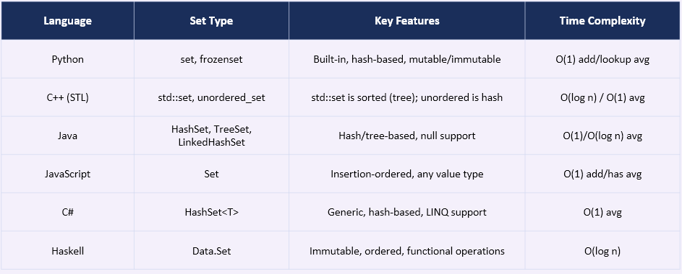
Examples of data types suitable for sets in computer programming
Often Most modern programming languages provide built-in data types that implement set semantics.
Lets look an overview using this table below

Slide 68
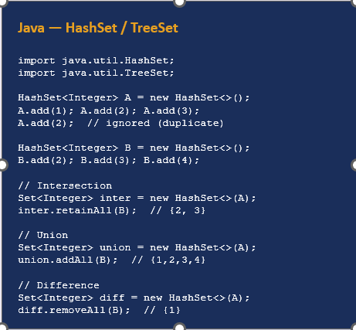
Example set in java

Slide 69
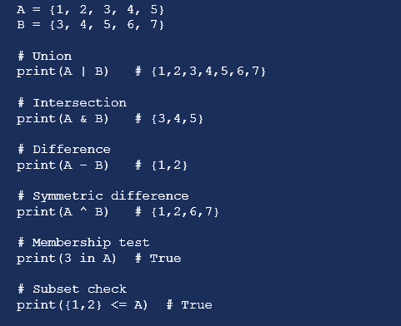
Sets in python
Python set operations for creating sets.

Slide 70
Python set notes.
Unordered.
Sets have no index. Someone cannot access elements by position.
No duplicates.
{1,1,2,2,3} automatically becomes {1,2,3}.
Hashable elements only.
Elements must be immutable (int, str, tuple). Lists and dicts cannot be set elements.
Frozenset
An immutable version of set. Can be used as a dictionary key or as an element of another set.

Slide 71
Advantages of Sets on their application in Computer Science
Mathematical precision and formal foundation.
Set Theory has precise, formal definitions, when a program's data types are specified using set theory, there is no ambiguity about what values are valid just eliminating entire classes of bugs at the specification stage.
Set theory is the foundation of all modern mathematics. Any mathematical result (graph theory, number theory, combinatorics) can be directly applied to CS problems, providing an enormous library of pre-proven tools.

Slide 72
ii. Efficiency, expressiveness, and abstraction.
Set operations abstract away implementation details. Writing 'A ∩ B' is clearer, more concise, and less error-prone than writing explicit loops to find common elements.
Sets inherently eliminate duplicates without any extra code. Collecting unique values, removing repeated data, finding distinct items — sets do this automatically.

Slide 73
iii.Versatility across computer science domains.
Example in computer science domain like databases , all these Relational algebra, SQL set ops, normalization use set theory.
Another one Circuit design, here stuffs like Relational algebra, SQL set ops, normalization use set theory too.

Slide 74
Disdvantages of Sets on their application in Computer Science
Performance and memory concerns
Sets are unordered ,meaning someone cannot access the 5th element of a set directly so converting to a list first adds overhead. Arrays/lists are needed when indexed access is required.So no random access by index.
Hash-based sets have O(1) average time, but O(n) worst-case when many elements hash to the same bucket. Adversarial inputs can deliberately trigger this.

Slide 75
ii.Conceptual and practical limitations
Many real-world problems require ordered data (sorted lists, priority queues). Using sets forces a conversion step that adds time and complexity to the algorithm.
Operations like union and intersection create NEW sets rather than modifying existing ones. This can lead to many temporary objects and increased garbage collection pressure.

Slide 76
Limitations of Set Theory in Computer Science and Engineering
i.Incompleteness and Paradoxes
Based on Rusell’s paradox who said that , Naive set theory (without axioms) allows the construction of paradoxical sets that cannot consistently exist. This forces the use of formal axiomatic systems that are more restrictive.
Some important mathematical statements (like the Continuum Hypothesis and the Axiom of Choice) are independent of ZFC so they can be neither proved nor disproved within the system. This limits what set theory can formally determine.

Slide 77
ii.Computational Limitations of Set Theory
Turing proved (using set-theoretic arguments) that the halting problem is undecidable so no program can determine if an arbitrary program terminates.
This is a fundamental computational limitation arising from set theory.

Slide 78
Practical limitations when applying Set theory in real engineering systems
Scalability issues
Real-time set operations on billions of records (social network graphs, genomics data) strain even the best implementations. Approximation algorithms (Bloom filters) sacrifice accuracy for speed.

Slide 79
References
[1] Rosen, K. H. (2019). Discrete Mathematics and Its Applications (8th ed.). McGraw-Hill Education. [Primary Textbook]
[2] Pace, G.J. (2012). Mathematics of Discrete Structures for Computer Science. Springer-Verlag Berlin Heidelberg.
[3] GeeksforGeeks. (2024). Set Theory — Definition, Types, Symbols, Examples & Operations. https://www.geeksforgeeks.org/maths/set-theory/
[4] Cormen, T.H., et al. (2009). Introduction to Algorithms (3rd ed.). MIT Press.

Slide 80
THANK YOU!

