Slide 1

Discrete Structure (IS143)
UNIVERSITY OF DAR ES SALAAM
Department of Computer Science & Engineering
Presentation on Propositional Logic

Slide 2
Group 20 Members
Student Name: Ridhiwani Ally Mkwasi
Programme: Computer Science
Registration no.: 2025-04-06806 Gender: Male
Student Name: Fredrick Alfred Mganga
Programme: Computer Science
Registration no.: 2025-04-06403
Gender: Male
Student Name: Kennedy Philipo Shigela
Programme: Computer Science
Registration no.: 2025-04-10693
Gender: Male
Student Name: Oscar Henry Mwambene
Programme: Computer Science
Registration no.: 2025-04-08104
Gender: Male
Student Name: James Yosse Mwanri
Programme: Computer Science
Registration no.: 2025-04-08224
Gender: Male

Slide 3
Contents
Introduction
History of the propositional logic concept
Definitions of the propositional logic
Propositional variables
Propositional connectives
Tautologies, contradictions, and contingents characteristics
Mathematical implication
concepts of vacuous true and trivial true of mathematical implication

Slide 4
Contents
Mathematical biconditional connective
Laws of propositional logic equivalences
Operators' precedence and logical gates
Limitations of propositional logic in the context of computer science and engineering
References

Slide 5
Introduction
Logic generally is the study of correct reasoning.
Propositional logic is the study of truth values of propositions, which are statements that can be either true or false.
Propositional logic is used to reason how the truth of a certain statement follows from other known truths.
It is used to distinguish between valid and invalid mathematical arguments
Its is needed in almost all fields, whether in other field of mathematics like geometry, proofs or algebra, or in other fields like computer science.

Slide 6
Propositional logic is distinguished from other logical systems by its treatment of entire propositions as a whole, and analyzing the relationships and properties derived from the combination of several propositions rather than their internal predicate-subject structure.
By abstracting natural language into a formal system of variables and connectives, logicians and engineers are able to evaluate the validity of complex arguments and design the computational architectures used in the contemporary digital age.

Slide 7
Statements in mathematics and sciences are in natural language and often are imprecise or ambiguous. To make such statements precise, they can be translated into the language of logic.
Logic has many important applications to mathematics, computer science, and numerous other disciplines.
Furthermore, propositional logic and logic gates are the ones used to design computer circuits and to construct computer programs.

Slide 8
History of propositional logic
The history of propositional logic begins as early as 300 BC.
It was initiated with a fundamental change in how humans thought about and approached the truth.
In ancient Greece, Aristotle dominated the field of logic by establishing his ‘term logic’, which focused on the internal structure of a sentence.
His logic was based on analyzing the relationships between classes of things. He looked at subjects and predicates(terms) and how they belonged to their categories.

Slide 9
Example, In "All men are mortal," Aristotle was interested in the categories "men" and "mortal" and how one fits inside the other.
His logic was built on syllogism as the connective of the subjects or predicates.
The syllogism was a three-part argument that links terms through a middle ground such as if A is B, and B is C, then A is C. (e.g. "All men are mortal; Socrates is a man; therefore, Socrates is mortal").
Aristotle’s logic was about determining if one group of things belongs to another or not.

Slide 10
However, in the 3rd century BCE, a Stoic philosopher named Chrysippus challenged this perspective.
Chrysippus treated the entire sentence as a single "brick" or proposition that can be either true or false.
He didn't care about the terms inside the sentence, he only cared about whether the sentence as a whole is true or not.
Unlike Aristotle, Chrysippus formalized how to connect independent thoughts using words like ‘and’, ‘or’, and ‘if...then’.

Slide 11
This allowed him to build complex "if-then" arguments that are the direct ancestors of modern logic, the one used in propositional logic or computer science today.
Chrysippus’s logic was about consequences and determining what must be true for a certain condition to be met.
He shifted the analytical focus from terms to entire propositions, recognizing that the logical significance of an argument often depends on connectives like "if," "and," and "or"
For nearly two millennia after, Aristotle’s categorical logic remained the dominant way of thinking in the western world, becoming the standard of what ‘logic’ meant, while the more abstract work of Chrysippus was largely forgotten or overshadowed.

Slide 12
In the 17th century, Gottfried Wilhelm Leibniz was the first to revive the idea of propositional logic initiated by Chrysippus.
Leibniz’s vision imagined a ‘universal language’ of reason.
He believed that human disagreements were often the result of the “ambiguousness" of language and proposed that if we could create a mathematical language of logic, people wouldn't need to argue aggressively anymore.
While Leibniz never fully completed this system, he was the first to strongly suggest that logic should be a branch of mathematics and be used as a universal language of reasoning.

Slide 13
The mid-19th century marked the most significant shift in the history of propositional logic through the work of George Boole and Augustus De Morgan.
In his 1847 work, “The Mathematical Analysis of Logic”, and his 1854 masterpiece, “An Investigation into the Laws of Thought”, Boole demonstrated that logical relations could be expressed as algebraic equations.
He proved that you could treat True and False exactly like the numbers 1 and 0, and that logical operations like "AND" and "OR" followed rules very similar to multiplication and addition.
This transition from a verbal to a mathematical form provided the foundations for Boolean algebra, which is the

Slide 14
theoretical basis for digital circuit design and computer programming.
De Morgan introduced his famous laws, which provided a precise way to handle negations in complex statements.
In the early 20th century, the concept reached its modern maturity as it merged with the foundations of mathematics.
Thinkers like Gottlob Frege and Bertrand Russell attempted to show that all of mathematics was essentially built upon propositional logic.
During this era, Ludwig Wittgenstein introduced the Truth table which provided a visual method for checking the truth of a statement based on its parts.
This finalized the transition of propositional logic.

Slide 15
Definitions of the Propositional Logic
The definition of propositional logic varies depending on whether it is approached linguistically or as a mathematical structure.
Informally, it is the study of how simple statements are combined to form compound ones and how the truth of those compound statements depends on their constituent parts.
It doesn't care about the content of the statements but only cares about their structures and their truth values (whether the statement is true or false).
.

Slide 16
Formally, propositional logic is a formal system consisting of a language of symbols(syntax), a set of rules for forming the symbols or well-formed formulas (WFFs), and a set of semantics for determining truth values of those formulas.
The syntax of a logic defines objects of the language, which are properly called well-formed formulae (wff).
Syntax consists of propositional variables (propositions) and logical connectives.
The semantics of a logic associate each formula with a meaning.

Slide 17
Propositions and propositional variables
A proposition is a declarative statement (a sentence that declares a fact) that is either true or false, but not both.
Examples of propositions include;
-Washington, D.C., is the capital of the United States.
-The sun rises in the East.
-1 + 1 = 2
The followings are not propositions;
-What time is it? (question)
-Read this carefully.(c0mmand)
-x + 1 = 2 (depends on value of x)

Slide 18
What makes a statement a proposition?
Not every sentence qualifies as a proposition in propositional logic. To be considered a “propositional logic statement" it must meet the following criteria;
It must be a declarative sentence: It needs to make a clear assertion or claim about something. It shouldn’t be a command or a question.
It must have a definite truth value: The statement must be either true or false, but it cannot be both at the same time.
propositional logic excludes paradoxes and statements that are neither true nor false.

Slide 19
Such as questions: "Are you a student?“, commands: "Close the window!" or the sentence “This statement is false”.
The reason a statement must be a proposition comes from the requirement for truth-functionality.
Propositional logic acts as a truth function, where operators like AND or OR take in truth values as inputs and yield a truth value as an output.
If the input (the statement) does not have a truth value, or has both truth values at the same time, the logical operation becomes undefined.

Slide 20
Types of propositions
There are two types of propositions; atomic propositions and compound propositions.
An atomic proposition is one that cannot be further decomposed into smaller statements.
Its truth value does not depend on the truth value of any other proposition.
They are usually represented by small letters p, q, r…
Examples of atomic propositions.
-Blue is my favorite colour.
-Today is Wednesday.
-20 is an odd prime.

Slide 21
A compound propositions is formed by combining two or more propositions using logical connectives.
Its truth value depends on the truth values of the propositions it contains.
They are usually represented by capital letters P, Q, R…
Examples;
-If Mary learns discrete mathematics, then she will find a good job.
-Today is Friday and it is raining today.
-If 2 + 2 = 4, then 7 x 3 = 19

Slide 22
Propositional variables
Rather than writing out propositions in full, statements are abstracted into propositional variables.
These variables, usually denoted by lower-case letters (p, q, r, s…), serve as placeholders for any declarative statement.
If we do this, we must define what we mean by writing Let p be “Michael’s PC runs on Linux”.
Propositional variables help us replace long sentences with simple logic symbols.
They also eliminate ambiguity by enabling us to use logical symbols which is easier to read.

Slide 23
Example , in the compound statement "If it is saturday and the weather is clear, then we will go to the event“ If we let the proposition variables be:
p = “it is saturday”
q = “the weather is clear”
r = “we go to the event”
We could write the statement in symbolic form as
(p ∧ q) ⇒ r
This statement is true unless in the case when both p and q are true and r is false.

Slide 24
Truth table
Is the table that shows all the possible combinations of the propositions joined together by logical connectives to form the given compound statement.
It helps us to know the truth value of a proposition in all possible scenarios.
Example; The truth table of p ∧ q
p | q | p ∧ q
T | T | T
T | F | F
F | T | F
F | F | F

Slide 25
Logical connectives
These are the logical symbols used to combine one or more propositions into new compound propositions.
They are also known as propositional operators.
They are the symbols used to connect variables and modify their truth values.
There are two main types of connectives: unary operators, which operate on a single proposition, such as negation( ∼ ) and binary operators, which join two or more propositions, such as conjunction( ∧ ) and disjunction( ∨ ).

Slide 26
Examples of logical connectives include;
-Negation( ∼ )
-Conjunction( ∧ )
-Disjunction( ∨ )
-Implication( ⇒ )
-Double implication( ⇔ ).

Slide 27
Negation
If p is a proposition, then the negation of p is denoted by ∼p or ¬p, which means "not p".
The truth value of ∼p is the opposite of the truth value of p.
The truth table of negation.
Example if p = “she is tall”, then negation of p will be ∼p = “she is not tall” or “she is short”
P | ∼P
T | F
F | T

Slide 28
Conjunction
For any propositions p and q, the conjunction of p and q, denoted by p ∧ q, is the proposition “p and q”.
The conjunction p ∧ q is true when both p and q are true and is false otherwise.
Truth table for conjunction.
p | q | p ∧ q
T | T | T
T | F | F
F | T | F
F | F | F

Slide 29
Example;
If p is the statement “Rebecca’s PC has more than 16 GB free disk space” and q is the statement “The processor in Rebecca’s PC runs faster than 1 GHz”, then the conjunction of p and q will be;
p ∧ q = “Rebecca’s PC has more than 16 GB
free disk space, and its processor runs faster than 1 GHz”

Slide 30
Disjunction
For any propositions p and q, the disjunction of p and q, denoted by p ∨ q, is the proposition “p or q”.
The disjunction p ∨ q is false when both p and q are false and is true otherwise.
Truth table for disjunction.
p | q | p ∨ q
T | T | T
T | F | T
F | T | T
F | F | F

Slide 31
Using the same example, If p is the statement “Rebecca’s PC has more than 16 GB free disk space” and q is the statement “The processor in Rebecca’s PC runs faster than 1 GHz”, then the disjunction of p and q will be;
p ∨ q = “Rebecca’s PC has more than 16 GB free disk space or the processor in Rebecca’s PC
runs faster than 1 GHz”

Slide 32
Exclusive OR
For any two propositions p and q, their exclusive or is denoted by p ⊕ q, which means "either p or q but not both".
The exclusive or p ⊕ q is true when either p or q is true, and false when both are true or both are false.
The truth table of p ⊕ q is
p | q | p ⊕ q
T | T | F
T | F | T
F | T | T
F | F | F

Slide 33
The only difference between exclusive OR and disjunction(inclusive OR) is that it is false when both p and q are true.
Example, if p = “students who have taken calculus can take this class” and q = “students who have taken computer science can take this class”,
The exclusive or of p and q would be
p ⊕ q = “Students who have taken calculus or
computer science, but not both, can take this class”

Slide 34
Conditional statement or implication
For any propositions p and q, the conditional statement p → q , read as “p implies q” is the proposition “if p, then q.”
The conditional statement p → q is false when p is true and q is false, and true otherwise.
Truth table for implication is
p | q | p ⇒ q
T | T | T
T | F | F
F | T | T
F | F | T

Slide 35
In the conditional statement p → q, p is called the hypothesis (or antecedent or premise) and q is called the conclusion (or consequence).
The statement p → q is called a conditional statement because p → q asserts that the conclusion q is true on the condition that the hypothesis p holds.
A conditional statement is also called an implication.

Slide 36
There are several ways to express this conditional statement p ⇒ q;
“if p, then q” “p implies q”
“if p, q” “p only if q”
“p is sufficient for q” “a sufficient condition for q is p”
“q if p” “q whenever p”
“q when p” “q is necessary for p”
“q unless ¬p” “q follows from p”
“a necessary condition for p is q”.

Slide 37
Example;
If p is the statement “Mary learns discrete mathematics” and q is the statement “Mary will find a good job”.
Then the implication p implies q will be
p ⇒ q = “If Mary learns discrete mathematics, then she will find a good job.”
or “Mary will find a good job if she learns discrete mathematics.”

Slide 38
Converse, contrapositive, and inverse
We can form some new conditional statements from the conditional statement p → q.
The proposition q → p is called the ‘converse’ of p → q, obtained by swapping the hypothesis and conclusion.
Note that an implication and its converse are not logically equivalent.
The proposition ¬p → ¬q is called the inverse of p → q, obtained by negating both parts.
The inverse is logically equivalent to the converse of the conditional statement.

Slide 39
The proposition ¬q → ¬p is called the contrapositive of p → q, obtained by negating and swapping the hypothesis and the conclusion.
Importantly, the contrapositive is logically equivalent to the original implication, which is a property frequently used in mathematical proofs.
Instead of proving an implication is true, we may instead proof that the contrapositive is true, if it is easier to prove.
Since they are logically equivalent, proving one of them will imply the other.

Slide 40
This can be verified by using the truth table with both p implies q and its contrapositive;
Since both columns have the same truth values for all cases, we say the statements are logically equivalent.
p | q | p ⇒ q | ∼q ⇒ ∼p
T | T | T | T
T | F | F | F
F | T | T | T
F | F | T | T

Slide 41
Concepts of Vacuous True and Trivial True in Mathematical implication
The definition of implication leads to two special cases that often conflict with common intuition, which are vacuous truth and trivial truth.
These arise because the implication p ⇒ q is defined to be true in every case except for only one case when the hypothesis is true and the conclusion is false.
p | q | p ⇒ q
T | T | T
T | F | F
F | T | T
F | F | T

Slide 42
Vacuous True
An implication p ⇒ q is vacuously true when the hypothesis p is false.
Because the condition for making the logical implication false (a true p and a false q) can never be met if p is false, the statement is true by default.
Examples:
"If 2 + 2 = 5, then the moon is made of cheese”
This is a true statement in propositional logic because the hypothesis (2 + 2 = 5) is false, no matter the truth value of the conclusion.

Slide 43
If I say “All my Porsches are red”, while in reality I don’t have any Porsche, the statement is vacuously true. It would only be false if I had at least one Porsche, and it is not red.
In computer programming(python, java, JavaScript), if you check if all elements in a list or set meet a certain criteria, and the list is empty, the program returns True, since the computer cannot find even a single element to invalidate the condition.

Slide 44
Trivial True
An implication p ⇒ q is trivially true when the conclusion q is true.
Since the conclusion is already satisfied, the truth of the hypothesis p becomes irrelevant to the overall truth of the implication.
Example: "If it rains, then 2 + 2 = 4." This statement is true whether it is raining or not, simply because 2 + 2 = 4 is an absolute truth.
While these cases might seem "pointless" in everyday speech, they are vital in formal mathematics to ensure that logical systems remain consistent

Slide 45
Biconditional statement or double implication
For any propositions p and q, the biconditional statement p ⇔ q is the proposition “p if and only if q”.
The biconditional statement p ⇔ q is true when p and q have the same truth values and is false otherwise.
Biconditional statements are also called double implications.
There are some other common ways to express p ⇔ q:
“p is necessary and sufficient for q”
“if p then q, and conversely”
“p iff q.”

Slide 46
Note that p ⇔ q is the same as (p ⇒ q) ∧ (q ⇒ p).
Sufficient: p ⇒ q (If p is true, that is enough to guarantee q is).
Necessary: q ⇒ p (For q to be true, it is necessary that p also be true).
The truth table of biconditional statement;
p | q | p ⇔ q
T | T | T
T | F | F
F | T | F
F | F | T

Slide 47
Examples; “An integer n is even if and only if there exists an integer k such that n = 2k."
This is a biconditional as if we find an integer that can be written as 2k, it is even by definition. Conversely, if we know an integer is even, it must be representable as 2k. There is no even number that is not 2k, and no 2k number that is not even.
Similarly, "A triangle is equilateral if and only if all its internal angles are 60 degrees".

Slide 48
Logical Equivalences
The compound propositions p and q are called logically equivalent if p ↔ q is a tautology.
The notation p ≡ q is used to denote that p and q are logically equivalent.
Logically equivalent compound propositions have the same truth values in all possible cases.
One way to determine whether two compound propositions are equivalent is to use a truth table.
In particular, the compound propositions p and q are equivalent if and only if the columns giving their truth values agree.

Slide 49
Example; ¬(p ∨ q) and ¬p ∧ ¬q are logically equivalent.
Because the truth values of the compound propositions ¬(p ∨ q) and ¬p ∧ ¬q agree for all possible combinations of the truth values of p and q, it follows that ¬(p ∨ q) ↔ (¬p ∧ ¬q) is a tautology and that these compound propositions are logically equivalent.
p | q | ¬p | ¬q | p ∨ q | ¬(p ∨ q) | (¬p ∧ ¬q)
T | T | F | F | T | F | F
T | F | F | T | T | F | F
F | T | T | F | T | F | F
F | F | T | T | F | T | T

Slide 50
Other examples of logical equivalences include;
p → q ≡ ¬p ∨ q
p → q ≡ ¬q → ¬p
p ∨ q ≡ ¬p → q
p ∧ q ≡ ¬(p → ¬q)
¬(p → q) ≡ p ∧ ¬q
p ↔ q ≡ (p → q) ∧ (q → p)
p ↔ q ≡ ¬p ↔ ¬q
p ↔ q ≡ (p ∧ q) ∨ (¬p ∧ ¬q)
(p → q) ∨ (p → r) ≡ p → (q ∨ r)
(p → r) ∨ (q → r) ≡ (p ∧ q) → r

Slide 51
How Propositional Variables and Connectives deduce Truth Value
The truth value of a proposition can be deduced using either the truth table or valuation functions together with recursive semantics.
We can use truth tables to determine the truth values of compound propositions, by using a separate column to find the truth value of each compound expression that occurs in the compound proposition as it is built up.

Slide 52
The truth values of the compound proposition for each combination of truth values of the propositional variables in it is found in the final column of the table.
For example, to find the truth value of the proposition (p ∨ ¬q) → (p ∧ q)
Since this proposition involves two propositional variables p and q, we use four rows in the truth table, one for each of the pairs of truth values TT, TF, FT, and FF.
The first two columns are used for the truth values of p and q, respectively.

Slide 53
In the third column we find the truth value of ¬q, which is used to find the truth value of p ∨ ¬q in the fourth column.
The fifth column gives the truth value of p ∧ q. Finally, the truth value of (p ∨ ¬q) → (p ∧ q) is found in the last column.
p | q | ¬q | p ∨ ¬q | p ∧ q | (p ∨ ¬q) → (p ∧ q)
T | T | F | T | T | T
T | F | T | T | F | F
F | T | F | F | F | T
F | F | T | T | F | F

Slide 54
A valuation function is defined as a mapping from the set of propositional variables P to the set of truth values B = {T, F}.
Simply a valuation function is a mapping that assigns a truth value (typically 1 for True and 0 for False) to atomic propositions.
We can then use recursive rules to deduce the truth value of compound propositions.
If a proposition has n variables, there are exactly 2^{n} possible valuations(corresponding to the 2^{n} rows of a truth table).

Slide 55
The Rules of Valuation;
Negation: v(¬p) = 1 - v(p)
Conjunction: v(p ∧ q) = min(v(p), v(q))
Disjunction: v(p ∨ q) = max(v(p), v(q))
Implication: v(p ⇒ q) = 1 if v(p) ≤ v(q), otherwise 0
Example deduction
To determine the truth value of the proposition:
P = (p ∧ q) ⇒ ∼r.
Define the Initial State
-suppose we have the following individual truth values for our atoms;

Slide 56
v(p) = 1 (True)
v(q) = 1 (True)
v(r) = 1 (True)
Evaluate the hypothesis(p ∧ q).
-using the conjunction rule;
v(p ∧ q) = min(v(p), v(q))
v(p ∧ q) = min(1, 1) = 1
Evaluate the negation(∼r)
-using the negation rule;
v(∼r)= 1 - v(r)
v(∼r)= 1 - 1 = 0

Slide 57
Deduce the Final Truth Value
-now we substitute the results into the implication:
v(P) = v((p ∧ q) ⇒ ∼r)
v(P) = v(1 ⇒ 0)
-Since v(hypothesis) = 1 and v(conclusion) = 0, the condition v(p) ≤ v(q) is not met, thus
v(P) = 0
Under this specific valuation, the proposition (p ∧ q) ⇒ ∼r is False.

Slide 58
Tautologies, Contradictions, and Contingents
A tautology is a compound proposition that is True regardless of the truth values assigned to its individual component propositions.
A proposition is a tautology if and only if it evaluates to True under every possible valuation in a truth table.
In determining logical equivalence, two propositions p and q are considered logically equivalent if the biconditional statement p ⇒ q is a tautology.
Example the statements p ∨ ∼p and [(p ⇒ q) ∧ p] ⇒ q are tautologies.

Slide 59
The truth table of p ∨ ∼p
The truth table of [(p ⇒ q) ∧ p] ⇒ q
p | ∼p | p ∨ ∼p
T | F | T
F | T | T
p | q | p ⇒ q | (p ⇒ q) ∧ p | [(p ⇒ q) ∧ p] ⇒ q
T | T | T | T | T
T | F | F | F | T
F | T | T | F | T
F | F | T | F | T

Slide 60
Contradiction
A contradiction is a compound proposition that is False for every possible assignment of truth values to its component propositions.
A proposition is considered a contradiction if there is no possible assignment or valuation where the statement becomes True.
For examples the propositions p ∧ ∼p and q ⇔ ∼q are contradictions as they are always false for any assignment of truth values to their variables.

Slide 61
The truth table of p ∨ ∼p
The truth table of (p ⇒ q) ∧ (p ∧ q)
p | ∼p | p ∧ ∼p
T | F | F
F | T | F
p | ∼p | p ⇔ ∼p
T | F | F
F | T | F

Slide 62
Contingencies
A contingency is a proposition that is neither a tautology nor a contradiction.
Its truth value is varies depending on the specific truth values assigned to its atomic parts.
It is true for at least one valuation and false for at least one other.
Most statements in propositional logic are contingent, as their truth values depends on the actual state of their component propositions which may vary.

Slide 63
For example, p ⇔ q and (p ∨ ¬q) → (p ∧ q).
Their truth tables are shown below;
p | q | p ⇔ q
T | T | T
T | F | F
F | T | F
F | F | T
p | q | ¬q | p ∨ ¬q | p ∧ q | (p ∨ ¬q) → (p ∧ q)
T | T | F | T | T | T
T | F | T | T | F | F
F | T | F | F | F | T
F | F | T | T | F | F

Slide 64
Laws of Propositional Logic equivalences
Laws of logical equivalences allow us to simplify complex formulas or transform them into equivalent forms.
They are as follows;
Identity law
p ∧ T ≡ p
p ∨ F ≡ p
Conditional law
p → q ≡ ¬p ∨ q

Slide 65
Domination law
p ∨ T ≡ T
p ∧ F ≡ F
Idempotent law
p ∨ p ≡ p
p ∧ p ≡ p
Double negation law
¬(¬p) ≡ p

Slide 66
Commutative law
p ∨ q ≡ q ∨ p
p ∧ q ≡ q ∧ p
Associative law
(p ∨ q) ∨ r ≡ p ∨ (q ∨ r)
(p ∧ q) ∧ r ≡ p ∧ (q ∧ r)
Distributive law
p ∨ (q ∧ r) ≡ (p ∨ q) ∧ (p ∨ r)
p ∧ (q ∨ r) ≡ (p ∧ q) ∨ (p ∧ r)

Slide 67
De Morgan’s law
¬(p ∧ q) ≡ ¬p ∨ ¬q
¬(p ∨ q) ≡ ¬p ∧ ¬q
Absorption law
p ∨ (p ∧ q) ≡ p
p ∧ (p ∨ q) ≡ p
Negation law
p ∨ ¬p ≡ T
p ∧ ¬p ≡ F

Slide 68
Precedence of Logical Operators
In both mathematics and engineering, clarity in the order of operations is required to prevent ambiguity.
Unless parentheses are used, logical operators are evaluated according to the following precedence;
Operator | Precedence
∼ | 1
∧ | 2
∨ | 3
⇒ | 4
⇔ | 5

Slide 69
For example, ¬p ∧ q is the conjunction of ¬p and q, that is (¬p) ∧ q, and not the negation of the conjunction of p and q, that is ¬(p ∧ q).
Generally, even with this precedence we still use parentheses to specify the order in which logical operators in a compound proposition are to be applied.
For instance, (p ∨ q) ∧ (¬r) is the conjunction of p ∨ q and ¬r and not the disjunction of p and p ∧ (¬r).

Slide 70
Logic gates
Logic gates are the fundamental building blocks of digital electronic circuits.
They are used to perform logical operations based on the inputs provided to it and gives a logical output that can be either high(1) or low(0).
The operation of logic gates is based on Boolean algebra.
They include AND, NOT, OR, XOR, NAND, NOR and XNOR gates.

Slide 71
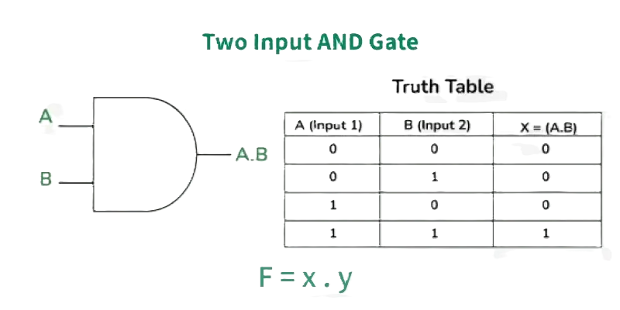
AND gate
An AND gate is used to perform logical multiplication of binary input.
The output of the AND gate will be 1 (high) if both the inputs are 1 (high), else the output will be 0 (low).

Slide 72
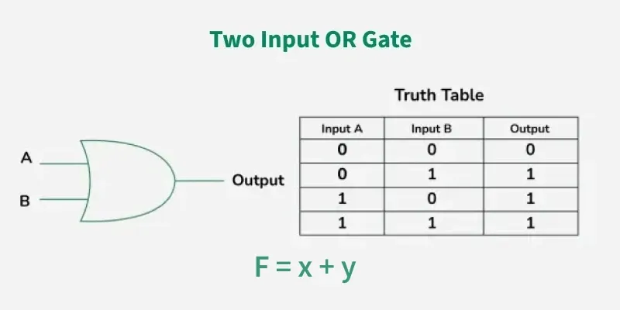
OR gate
An OR gate is used to perform logical addition of binary inputs.
The output state of OR gate will be 1 (high) if any of the input state is 1 (high), else output state will be 0 (low).

Slide 73
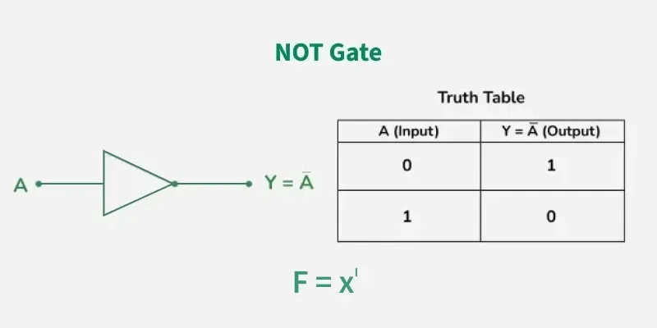
NOT gate
It is also known as an inverter.
When the input signal is 0 (low), the output signal is 1 (high) and vice-versa.

Slide 74
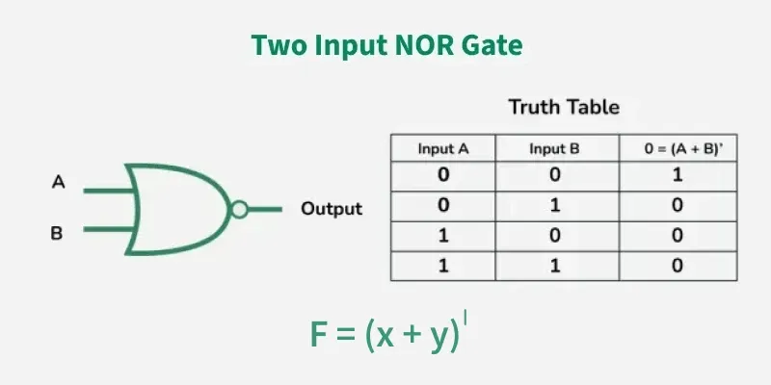
NOR gate
The output state of the NOR gate will be high (1) when all the inputs are low (0).
NOR gate returns the complement result of the OR gate, as it is basically a combination of OR gate and NOT gate

Slide 75
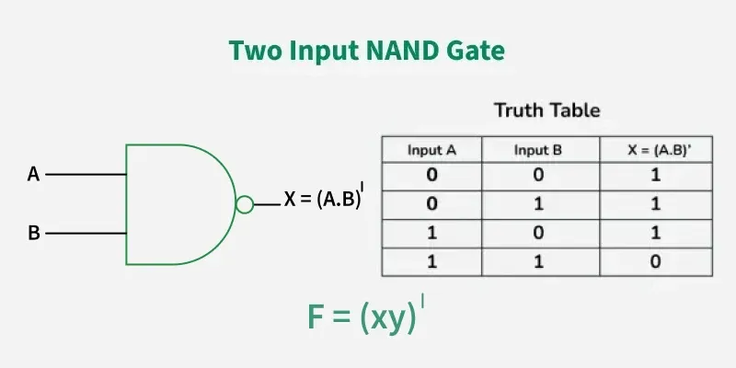
NAND gate
The output of the NAND gate will be 0 (low) when both inputs are 1 (high) and 0 (low) otherwise.
It simply performs the inverted operation of AND gate as it is a combination of AND gate and the NOT gate.

Slide 76
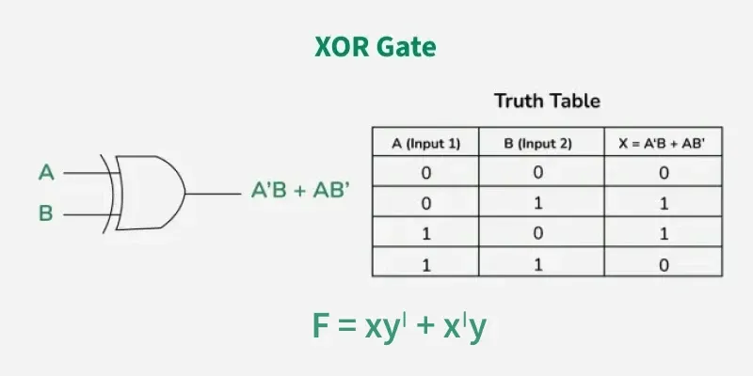
XOR gate
The output of an XOR gate is 1 (high) only when its two inputs are not similar, and 0 (low) otherwise.

Slide 77
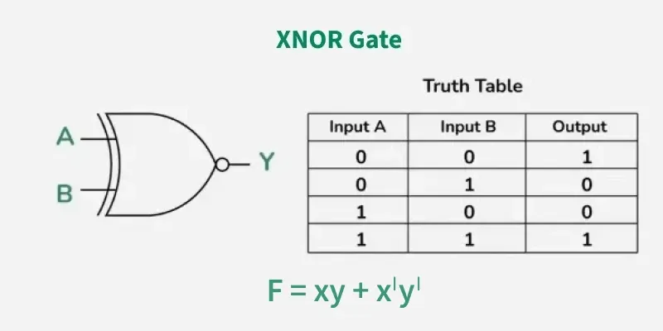
XNOR gate
The XNOR gate is the combination of XOR gate and NOT gate.
The output of the XNOR gate is 1 (high) when both the inputs are 1(high) or both are o (low).

Slide 78
Limitations of Propositional Logic in the context of computer science and engineering.
Computational complexity as the number of variables increase.
The use of truth tables to determine the truth values of propositions is only possible if the number of variables is small. For large number of variables, it becomes complex and cumbersome.
For instance, while a truth table for 2 variables has 4 rows, a system with just 20 variables will require over 1 million rows (2²⁰).

Slide 79
Lack of Quantifiers.
Propositional logic treats atomic propositions as a whole unit. It cannot analyze properties of individuals or relationships between them.
For instance, the statement "Every computer on this network is secure" cannot be represented effectively in propositional logic because it lacks the use of quantifiers like “for every" or “there exists”, where as such predicate logic handle such statements.

Slide 80
Inability to express relationships and identity
This system cannot express that two different variables refer to the same object or are related in a specific way. Reasoning about arithmetic or sets often requires showing how x relates to y. Propositional logic cannot do this because it does not use variables to represent individual objects, but rather only entire statements.
It also lacks the "equal sign" for objects, meaning it cannot formally state that "The Morning Star is the same as the Evening Star“(the use of implication instead results into complexities).

Slide 81
Its static nature and the strict truth constraint
Propositional logic operates under the strict law that every statement is either true or false. It cannot naturally handle time-dependent truths (e.g. "It is raining now, but it will stop later"). This requires "temporal logic“.
It also does not account for probabilistic truths(e.g. the certainty that something is true is 80%), which are essential for modern artificial intelligence systems dealing with noisy data.

Slide 82
References
Bobzien, S.(2003). Logic. In B. Inwood(Ed.), The Cambridge companion to the Stoics (pp. 85-123). Cambridge University Press.
Rosen, K. H. (2019). Discrete mathematics and its applications (7th ed.) (pp 1-78). McGraw-Hill Education
Wikipedia contributors. (2026, March 23). Propositional logic. In Wikipedia, The Free Encyclopedia.
https://en.wikipedia.org/wiki/Propositional_logic#History

Slide 83
Łukasiewicz, J. (1957). Aristotle’s syllogistic from the standpoint of modern formal logic(2nd ed.). Clarendon Press.
Tutorials Point. (2026). Discrete mathematics - propositional logic. https://www.tutorialspoint.com/discrete_mathematics/discrete_mathematics_propositional_logic.htm
GeeksforGeeks. (2025, September 24). Propositional logic. https://www.geeksforgeeks.org/engineering-mathematics/proposition-logic/

Slide 84
M. Wooldridge. Propositional logic(1). Oxford Department of computer science.(pp. 1-21). https://www.cs.ox.ac.uk/people/michael.wooldridge/teaching/soft-eng/lect07.pdf
B. Selman, H. Kautz, D. McAllester. Ten challenges in propositional reasoning and search. https://www.cs.cornell.edu/selman/papers/pdf/97.ijcai.challenge.pdf

Slide 85
GeeksforGeeks. Logic gates. https://www.geeksforgeeks.org/digital-logic/logic-gates/

