Slide 1
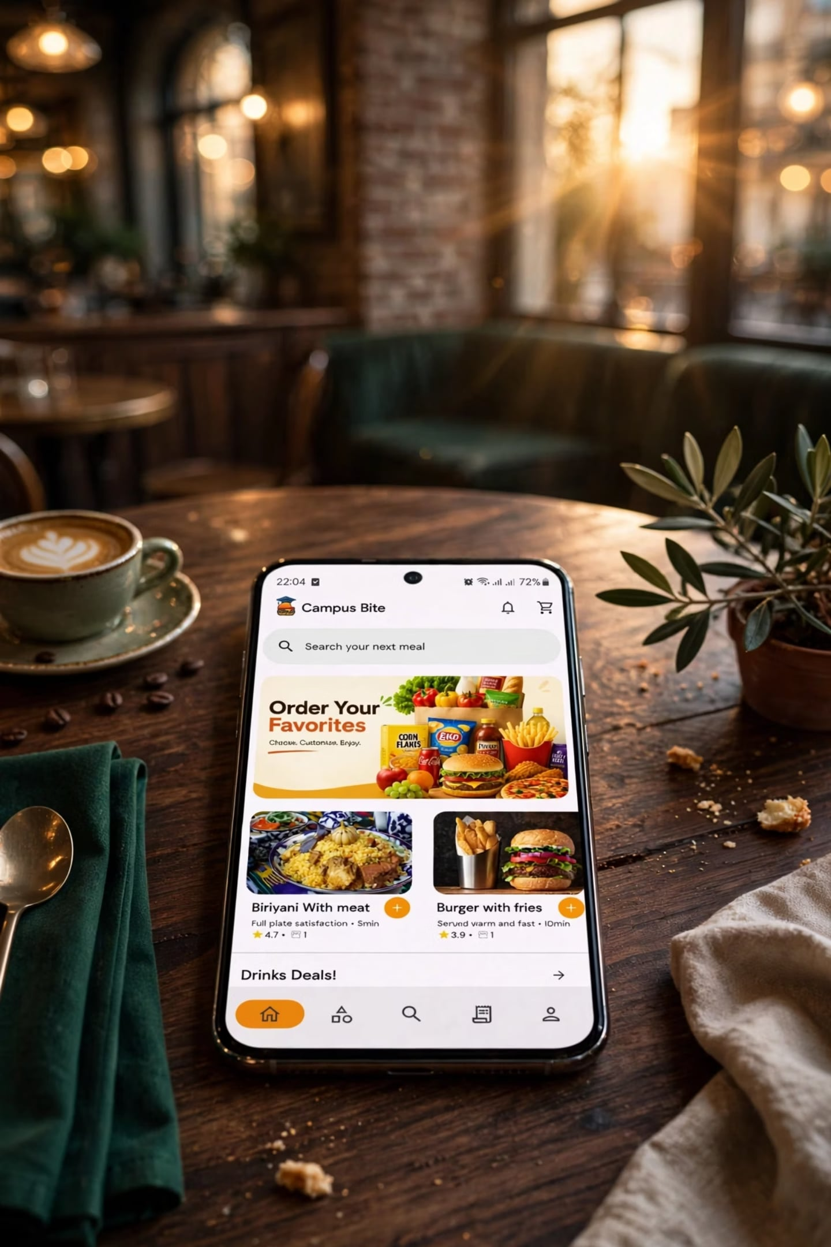
🍔 CampusBite — Student Food Ordering App
A Flutter mobile application that lets university students browse the campus cafeteria menu, place food orders in advance, and skip the queue. Built with Flutter and Firebase.
This repository (foodorder) contains the Student App. There is the admin companion app which will not be published.

Slide 2
Project Overview
CampusBite solves common problems at university cafeterias:
Problem
Solution
Long queues at meal times
Students order in advance from their phone
No visibility into today's menu
Live menu synced from Firestore in real-time
Abandoned orders causing food waste
Pickup deadline engine with countdown timers
No accountability for no-shows
Automated strike system for missed pickups
The system consists of three components only the foodorder student app is in this directory but all two share a single Firebase project:

Slide 3
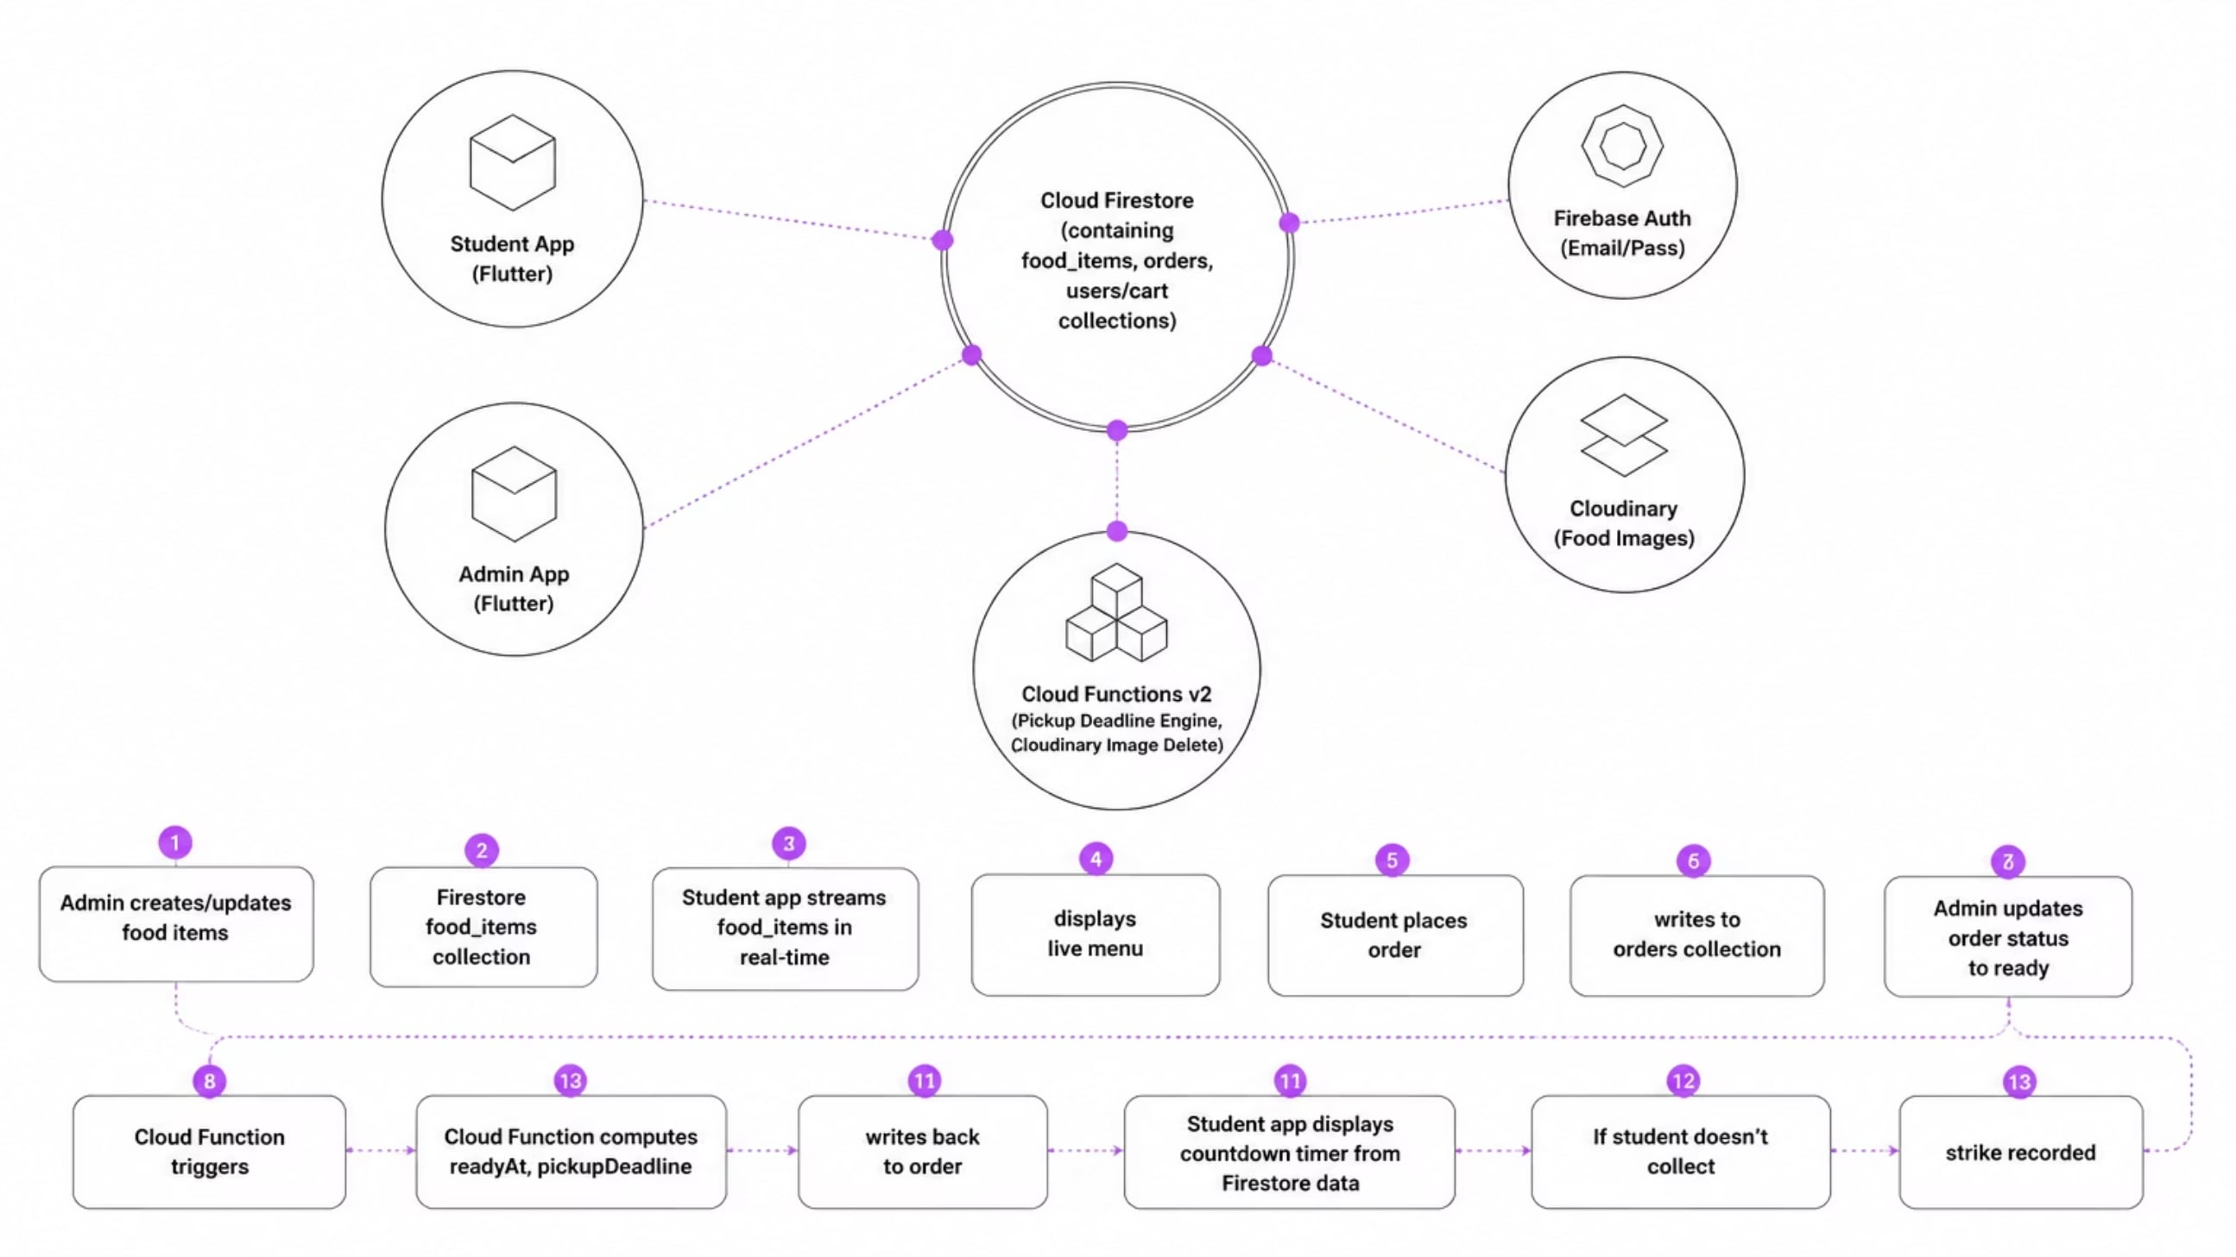
System Architecture

Slide 4
Data Flow Steps
Admin creates/updates food items → Firestore food_items collection
Student app streams food_items in real-time → displays live menu
Student places order → writes to orders collection
Admin updates order status to "ready" → Cloud Function triggers
Cloud Function computes readyAt, pickupDeadline → writes back to order
Student app displays countdown timer from Firestore data
If student doesn't collect → strike recorded

Slide 5
App Navigation
The student app uses go_router with authentication-aware redirects:
/
WelcomeScreen (unauthenticated landing)
/register
RegisterScreen
/login
LoginScreen
/main
MainScreen (authenticated, contains bottom nav)
/terms
TermsScreen
/support
SupportScreen
/support/faq
FaqScreen
/support/contact
ContactScreen

Slide 6
Bottom Navigation Bar
Index
Tab
Screen
0
Home
HomeScreen — featured items, sections, food feed
1
Categories
CategoryScreen — browse by Breakfast, Lunch, etc.
2
Search
SearchBarScreen — Firestore prefix-based search
3
Orders
OrdersScreen — active orders with countdown, history
4
Account
AccountScreen — profile, strikes, settings, logout

Slide 7
Key Features
For Students
For Cafeteria Admins
Registration & Login — Email/password authentication via Firebase Auth.
Browse Menu — Real-time Firestore stream of available food items sorted by category.
Categories — Quick navigation to browse food items by categories (e.g. Breakfast, Lunch, Dinner, Teasers, Drinks).
Search — Fast, prefix-based Firestore search with 300ms debounce and in-memory caching.
Cart & Checkout — Add items, choose target cafe, and review total amount before placing orders.
New Order Alerts — Automatic notification of incoming student orders in real time.
Order Flow Manager — Control order stages from pending, accepted, preparing, to ready for collection.
Automatic Strike Engine — Automated detection of missed pickup deadlines that flags no-shows, issues strikes, and suspends repeat offenders.
Admin Pardon/Reactivation — Transactional tools to pardon strikes, reset counts, and lift user suspensions, fully logged via audit trails.

Slide 8
Key Features
For Students
Orders & Countdown Timers — Track active order statuses and see real-time pickup countdown timers synced with server-enforced deadlines.
Student Discipline Card — Transparent in-app view of current strikes and suspension status.
Notification Center — In-app notification feed supporting real-time alerts for order status changes, pickup reminders, strike actions, and account suspension events.
Distance-Based Pickup Window — Automatically calculates walking distance to target cafe using GPS/Geolocator and requests corresponding pickup time window at checkout (from 10 to 25 minutes) to ensure freshness.

Slide 9

Search System
The search feature uses a prefix-based array-contains strategy for Firestore:
1
2
3
When admin creates/updates a food item
When a student searches
The search UI (SearchBarScreen)
SearchService:
Debounces input by 300ms and displays results with food images, price, category, and cafe info.
Trims and lowercases the query
Checks an in-memory cache before hitting Firestore
Queries food_items where available == true AND searchPrefixes array-contains query
SearchHelper auto-generates:
titleLower — lowercase title
keywords — unique lowercase words from title, category, and dietary tags

Slide 10
Distance-Based Pickup Deadline & Location-Based Calculations
To minimize food waste from abandoned orders while keeping pickup schedules fair for students, CampusBite calculates a dynamic pickup window based on the student's walking distance to the cafeteria at the moment they checkout:
1
GPS Distance Calculation
2
Dynamic Pickup Windows
When the student clicks "Place Order", the app requests temporary, single-use access to device location. It computes the straight-line walking distance (in meters) between the student's coordinates and the selected cafe's geographic coordinates using the Geolocator.distanceBetween API.
The calculated distance maps to specific pickup windows via the PickupWindowService:
0 – 250 meters: 10-minute pickup window
251 – 600 meters: 15-minute pickup window
601 – 1200 meters: 20-minute pickup window
Above 1200 meters: 25-minute pickup window

Slide 11

Location-Based Calculation
1
Privacy Protections
2
Deadline Enforcement
To protect student privacy, the app never uploads, stores, or transmits precise GPS coordinates or location history to Firestore or any external server. Location data is calculated strictly client-side. Only the resulting distance (in meters) and the pickup window (in minutes) are persisted inside the order document under distanceMeters and pickupWindowMinutes.
When a cafeteria admin marks the order's status as "ready", the onOrderStatusChanged Cloud Function reads the stored pickupWindowMinutes from the order document and atomically calculates the deadline:
The function updates pickupDeadline and sets deadlineStatus to "ACTIVE". If pickupWindowMinutes is missing, it defaults to a 20-minute fallback.

Slide 12
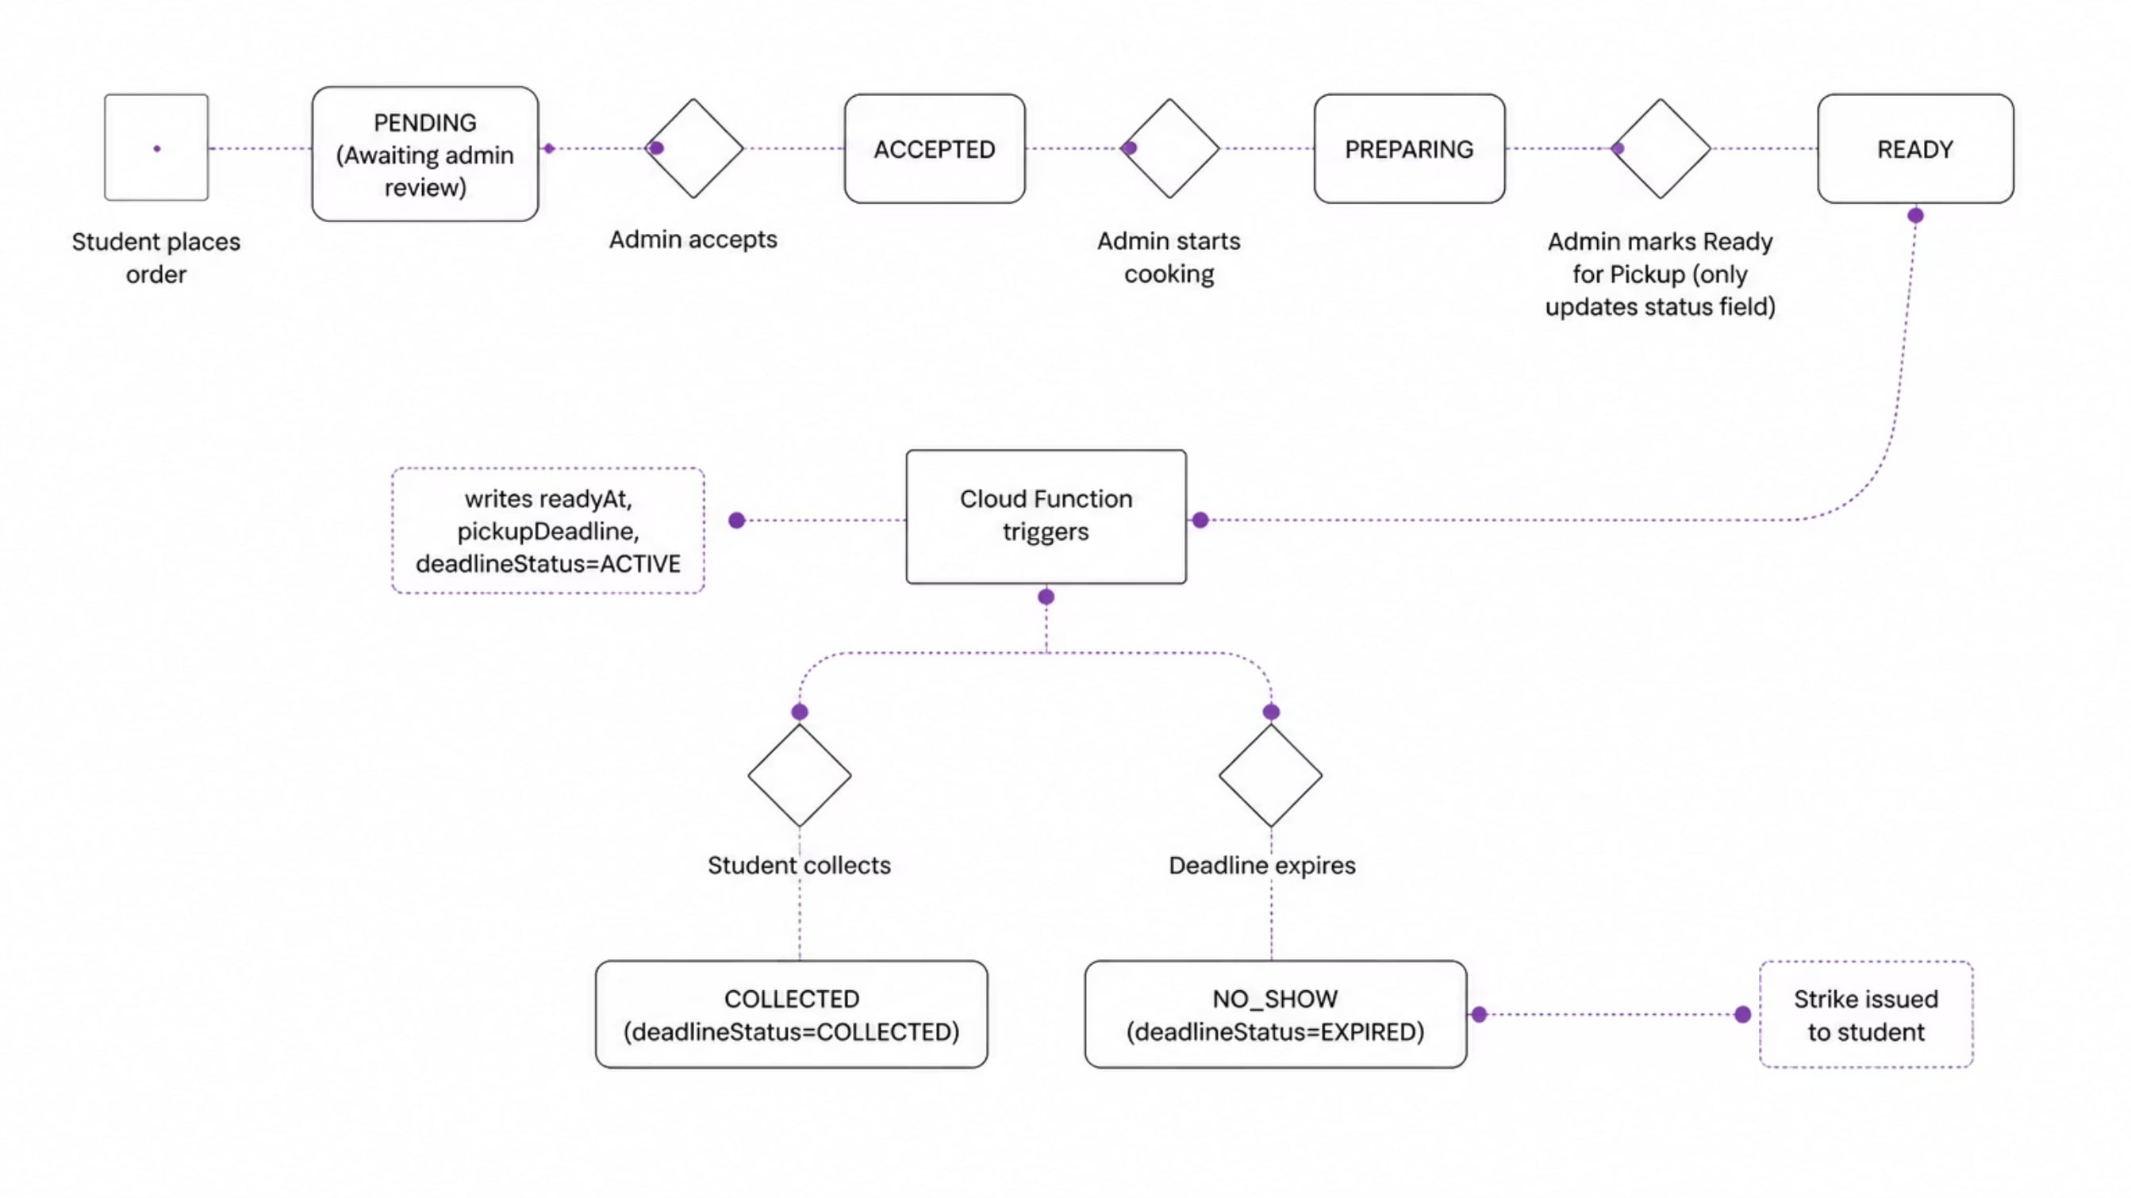
Order Lifecycle

Slide 13
Student Discipline & Automatic Strike Engine
CampusBite enforces pickup accountability with an automated discipline system that marks missed orders, limits repeat offenses, and lets administrators restore accounts when needed.
1. Automatic Strike Engine
2. Suspension Enforcement
A scheduled Cloud Function checks for orders that were ready but not collected before the pickup deadline.
Expired orders are marked no_show and the student receives a strike.
Repeated no-shows can raise the strike count to the suspension threshold.
Students are notified when a strike is issued, and again if their account becomes suspended.
When a student reaches the suspension threshold, the account is blocked from placing new orders or adding items to the cart.
isAccountSuspended() prevents further ordering.
The Account Screen shows a suspension banner.
3. Administrative Actions & Pardons
Administrators can review and adjust strike status in the Admin App.

Slide 14
Production Notification Platform
CampusBite uses a scalable notification layer that keeps delivery decoupled from core business logic.
1. Architectural Flow
2. Key Features
Duplicate Prevention: Each business event gets a unique eventId. NotificationService checks for an existing notification first, so each event is written exactly once.
Decoupled Logic: Notifications react to business events only; they never block or drive core app behavior.
Real-Time Streams: Student and admin apps listen to their own notification stream for instant updates.
Soft Delete: Deleted notifications are flagged out of the UI instead of being removed immediately.
Deep Linking: Tapping a notification takes users straight to the relevant screen, such as an order, account, or strike history.

Slide 15
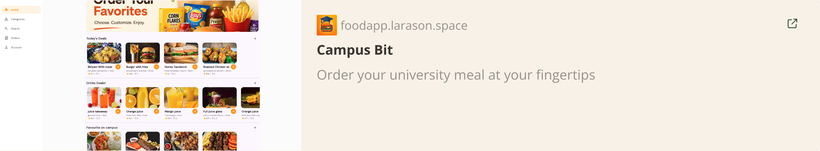
Website.

