Slide 1
Stop and Frisk in NYC (2012)
David Koh

Slide 2
Stop and Frisk
See how “stop and frisk” was being implemented in NYC in 2012.
Obtained dataset from NYCLU website.
Of the people who were stopped I used different methods to determine the best model in predicting who was “frisked.”

Slide 3
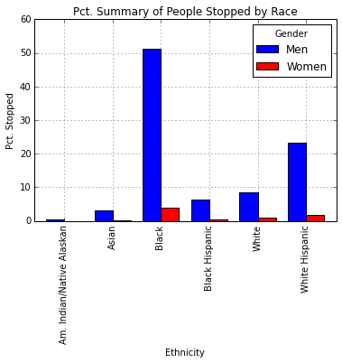

Slide 4
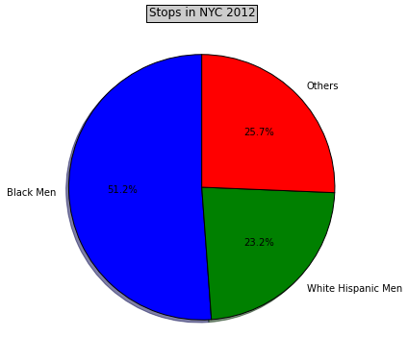

Slide 5
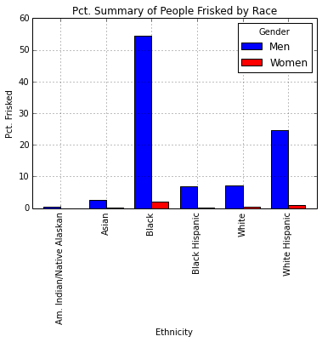

Slide 6
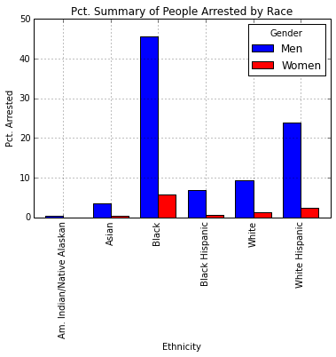

Slide 7
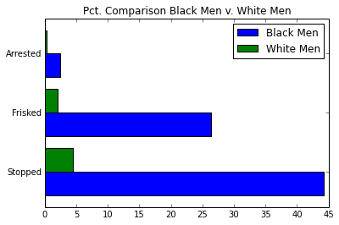
Percentages calculated as totals per category divided by the number of people in each category aged 16-64 per the 2010 census data.

Slide 8
Models used to predict people who were “frisked”
 | PCA | Non-PCA
Logistic Regression | 52% | 56%
Random Forest | 67% | 73%

Slide 9
Takeaways
Stops are being performed based on “hunches” and rarely lead to arrests.
Civil liberties > “Stop and Frisk” as a deterrent.
Running different models helped me to confirm that “race”, “sex”, and “age” were strong at predicting if someone was to get frisked.

Slide 10
Next Steps
Perform more analysis on data from more years (electronic database published yearly in SPSS format but PDFs available quarterly.)
Improve model. Possible recommendation system?
Compare findings to crime statistics to determine reasonableness of the amount of stops.
More visualizations.

