Slide 1

COE 381 — Microprocessors | Computer Engineering | Project Report
Microprocessor-Based
Smart Energy Monitor
with Overload Protection
GROUP 10
Fredrick Banu-Benser 7320123
Asamoah Gihda 7316423
Asempa Seyram 7317323
Nana Kojo Awuku 7318623
Asamoah Edmond Ohene Kyere 7316323
Elisah Ayeh 7318723
Atinbere Melina Blessing 7317923
Asamoah Sally Konadu 7316523
David Kudivi Azare 7319023
KWAME NKRUMAH UNIVERSITY OF SCIENCE AND TECHNOLOGY

Slide 2
Table of Contents
01 Problem Statement
Energy waste, overload hazards, no usage tracking
02 System Overview
Ardurino overlook, Hardware
03 System Architecture
Block diagram, components, and pin assignments
04 Circuit & Code
TinkerCad assembly + Arduino firmware overview
05 Demonstration
Normal operation, overload tests, output verifications
06 Conclusion
Findings, challenges, improvements, and real-world path

Slide 3
Problem Statement
Unmonitored Energy
No real-time per-device visibility into power draw. Households and businesses waste electricity with no way to identify high-consumption appliances.
Overload Hazards
Devices exceeding current thresholds cause overheating, equipment damage, and electrical fires. Without automatic cut-off, damage is inevitable.
No Usage Records
Without Wh accumulation, users cannot track energy over time, compare device costs, or plan load management for cost reduction.
Solution
Arduino-based smart monitor with:
Real-time current sensing
Power calculation (P=VI)
Energy accumulation (Wh)
Automatic relay trip on overload

Slide 4
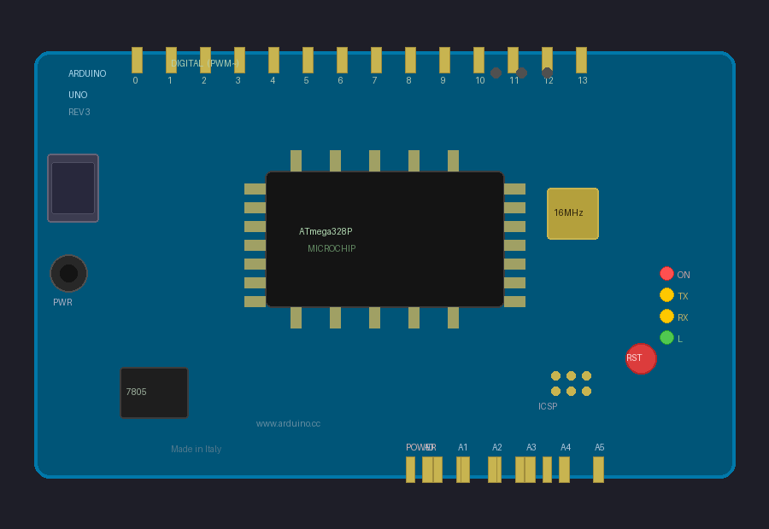
System Overview- Ardurino overview
ATmega328P MCU
8-bit AVR, 16MHz, 32KB flash, 2KB SRAM. Executes all 9 firmware functions: sensor reading, power calculation, relay control, LCD management.
Analog Inputs A0–A2
Three ADC channels reading potentiometers (0–5V → 0–3A). 10-bit resolution = 1024 steps for precise current mapping.
Digital Outputs D2–D13
D2–D4: relay control. D5–D6: green LEDs. D7–D12: LCD 4-bit interface. D13: red alert LED. A3: buzzer output.
Key Specifications
MCU: ATmega328P
Clock: 16 MHz
Flash: 32KB
SRAM: 2KB
EEPROM: 1KB
Digital I/O: 14 pins (6 PWM)
Analog Inputs: 6 pins
Operating Voltage: 5V
Input Voltage: 7–12V
USB + Power Jack
USB for code upload & Serial Monitor. DC jack (7–12V) for standalone. Onboard 7805 voltage regulator.

Slide 5
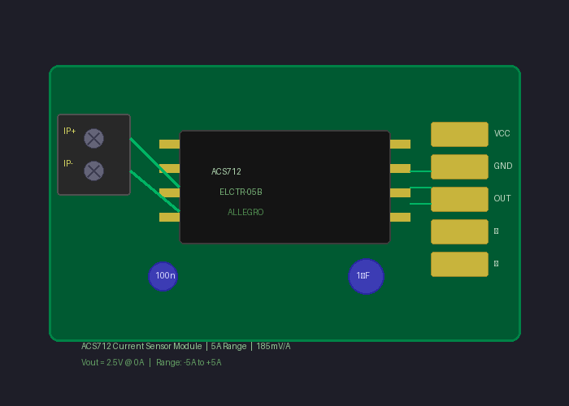
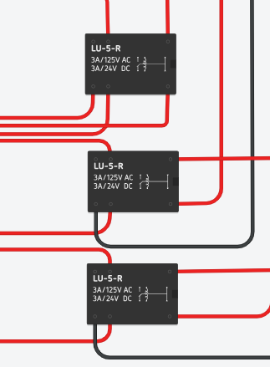
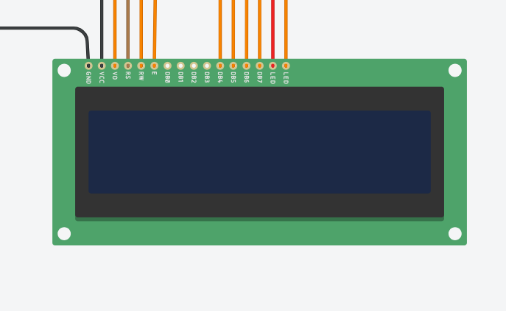
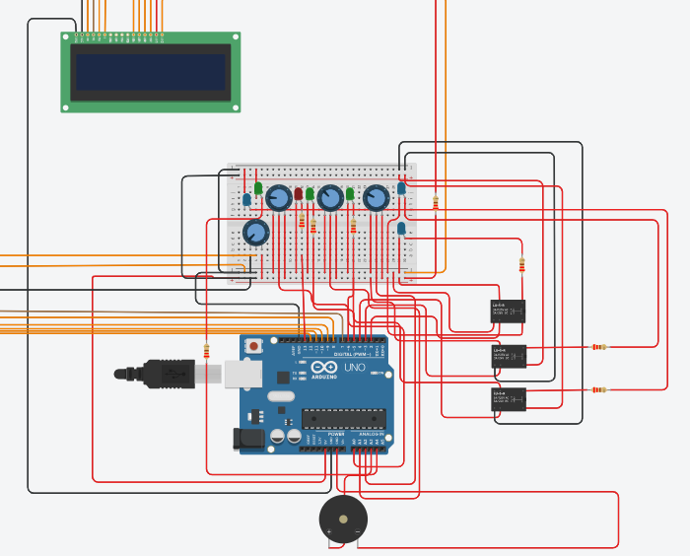
System Overview- Hardware Components
ACS712-05B Current Sensor
Hall-effect current sensing
185mV per ampere sensitivity
Simulated by 10kΩ potentiometer
3× instances on A0, A1, A2
5V 3-Channel Relay Module
SPDT contacts: COM / NO / NC
IN1→D2, IN2→D3, IN3→D4
HIGH = ON (device powered)
LOW = TRIPPED (auto-disconnects)
16×2 LCD (HD44780)
4-bit interface: D7–D12
4 rotating display pages
Contrast via 10kΩ pot
Full Assembled Circuit
1× Arduino Uno
3× Relays + 6× LEDs + Buzzer
3× Potentiometers (10kΩ)

Slide 6
System architecture
INPUT STAGE
POT1 → A0: 10kΩ | 0–3A | Device 1 sensor
POT2 → A1: 10kΩ | 0–3A | Device 2 sensor
POT3 → A2: 10kΩ | 0–3A | Device 3 sensor
ARDUINO UNO FUNCTIONS
readSensors() — ADC sampling
calculatePower() — P = V × I
checkOverload() — threshold detection
accumulateEnergy() — E += P×Δt
updateDisplay() — LCD management
handleAlerts() — buzzer + LED
serialReport() — debug logger
OUTPUT STAGE
3× Relay (D2–D4): Auto-trip on overload
16×2 LCD (D7–D12): 4 rotating info pages
Green LEDs D5, D6: Normal operation indicators
Red LED D13: Overload alert
Buzzer (A3): Two-tone alarm on overload
Thresholds
Per Device: > 1.5A trips relay
System Total: > 4.0A trips all relays

Slide 7
TinkerCad Assembly
Step 1 — Place Arduino Uno
Drag Arduino Uno onto breadboard area. Set simulation speed to 1.0×. This is the central controller for all 9 firmware functions.
Step 2 — Add Potentiometers (Current Sensors)
Place 3× 10kΩ potentiometers. Connect: left pin → GND, right pin → 5V, wiper → A0/A1/A2 respectively. These simulate ACS712 current sensors.
Step 3 — Connect Relay Module
Place 3× SPDT relays. Connect IN1→D2, IN2→D3, IN3→D4. Relay COM connected to load, NO to power. HIGH signal = relay ON (device powered).
Step 4 — Wire LCD Display
16×2 LCD in 4-bit mode. RS→D7, E→D8, D4→D9, D5→D10, D6→D11, D7→D12. Contrast potentiometer on V0 pin. Backlight via 220Ω to 5V.
Step 5 — Status LEDs
Place 3× green LEDs (D5, D6, A4) for normal operation status. Place 1× red LED (D13) for overload alert. Place 3 blue LEDs to the three relays to indicate whether or not the device is working/on. Each LED connected via 220Ω current-limiting resistor to GND.
Step 6 — Buzzer + Load LEDs
Piezo buzzer on A3 (used as digital output via tone()). 3× load LEDs representing the controlled devices — connected through relay NO contacts

Slide 8
Code & Documentation
Initialisation
setup(): LCD init, pin modes, all relays ON (HIGH), startup header to Serial Monitor
Main Loop
loop(): Samples every 500ms, rotates LCD every 3s, dispatches to all subsystems
Sensor Reading
readSensors(): Reads A0–A2. Maps raw 0–1023 to 0.00–3.00A via map()/100.0
Power & Energy
calculatePower(): P = 12 × I per device; total system power in Watts
accumulateEnergy(): E += P × (millis()-lastTime) / 3600000.0 to accumulate Wh
Overload Detection
checkOverload(): Trips relay LOW if current >1.5A per device or >4A system total
Display & Alerts
updateDisplay(): Rotates 4 pages: Device 1, Device 2, Device 3, System Summary every 3s
handleAlerts(): Two-tone buzzer (tone/noTone) + Red LED HIGH on any overload flag
Debug Logger
serialReport(): Formatted current/power/status table to Serial Monitor every 500ms

Slide 9
Code Logic
No delay() Anywhere
millis()-based timing keeps LCD, Serial, and buzzer running concurrently without blocking any subsystem.
if(millis()-t >= 500){ /* run */ }
ADC → Current Mapping
Integer map then divide avoids messy float arithmetic. Clean 0.00–3.00A output from raw ADC.
current=map(raw,0,1023,0,300)/100.0;
F() Macro Saves SRAM
All string literals wrapped in F() to store in Flash, freeing the ATmega's limited 2KB SRAM for data.
Relay Trip Logic
When current drops below threshold, relay returns HIGH automatically — demonstrates full trip & restore cycle.
if(current > THRESHOLD_A){
digitalWrite(relayPin, LOW);
overloadFlag = true; }
Energy Accumulation
Wh accumulates proportionally to power over time using millisecond-accurate timing.
dt = millis() - lastTime;
energy += power*(dt/3600000.0);

Slide 10
Demonstration
Step-by-Step Test Procedure
1 Start Simulation: All 3 load LEDs ON — relays HIGH. Green status LEDs D5/D6 lit. LCD initialises with startup header.
2 LCD Cycles Pages: Every 3 seconds rotates: Dev1 → Dev2 → Dev3 → Summary. Current + Power + Wh shown on each page.
3 Rotate Potentiometers: Turning CW increases simulated current. LCD values update every 500ms in real-time.
4 Serial Monitor: Open at 9600 baud. Tabular output: Device | Current | Power | Status — updates every 500ms continuously.
5 Energy Accumulates: Summary page (Page 4) shows Wh growing over time, proportional to total power load.
TEST A — Single Device Overload
Action: Rotate POT1 fully CW (~3.0A)
Result: Relay 1 trips → D1 LED goes OFF
LCD: Shows '!! OVERLOAD !! D1: 2.95A > 1.5A'
Alerts: Red LED D13 ON + Buzzer two-tone alarm
Restore: Reduce POT1 < 1.5A → auto-reconnects
TEST B — System-Wide Overload
Setup: All 3 POTs at 70% (~2A each → 6A total)
Limit: System threshold: 4A — 6A exceeds it
Result: ALL 3 relays trip simultaneously
Display: LCD: 'SYS D1 D2 D3' overload screen
Restore: Reduce all pots → all channels reconnect
Verified Behaviours
Relay trips exactly at 1.5A/device and 4A system total
All 3 relays reconnect automatically when load drops
LCD and Serial both refresh every 500ms

Slide 11
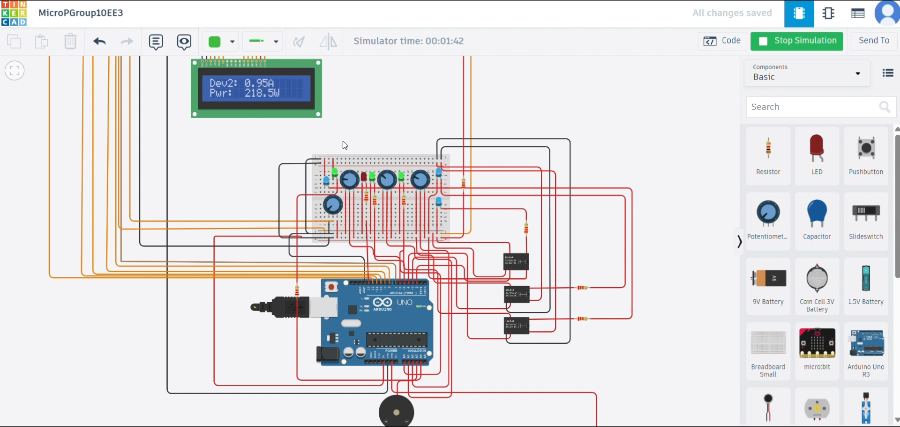
Demonstration — simulation of test A

Slide 12
Outputs & Verification
Verification Summary
Real-time Update: LCD and Serial both refresh every 500ms — live values verified during simulation.
Threshold Accurate: Relay trips exactly at 1.5A/device and 4A system total — no false trips observed.
Auto-Restore Works: All 3 relays reconnect automatically when load drops below threshold.
Wh Grows Correctly: Energy accumulation proportional to power — verified over 2-minute test runs.

Slide 13
Conclusion
Findings
Successfully built 3-device smart energy monitor on Arduino Uno
Relay overload protection trips and auto-restores correctly in simulation
LCD rotates 4 info pages; Serial Monitor logs values every 500ms
Wh energy accumulation verified to grow proportionally with power load
Challenges
TinkerCad lacks ACS712 sensor — potentiometers used as substitutes
Coordinating 3 concurrent millis()-based tasks without delay() calls
Physical implementation of 16 x 2 LCD display
Improvements
Real ACS712-05B Hall-effect sensors for true physical current measurement
IoT: ESP8266 / SIM800L for cloud dashboard or SMS overload alerts
EEPROM or SD card for persistent timestamped energy consumption logging
Real-time clock for time-stamped reports and billing
Thank You | Questions Welcome
COE 381 — KNUST Department of Computer Engineering | Group 10

