Slide 1
Introduction to GitFlow
David Lambl

Slide 2
What is a “Branching Strategy?”
Branching and merging strategies (or models) help to allow teams to work in parallel, on different tasks, in a way that minimizes later friction of integrating (merging) all of that work together (merge conflicts).
GitFlow is one such branching strategy.
Others Git Models include:
Centralized Model
Feature Branch Model

Slide 3
Centralized Model
A centralized repository exists
Each developer clones this repository locally
All developers work off of a single branch (master)
Developers push local changes directly to master
Similar to Subversion (SVN)
Notes:
To allow us to better compare and contract the pros and cons of gitflow vs. some other branching models, let’s take a quick look at the Centralized model, and then Feature Branch Model.
In the centralized model:

Slide 4
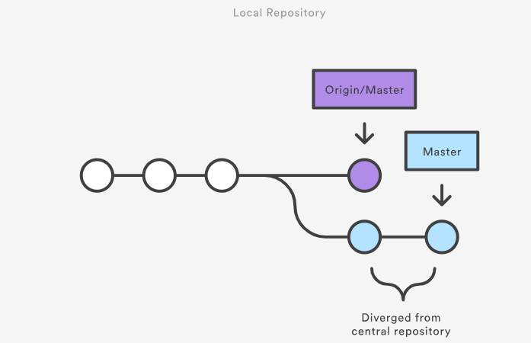
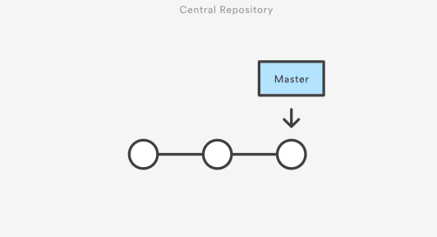
Centralized Model
Notes:
Here’s how this looks visually.
On the left, we can see the central repository which a developer cloned. On the right, we see that developer’s local repository, after making changes to it, and before pushing those changes back to the central repository.
Whenever the repository was initially cloned locally, git created a tag called “origin” which is a pointer to the central repository’s latest commit.

Slide 5
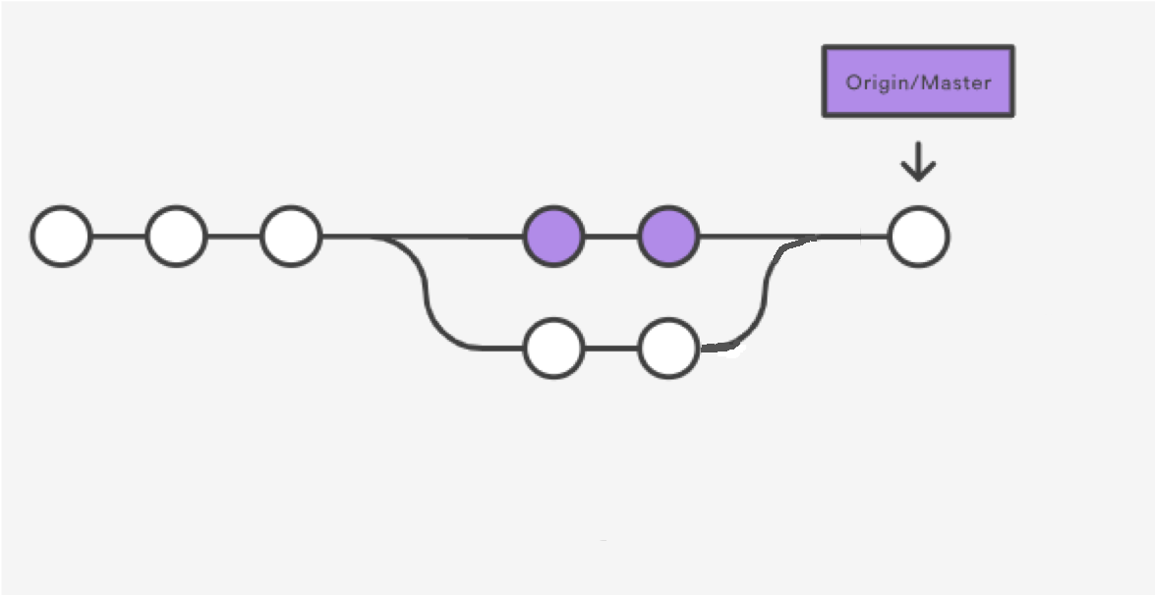
Centralized Model
Notes:
The developer will need to be sure to “pull” the latest from the central repository first. Assuming no one else has made any changes, this won’t cause any problems.
However, if someone else has made changes, if those changes conflict with the changes we’re trying to make here, we’ll have to manage our merge conflicts before we’ll be allowed to push our changes to the central repository.

Slide 6


Slide 7
Centralized Model
Pros
Very similar workflow to SVN, good for transitioning to Git
Works for small teams
Cons
Doesn’t embrace the distributed nature of Git
Doesn’t scale with larger team sizes
Notes:
The developer will need to be sure to “pull” the latest from the central repository first. Assuming no one else has made any changes, this won’t cause any problems.
However, if someone else has made changes, if those changes conflict with the changes we’re trying to make here, we’ll have to manage our merge conflicts before we’ll be allowed to push our changes to the central repository.

Slide 8
Feature Branch Model
Extension of Centralized Model
All feature development work takes place in a dedicated branch, not master
Allows for Pull Requests
Master branch should never contain broken code (critical for continuous integration)
Notes:
The feature branch model is an extension of the centralized model.
In this model, rather than developers working directly on the master branch, a branch is dedicated for feature development work, allowing the main branch “master” to remain isolated while multiple developers work on a different branch.
Pull Requests also become possible, because feature branches are pushed to the central repository, and be compared against the master branch, without yet being a part of it.
This is a big win for continuous integration environments also, because master should not contain broken code (not result in broken builds).

Slide 9
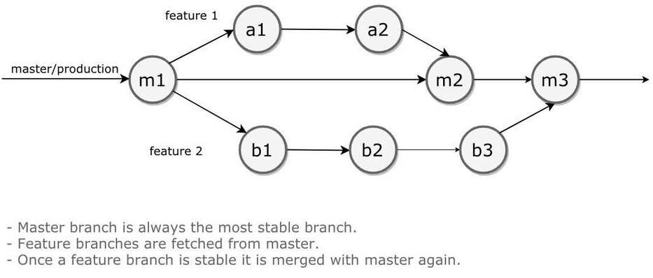
Feature Branch Model
Notes:
Here’s how this looks visually.

Slide 10
Feature Branch Model
Pros
Allows for Pull Requests
Keeps master clean by only merging in stable, approved code
Provides more liberty for experimentation
Reasonably simple
Cons
One feature release at a time if automating release on master
No dedicated branch for testing multiple integrated feature branches
Features (user stories) almost always rely on one another (epics) to create a sensible release
Notes:
The feature branch has some nice benefits. We can utilize pull requests, we can keep our master branch clean by only merging in stable, approved code.
We can easily create “experimental” branches to test out different designs. And all of this is relatively easy to do.
However, drawbacks still existing with this model are that: if we’re using continuous integration, and builds automate off of the master branch, one feature merge will create a new build. So, there’s no dedicated branch for testing multiple features integrated together, before merging them all together into master. And often, different feature branches (user stories) will be required to be combined together to satisfy an epic. It would probably be silly to do something like create a release which provides the user with the ability to upload a profile photo, but does not include the feature of showing a user profile page with this photo on it.

Slide 11
GitFlow Model
Very similar to the Feature Branch Model, but adds the concept of a
Develop branch
Hotfix branch
Release branch
Notes:
The GitFlow model doesn’t add any new concepts from the feature branch model, but what it does do is adds the concept of a few additional branches: develop, hotfix, and release.

Slide 12
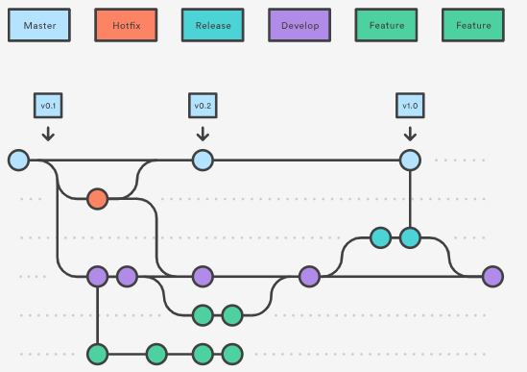
GitFlow Model
Notes:
Here’s how this looks visually.
Now, just looking at this, you can see that things are more complicated than the other two models we looked at. Fortunately, however, there is tooling available to automate a lot of the git commands used in this model, and that makes things a lot easier (though you can use raw git commands if you absolutely prefer, you just need to be careful to perform the correct ones).
But what benefits can we already see from this example? We can see that, for instance, if we’ve release v0.1 on master, we can immediately begin to start work in our develop branch on release v0.2. If some emergency hotfix is required, however, we can simply switch to our hotfix branch, which still just contains v0.1 code, make our fix, and then release the fix – and afterwards, immediately switch back to develop to continue working on v0.2. And, of course, if we’re on a larger team, a developer dedicated to the hotfix can perform the work on that branch, while the developer(s) working on features for v0.2 needn’t worry about ever switching to the hotfix branch at all.
(the hotfix branch is merged into master and develop after completion)
We can also see that we can have features we decide we no longer want in the release, or experimental branches, be safely abandoned. Also, we can see from the release branch timeline, once we create a release branch, this need not be merged immediately into master. Commits can continue to be added to the release branch for bug fixes until all testing is completely, and then we can merge release into master when we’re satisfied that everything is ready to go.

Slide 13
GitFlow Branch Model
Pros
Adds concepts of develop, release and hotfix branches
Quickly and painlessly switch to hotfix from feature development (or dedicate developers to separate branches)
Tweak release branch with bug fixes before merging into master
Work on v2.0 can begin before v1.0 has been merged into master while testing is ongoing, no need to stall development during code freeze
Provides much more flexibility for larger teams to work without stomping on each other’s toes
Tooling freely available
Cons
More complicated than Feature Branch Model

Slide 14
Installing Gitflow
Good news! Git for Windows includes GitFlow out of the box, as does SourceTree and GitKracken.
However, instructions for each OS (using bash) at:
https://github.com/nvie/gitflow/wiki/Installation
GitKracken GitFlow configuration steps at:
https://support.gitkraken.com/git-workflows-and-extensions/git-flow
Notes:
So, tooling can greatly help us with using GitFlow. Again, you can use standard git commands, but installing gitflow provides a wrapper around these commands to make life easier and less error-prone, plus, it’s already included in the Git for Windows installer, so you probably already have it. If for some reason you don’t, here’s the link which has installation instructions for each OS.
I’ll cover the tooling for using bash primarily, but I’ll also briefly demonstrate using my preferred git GUI tool, Atlassian’s SourceTree, to do the same things. And for GitKracken users, there’s also documentation on their page that I’ll provide a link to if that’s the tool you prefer (https://support.gitkraken.com/git-workflows-and-extensions/git-flow/).

Slide 15
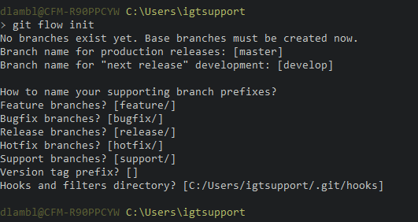
Initializing a Repository
To begin using GitFlow in a repository, the first command which needs to be run is: git flow init

Slide 16
Demo
Most Frequently Used Commands: https://danielkummer.github.io/git-flow-cheatsheet/
Translations of GitFlow to raw git: https://gist.github.com/JamesMGreene/cdd0ac49f90c987e45ac

Slide 17
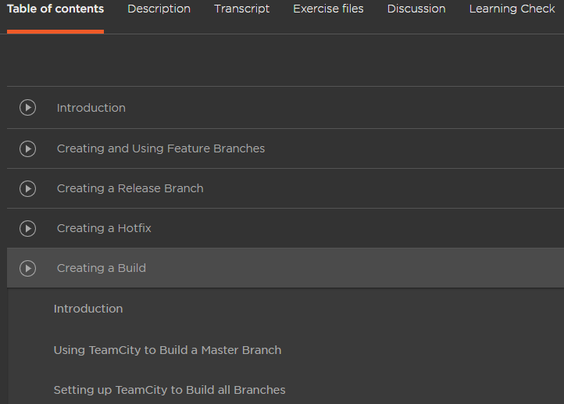
Out of Scope, but relevant

Slide 18
Thanks! References…
https://www.atlassian.com/git/tutorials/comparing-workflows
https://www.atlassian.com/git/tutorials/comparing-workflows/feature-branch-workflow
https://www.atlassian.com/git/tutorials/comparing-workflows/gitflow-workflow
https://github.com/nvie/gitflow/wiki/Windows
https://app.pluralsight.com/library/courses/using-gitflow/

