Slide 1
Templates Sample layouts
Inspiration
These samples are built on the template slides. They demonstrate various content layout options.
Some headlines, body copy, sources and footers, while taken from actual presentations, are jumbled on purpose to avoid being mistaken for authentic IBM material.
Study the size and placement of various elements as well as the relationships between them. Feel free to lift layout ideas as you build your presentation deck.

Slide 2

Software business controls 1Q27 IBM Confidential

Slide 3

Software business controls
IBM Confidential
1Q27

Slide 4

Build and modernize faster

Slide 5

IBM Infrastructure for AI

Slide 6
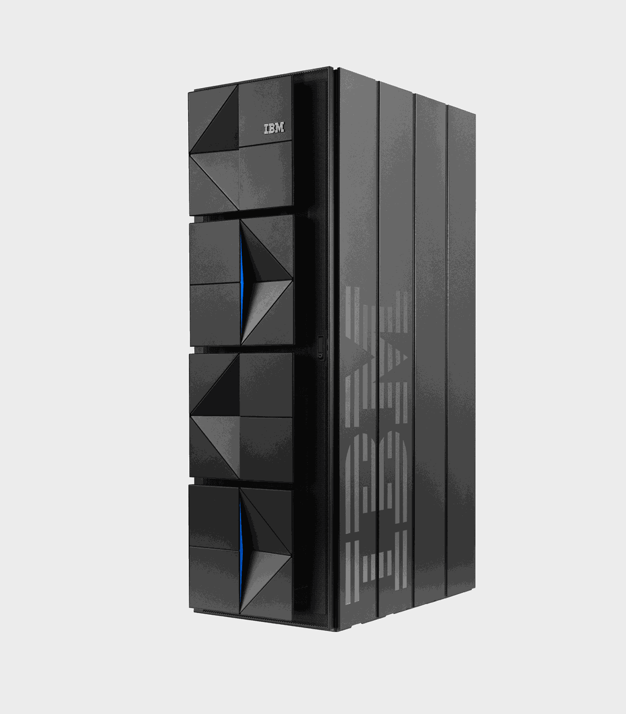

IBM Z

Slide 7
Exceed customer expectations through exceptional brand experiences
28pt label

Slide 8

Intelligent marketing Growth through orchestration

Slide 9
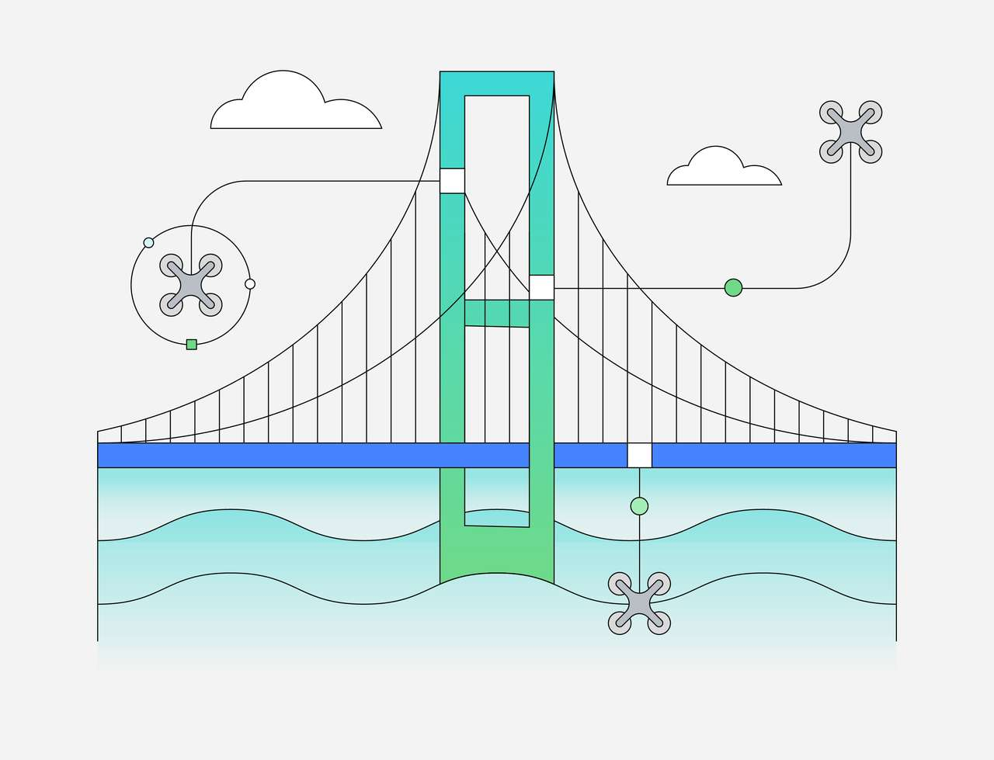
Sustainability as a transformation catalyst
January 2027

Slide 10

Sustainability as a transformation catalyst
January 2027

Slide 11
Where innovation and transformation come together
IBM client stories

Slide 12

Manufacturing excellence for edge
IBM Sales Enablement
Firstname Lastname Partner—Global Leader Manufacturing and Industry 4.0
w3 profile ↗ Slack ↗

Slide 13
Where innovation and transformation come together
28pt label

Slide 14

Intelligence planning
Firstname Lastname Job Title
email.address@ibm.com
123.456.7890

Slide 15
IBM client success stories
16 ASTEX
17 Audi UK
18 Bestseller India
19 Energinet
20 Etihad Airways
FlightSafety International
Frito-Lay North America
23 Harry Rosen
24 Luftfartsverket
25 MANA-Vox
26 Seguros Ocaso
27 State Bank of India
28 The Climate Service

Slide 16
Why do 70% of digital transformation efforts fail?

Slide 17
Sustainability is the key to a better future

Slide 18
Top 5 business risks ↓ are related to the environment

Slide 19



Slide 20




Automation

Slide 21
Here’s how IBM automation can improve sustainable enterprise delivery
Solutions

Slide 22

Here’s how IoT automation delivered our sustainability goals

Slide 23
Here’s how IoT automation delivered our sustainability goals

Slide 24
Here’s how hybrid cloud solved the supply chain issue

Slide 25
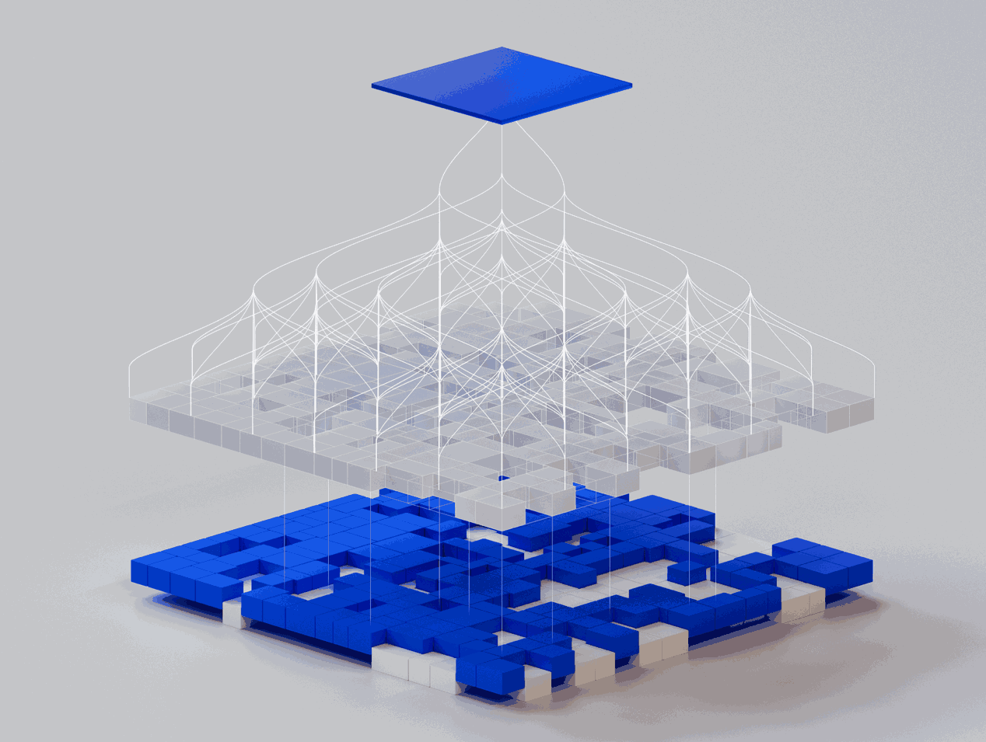
Data-driven AI solutions

Slide 26
How can a luxury car brand bring smarter experiences to its customers?
Automotive
With 90% of car purchases now starting online, Audi UK is reimagining its digital experiences to complement the entire customer journey. To improve digital front-end development and analytics, the team tapped into the IBM and Adobe partnership. Audi UK moved to the latest version of Adobe Experience Manager and worked with the IBM team to build the custom website’s analytics platform from scratch on Adobe Analytics.
More information:
Audi UK →
IBM and Adobe partnership →
Results
Lead generation increased 59% in 2020 and Audi UK delivers tools 75% faster.
Solution components
IBM Storage Scale
Adobe Analytics
Adobe Experience Manager
Read the full story →
“We are able to show what we’ve delivered. It’s a testament to the way that we’ve been working with IBM. We are not just talking agile; we are proving it through delivery.”
Jay Sadier Head of Digital Product & Transformation, Audi UK

Slide 27
How can a luxury car brand bring smarter experiences to its customers?
Automotive
With 90% of car purchases now starting online, Audi UK is reimagining its digital experiences to complement the entire customer journey. To improve digital front-end development and analytics, the team tapped into the IBM and Adobe partnership. Audi UK moved to the latest version of Adobe Experience Manager and worked with the IBM team to build the custom website’s analytics platform from scratch on Adobe Analytics.
More information:
Audi UK →
IBM and Adobe partnership →
Results
Lead generation increased 59% in 2020 and Audi UK delivers tools 75% faster.
Solution components
IBM Storage Scale
Adobe Analytics
Adobe Experience Manager
Read the full story →
“We are able to show what we’ve delivered. It’s a testament to the way that we’ve been working with IBM. We are not just talking agile; we are proving it through delivery.”
Jay Sadier Head of Digital Product & Transformation, Audi UK

Slide 28
Talent challenges
Talent acquisition
is ripe for reinvention
Fragmented data yields limited insights
Talent market dynamics and a lack of data-driven insights impede talent acquisition strategy.
Teams are
not set up
to succeed
Process variance diverts human resources from areas of impact, hindering efficiency and innovation.
Value is hard
to measure
and repeat
Differentiators are difficult to measure without a way to predict the reasons why top performers join and stay.

Slide 29
Business outcomes
Partner with IBM to elevate TA beyond expected outcomes
Transform experiences
Adopt intelligent workflows to transform experiences for candidates throughout the hiring process.
Amplify human impact
Intentionally augment your teams with technology to help them create moments of impact.
Accelerate business value
Create value beyond TA efficiencies with a dynamic, data-driven solution.
↓30%
Average reduction
in staff time per hire
92%
Hiring manager
satisfaction
↑83%
Employee perception
↑40 pts
Hiring manager satisfaction with talent acquisition experience
Top 100
Ranked internship program
↓51%
Total HR spend in
less than five years

Slide 30
Partners are a company’s growth engine
78%
62%
70%
plan to increase their channel spending
are overhauling their channel sales strategy
plan to grow their programs
Source: Channelonomics 2027 Channel Chief Outlook Report

Slide 31
IBM Expertise with Cloud HCM and Taleo
800+
35+
8
IBM has more than 950 Oracle HR consultants who hold 800+ Oracle Cloud HCM and Oracle Taleo certifications.
We are a preferred BPO Partner for HCM and Payroll
on the Oracle Cloud platform, and a Cloud Excellence Implementer (CEI) approved for several Oracle Cloud HCM and Taleo modules.
Oracle Cloud HCM and Taleo certified consultants
Oracle Cloud HCM and Taleo go-lives
CEI-approved for eight Cloud HCM and Taleo modules

Slide 32
Next steps
Update solution guidance
Update bid metrics to include benefits of using the Hybrid Cloud Mesh
Update costing, recovery and risk rating
Deploying the Hybrid Cloud Mesh as the de facto tool for migration and app modernization for solutioning and delivery
Update SIH guidance to mandate usage of Hybrid Cloud Mesh on all deals—scope, journey supported, otherwise default to traditional process
Institutionalize exception workflows, and exception reporting and track adoption metrics
Hybrid Cloud Workbench helps perform automated delivery for migration and app modernization journeys with committed outcomes, for example reduction of x% of DCUT effort for rehosting, replatforming or refactoring
Charge fee for Hybrid Cloud Mesh with trade-off for lower risk rating and contingency on contracts. Fee covers:
Recovery for ongoing development costs
Certain complex deals determined by certain clip level or other criteria, including deployment of a Hybrid Cloud Mesh adoption squad on engagements responsible for landscape tailoring through the workbench adoption workshop, provisioning of necessary accelerators and tools within the client environment, and identifying opportunities for additional journeys
Initially the Hybrid Cloud Mesh adoption squad will be incubated within the global CoC—eventually CIC and each geo should be self-sufficient
With Hybrid Cloud Mesh, given the improved guided delivery with a higher degree of automation, we’re now able to deliver with lower banded resources, which will be reflected in the bid metrics.

Slide 33
Client name or logo
What we know about [Client Name] today
Strategic goals
Build world-class recruitment model
Optimize existing technology infrastructure
Bring visibility into process and ensure ongoing improvement
Allow hiring managers to focus on core competencies
Pain points
Scalability—accommodating hiring peaks/valleys
Process inconsistency
Post and pray recruitment strategy
Targeted areas for improvement
Hiring costs
Process efficiency
Time-to-fill
Hiring manager and new hire satisfaction

Slide 34
Client name or logo
What we know about [Client Name] today
Strategic goals
Build world-class recruitment model
Optimize existing technology infrastructure
Bring visibility into process and ensure ongoing improvement
Allow hiring managers to focus on core competencies
Pain points
Scalability—accommodating hiring peaks/valleys
Process inconsistency
Post and pray recruitment strategy
Targeted areas for improvement
Hiring costs
Process efficiency
Time-to-fill
Hiring manager and new hire satisfaction

Slide 35
The IBM-Azure Migration Factory
Tools and accelerators
Discovery
AWD—Cardinal Discovery Manager
AMMS—Excel or web-based questionnaire
IBM Cloud Transformation Advisor
Red Hat Application Migration Toolkit (RHAMT)
Simple Quick Access Dashboard (SQUAD)
Data and app migration assistant for Azure
Design
Delivery curator—Mod workbook generation
JIRA—processes tracking
Candidate Microservices Advisor
Monolith application modernizer
Insight
Delivery curator—Continuous Modernization Analytics Tool (CMAT)
Transformation Advisor (TA)
Red Hat Application Migration Toolkit (RHAMT)
Auto scheduler
Static Code Analysis Tools (CAST)
Data and app migration assistant for Azure)
Delivery Curator—Framework for Mod workbook
Implement
DevOps tool chain
Application Development Studios
Digital Microservices Builder
Testing tools (Selenium, etc.)
DB migration tools (Azure Database Migration Service)
Landing zone automation
Migration tools, such as Zinstall for IBM, Azure Migrate, AzCopy, Azure File Sync, Azure Data Box, Azure Site Recovery

Slide 36
Client highlights
Intelligent asset management uses best-in-class workflows integrated with enterprise systems to optimize uptime, output, and costs
Enterprise asset management
Facilities and real estate management
Industry solutions
Environmental intelligence

Slide 37
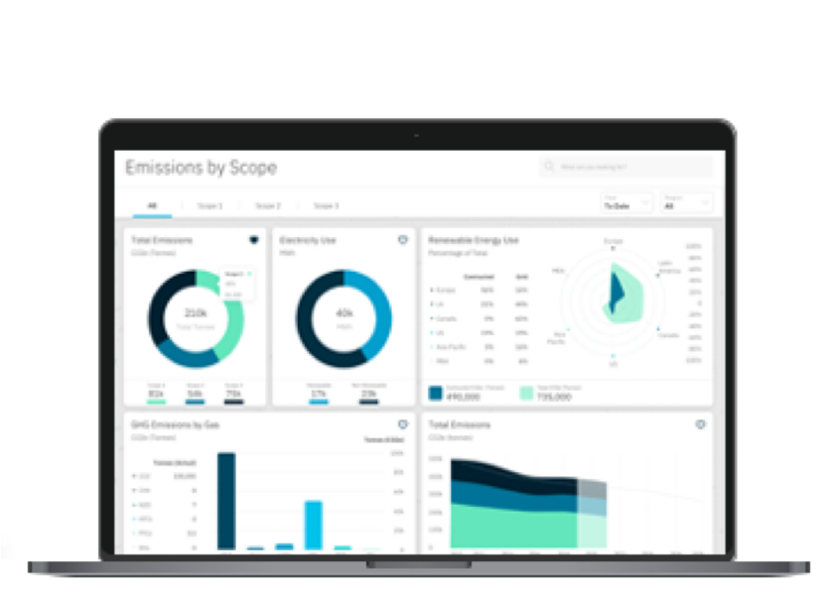
Next-gen sustainability performance management
Sam
Emily
Sergei
A sustainability manager
Measure what matters
Make better decisions
Focus attention
An operations manager
Simplify reporting
Use an effective operations strategy
Use automated alerts
A sourcing manager
Recommend effective sourcing
Gather real-time insights
Increase transparency
All other copy goes into speaker notes
Name of product here

Slide 38



Evaluating the landscape
We evaluated the use of 3D workflows by others in related and different industries. The purpose of this evaluation was to prove that the visuals created in a virtual scenario could live up to the high standard of modern Kichler photography and to learn more about the process and workflow these companies chose.
IKEA began migrating to a 3D workflow in 2004. By 2014, approximately 75% of their images were created in 3D.
Steelcase creates virtual office spaces to visualize spaces for customers and makes their 3D assets available to anyone.
Automobile manufacturers were some of the earliest adopters of 3D in advertising, online showrooms, and configurators.

Slide 39
Addressing the public cloud challenge for financial services
CTO/IT Transformation Leader
Chief Information Security Officer
Chief Data Officer

Slide 40




Client outcomes improved through IBM Hybrid Cloud and AI strategy
Modernize
Multicloud operability with application modernization and new IT operating model, using IBM Hybrid Cloud with Red Hat® OpenShift® Container Platform and IBM Cloud Paks®
↑30% developer productivity
↓70% time to market
Predict
Data-driven prediction and decision-making, enabled by digital modernization using IBM Cloud Pak for Data
↑Business acceleration
↑AI-based audit insights
Automate
Enterprise workflow and business automation scaled with intelligent automation for better customer and associate experiences
↑50% institutional account opening
↑30% retail account opening
Secure
Zero trust that creates secure business with real-time threat insights and automation tools
↓300% false positive alerts

Slide 41
Uniquely IBM Healthcare and life sciences
$5B+
invested in healthcare and
life sciences competencies
and acquisitions
$210M
clinical and claims data records 45% refreshed quarterly
115K+
people touched by Watson Health® cognitive offerings
250
active partners in healthcare and life sciences
9,100
U.S. patents in 2018—more
than Microsoft, Apple, and Google combined
2,500+
active and granted U.S. patents in healthcare and life sciences
50
industry leaders work with top 30 pharmaceutical and top 20 medical device companies
#1
IBM thought leadership rated by Source Global Research for 8 of the last 9 quality ratings¹
3,000+
researchers cross-pollinate ideas that lead to major breakthroughs
2,000+
consultants, medical practitioners, and clinicians dedicated to serve our clients
1,000
clinicians, clinical/data scientists, people with advanced degrees
6
Nobel laureates
Source: 1. Lorem source name

Slide 42
Case study Digital transformation
Revolutionizing retail in India, design → store
Challenge
In 2019, Bestseller India experienced significant decline in its top brand, Only, after 11 years of ~50% growth across all of its 4 main brands.
This presented an opportunity to reinvent how it plans and executes across its entire design, production and supply chain workflow while addressing sustainability concerns.
Solution
IBM designed and launched Fabric.ai, the first AI-powered platform for the Indian fashion industry.
The platform uses IBM watsonx AI tools, automation and process orchestration to predict which designs to manufacture and the right quantities for each location to improve efficiency of the supply chain.
Outcome
Bestseller India now has access to data-driven insights to make sustainable design and production decisions.
4% revenue uplift
15% decrease in supply chain cost
5% decrease in unsold inventory
New ways of working empower talent to work smarter with AI-driven decision-making.
Source or label

Slide 43
C&CS corporate directive deviations
High risks
Risks extended
more than 3x
New risks
identified in Q4
IBM Automation
Still on target for March 2027 completion
The migration of the source code to IBM-approved repositories
The deployment of a secure network infrastructure
Compliance with data privacy standards for our HR management application
Stronger site physical security controls
AI applications
P2PaaS (4x)—Weak encryption on SoftLayer Bare Metal servers; public cloud still working on issue via ticket CS2059135 with no resolution timeframe; extension will occur
Emptoris (3x)—Patching not meeting FBA required timelines; decommissioning environment in effect as there are only five customers left; expect to have only one customer left in January 2023
Security
Trusteer (3x)—Migration of all applications and products to secret vaults delayed to due resource limitations: target February 2027
AI applications
ClearObject—Required removal of Ivanti Connect Secure VPN per IBM CISO mandate; migrating to IBM Cloud native VPC.
Data & AI
DB2WoC—Migration from seeded SHA-1 to more secure SHA-2 or SHA-3
encryption algorithm is needed for storing passwords; (2) Actiance (Smarsh): FBA-FSRA Agreement Completion for supplier
IBM Automation
Blue Diamond Lab—Resolving Nagios server vulnerability by moving to Instana
Enterprise Content Manager—Patch backlog due to not meeting ITSS timelines
Instana—Resource limitations preventing implementation of security services (Tenable, etc.).
Watson Health
Curam—Application not patched (out of support); upgrade in progress
Heritage—Migration off Pulse VPN, per requirement from IBM CIO
Truven—Migration to new version of SSL certificate
Truven—AppScan on cloud, creating findings that require manual investigation
Talent management
All offerings—Elimination of systemic deviation approval for inability to meet patch timelines for remaining divestiture period

Slide 44
28pt short headline no more than two or three lines max
Contact or callouts
In nec rhoncus sapien. Proin ac libero sed sapien ullamcorper ultricies eget nec neque. Nunc a ex pulvinar, sodales purus non, tempus erat.
Contact or callouts
In nec rhoncus sapien. Proin ac libero sed sapien ullamcorper ultricies eget nec neque. Nunc a ex pulvinar, sodales purus non, tempus erat.
Contact or callouts
In nec rhoncus sapien. Proin ac libero sed sapien ullamcorper ultricies eget nec neque. Nunc a ex pulvinar, sodales purus non, tempus erat.
Subheading
Pellentesque habitant morbi tristique senectus et netus et malesuada fames ac turpis egestas. Ut a ante tempor, posuere tellus in, vulputate dui. Curabitur dignissim et orci in ultrices. Quisque justo est, aliquet at aliquam nec, lobortis et enim.
Donec tempor, diam eu hendrerit accumsan
Enim ipsum varius purus, quis suscipit purus urna nec leo. In nec rhoncus sapien. Proin ac libero sed sapien ullamcorper ultricies eget nec neque.
Nunc a ex pulvinar, sodales purus non, tempus erat.
Vivamus placerat scelerisque dui, at elementum.
Amus elementum massa sed urna venenatis ornare nisi scelerisque loramus altus.
Praesent at ullamcorper eros, in vehicula justo. Mauris tempus arcu et molestie pretium.
Pellentesque eget egestas massa. Pellentesque habitant morbi tristique senectus et netus et malesuada fames ac turpis egestas. Aenean eget semper sem. Integer egestas mauris orci.
Subheading
Pellentesque habitant morbi tristique senectus et netus et malesuada fames ac turpis egestas. Ut a ante tempor, posuere tellus in, vulputate dui. Curabitur dignissim et orci in ultrices. Quisque justo est, aliquet at aliquam nec, lobortis et enim. Donec tempor, diam eu hendrerit accumsan, enim ipsum varius purus, quis suscipit purus urna nec leo.
In nec rhoncus sapien. Proin ac libero sed sapien ullamcorper ultricies eget nec neque. Nunc a ex pulvinar, sodales purus non, tempus erat. Vivamus placerat scelerisque dui, at elementum ante pretium in. Vivamus elementum massa sed urna venenatis, eu ornare nisi scelerisque.
Praesent at ullamcorper eros, in vehicula justo. Mauris tempus arcu et molestie pretium. Pellentesque eget egestas massa. Pellentesque habitant morbi tristique senectus et netus et malesuada fames ac turpis egestas. Suspendisse egestas sem ex, ut tristique magna interdum blandit. Cras eget tempus ligula. Nam a turpis enim. Aenean eget semper sem. Integer egestas mauris orci, hendrerit varius dui pellentesque at. In a molestie nunc. Integer sed posuere magna. Nulla viverra lectus eget lorem lacinia, et mollis lectus dictum. Sed eget commodo erat.
Subheading
Pellentesque habitant morbi tristique senectus et netus et malesuada fames ac turpis egestas. Ut a ante tempor, posuere tellus in, vulputate dui. Curabitur dignissim et orci in ultrices. Quisque justo est, aliquet at aliquam nec, lobortis et enim. Donec tempor, diam eu hendrerit accumsan, enim ipsum varius purus, quis suscipit purus urna nec leo.
In nec rhoncus sapien. Proin ac libero sed sapien ullamcorper ultricies eget nec neque. Nunc a ex pulvinar, sodales purus non, tempus erat. Vivamus placerat scelerisque dui, at elementum ante pretium in. Vivamus elementum massa sed urna venenatis, eu ornare nisi scelerisque.
Praesent at ullamcorper eros, in vehicula justo. Mauris tempus arcu et molestie pretium. Pellentesque eget egestas massa. Pellentesque habitant morbi tristique senectus et netus et malesuada fames ac turpis egestas. Suspendisse egestas sem ex, ut tristique magna interdum blandit. Cras eget tempus ligula. Nam a turpis enim. Aenean eget semper sem. Integer egestas mauris orci, hendrerit varius dui pellentesque at. In a molestie nunc. Integer sed posuere magna. Nulla viverra lectus eget lorem lacinia, et mollis lectus dictum. Sed eget commodo erat.
Subheading
Pellentesque habitant morbi tristique senectus et netus et malesuada fames ac turpis egestas. Ut a ante tempor, posuere tellus in, vulputate dui. Curabitur dignissim et orci in ultrices. Quisque justo est, aliquet at aliquam nec, lobortis et enim. Donec tempor, diam eu hendrerit accumsan, enim ipsum varius purus, quis suscipit purus urna nec leo.
In nec rhoncus sapien. Proin ac libero sed sapien ullamcorper ultricies eget nec neque. Nunc a ex pulvinar, sodales purus non, tempus erat. Vivamus placerat scelerisque dui, at elementum ante pretium in. Vivamus elementum massa sed urna venenatis, eu ornare nisi scelerisque.
Praesent at ullamcorper eros, in vehicula justo. Mauris tempus arcu et molestie pretium. Pellentesque eget egestas massa. Pellentesque habitant morbi tristique senectus et netus et malesuada fames ac turpis egestas. Suspendisse egestas sem ex, ut tristique magna interdum blandit. Cras eget tempus ligula. Nam a turpis enim. Aenean eget semper sem. Integer egestas mauris orci, hendrerit varius dui pellentesque at. In a molestie nunc. Integer sed posuere magna. Nulla viverra lectus eget lorem lacinia, et mollis lectus dictum. Sed eget commodo erat.

Slide 45
36pt short headline no more than two or three lines max
36pt short headline
Praesent at ullamcorper eros, in vehicula justo. Mauris tempus arcu et pretium agrico. Pellentesque eget egestas massa. Pellentesque habitant morbi tristique sene et netus et malesuada fames ac turpis egestas. Suspendisse egestas sem ex, ut tristes magna interdum blandit. Cras eget tempus ligula. Nam a turpis enim. Aenea eget non semper sem. Integer egestas mauris orci, hendrerit varius dui pellentes at. In a nunc. Integer sed posuere magna. Nulla viverra lectus eget lorem lacinia, et mollis lectus dictum. Sed eget commodo erat nonamus sint.
Contact or callouts
Pellentesque habitant morbi tristique senectus et netus et malesuada fames ac turpis egestas.
Ut a ante tempor, posuere tellus in, vulputate dui. Curabitur dignissim et orci in ultrices. Quisque justo est, aliquet at aliquam nec, lobortis et enim.
Donec tempor, diam eu hendrerit accumsan, enim ipsum varius purus, quis suscipit purus urna nec leo.
Subheading
Pellentesque habitant morbi tristique senectus et netus et malesuada fames ac turpis egestas. Ut a ante tempor, posuere tellus in, vulputate dui. Curabitur dignissim et orci in ultrices. Quisque justo est, aliquet at aliquam nec, lobortis et enim.
Donec tempor, diam eu hendrerit accumsan
Enim ipsum varius purus, quis suscipit purus urna nec leo. In nec rhoncus sapien. Proin ac libero sed sapien ullamcorper ultricies eget nec neque.
Nunc a ex pulvinar, sodales purus non, tempus erat.
Vivamus placerat scelerisque dui, at elementum.
Amus elementum massa sed urna venenatis ornare nisi scelerisque loramus altus.
Praesent at ullamcorper eros, in vehicula justo. Mauris tempus arcu et molestie pretium.
Pellentesque eget egestas massa. Pellentesque habitant morbi tristique senectus et netus et malesuada fames ac turpis egestas. Aenean eget semper sem. Integer egestas mauris orci.
Subheading
Pellentesque habitant morbi tristique senectus et netus et malesuada fames ac turpis egestas. Ut a ante tempor, posuere tellus in, vulputate dui. Curabitur dignissim et orci in ultrices. Quisque justo est, aliquet at aliquam nec, lobortis et enim. Donec tempor, diam eu hendrerit accumsan, enim ipsum varius purus, quis suscipit purus urna nec leo.
In nec rhoncus sapien. Proin ac libero sed sapien ullamcorper ultricies eget nec neque. Nunc a ex pulvinar, sodales purus non, tempus erat. Vivamus placerat scelerisque dui, at elementum ante pretium in. Vivamus elementum massa sed urna venenatis, eu ornare nisi scelerisque.
Praesent at ullamcorper eros, in vehicula justo. Mauris tempus arcu et molestie pretium. Pellentesque eget egestas massa. Pellentesque habitant morbi tristique senectus et netus et malesuada fames ac turpis egestas. Suspendisse egestas sem ex, ut tristique magna interdum blandit. Cras eget tempus ligula. Nam a turpis enim. Aenean eget semper sem. Integer egestas mauris orci, hendrerit varius dui pellentesque at. In a molestie nunc. Integer sed posuere magna. Nulla viverra lectus eget lorem lacinia, et mollis lectus dictum. Sed eget commodo erat.
Subheading
Pellentesque habitant morbi tristique senectus et netus et malesuada fames ac turpis egestas. Ut a ante tempor, posuere tellus in, vulputate dui. Curabitur dignissim et orci in ultrices. Quisque justo est, aliquet at aliquam nec, lobortis et enim. Donec tempor, diam eu hendrerit accumsan, enim ipsum varius purus, quis suscipit purus urna nec leo.
In nec rhoncus sapien. Proin ac libero sed sapien ullamcorper ultricies eget nec neque. Nunc a ex pulvinar, sodales purus non, tempus erat. Vivamus placerat scelerisque dui, at elementum ante pretium in. Vivamus elementum massa sed urna venenatis, eu ornare nisi scelerisque.
Praesent at ullamcorper eros, in vehicula justo. Mauris tempus arcu et molestie pretium. Pellentesque eget egestas massa. Pellentesque habitant morbi tristique senectus et netus et malesuada fames ac turpis egestas. Suspendisse egestas sem ex, ut tristique magna interdum blandit. Cras eget tempus ligula. Nam a turpis enim. Aenean eget semper sem. Integer egestas mauris orci, hendrerit varius dui pellentesque at. In a molestie nunc. Integer sed posuere magna. Nulla viverra lectus eget lorem lacinia, et mollis lectus dictum. Sed eget commodo erat.
Subheading
Pellentesque habitant morbi tristique senectus et netus et malesuada fames ac turpis egestas. Ut a ante tempor, posuere tellus in, vulputate dui. Curabitur dignissim et orci in ultrices. Quisque justo est, aliquet at aliquam nec, lobortis et enim. Donec tempor, diam eu hendrerit accumsan, enim ipsum varius purus, quis suscipit purus urna nec leo.
In nec rhoncus sapien. Proin ac libero sed sapien ullamcorper ultricies eget nec neque. Nunc a ex pulvinar, sodales purus non, tempus erat. Vivamus placerat scelerisque dui, at elementum ante pretium in. Vivamus elementum massa sed urna venenatis, eu ornare nisi scelerisque.
Praesent at ullamcorper eros, in vehicula justo. Mauris tempus arcu et molestie pretium. Pellentesque eget egestas massa. Pellentesque habitant morbi tristique senectus et netus et malesuada fames ac turpis egestas. Suspendisse egestas sem ex, ut tristique magna interdum blandit. Cras eget tempus ligula. Nam a turpis enim. Aenean eget semper sem. Integer egestas mauris orci, hendrerit varius dui pellentesque at. In a molestie nunc. Integer sed posuere magna. Nulla viverra lectus eget lorem lacinia, et mollis lectus dictum. Sed eget commodo erat.

Slide 46
36pt short headline
Praesent at ullamcorper eros, in vehicula justo. Mauris tempus arcu et pretium agrico. Pellentesque eget egestas massa. Pellentesque habitant morbi tristique sene et netus et malesuada fames ac turpis egestas. Suspendisse egestas sem ex, ut tristes magna interdum blandit. Cras eget tempus ligula. Nam a turpis enim. Aenea eget non semper sem. Integer egestas mauris orci, hendrerit varius dui pellentes at. In a nunc. Integer sed posuere magna. Nulla viverra lectus eget lorem lacinia, et mollis lectus dictum. Sed eget commodo erat nonamus sint.
Contact or callouts
Pellentesque habitant morbi tristique senectus et netus et malesuada fames ac turpis egestas.
Ut a ante tempor, posuere tellus in, vulputate dui. Curabitur dignissim et orci in ultrices. Quisque justo est, aliquet at aliquam nec, lobortis et enim.
Donec tempor, diam eu hendrerit accumsan, enim ipsum varius purus, quis suscipit purus urna nec leo.
Subheading
Pellentesque habitant morbi tristique senectus et netus et malesuada fames ac turpis egestas. Ut a ante tempor, posuere tellus in, vulputate dui. Curabitur dignissim et orci in ultrices. Quisque justo est, aliquet at aliquam nec, lobortis et enim.
Donec tempor, diam eu hendrerit accumsan
Enim ipsum varius purus, quis suscipit purus urna nec leo. In nec rhoncus sapien. Proin ac libero sed sapien ullamcorper ultricies eget nec neque.
Nunc a ex pulvinar, sodales purus non, tempus erat.
Vivamus placerat scelerisque dui, at elementum.
Amus elementum massa sed urna venenatis ornare nisi scelerisque loramus altus.
Praesent at ullamcorper eros, in vehicula justo. Mauris tempus arcu et molestie pretium.
Pellentesque eget egestas massa. Pellentesque habitant morbi tristique senectus et netus et malesuada fames ac turpis egestas. Aenean eget semper sem. Integer egestas mauris orci.
Subheading
Pellentesque habitant morbi tristique senectus et netus et malesuada fames ac turpis egestas. Ut a ante tempor, posuere tellus in, vulputate dui. Curabitur dignissim et orci in ultrices. Quisque justo est, aliquet at aliquam nec, lobortis et enim. Donec tempor, diam eu hendrerit accumsan, enim ipsum varius purus, quis suscipit purus urna nec leo.
In nec rhoncus sapien. Proin ac libero sed sapien ullamcorper ultricies eget nec neque. Nunc a ex pulvinar, sodales purus non, tempus erat. Vivamus placerat scelerisque dui, at elementum ante pretium in. Vivamus elementum massa sed urna venenatis, eu ornare nisi scelerisque.
Praesent at ullamcorper eros, in vehicula justo. Mauris tempus arcu et molestie pretium. Pellentesque eget egestas massa. Pellentesque habitant morbi tristique senectus et netus et malesuada fames ac turpis egestas. Suspendisse egestas sem ex, ut tristique magna interdum blandit. Cras eget tempus ligula. Nam a turpis enim. Aenean eget semper sem. Integer egestas mauris orci, hendrerit varius dui pellentesque at. In a molestie nunc. Integer sed posuere magna. Nulla viverra lectus eget lorem lacinia, et mollis lectus dictum. Sed eget commodo erat.
Subheading
Pellentesque habitant morbi tristique senectus et netus et malesuada fames ac turpis egestas. Ut a ante tempor, posuere tellus in, vulputate dui. Curabitur dignissim et orci in ultrices. Quisque justo est, aliquet at aliquam nec, lobortis et enim. Donec tempor, diam eu hendrerit accumsan, enim ipsum varius purus, quis suscipit purus urna nec leo.
In nec rhoncus sapien. Proin ac libero sed sapien ullamcorper ultricies eget nec neque. Nunc a ex pulvinar, sodales purus non, tempus erat. Vivamus placerat scelerisque dui, at elementum ante pretium in. Vivamus elementum massa sed urna venenatis, eu ornare nisi scelerisque.
Praesent at ullamcorper eros, in vehicula justo. Mauris tempus arcu et molestie pretium. Pellentesque eget egestas massa. Pellentesque habitant morbi tristique senectus et netus et malesuada fames ac turpis egestas. Suspendisse egestas sem ex, ut tristique magna interdum blandit. Cras eget tempus ligula. Nam a turpis enim. Aenean eget semper sem. Integer egestas mauris orci, hendrerit varius dui pellentesque at. In a molestie nunc. Integer sed posuere magna. Nulla viverra lectus eget lorem lacinia, et mollis lectus dictum. Sed eget commodo erat.
Subheading
Pellentesque habitant morbi tristique senectus et netus et malesuada fames ac turpis egestas. Ut a ante tempor, posuere tellus in, vulputate dui. Curabitur dignissim et orci in ultrices. Quisque justo est, aliquet at aliquam nec, lobortis et enim. Donec tempor, diam eu hendrerit accumsan, enim ipsum varius purus, quis suscipit purus urna nec leo.
In nec rhoncus sapien. Proin ac libero sed sapien ullamcorper ultricies eget nec neque. Nunc a ex pulvinar, sodales purus non, tempus erat. Vivamus placerat scelerisque dui, at elementum ante pretium in. Vivamus elementum massa sed urna venenatis, eu ornare nisi scelerisque.
Praesent at ullamcorper eros, in vehicula justo. Mauris tempus arcu et molestie pretium. Pellentesque eget egestas massa. Pellentesque habitant morbi tristique senectus et netus et malesuada fames ac turpis egestas. Suspendisse egestas sem ex, ut tristique magna interdum blandit. Cras eget tempus ligula. Nam a turpis enim. Aenean eget semper sem. Integer egestas mauris orci, hendrerit varius dui pellentesque at. In a molestie nunc. Integer sed posuere magna. Nulla viverra lectus eget lorem lacinia, et mollis lectus dictum. Sed eget commodo erat.

Slide 47

Proven method
Co-create
Co-execute
When working with IBM Client Engineering, attention is focused on the customer’s critical points. Team efficiency is increased to take manageable risks. Cutting-edge technologies are adopted, speeding up product development and measuring the value of any operation. We provide support for all business objectives, helping to respond quickly to outages or leading the complete transformation. The final step is dedicated to MVP development.
Framing
Understand the strategy.
Determine business/technology
initiative(s) to focus on.
Align stakeholders on vision and desired outcome.
Confirm executive sponsor, product owner, and governance model.
Discovery
Understand target end users.
Understand “as-is” context of business and/or technology.
Guide narrowing focus.
Solutioning
Diverge to explore potential solutions. Converge to select solution to invest in validating. Identify platform/initial technical components to be used. Develop roadmap.
Scoping
Hypothesis to be tested/proof points to be proven.
Define scope of MVP. Identify resources needed to build MVP.
MVP build
Build MVP that leverages IBM hybrid cloud technologies.
Define a secure minimum viable architecture that mitigates risk.
Set up cloud platform and automation.
Build skills and evolve culture through pairing.

Slide 48
Research objectives and approach
Gather messaging concepts for IBM AI solutions
Conduct qualitative, one-on-one interviews
Review objectives and drivers or outcomes motivating them
Study strategies and approaches for meeting objectives
Define KPIs used to track progress toward objectives
Articulate challenges and uncertainties in meeting objectives
Develop roles and select teams for executing on objectives
Determine how sustainability investments are capitalized
Collect reactions to business imperatives for use in IBM messaging
Enable consistent coverage of major topics while probing important characteristics of each organization’s situation
Complete 20 30-minute Zoom interviews with chief sustainability officers or most senior director plus sustainability executive in organization
Complete 35 interviews with CIOs, CFOs, COOs and CEO
Focus coverage primarily in North America, with some representation in UK and Germany
Focus on large and very large enterprises to extent possible, though some midmarket as well

Slide 49


Client highlights
Manage critical assets to optimize performance and reduce operational downtime
The Hub Power Company Limited
Improved its specialized health, safety, and environment-related processes to drive greater safety, efficiency, and productivity of its critical assets. Reduced safety incidents by 20%.
Metropolitan Atlanta Rapid Transit Authority
Predicted asset health to improve asset condition assessment and extend the asset lifespan.
Provided a centralized view of asset performance, upping safety and efficiencies. Achieved ISO 15000 certification.

Slide 50
Challenges
01
Chapter 2 requirements
Mission-critical middleware, databases and existing apps make up ~60% of the opportunity; bulk of growth will be funded through digital acceleration (80%)
Containerization to increase substantially: ~45%–50% rewrites and ~65% net new.
Our actions
In 2021, we introduced hybrid cloud journeys to capture Chapter 2 workloads on the Red Hat® OpenShift® platform: middleware, databases and Microsoft applications.
Now we’re expanding hybrid cloud journeys to support migrations and app modernization, and to build on IBM Cloud, Microsoft Azure, Amazon Web Services (AWS) and Google Cloud Platform (GCP).
We are also strengthening capabilities to accelerate existing mainframe modernization.

Slide 51

Discussion guide
Key elements of cloud migrations
IBM and Microsoft Azure partnership
Case overviews
Our assets and accelerators
Path forward

Slide 52
Making cloud work for regulated industry
Stability and resiliency
Visibility and control of resources, applications
Isolation and privacy
Compliance, compliance, compliance
Security
Change management
Data security and privacy
Data policy and ownership
Key management (including KYOK)
Quantum-safe encryption

Slide 53
Organizations that invest in digital experience report three times higher revenue growth for the last two fiscal years (3.6%) compared to other organizations in our survey (1.2%).
3x
Source: add source here

Slide 54
Revenue 2021
Percent increase
$1.5B
+1%
Source: Lorem source name

Slide 55
Leaders are digitally transforming business models to accelerate growth
The great digital shift: 10 years of digitalization in under 1 year
18% increase from 2025 to 2026
Percentage of business
channels replaced by digital
With an increased focus on:
Operational excellence
Product leadership
Customer intimacy

Slide 56
Team structure: Role definitions
Program leadership
Strategy and innovation
Account director
Serves as the point of contact for client’s executive and C-level staff to align the RPO program at a strategic level. Owns the RPO partnership and is the ultimate point of accountability for program success; ensures client’s satisfaction with the services we provide.
Talent acquisition manager
Manages day-to-day RPO operations, ensuring ongoing fulfilment of hiring requests and resource alignment relative to client’s hiring demand.
Technology lead
Offers guidance on applicable IBM technologies and how they will be incorporated to elevate performance and value.
Innovation council and client success lead
Drive the long-term success of your RPO program by aligning IBM’s ongoing innovations in talent acquisition with client’s hiring needs and manages change across RPO partnership stakeholders, both at the onset of the contract as well as throughout its duration/evolution.

Slide 57
To establish market dominance in hybrid cloud consulting, hybrid cloud solutions must address two challenges:
↓
Our actions
01
Help clients address complexity of Chapter 2 cloud modernization
Chapter 2 requirements:
Mission-critical middleware, databases and existing apps make up ~60% of the opportunity; bulk of growth will be funded through digital acceleration (80%)
Containerization to increase substantially: ~45%-50% rewrites and ~65% net new
In 2021, we introduced hybrid cloud journeys to capture Chapter 2 workloads on the Red Hat® OpenShift® platform: middleware, databases and Microsoft applications
Now we’re expanding hybrid cloud journeys to support migrations and app modernization, and to build on IBM Cloud, Microsoft Azure, Amazon Web Services (AWS) and Google Cloud Platform (GCP)
Also strengthening capabilities to accelerate existing mainframe modernization
02
Simplify and accelerate solutioning and delivery at global scale
Proposal development relies heavily on a few local experts with multiple handoffs to different SMEs—time consuming and not scalable
Delivery driven by aggregation of best practices, offering content in scope, assets and methods; relying primarily on skills of resources available, leading to inconsistency and higher risk exposure
Limited reuse and harvesting of content development by proposal and client delivery teams globally
Through the introduction of the Hybrid Cloud Workbench:
Accelerate discovery, sizing, solutioning and proposal generation, and guided low-touch delivery with codified assets and accelerators, driving consistency and predictability in outcomes
Improve co-creation and reuse of assets through crowdsourcing across clients, acquisitions, partners and open source
Improve branding of Hybrid Cloud Workbench to differentiate against Accenture myNav, Deloitte innoWake, TCS MasterCraft and other competitors

Slide 58
IBM Expertise with Oracle Cloud HCM and Taleo
IBM has more than 950 Oracle HR consultants who hold 800+ Oracle Cloud HCM and Oracle Taleo certifications. We are a preferred BPO partner for HCM and payroll on the Oracle Cloud platform, and a Cloud Excellence Implementer (CEI) approved for several Oracle Cloud HCM and Taleo modules.
800+
Oracle Cloud HCM and Taleo certified consultants
35+
Oracle Cloud HCM and Taleo go-lives
8
CEI approved for eight Cloud HCM and Taleo modules

Slide 59
Understanding the disconnect between buyers and sellers
Buyers’ expectations have skyrocketed and many organizations have not kept pace
Internal competing objectives and priorities causing silos and lack of coordination
Complex tech, process and compensation integration due to M&A
High turnover
Lack of modernization of processes and workflows, causing friction in the system
Failed tech platform programs that did not deliver on the promised KPIs
That is why we have launched the business of intelligent sales.
We are laser-focused on driving top-line growth by bridging the gap between sellers and buyers, from the moment a buyer has a need through a seller making a product or service available, to the final moment of truth, when the buyers’ and sellers’ needs are fully satisfied.
20%
Only 20% of buyers see sellers as a resource to solve their problems.
25%
The success rate for businesses at launching new initiatives and markets to capture new revenue streams is 25%
67%
Sixty-seven percent of buyers say their standard for customer experience is higher than ever. Despite efforts to automate, human interactions still critically impact the customer experience

Slide 60
Understanding the disconnect between buyers and sellers
Buyers’ expectations have skyrocketed and many organizations have not kept pace
Internal competing objectives and priorities causing silos and lack of coordination
Complex tech, process and compensation integration due to M&A
High turnover
Lack of modernization of processes and workflows, causing friction in the system
Failed tech platform programs that did not deliver on the promised KPIs
That is why we have launched the business of intelligent sales.
We are laser-focused on driving top-line growth by bridging the gap between sellers and buyers, from the moment a buyer has a need through a seller making a product or service available, to the final moment of truth, when the buyers’ and sellers’ needs are fully satisfied.
20%
Only 20% of buyers see sellers as a resource to solve their problems.
25%
The success rate for businesses at launching new initiatives and markets to capture new revenue streams is 25%
67%
Sixty-seven percent of buyers say their standard for customer experience is higher than ever. Despite efforts to automate, human interactions still critically impact the customer experience

Slide 61
Talent challenges: Traditional RPO has limitations
1
Siloed systems leave valuable data untapped
2
Overburdened resources can’t focus on building relationships
3
Inefficient processes shuffle candidates from contact to contact

Slide 62
Understanding the disconnect between buyers and sellers
20%
Only 20% of buyers see sellers as a resource to solve their problems.¹
25%
The success rate for businesses at launching new initiatives and markets to capture new revenue streams is 25%.²
67%
Sixty-seven percent of buyers say their standard for customer experience is higher than ever. Despite efforts to automate, human interactions still critically impact the customer experience.³
1. Lorem source name
2. Lorem source name
3. Lorem source name

Slide 63

80%
of respondents agreed that real-time insights are important¹
49%
say getting insights where and when they are needed is a big challenge²
89%
of advanced adopters are reducing operating costs with AI³
1. Lorem source name
2. Lorem source name
3. Lorem source name

Slide 64
IBM experts
We’ll assemble the right squad for your project and bring in the best talent from across IBM flexibly.
Business
Design
Tech

Slide 65
Creating beautiful 3D scenes
Over the past 16 years, IKEA has modeled thousands of products and created many beautiful scenes intended for its print advertising.
The store’s worldwide footprint requires the same room scenes to be configured differently for various countries. For instance, wall outlets in the USA are different from those in Europe.
In 2004, IKEA’s main motive was to streamline its photoshoot operations. However, as the augmented reality (AR) and virtual reality (VR) worlds began to take shape, their 3D work has positioned them nicely to take advantage of new immersive technologies.

Slide 66
Creating beautiful 3D scenes
Over the past 16 years, IKEA has modeled thousands of products and created many beautiful scenes intended for its print advertising.
The store’s worldwide footprint requires the same room scenes to be configured differently for various countries. For instance, wall outlets in the USA are different from those in Europe.
In 2004, IKEA’s main motive was to streamline its photoshoot operations. However, as the augmented reality (AR) and virtual reality (VR) worlds began to take shape, their 3D work has positioned them nicely to take advantage of new immersive technologies.

Slide 67
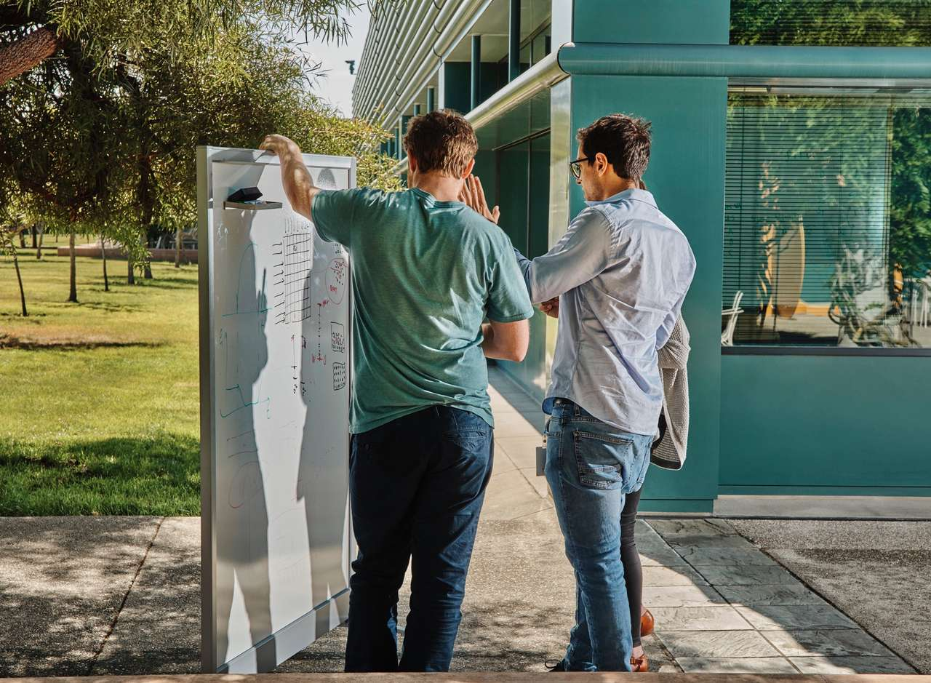
IT Automation
Explore solutions that help you optimize your IT operations with a seamless environment integration. Simultaneously reduce cloud infrastructure costs by 30% and speed up mean time to repair by 50%.

Slide 68
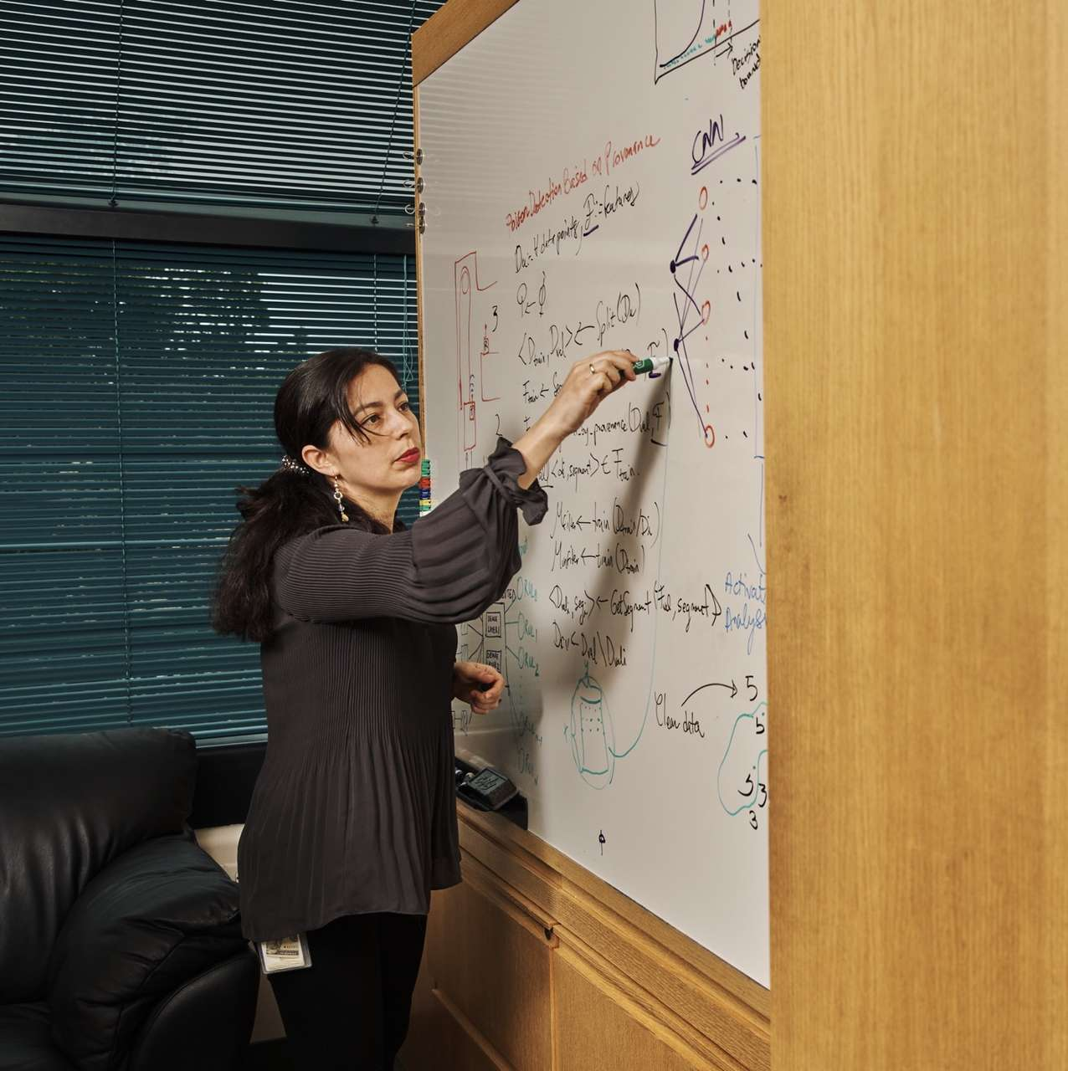
03 Simplify, unify and connect all your data
Most organizations are dealing with an overwhelming volume of data from disparate sources. It’s often siloed and sprawled out across multiple clouds, data stores, locations and vendors—making data access time-consuming and complicated for data scientists, business analysts and other stakeholders.
The challenges of data consolidation
Many organizations depend on outdated data architectures that attempt to consolidate disparate, siloed data into data warehouses or data lakes. Consolidation approaches that use extract, transform and load (ETL) procedures to copy data into a single data store are time-consuming and costly, adding complexity to the data landscape. And most organizations still end up with multiple repositories. As a result, data scientists struggle with lengthy data preparation cycles and difficulty organizing data to achieve a single view.
Unifying the data landscape for easier access and universal queries
A data fabric is the architectural answer to these challenges, helping businesses unify and simplify their information architecture for AI and empower their users with faster access to the business data they need. A data fabric uses data virtualization to access disparate sources across an environment, so you no longer need to move data or create duplicate sets. Data virtualization provides a single, seamless view without copying data. As a result, a data fabric enables self-service access, so users can simply query the data where it resides. This capability gives data scientists and other data citizens faster access to information—no matter what platform or geography it’s located in. Self-service access also means users can start querying the data immediately, without waiting on a data engineer to find and prepare it first.
One-third of organizations cite data complexity and silos as the top barrier to AI adoption.

Slide 69
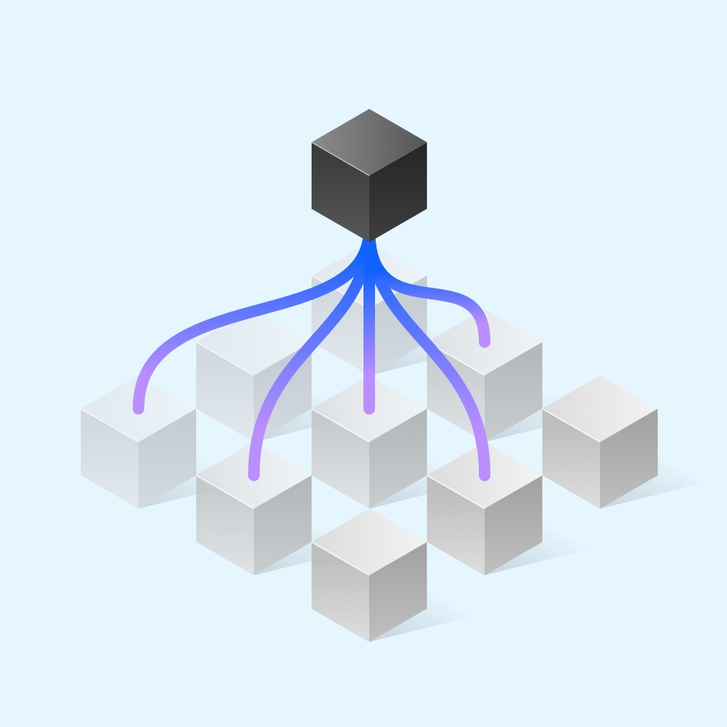
Innovate
01
What is it?
A combined team of diverse subject matter experts are immersed in intensive design thinking and research activities to expose the true nature of a client’s opportunity.
What is the goal?
Establish alignment on a “big idea” to address a specific pain point for a typical end user and create a vision for a minimum viable product (MVP).

Slide 70

Digitization of sales is table stakes
Leading organizations are evolving their strategy and processes to enable an experience-led and agile virtual enterprise.
01
It is about having an elastic strategy that can achieve KPIs in a dynamic, ever-changing marketplace.
02
It’s about reinventing legacy processes to intelligent workflows and infusing automation and intelligence to maximize sales effectiveness.
03
It is about designed experiences for sellers and buyers that drive intimacy and engagement.
04
Lastly, it’s about leveraging the latest technology, analytics and platforms to support the growth strategy.

Slide 71

Focus on growth presents complex challenges for CMOs
Budget constraints
Maintaining scrutiny on spend
Privacy impacts
Measuring marketing despite customer data limitations
Personalization management
Delivering personalization through data and technology
Talent and culture
Building operating models for collaboration and customer focus

Slide 72

Intelligent sales drive ROI and sustainable growth
22%
30%
increase in Net Promoter Score
increase in sales with increased average transaction values
We drive client results with a laser focus on the strategy, activated by best-of-breed, human-centered design, technology and analytics that delivers:
Improved forecasting, matching the right seller to the right buyer at the right time
Increased engagement between customers and brands across the business lifecycle
Rapid onboarding of new talent and meaningful collaboration in a remote-first workforce
Alignment across the business, shifting sales from reactive to proactive engagement

Slide 73

IBM
Our own transformation
Focusing on customer-centricity, a data-and-analytics-driven management and operational system was set up to build a management system around marketing investment efficiency to ensure marketers are making data-driven decisions and to earn business trust and credibility.
1K+
Data sources integrated into one single source of truth (marketing data lake)
22%
Improvement in campaign efficiency in first 12 months of launch
5K+
Marketers across 100 countries with access to data-driven tools

Slide 74

This results in inefficient operational performance and reliability issues, driving costly downtime and defects.
82%
of asset failures
appear random
10%
of annual revenue is scrap and defects costs
40%
of maintenance has
no effect on uptime

Slide 75

No. 7 Security-hardened transfers
IBM Sterling Connect: Direct embeds allow-list security architecture with no reported breaches in its 30+ years of usage
Proprietary protocol with built-in encryption that isn’t readily available to most bad actors
IBM Sterling File Gateway encrypts data at rest and in motion, minimizing effects if data loss occurs
Limit potential entry points into your network while still supporting common open source protocols like FTP(S), SFTP, SSH, SCP, and HTTP(S), which are needed to power your business
“All communication is secured regardless of network location.” John Moniker VP, Security

Slide 76
The virtual enterprise: The future of business
Openness
Connect divisions, functions and partners in more collaborative and agile workflows.
Acceleration
Continuous experimentation relies on predictive and prospective analysis of massive amounts of data.
Purpose
Align purpose and intent with wider societal impact on climate, health, security and equality.
Culture
Embrace new digital tools and methods without sacrificing human empathy, creativity and sense of belonging.
Resilience
Optimize flexibility and nimbleness of the hybrid cloud approach to connect with business partners and access leading open technologies.
Agility
Create a seamless flow of communication and productivity with intelligent workflows.

Slide 77






Salesforce powers the entire indirect sales channel
Partner marketing
Partner management
Partner recruiting and enablement
↓
Built on the Salesforce platform
Partner co-selling
Partner service
Partner analytics

Slide 78
Successful transformation requires a cultural shift for sustained change using shared purpose for flow IBM provides a space and methodology to initiate, measure, iterate, and grow the sustainable enterprise.
Humanize the climate emergency and equity for all
We support stakeholders in refining their enterprise’s purpose-led strategy, ensuring that all the dimensions of Planet, People, Prosperity are prioritized and balanced accordingly.
Rethinking future fitness
and brand equity
New process, tools, and interfaces are rooted in sustainable research and co-created with all impacted stakeholder groups to ensure successful future adoption.
Embedding change in the corporate DNA
All stakeholder groups embrace the new tools, processes, and ways of working in IBM Garage with a cadence of playbacks to socialize changes in their communities.
Empathy as core design principle in ethical innovation
Use proven frameworks to create comprehensive yet simple persona-based artifacts to guide all stakeholder groups through change.
Transparent impact
reporting
Use a custom-built Change Insights Dashboard to track adoption and sentiment and discover opportunities for continuous improvement.
Adapt to ever-changing ESG and regulatory requirements
Establish a framework and governance structure to support evolution of process, people and tools to ensure ESG transparency and compliance, and to propel innovation.

Slide 79

Maximize your intelligent sales strategy
Client attrition
“Who are key clients that are at risk?”
Client attrition predicts which clients mostly likely to cancel service and provides list of actions to execute for clients at risk.
Lead management
“What leads are most likely to convert?”
Lead scoring provides the right segment by geography, demographic, products, with the right message, at the right moment using insight-based segmentation.
Sales acceleration
“How do I reach more customers with deeper engagement?”
Sales acceleration increases outreach and standardize experiences by using Chatbots to drive focused selling and customer engagement and allows reps to prioritize high-potential opportunities.
Successful strategy development has moved beyond just diagnosing and solving problems. It blends implementation processes in creative ways to steer business in a hands-on manner.
This offering is focused on understanding, validating and scaling sales strategies quickly.
Product propensity
“What is the best price for this prospect or customer?”
Price optimization delivers the optimal price to customers with minimal administrative overhead and reduce sales cycle times. Improve deal conversion rates and renewals.
Pipeline velocity
“Generate more relevant leads likely to become customers.”
Pipeline velocity mines unstructured data like news stories and social media to bring in new leads. Focus on leads that are likely to convert based on hard data.
79

Slide 80

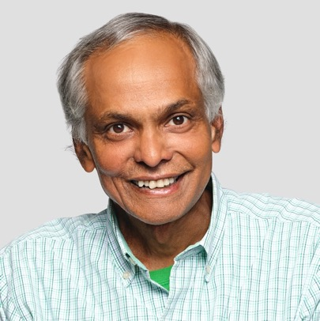




With you today
Firstname Lastname Managing Partner
Firstname Lastname
Chief Architect
Firstname Lastname Global Managing Partner
Firstname Lastname Managing Partner
Firstname Lastname CTO, Hybrid Cloud Services
Firstname Lastname VP, Senior Partner

Slide 81
Intelligent sales is built with 3 levers of growth
01
02
03
Experience
Maximize your intelligent sales strategy for success
Experience
Design effective seller experiences to drive engagement, adoption and conversion, and reinvent processes into intelligent workflows
Technology
Deliver results with insight, automation and intelligence with the latest technology

Slide 82





Next steps Our path to success
Week 1
Discover with a
maturity assessment
Week 2
Co-design an
actionable strategy
Week 3
Co-design a
proof of value
Plan for go live, hypercare and ongoing operations
Co-execute at
scale with confidence
Deliver ongoing operations and feedback loops
Cooperate with
a dynamic partnership

Slide 83
Accelerating digital transformation: a case study
→
Services
Infrastructure modernization advisory
Cloud foundation, automation
Migration rehost, replatform, refactor
DevOps transformation
Security foundation
Challenges
Modernize and transform the existing environment through automation and accelerate the institution’s move to the cloud.
Improve efficiency in managing critical infrastructure and increase speed to market for new initiatives.
Extend the infrastructure, security and monitoring capabilities to Azure.
Added value
Provided capability that can be used for Azure, on premise or future cloud offerings​
Enhanced the security posture significantly by eliminating configuration drift​
Supported end-of-life migrations and retrofit for other Windows and Red Hat Enterprise Linux environments

Slide 84
Collaborate with ecosystems and supply chains
Leaders are willing to change who they work with. Change suppliers and vendors based on their sustainability profile.
Transformation
trailblazers
Sustainability
strivers
Execution
stragglers
Commitment
sideliners
37%
29%
28%
26%
Source: Q11. What environmental sustainability initiatives has your organization undertaken or will it undertake in its operations—Today and in 3 years? (n=1958)

Slide 85
Collaborate with ecosystems and supply chains
Leaders are willing to change who they work with. Change suppliers and vendors based on their sustainability profile.
Transformation
trailblazers
Sustainability
strivers
Execution
stragglers
Commitment
sideliners
37%
29%
28%
26%
Source: Q11. What environmental sustainability initiatives has your organization undertaken or will it undertake in its operations—Today and in 3 years? (n=1958)

Slide 86
Collaborate with ecosystems and supply chains
Leaders are willing to change who they work with. Change suppliers and vendors based on their sustainability profile.
Transformation
trailblazers
Sustainability
strivers
Commitment sideliners
Execution stragglers
37%
29%
28%
26%
Source: Q11. What environmental sustainability initiatives has your organization undertaken or will it undertake in its operations—Today and in 3 years? (n=1958)

Slide 87
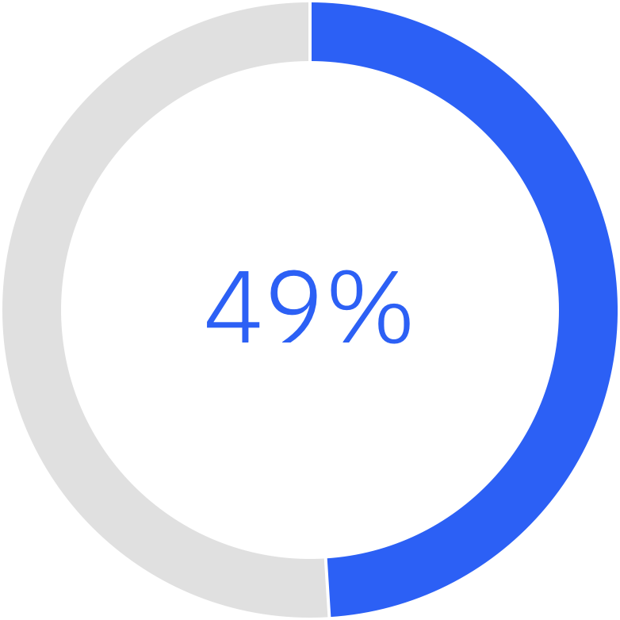
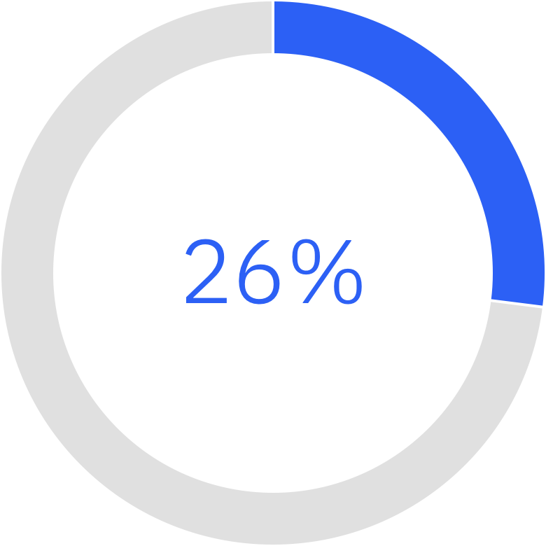
Acknowledgement of the need for fundamental change to address sustainability has been less than forthcoming
Current stats
Our organization is willing to change existing business practices at the expense of profit to improve sustainability
Sustainability is a core element of our business

Slide 88
Partners are a company’s growth engine
The percentage of the world’s commerce that flows through indirect channels
75%

Slide 89
Current state
Sustainability measurement is in place for over half of respondents and risk quantification is expected to grow significantly.
54%
66%
Use recognized frameworks, standards, metrics, and data
52%
67%
Measure contributions and progress towards sustainability goals
38%
59%
Quantify physical, operational financial, and environmental risks
Today
In 3 Years
Source: Q10. What sustainability reporting initiatives has your organization undertaken or will it undertake—Today and in 3 years? (n=1958)

Slide 90
Client resource recommendations for transition
Pre-transition readiness
Week 1
Week 2
Week 3
Week 4
Week 5
Week 6
Week 7
Week 8
Week 9
Week 10
Week 11
Week 12
Initiate
SOW finalized
Verify readiness
Build foundation
Plan
Finalize project plan
Conduct kickoff meeting
Assess change management readiness
Administer process surveys
Conduct design meeting
Execute
Design and document future-state SOPs
Execute change management strategy and training
Establish continuous improvement (CI) program
Transition requisitions to IBM
Program go live
Control
Complete audit prep with operations
Complete control evaluation
Close
Schedule and conduct post launch meeting
Review remaining open items
Obtain operations signoff
Source: If applicable, describe source origin

Slide 91
Roadmap | In production | 1H 2027 | 2H 2027
Analytics and cognitive | Alerts from real-time dashboard alerts from IPC Reports—MTTR, ticket volume | Time Machine—Past snapshots Cognitive Assist—Search Alerts—Expected Volume Forecast at Service Line Level/Account/severity level—Next Day & Week Alerts only | Cognitive Assist—Actionable Insights Predictive insights (correlated with real time) Log analytics
Real time | Server correlated application health | Integrated real time system monitoring (application, infra) and alerting (Integrate with AppDynamics/Dynatrace) | E2E view of the environment (including vendors other than IBM)
Self-service |  | Authoring of self-service reports Self-upload of xls/ppt—Upload, Share and Download
Nonfunctional requirements | Data lake (BDACS) | Role-Based Access for Client Personas and IBM Personas | Mobile access Feedback/client scores Personalization
Data source | ITSM Tool—Remedy, ServiceNow, ICCD Event Management—Netcool | App Monitoring—AppDynamics / Dynatrace CMDB (GACDW, sysdir); SRM; BigFix Direct access to client daata | BigFix IBM financial systems

Slide 92
Roadmap | In production | 1H 2027 | 2H 2027
Analytics and cognitive | Alerts from real-time dashboard alerts from IPC Reports—MTTR, ticket volume | Time Machine—Past snapshots Cognitive Assist—Search Alerts—Expected Volume Forecast at Service Line Level/Account/severity level—Next Day & Week Alerts only | Cognitive Assist—Actionable Insights Predictive insights (correlated with real time) Log analytics
Real time | Server correlated application health | Integrated real time system monitoring (application, infra) and alerting (Integrate with AppDynamics/Dynatrace) | E2E view of the environment (including vendors other than IBM)
Self-service |  | Authoring of self-service reports Self-upload of xls/ppt—Upload, Share and Download
Nonfunctional requirements | Data lake (BDACS) | Role-Based Access for Client Personas and IBM Personas | Mobile access Feedback/client scores Personalization
Data source | ITSM Tool—Remedy, ServiceNow, ICCD Event Management—Netcool | App Monitoring—AppDynamics / Dynatrace CMDB (GACDW, sysdir); SRM; BigFix Direct access to client daata | BigFix IBM financial systems

Slide 93
Hybrid Cloud Workbench: Released journeys
IBM Cloud
Company | Rehost existing
 | Rehost Linux apps on Red Hat OpenShift
 | Rehost Windows apps on Red Hat OpenShift
 | Rehost databases on Red Hat OpenShift
 | Replatform virtualized applications to Red Hat OpenShift Container Platform Virtualization
 | Rehost infrastructure services and packaged apps on Red Hat OpenShift
 | Rehost Windows VMs on Amazon Elastic Compute Cloud (Amazon EC2)
 | Rehost SQL Database on Amazon EC2
 | Rehost Linux apps on Amazon EC2
 | Rehost Windows apps on Amazon EC2
 | Rehost Windows VMs to Microsoft Azure Virtual Machines
Red Hat
AWS
Azure
GCP

Slide 94
Current state
Sustainability ranks fourth in the most important business objectives and grows to second most important in three years
Objective | Today |  | In 3 years
Reduce operational cost | 52% | 1 | 55% | 1
Grow market share | 48% | 2 | 51% | 3↓
Improve employee engagement | 42% | 3 | 47% | 4↓
Achieve environmental sustainability objectives | 39% | 4 | 53% | 2↑
Launch new products or services or value propositions | 38% |  | 53%
Execute digital transformation | 33% |  | 45%
Conduct open innovation | 32% |  | 41%
Improve cybersecurity | 30% |  | 41%
Embrace corporate social responsibility | 29% |  | 34%
Enter new geographic markets | 25% |  | 38%
Increase partnerships/alliances | 23% |  | 29%
Provide a seamless omnichannel customer experience | 21% |  | 32%
Enhance efficiency through robotics/automation | 19% |  | 27%

