Slide 1
Pedestrian Jaywalking
Instruction for Detection Program
Yifan Li
Notes:
Hi I am Yifan Li.
This video is an instruction of my project program , which is about analyzing pedestrian’s jaywalking behavior.

Slide 2
Prerequisites
Videos about traffic intersection in front of MSEE building
Windows System
Microsoft Visual Studio 2013
https://github.com/yifanli8086/PedCount.git
OpenCV 2.4.13 (You should add it into the project properties and system environment variables)
Notes:
This is the prerequisites of running programs.

Slide 3
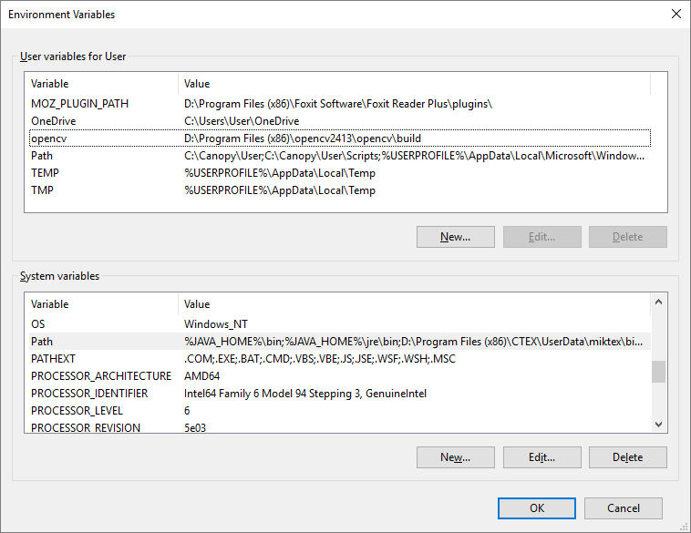
%youropencvfolder%\opencv\build
%youropencvfolder%\opencv\build\x86\vc12\bin
Notes:
This page is about environment variable, that you should add your opencv location into Path System Variable
If you only want to try the program, setting environment variable is enough.

Slide 4
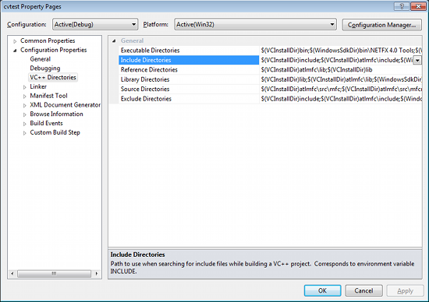
%youropencvfolder%\opencv\build\include;
%youropencvfolder%\opencv\build\include\opencv; %youropencvfolder%\opencv\build\include\opencv2;
%youropencvfolder%\opencv\build\x86\vc12\lib;
Notes:
If you want to modify the code through Visual Studio, you need to add opencv file location into Project properties. When you open the project by Visual Studio, you can open the project properties and add those info in here and there.

Slide 5
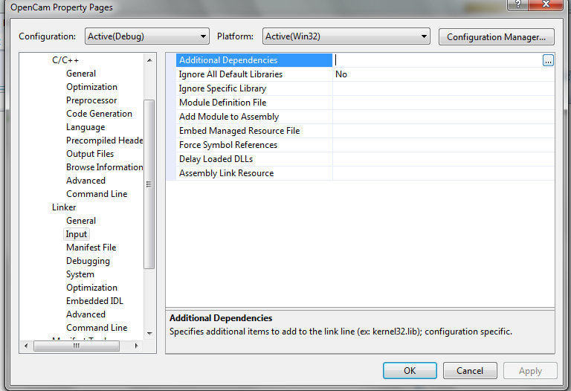
opencv_calib3d2413.lib;ope….
Please check
http://docs.opencv.org/2.4/doc/tutorials/introduction/windows_visual_studio_Opencv/windows_visual_studio_Opencv.html
For detailed dependencies list, then put all .lib files into
(make sure version is correct)
Notes:
Also you need to check this list online, then copy all the name of .lib files in here: Additional Dependencies

Slide 6
How to run the program
Command interface
Process interface
Notes:
Here I want to talk about the how the program looks like
]

Slide 7
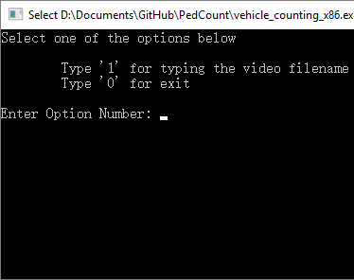
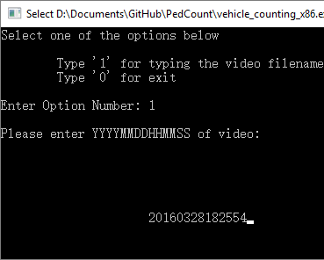
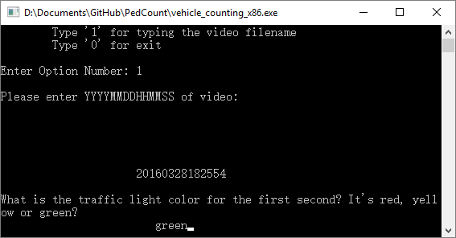
1
2
3
Notes:
First you need to type 1 for entering your filename, and then you need to type the color of traffic light at the first second of the video It helps program to catch traffic light better,

Slide 8
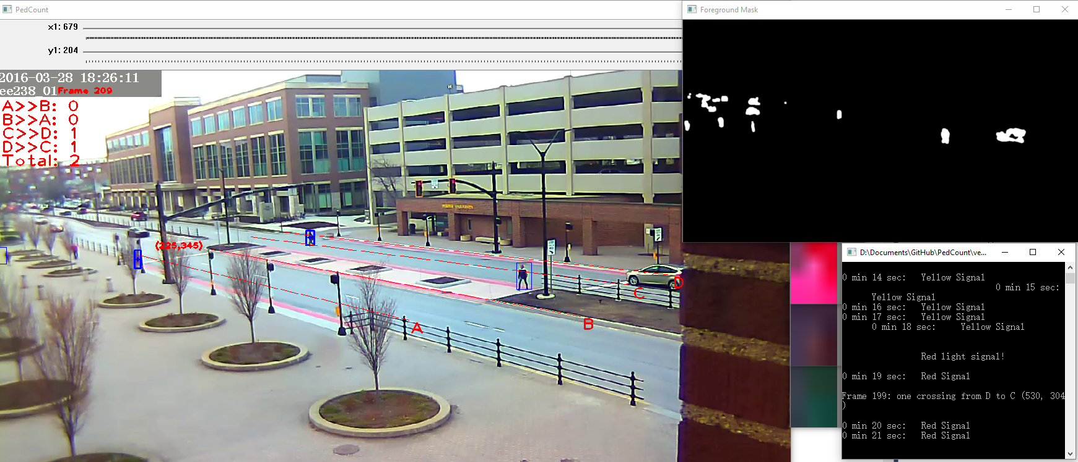
Foreground Mask
Trafficlight Location Calibration
Time, Frame #
A>>B:
# of crossing through A to B
A, B, C, D:
Sidewalk Borderline
Camera View
Output Window
Traffic Light Zoom-in
Notes:
Then you can see the program starts to calculate the background of video, then it will start background subtraction and traffic light recognition

Slide 9
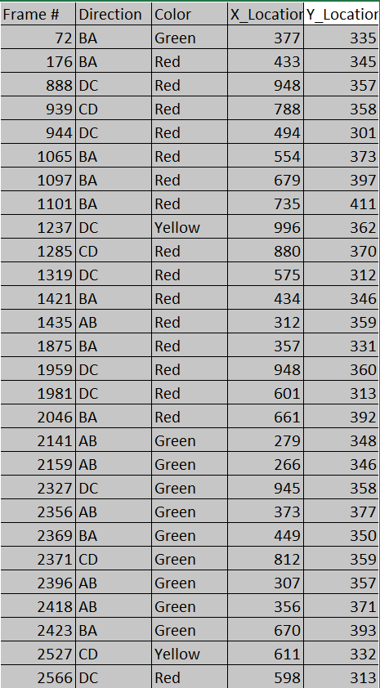


Jaywalk Rate =
(# crossing in Green, Yellow) /(# crossing in Green, Yellow, Red)
Notes:
After the program finish processing, it will generate a jaywalk.txt file.
All you need to do is open this file by Excel, and then you can see your data.

Slide 10
Code
Structure of Project codes
Change video repository default address
Calibrate traffic light default location
Notes:
Here I want to show you about how to modify my code, and I will talk about three parts.

Slide 11
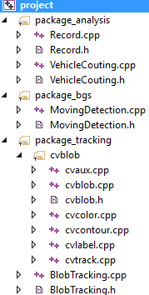
Structure of Project codes
Package_analysis: track pedestrian in each frames
Package_bgs: do background subtraction method and send each frame to package_analysis
Package_tracking: a open-sourced library providing blob tracking features
Main.cpp: where the program starts
Notes:
Here is the structure of the project.
Totally it has three main module:
First one is package for analysis. This package is designed to process information in each frame. For example the tracking of pedestrian, and the detection of pedestrian’s location. If a pedestrian is crossing through line A, this package will catch that and save it into txt files.
Second is package for background subtraction. This package gets input video files and calculates the background images. Then it process each frames and send each frame into package_analysis. It also send blob information to package_tracking, which I am about to mention in the following
The last package is for tracking. This package catches blob information from previous package and identify pedestrian then make bounding boxes around pedestrian. Then it will send tracking information to package_analysis.

Slide 12
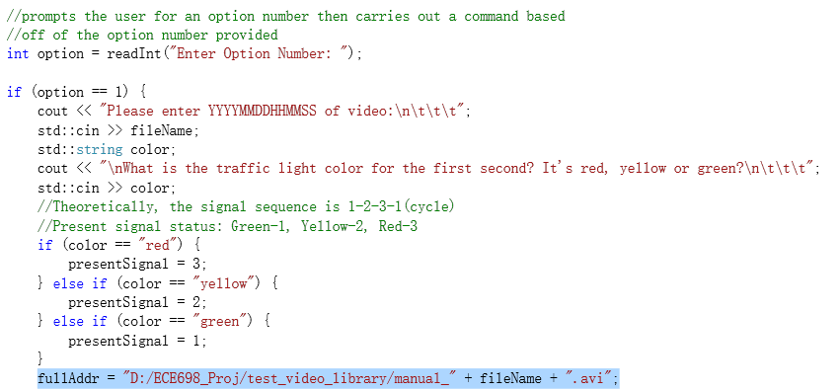
Change repository location
Please change this default repository address into your own repository address
PedCount\package_bgs\MotionDetection.cpp, Line 64:
Notes:
In this part you can change the default video repository location.
In Line 64, you can change the location before the filename variable
And please also pay attention to the file type. The sample video I used is avi format. If you wanna use MKV, you need to modify it in here.

Slide 13


Calibrate traffic light default location
PedCount\package_bgs\MotionDetection.cpp, Line 554-557:
In this example,
(679, 204) is pointing to the upper left corner of red light,
“gap” is the distance between upper left corner of red light and upper left corner of yellow light
(also distance for yellow and green light )
Notes:
If you get the video, you may need to calibrate the location of traffic light. This program is not smart enough to recognize the traffic light location, so you have to assign the location value by yourself.
For the default value I used for this sample, the x, y location is the upper left corner of right light. And the distance between each light’s upper left corder is 8 pixels.
You need to manully meature the upper left corner location of right light in your video, then update this value in MothinDetection.cpp files.

Slide 14
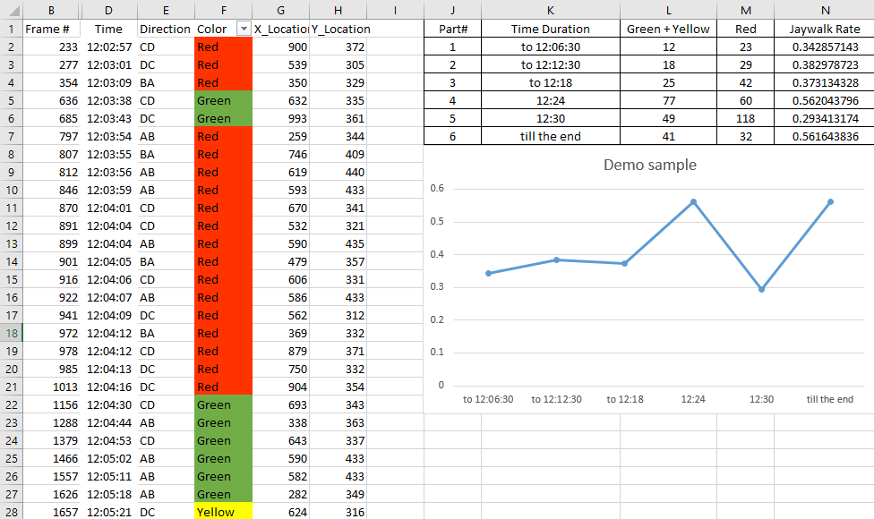
Notes:
You can see sample document about how to calculate jaywalk rate in my Github Repository.
After all the procedure, you can detect the jaywalking rates like I did. Thank you for your watching!

