Slide 1

Vivus Inc.
Dumitrescu Dragoș Haneș Camelia Mali Imre Gergely Leiti Dávid
Luca Alex Macarie Cristian Mălai Emil Perișanu David

Slide 2
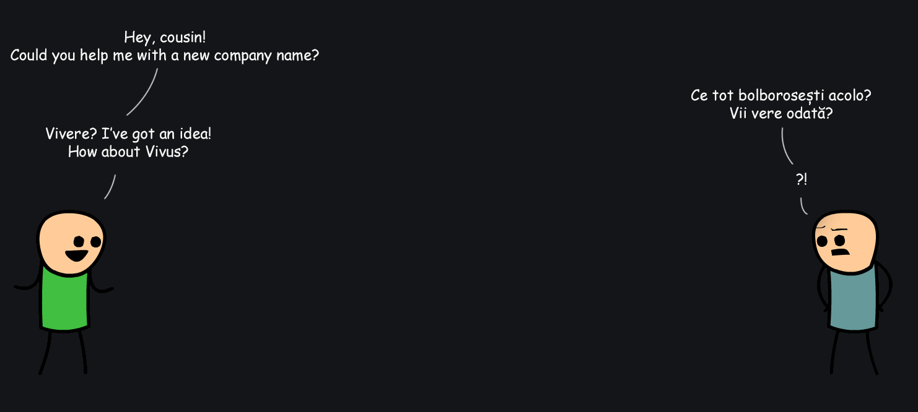
Why Vivus?

Slide 3
Short Problem Description
Develop a medical application which should
facilitate and encourage the whole blood
donation process

Slide 4
Project Solution
Desktop Application

Slide 5
Project Planning
5 Iterations

Slide 6
Project Planning
1st Iteration

Slide 7
Project Planning
2nd Iteration

Slide 8
Project Planning
3rd Iteration

Slide 9
Project Planning
4th Iteration

Slide 10
Project Planning
5th Iteration

Slide 11
Project Solution
Desktop Application

Slide 12
Project Solution
Technologies

Slide 13
Team organization
The Process

Slide 14
Team organization
Management Tools

Slide 15
Team organization
Other Tools

Slide 16
Learned Lessons
Communication

Slide 17
Learned Lessons
Time Management

Slide 18
Improvements Proposals
Application

Slide 19
Improvements Proposals
Laboratory

Slide 20
Demo

