Slide 1

Introduction to Intelligent, Cognitive and Knowledge-Based Systems
David Levin

Slide 2
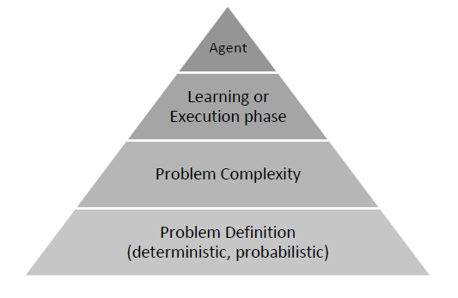
Architecture
01
Agent architecture is built along several steps:
Domain type (deterministic, probabilistic)
Approximation complexity of the problem
Learning or Executing

Slide 3
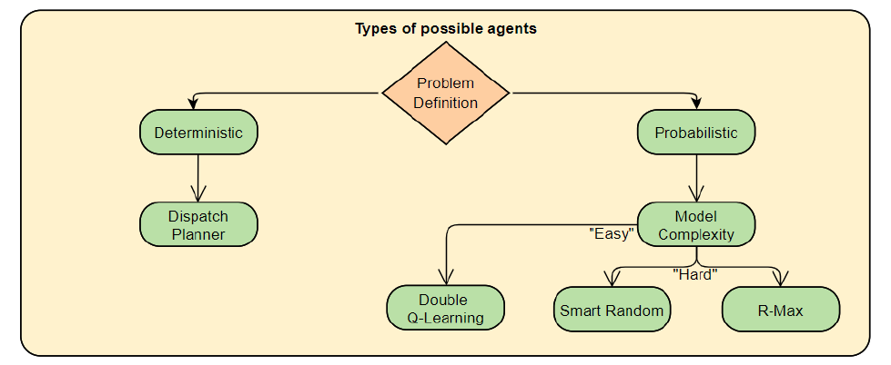
Learning & Execution
02
The agent's learning process will be characterized by the following:
Deterministic .vs. Probabilistic
Easy .vs. Hard
Reward function
Export the learning result
Multiprogramming
The agent’s execution process will be based on model type and whether the agent has performed learning for the given problem

Slide 4
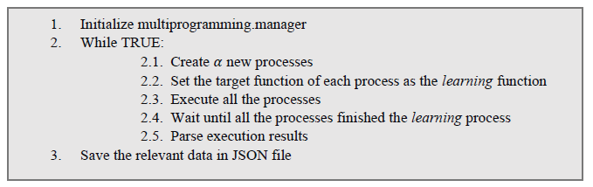
Multiprogramming Flow

Slide 5
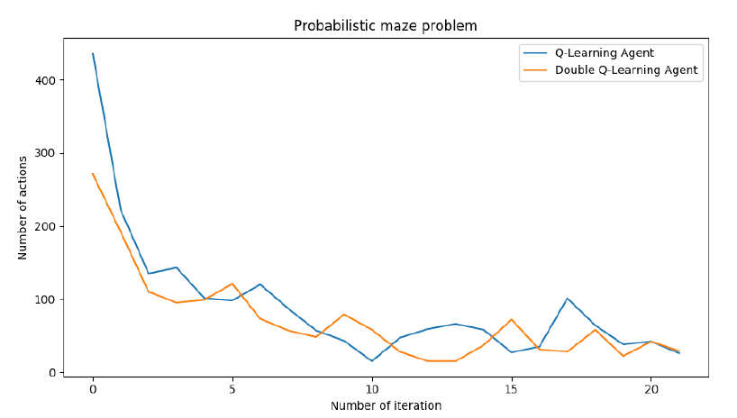
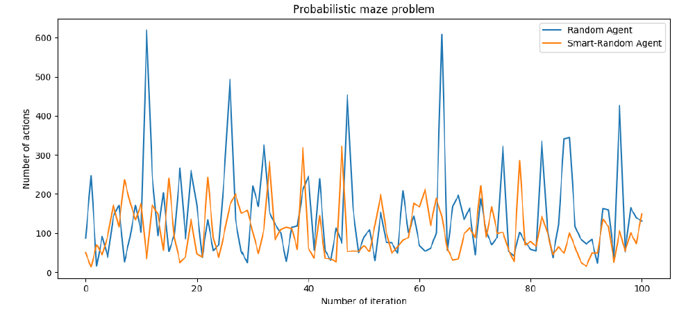
Performance Analysis
03
Vanilla Q-Learning .vs. Double Q-Learning
Avoid the past .vs. Random

