Slide 1
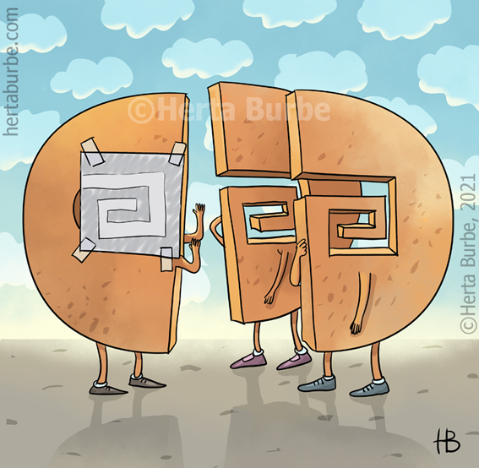
Connector

Slide 2
Picture

