Slide 1

Home Depot Product Search Relevance
David Lichacz
Springboard Capstone Project #1

Slide 2
The Problem
Build a model that can accurately predict the relevance of search results to create an improved customer experience.
Home Depot currently uses human raters to evaluate changes to their search algorithms
Attempt to minimize or remove the amount of human input leading to a faster and more accurate process.

Slide 3
The Data
Product Attributes: product id, name of attribute, value attribute
Product Description: product id, product description
Search Data: product id, name of product, search term, assigned relevance score (real number between 1 and 3)

Slide 4
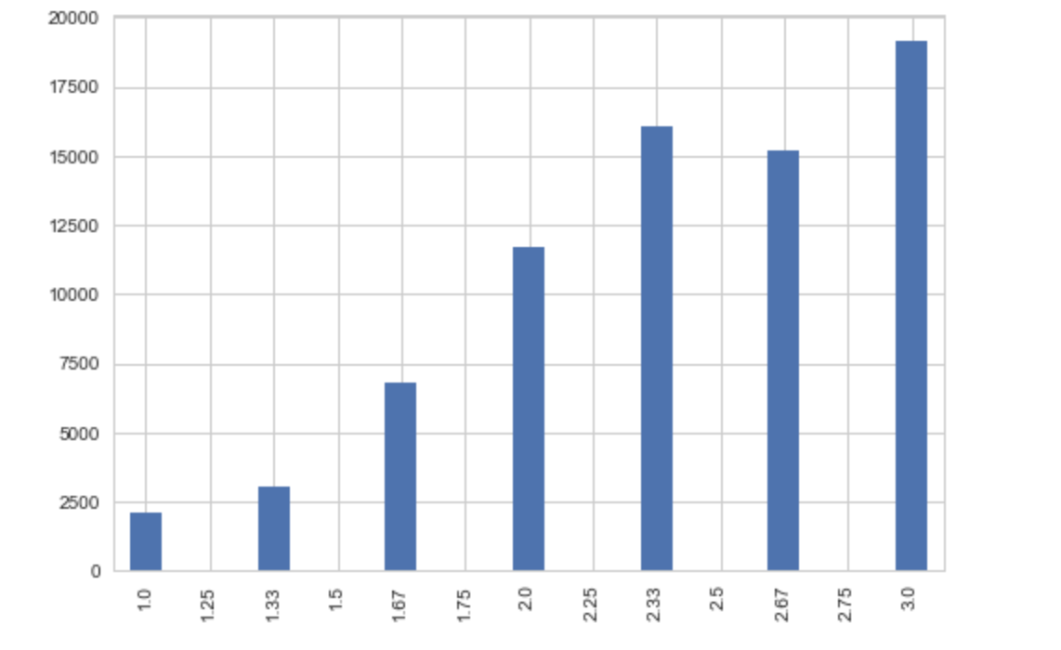
The Data
Distribution of Relevance Scores

Slide 5
Missing Values
Some entire rows were blank. These were deleted.
Some attribute values were missing. These were recoded as ‘None’.

Slide 6
Data Preparation
Master product dataframe constructed by merging id, title, description and concatenated attributes.
Stemming
Remove stop words

Slide 7
Generating Numerical Fields
Long text fields: Title, Description, Attributes
Percentage of search words in long text fields
Percentage of long text fields that contain search words
Total, average &maximum number of search words that appear in long text fields
Does search phrase appear in long text fields?

Slide 8
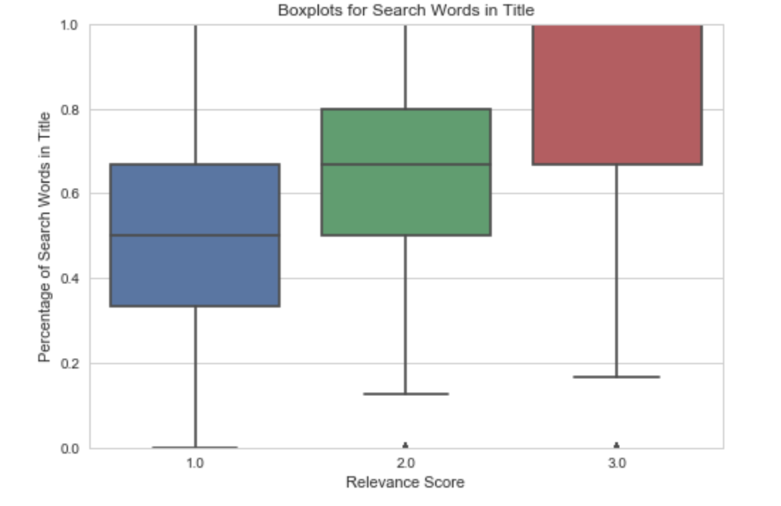
Exploratory Analysis

Slide 9
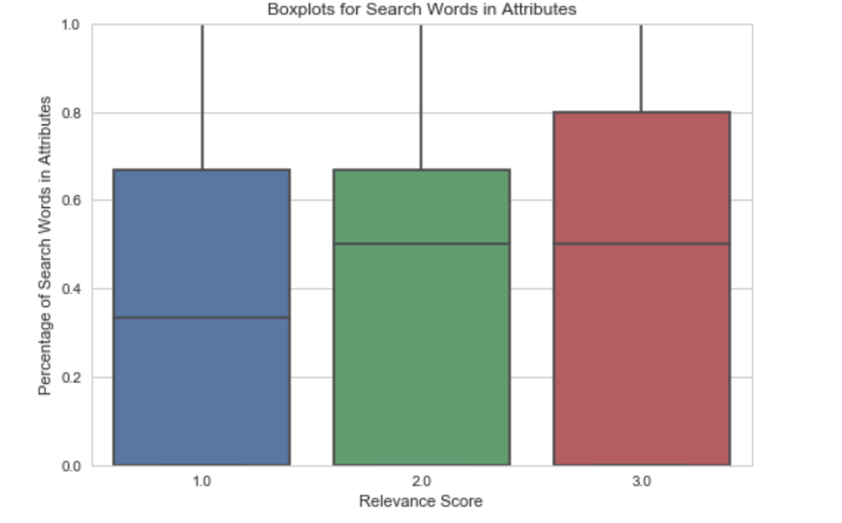
Exploratory Analysis

Slide 10
Exploratory Analysis

Slide 11
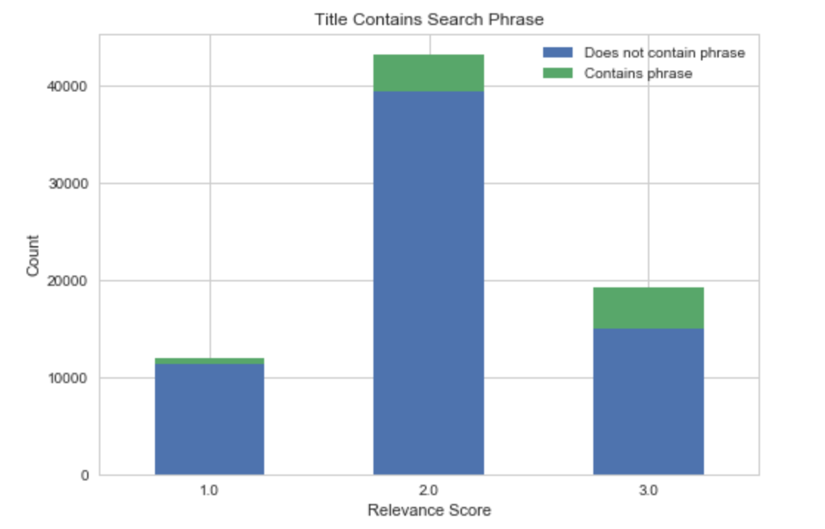
Exploratory Analysis

Slide 12
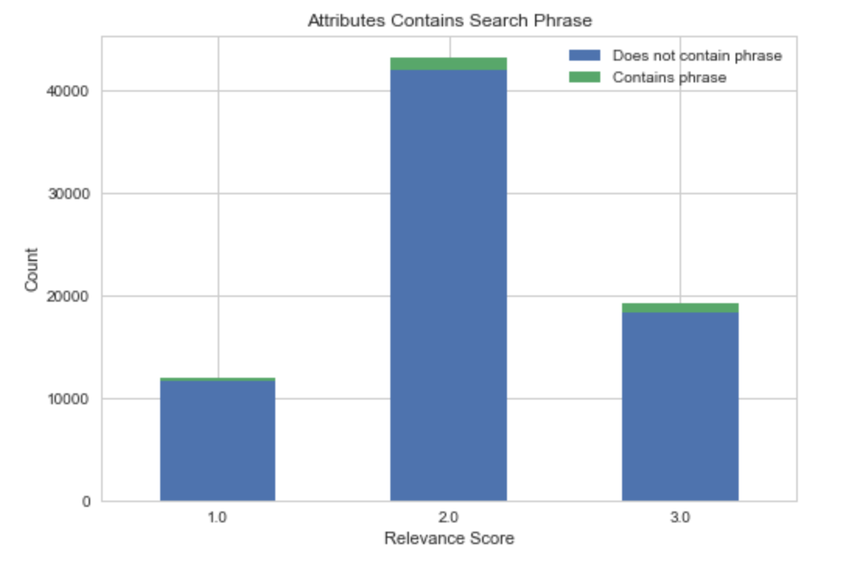
Exploratory Analysis

Slide 13
Machine Learning
Regression problem due to RSME being the metric
Regression algorithms tested: Linear, Lasso, Ridge, Random Forest, SVM
Pipeline: Scale variables, fit model, grid search cross validation to tune parameters.

Slide 14
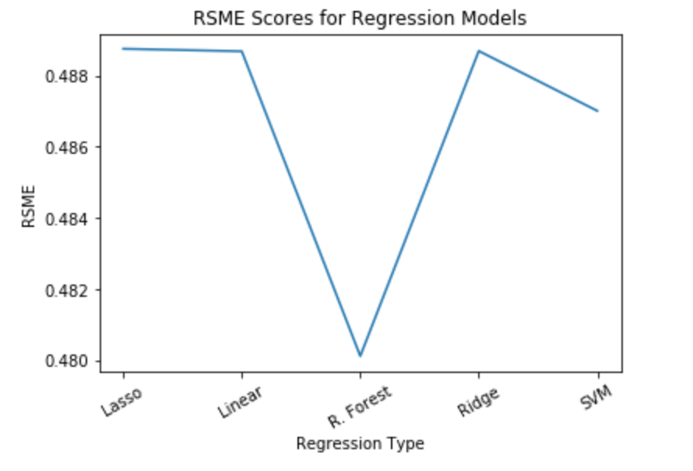
Machine Learning

Slide 15
Conclusion
Random Forest Regression model performed the best
Final Kaggle submission score was 0.48614
Results was consistent with those previously seen, so model translates well to new data

Slide 16
Next Steps
More thorough use of Natural Language Processing
Revisit the attributes data to extract more valuable information from it
Recommend a five or ten-point scale to measure relevance for greater flexibility

