Slide 1
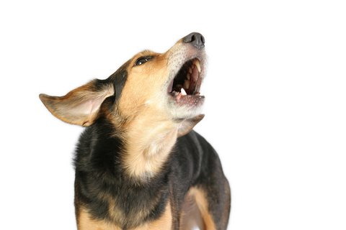
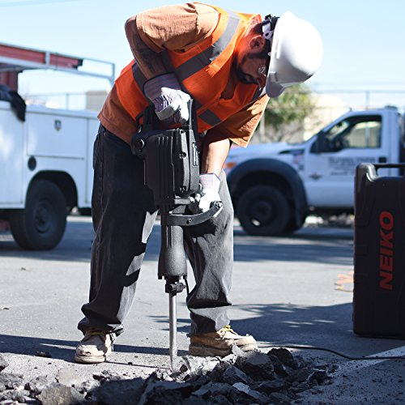

Urban Sound Classification

Slide 2
The Problem
The project will attempt to classify sound files of less than four seconds each into 10 classes of urban sounds, such as a dog barking or a car horn.

Slide 3
The Client
The fictional client is a home security company that wishes to build a more effective system for their clients that helps to anticipate problems in an attempt to prevent problems before they happen.

Slide 4
The Data
The data consists of 5435 .wav files of no more than four seconds in length. Each of these sounds is labeled with one of ten possible urban sounds.

Slide 5
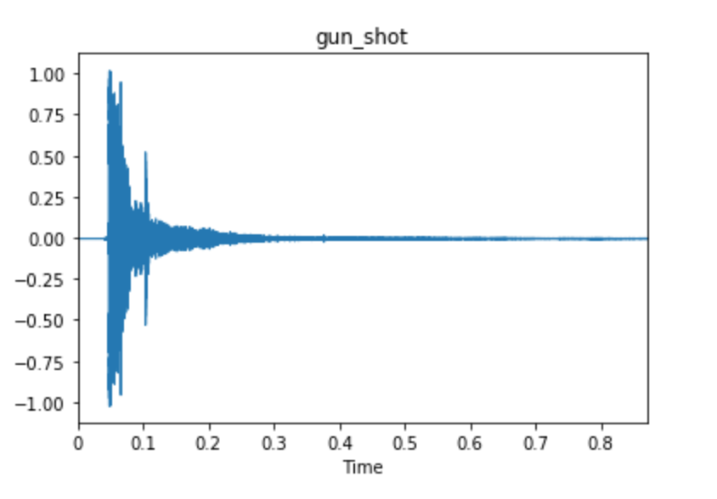
Exploratory Data Analysis

Slide 6
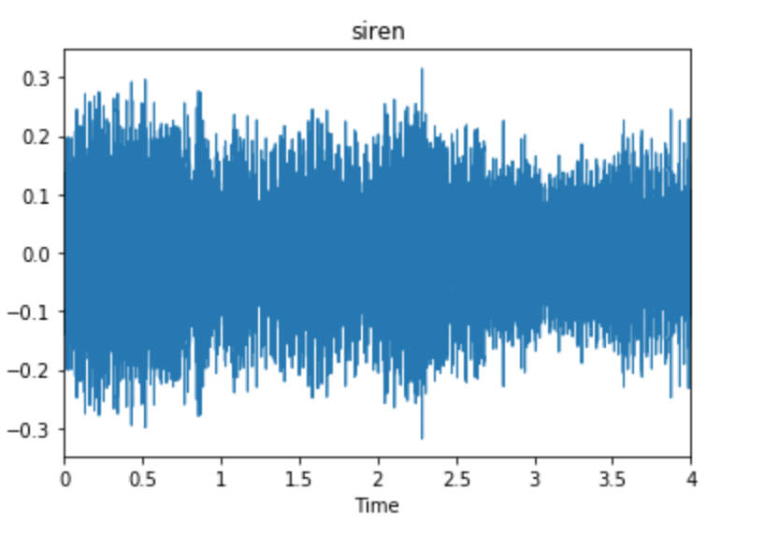
Exploratory Data Analysis

Slide 7
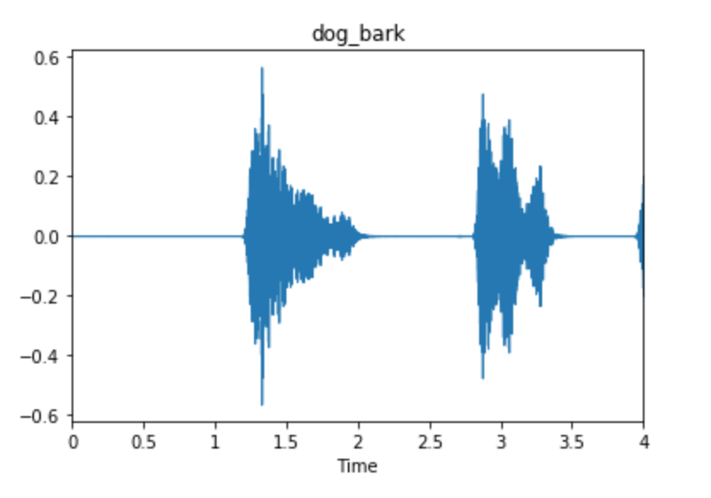
Exploratory Data Analysis

Slide 8
Features
Mel-frequency cepstrum coefficients
Chromagram
Mel-spectrogram
Spectral contrast
Tonnetz

Slide 9
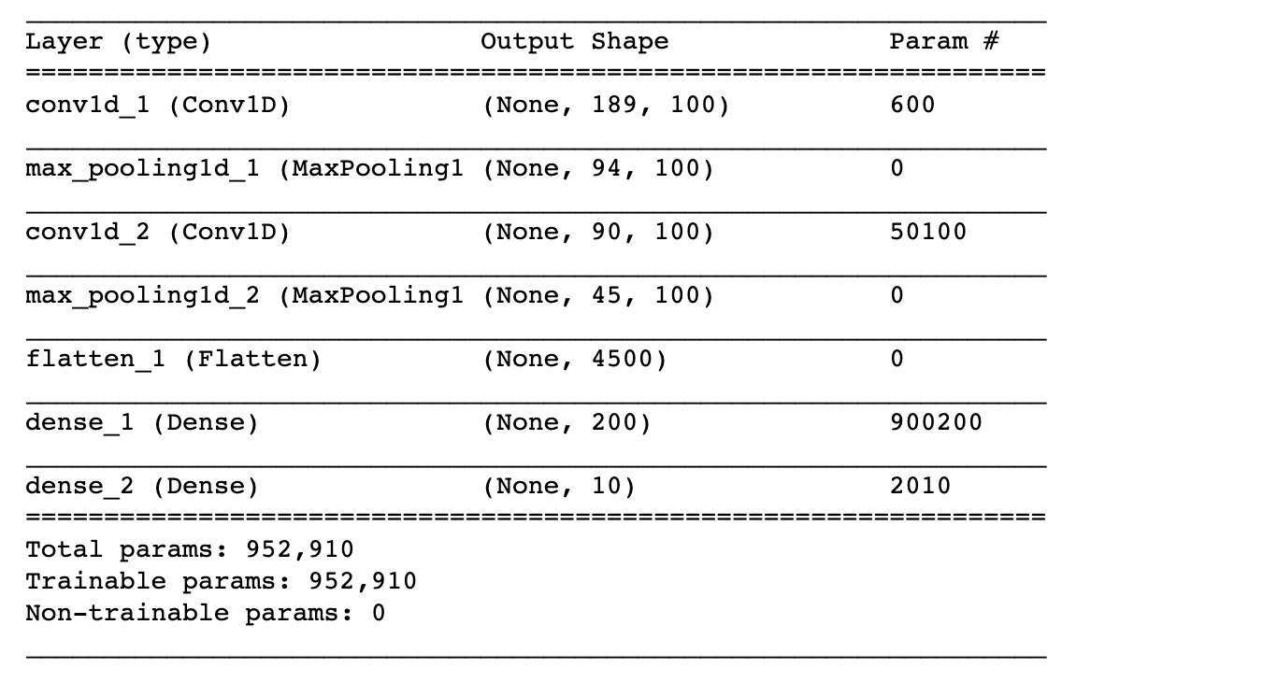
Machine Learning

Slide 10
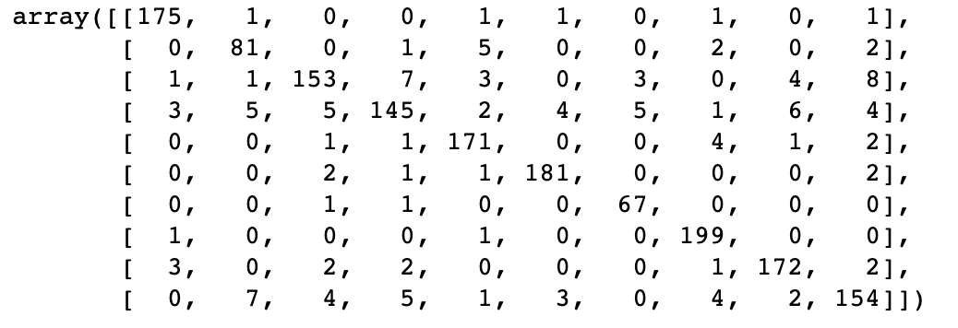
Machine Learning

Slide 11
Conclusions and Next Steps
91.9% accuracy with cross-validation
Extract different features
Better feature selection
Different neural network architectures

