Slide 1
Low-Dimensional Filamentary Structures
David Lieberman

Slide 2
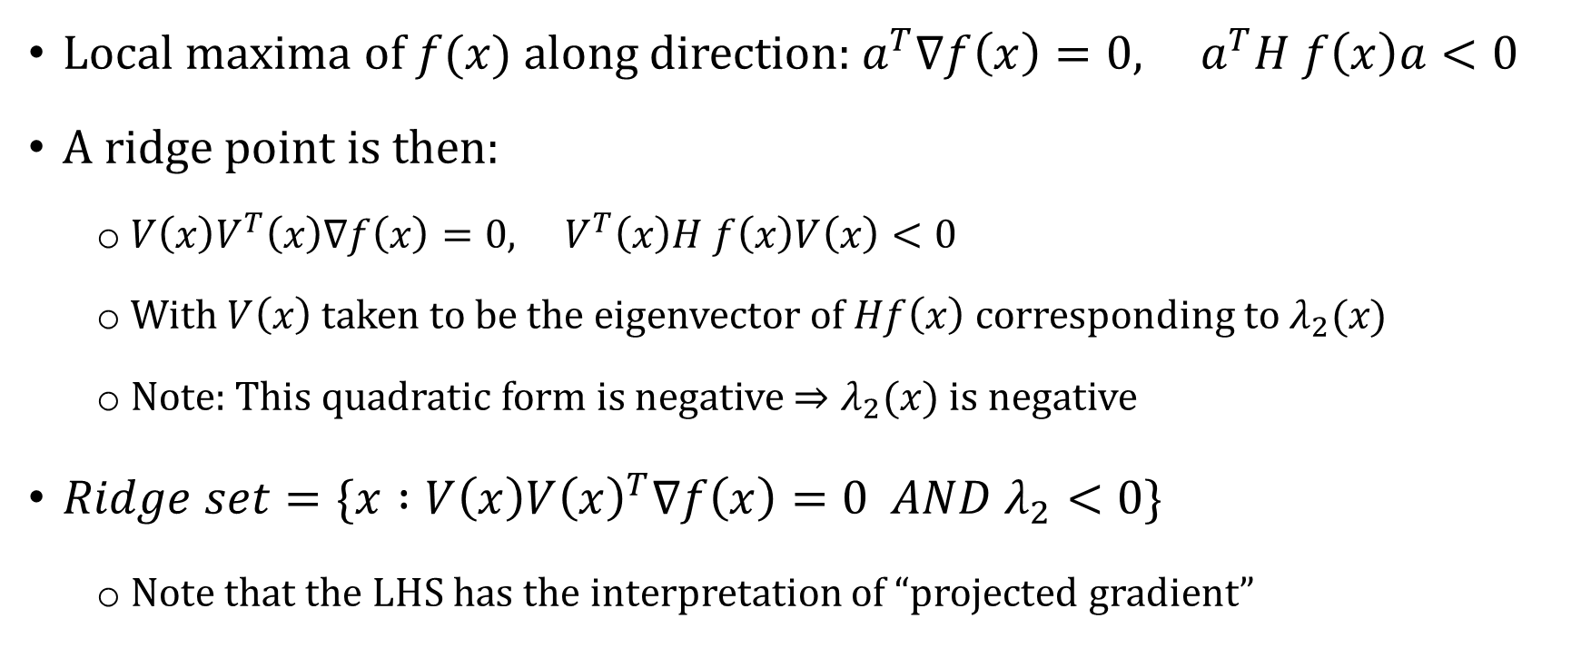
What is a ridge?
Local maxima of $f(x)$ along direction:${ a}^{T}∇f\left(x\right)=0, a^{T}H f\left(x\right)a<0$
A ridge point is then:
${V\left(x\right)V}^{T}\left(x\right)∇f\left(x\right)=0, V^{T}\left(x\right)H f\left(x\right)V\left(x\right)<0$
With $V\left(x\right)$taken to be the eigenvector of $Hf\left(x\right)$corresponding to $λ_{2}(x)$
Note: This quadratic form is negative $⇒λ_{2}(x)$ is negative
$Ridge set=\{x :V\left(x\right)V{\left(x\right)}^{T}∇f\left(x\right)=0 AND λ_{2}<0\}$
Note that the LHS has the interpretation of “projected gradient”

Slide 3
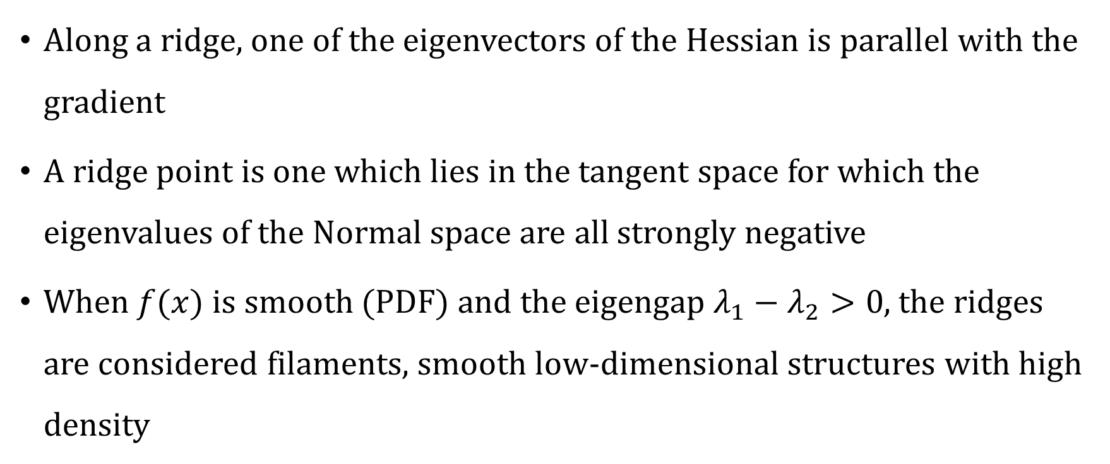
What is a filament?
Along a ridge, one of the eigenvectors of the Hessian is parallel with the gradient
A ridge point is one which lies in the tangent space for which the eigenvalues of the Normal space are all strongly negative
When $f(x)$ is smooth (PDF) and the eigengap $λ_{1}−λ_{2}>0$, the ridges are considered filaments, smooth low-dimensional structures with high density

Slide 4
Inspired by Clustering
Set of filament points is by construction are the local maxima points of the PDF
Similar to the likelihood maximization mean-shift algorithm widely used in clustering
Subject to the constraint that it is also a local maximum in the tangent space

Slide 5
Filament Estimation via KDE-SCMS(V2)
Step 1:
Compute the Kernel Density Estimator using the data
Ignore points in regions of low-density
Step 2:
Perform the subspace constrained mean-shift algorithm to converge to the local maxima, iteratively

Slide 6
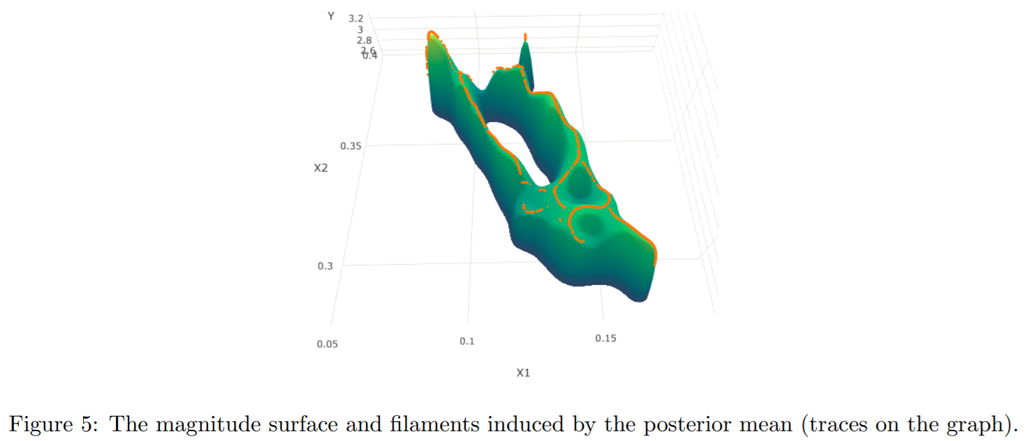
Bayesian Filament Estimation (Generalization)

Slide 7
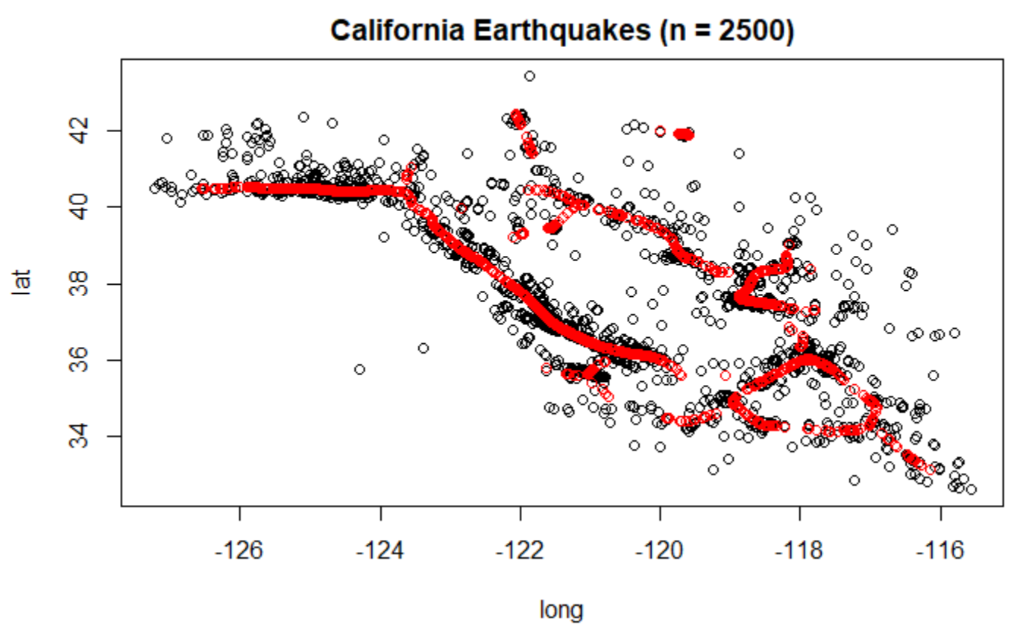
KDE-SMCS(V2) Replication
Bayesian
KDE-SMCS

Slide 8
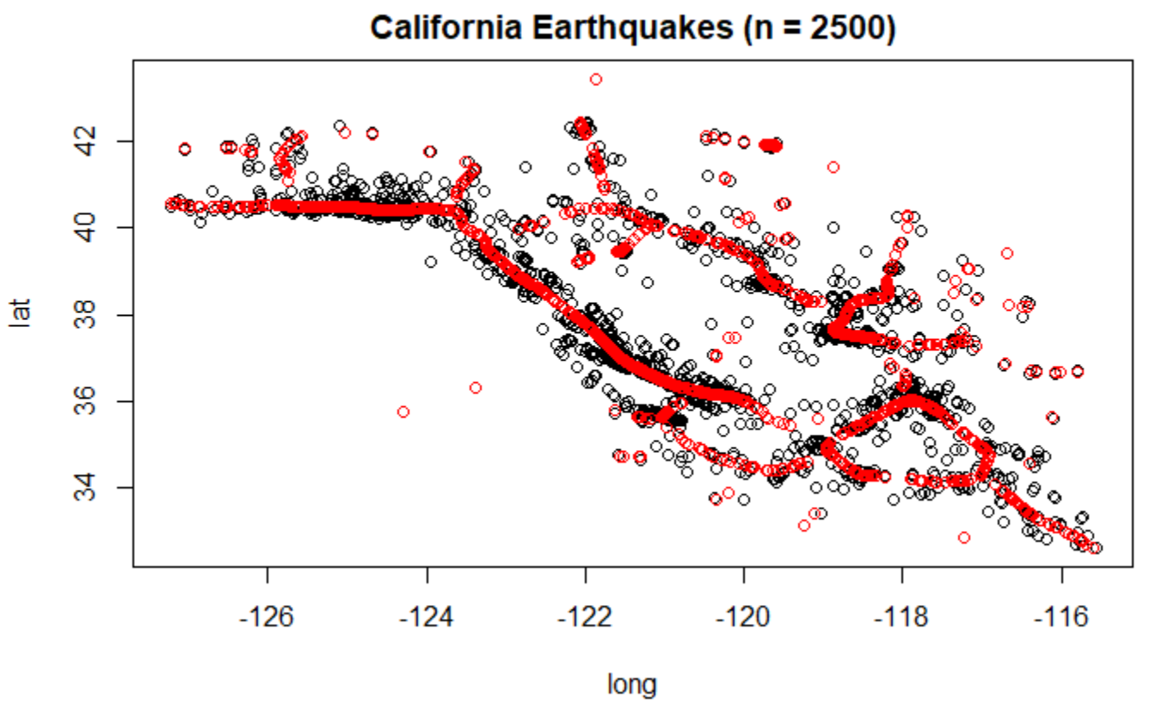
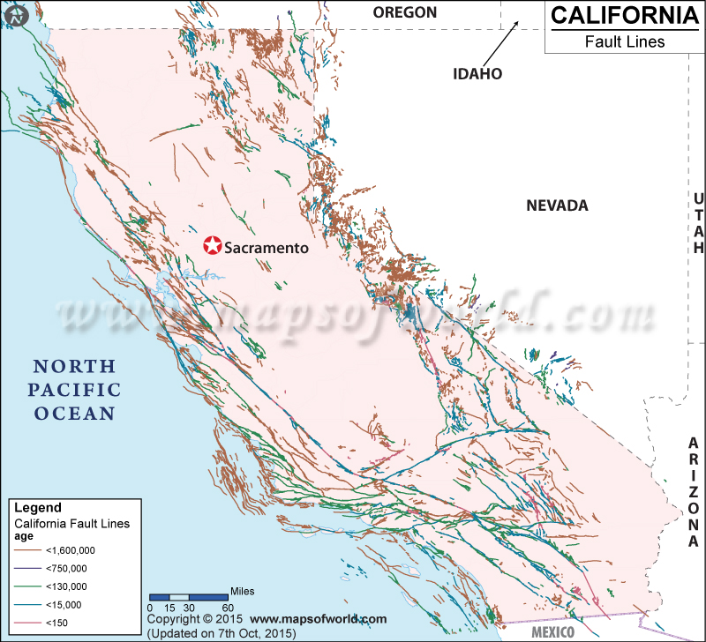
Effect of Denoising (V1 vs V2)
V1
Faults
V2

Slide 9
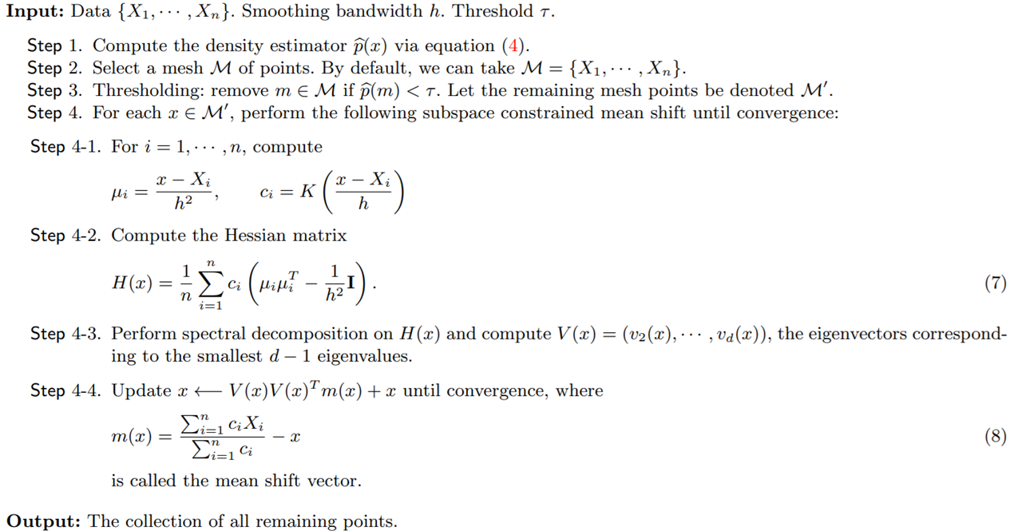
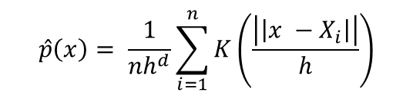
Algorithm Details
$$\hat{p}\left(x\right)= \frac{1}{nh^{d}}\sum_{i=1}^{n}{K\left(\frac{\left|\left|x −X_{i}\right|\right|}{h}\right)}$$

Slide 10
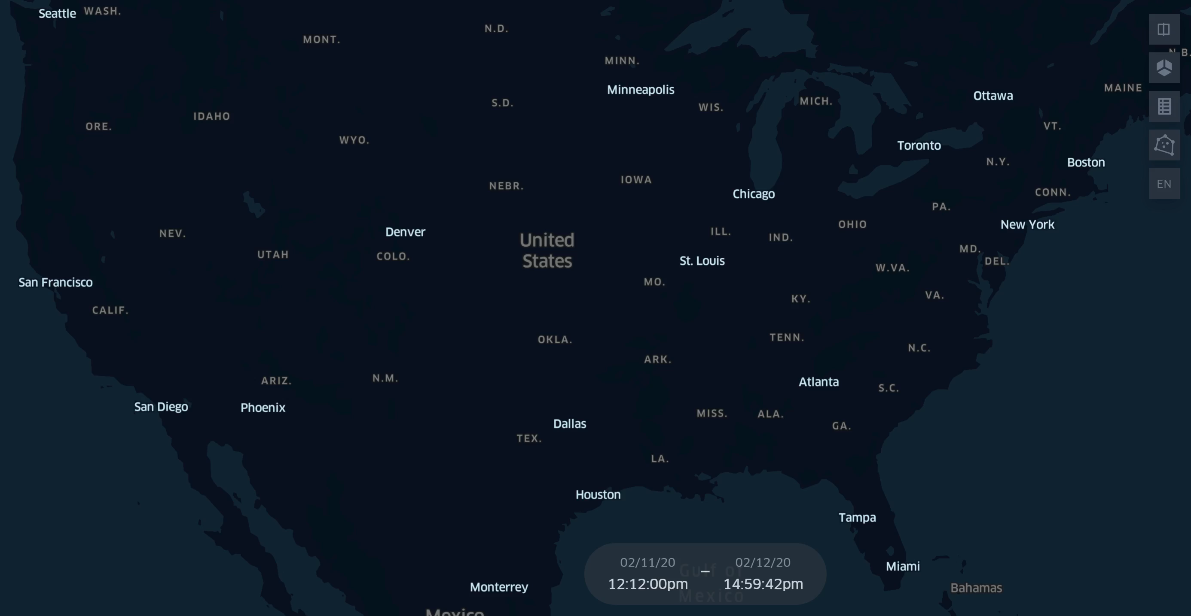
COVID Application
Map

Slide 11
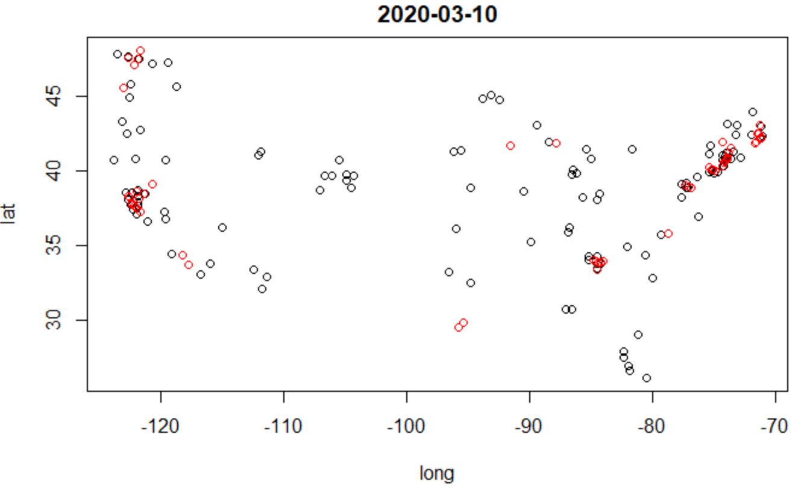
Preliminary Results

Slide 12
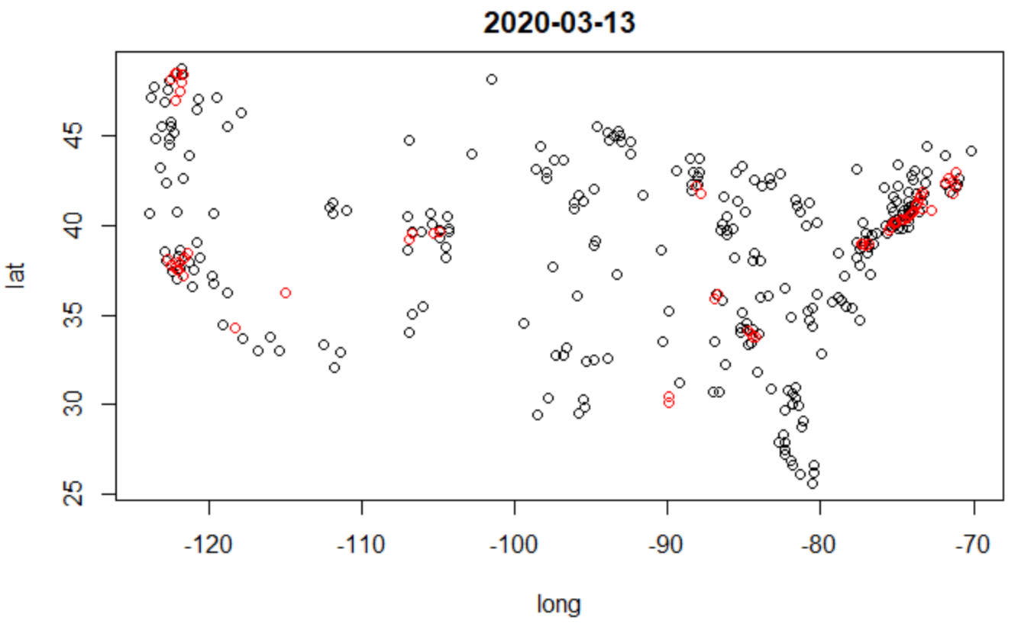
Preliminary Results

Slide 13
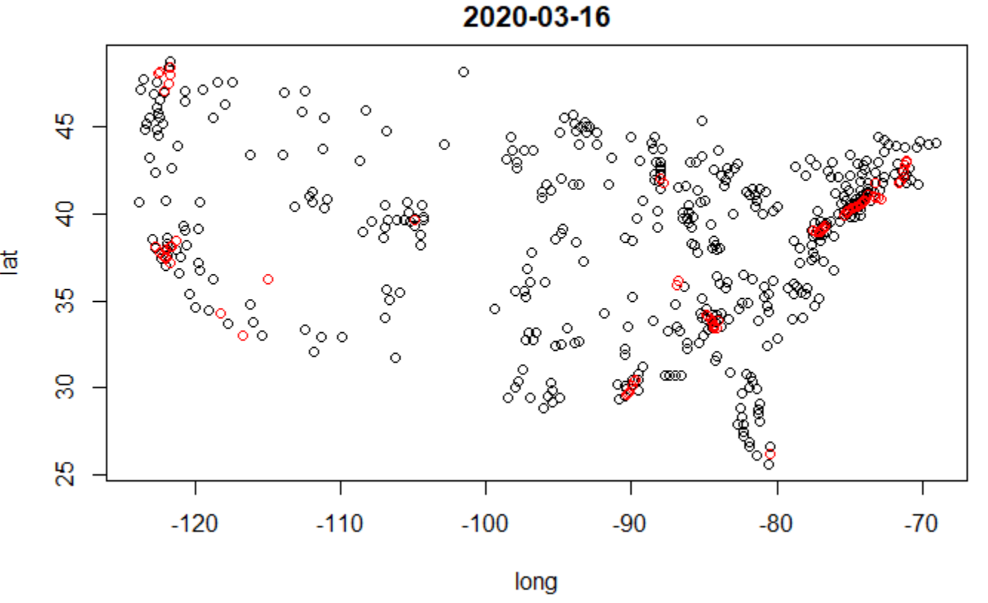
Preliminary Results

Slide 14
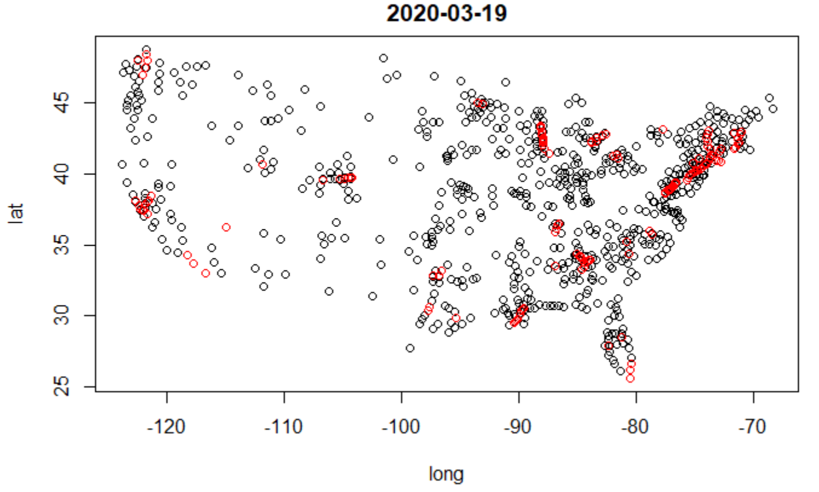
Preliminary Results

Slide 15
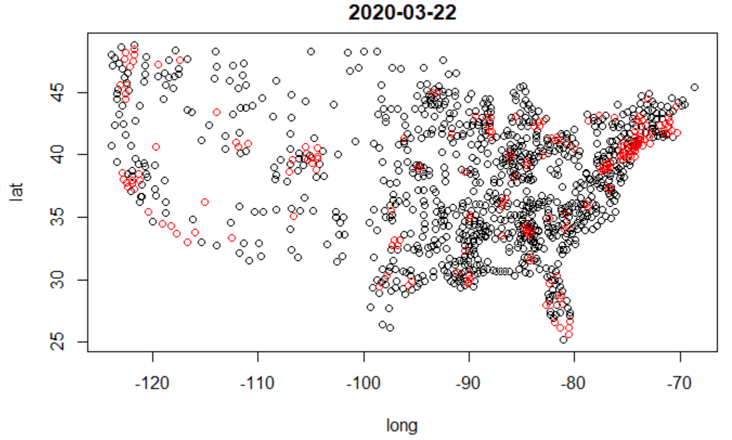
Preliminary Results

Slide 16
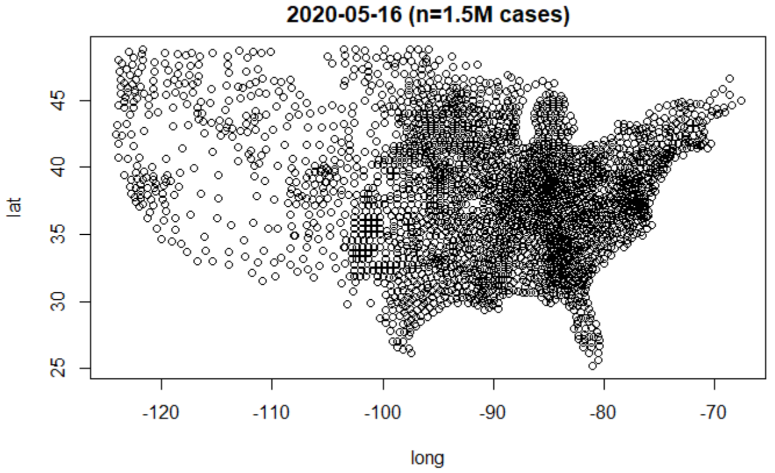
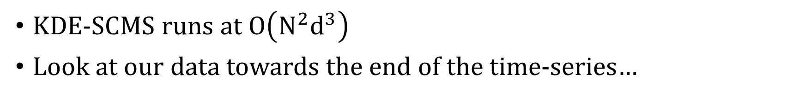
Problems!
KDE-SCMS runs at $O\left(N^{2}d^{3}\right)$
Look at our data towards the end of the time-series…

Slide 17
Solution Attempts
Radius Nearest Neighbors within 3*SD (approx. bandwidth) of point
Gaussian Kernel dies off quickly
Far points’ contributions are small
Improved runtime with indistinguishable impact on accuracy; not improved enough to run on >50K points
How COVID plots were generated on previous slides
KD-tree construction at every iteration is still too slow
Approximate Hierarchical Nearest Neighbor Implementation
Coming soon

Slide 18
Additional Solution Attempts
Potential Optimizations due to time series?
Pass previously converged filament as initial mesh; append a random sample of #(percent difference in size) points from new data
Good Initial Guess = Faster Convergence?
Yes, to an extent, but only reduced iterations ~15% (with caveats)
New problem, small errors compound in time

Slide 19
References
Cosmic Web Reconstruction through Density Ridges: Method and Algorithm
https://arxiv.org/abs/1501.05303v3
Locally Defined Principal Curves and Surfaces
https://dl.acm.org/doi/10.5555/1953048.2021041
Topological Data Analysis
https://www.annualreviews.org/doi/pdf/10.1146/annurev-statistics-031017-100045

