Slide 1
Building a Recommender System with Python
David Lim Cheng (X017427)
COMPSCI X433.3 - 005
Notes:
For my final project, I built a recommender system. The recommender system uses a dataset containing 1 million ratings from 6000 users on 4000 movies. What does this mean?
This means that I do not have a user rating from every user for every movie. My data is sparse.
So, we will use a recommender system to work with the existing data and make predictions on what new movies a certain user would like, based off of their user ratings
I chose this project because I’m always amazed at how accurate some recommendation systems are, especially the add recommendations on LinkedIn

Slide 2
Recommender Systems Overview
Content-Based Filtering
Uses information about the description and attributes of previously-consumed items
Candidate items are compared to previously-consumed items, and similarly-matched items are recommended
Collaborative Filtering
Makes predictions about user interests based on the interests of many users (collaborating)
If Person A has the same opinion as Person B on Item 1, then Person A is more likely to share Person B’s opinion for any given item
Notes:
There are two routes you can take when building a basic Recommender System:
A system built with content-based filtering, or
A system built with collaborative filtering
Content based filtering uses information about the description and attributes of previously-consumed items to match with similar new items, which are recommended to the user.
We’re going to be using Collaborative Filtering, which is why it’s in green. Collaborative Filtering (read bullets off slide)

Slide 3
Singular Value Decomposition (SVD)
Algorithm that leverages a latent factor model to capture similarities between users and items
Decreases dimensionality of the utility matrix by extracting latent factors
Given by the following equation:
R = M∑U^{T}
Where:
M is orthogonal to the column space of R,
U is orthonormal to the row space of R
Notes:
Alex mentioned this term on day one - SVD. SVD is the heart and soul of the recommendation system we will be going over today.
SVD is an algorithm that leverages a latent factor model to capture similarities between users and items
It decreases the dimensionality of the utility matrix by extractings its latent factors.
It’s given by the following equation, where M is orthogonal to the column space of R and U is orthonormal to the row space of R.
Everyone following along so far? Any questions?

Slide 4

Uhhhhhhh……………
Notes:
I am not a smart man. For me to understand something, I need it to be explained to me like a five year old. I don’t know what the heck orthonormal is.
But, it is important to understand the SVD algorithm, because it is the “meat” of the recommender system
So, since it is so integral to understanding how a RecSys is built, my goal for the rest of this presentation is to try to make SVD easier to understand

Slide 5

Latent Factors
“Algorithm that leverages a latent factor model to capture similarities between users and items”
Important part of Principal Component Analysis (PCA), a precursor to SVD
Another way to say “latent factors” is “typical traits”
Oversimplified example:
Our dataset is full of movies and user ratings
“Latent factors” or “typical traits” of movies: GENRE!
“45% Drama, 25% Action, 10% Comedy, 5% Thriller…”
Notes:
So, let’s revisit the first thing we said about SVD: It leverages a latent factor model to find similarities between users and items
Latent factors are an important part of Principal Component Analysis or PCA - a precursor to SVD
Another way to say “latent factors” is “typical traits”. Since we are working with movie recommendations, let’s use movies as an example.
When using PCA to reveal latent factors in a set of movies, an intuitive way to think about the latent factors is to think about them as the genres that make up the movie.
Take the movie Titanic, for example. Using PCA to reveal the latent factors (or typical traits) of Titanic, the latent factors may tell us that it is mostly a drama, but it has some action and comedy in it.
This is why they are called “latent”, because the traits were always there, we just needed PCA to reveal them.
I want to repeat the caveat that this is an OVERSIMPLIFICATION. In reality, we don’t know what the latent factors are. We are only talking about it in terms of genre because it is an intuitive example.

Slide 6

Latent Factors (Continued)
Oversimplified example:
Our dataset is full of movies and user ratings
“Latent factors” or “typical traits” of user ratings: AFFINITY TO GENRES
“50% Affinity for Drama, 25% Affinity for Comedy, 15% Affinity for True Crime…”
Notes:
What about the user ratings? What will PCA tell us about those?
Following our oversimplified example of latent factors being genres, principal component analysis on the user ratings will reveal that user’s affinity to different genres.
So if we run PCA on Cheryl, her latent factors will tell us that she has an affinity for dramas, comedies, and true crime documentaries.

Slide 7
“45% Drama
25% Action
10% Comedy
5% Thriller…”
“50% Affinity for Drama,
25% Affinity for Comedy,
15% Affinity for True Crime…”
SVD Says: “Bet that old lady likes Titanic!”
Notes:
So, we have the movie Titanic, which is mostly a Drama, but also has some action and a bit of comedy as well.
Cheryl here loves dramas, and likes comedies as well.
So, SVD will tell us that Cheryl would love Titanic

Slide 8
Matrix Factorization
“Decreases dimensionality of the utility matrix”
Analogy: Polynomial Factorization
X² - 4 → (x - 2)(x + 2)
Took one item, and simplified it by turning it into two items
We can rebuild the original term using the simplified terms
Matrix Factorization is the same thing
Matrix → (Vector)(Vector)(Vector)
Took one item, and simplified it by turning it into three items
We can rebuild the original matrix using the simplified vectors
Matrix = (Vector)(Vector)(Vector)
R = M∑U^{T}
Notes:
So, now we know what latent factors are. Let’s look at the next trait of SVD that we mentioned: it “decreases the dimensionality of the utility matrix
What does it mean to decrease the dimensionality of a matrix? In plain english, it means to simplify it. To better explain this, let’s use some precalculus. We all remember these kind of problems.
We have a polynomial x^2-4, and we simplify it by factoring it into two simpler terms. We “decreased the dimensionality” of x from x^2 to x.
Matrix factorization is the same thing. We take one matrix, and reduce its complexity by simplifying it into multiple vectors. If we multiply the vectors together, we’ll reassemble the original matrix.
This is the heart of SVD.
The important thing to takeaway here is that we are essentially applying SVD to a dataset to reveal its latent factors, and using those latent factors to rebuild a prediction matrix.

Slide 9
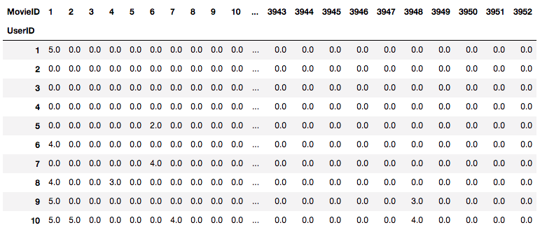
Matrix Factorization (Continued)
“Decreases dimensionality of the utility matrix”
Notes:
What the hell is a utility matrix?
Well, for our dataset, it is simply a matrix in which the rows are users, and the columns are movies. Each (row, column) value is the user rating for that particular movie.
You can see that I have some values filled in here, but most of the movies have not yet been rated by the users.

Slide 10
Recap
Reveal the latent factors of both the movies and the users using SVD
Rebuild the utility matrix using these latent factors
Use the rebuilt matrix to make predictions of what movies would receive a high rating for a particular user
Notes:
So, let’s recap our extremely simplified crash course of SVD. To built our recommender system,
We will reveal the latent factors of both the movies and the users, using SVD
We will rebuild the utility matrix using these latent factors
Using the rebuilt matrix, we will make predictions on what movie a user might like
So, what did we do today? We went from this... (next slide)

Slide 11

Notes:
To this…(next slide)

Slide 12

“SVD? Yeahhhh, baby!”

