Slide 1
APIs
Restful api | flask | cloud

Slide 2
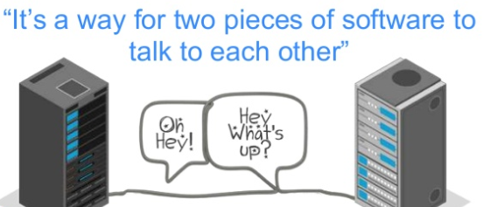
Application Programming Interface

Slide 3
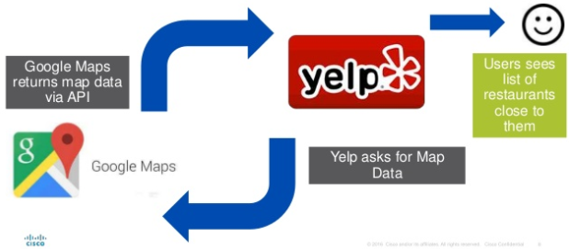
APIs – developers ←→user

Slide 4
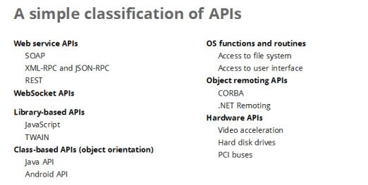
Types of API

Slide 5
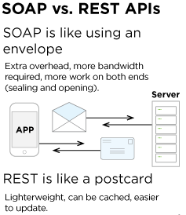
In a nutshell

Slide 6
So what is REST API?
A REST API defines a set of functions which developers can perform requests and receive responses via HTTP protocol such as GET and POST
In simple words – REST is a way to talk to other machines through the server with an HTTP protocol
Using actions and items

Slide 7
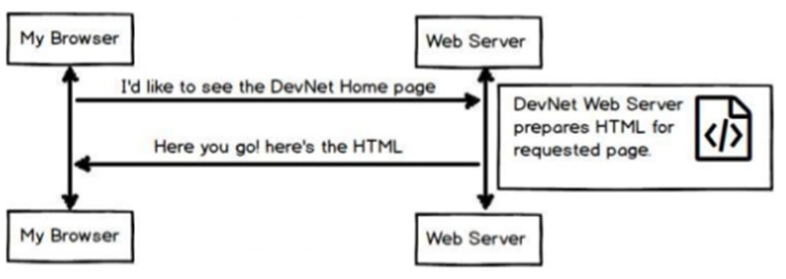

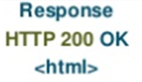
If you want to view a web page

Slide 8
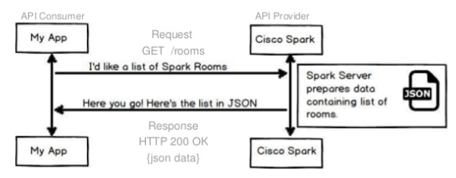
Similarly 2 Apps can talk to each other

Slide 9
REST
REpresentational State Transfer
It represents the state of the database at a time
REST is based on HTTP Protocol
Everything in REST is called a resource
Resources are accessed via a common interface based on HTTP standards
REST server provides access to the resources
REST client accesses and modifies the resources
It leverages lesser bandwidth and hence makes the application more suitable for the internet

Slide 10
What?
REST suggests to create an object of the data requested by the client and send the values of the object in response to the user.
For example, if the user is requesting for a movie in Victoria at a certain place and time, then you can create an object on the server-side.
So, over here, you have an object and you are sending the state of an object. This is why REST is known as Representational State Transfer.

Slide 11
Simple Example
REST is a design pattern.
It is an approach to creating Web Services.
Let’s create our own Airline Reservation System – Light-Air

Slide 12
Example
We want to create a telephone reservation system for customers to call in and make flight reservations.
Ensure that its premier members get immediate service, its frequent flyer members get expedited service and all others get regular service.
There are two main approaches to implementing the reservation service.

Slide 13
Approach 1
"Press 1 for Premier, Press 2 for…“
The airline provides a single telephone number. Upon entry into the system a customer encounters an automated message, "Press 1 if you are a premier member, press 2 if you are a frequent flyer, press 3 for all others."
Premier
Customer
Representative
Premier Members
Answering
Machine
F.F.
Customer
Representative
Airline Reservations
Frequent Flyer Members
Regular
Customer
Representative

Slide 14
Approach 2
The airline provides several telephone numbers - one number for premier members, a different number for frequent flyers, and still another for regular customers.
Premier
Customer
Representative
1-800-Premier
Premier Members
F.F.
Customer
Representative
1-800-Frequent
Frequent Flyer Members
Regular
Customer
Representative
1-800-Reservation
Regular Members

Slide 15
Comments
In Approach 1 the answering machine introduces an extra delay, which is particularly annoying to premier members. (Doesn't everyone hate those answering systems)
With Approach 2 there is no intermediate step. Premier members get instant pickup from a customer service representative. Others may have to wait for an operator.

Slide 16
Web Based Reservation System
Who uses phones in 2020?
Just as with the telephone service, the airline wants to ensure that its premier members get immediate service, its frequent flyer members get expedited service, all others get regular service.
There are two main approaches to implementing the Web reservation service. The approaches are analogous to the telephone service.

Slide 17
Approach 1
The airline provides a single URL. The Web service is responsible for examining incoming client requests to determine their priority and process them accordingly.
client
Premier Members
Premier
Customer
Web
Reservation
Service
Determine
Priority
F.F.
Customer
client
Frequent Flyer Members
Regular
Customer
client
Regular Members

Slide 18
Disadvantages
There is currently no industry accepted practice (rules) for expressing priorities, so rules would need to be made. The clients must learn the rule, and the Web service application must be written to understand the rule.
This approach is based upon the incorrect assumption that a URL is "expensive" and that their use must be rationed.
The Web service is a central point of failure. It is a bottleneck. Load balancing is a challenge.
It violates Tim Berners-Lee Web Design, Axiom 0.

Slide 19
Axiom 0
Axiom 0: all resources on the Web must be uniquely identified with a URI.
URL1
resource1
URL2
resource2
URL3
resource3

Slide 20
Approach 2
The airline provides several URLs - one URL for premier members, a different URL for frequent flyers, and still another for regular customers.
Premier
Member
Reservation
Service
http://www.light-air/reservations/premier
client
Premier Members
Frequent
Flyer
Reservation
Service
http://www.light-air/reservations/frequent-flyer
client
Frequent Flyer Members
Regular
Member
Reservation
Service
http://www.light-air/reservations/regular
client
Regular Members

Slide 21
Advantages of Approach 2
The different URLs are discoverable by search engines.
It's easy to understand what each service does simply by examining the URL, i.e., it exploits the Principle of Least Surprise.
There is no need to introduce rules. Priorities are elevated to the level of a URL. "What you see is what you get."
It's easy to implement high priority - simply assign a fast machine at the premier member URL.
There is no bottleneck. There is no central point of failure.
Consistent with Axiom 0.

Slide 22
Which one is REST?
Premier
Customer
Representative
Premier Members
Answering
Machine
F.F.
Customer
Representative
Airline Reservation
Frequent Flyer Members
Regular
Customer
Representative
Regular Members

Slide 23
Which one is REST?
Premier
Customer
Representative
1-800-Premier
Premier Members
F.F.
Customer
Representative
1-800-Frequent
Frequent Flyer Members
Regular
Customer
Representative
1-800-Reservation
Regular Members

Slide 24
Which one is REST?
client
Premier Members
Premier
Customer
Reservation
Web
Service
Determine
Priority
F.F.
Customer
client
Frequent Flyer Members
Regular
Customer
client
Regular Members

Slide 25
Which one is REST?
Premier
Member
Reservation
Service
http://www.light-air/reservations/premier
client
Premier Members
Frequent
Flyer
Reservation
Service
http://www.light-air/reservations/frequent-flyer
client
Frequent Flyer Members
Regular
Member
Reservation
Service
http://www.light-air/reservations/regular
client
Regular Members

Slide 26
REST is a design pattern
Resources
Every distinguishable entity is a resource. A resource may be a Web site, an HTML page, an XML document, a Web service, a physical device, etc.
URLs Identify Resources
Every resource is uniquely identified by a URL. This is Tim Berners-Lee Web Design, Axiom 0.

Slide 27
Why do we need REST?
Consider a scenario where you are using an app to book movie tickets.
Now, obviously, this application needs a lot of Input data, as the data present in the application is never static. Either it is movies getting released on a frequent basis, or various cities showing different languages movies at various times of the day. It’s never static which implies the fact that data is always changing in these applications.
Now, where do you think we get this data from?
Well, this data is received from the Server or most commonly known as a Web-server. So, the client requests the server for the required information, via an API, and then, the server sends a response to the client.
Over here, the response sent to the client is in the form of an HTML Web Page. But, do you think this is an apt response that you would expect when you send a request?

Slide 28
Why do we need REST?
You would prefer the data to be returned in the form of a structured format, rather than the complete Web page.
So, for such reasons, the data returned by the server, in response to the request of the client is either in the format of JSON or XML. Both JSON and XML formats have a proper hierarchical structure of data.
Now, this sounds quite simple, right?
But, the only issue which is present in this framework until now is that you have to use a lot of methods to get the required information. To the fact, using these methods to retrieve information, becomes quite cumbersome when you require complex data.
So, this is where REST API comes into the picture. The REST API creates an object, and thereafter sends the values of an object in response to the client. It breaks down a transaction in order to create small modules. Now, each of these modules is used to address a specific part of the transaction. This approach provides more flexibility but requires a lot of effort to be built from the very scratch.

Slide 29
Principles of REST API
Stateless
The requests sent from a client to a server will contain all the required information to make the server understand the requests sent from the client.
This can be either a part of URL, query-string parameters, body, or even headers.
The URL is used to uniquely identify the resource and the body holds the state of the requesting resource.
Once the server processes the request, a response is sent to the client through body, status or headers

Slide 30
Principles of REST API
Client-Server
The client-server architecture enables a uniform interface and separates clients from the servers.
This enhances the portability across multiple platforms as well as the scalability of the server components.

Slide 31
Principles of REST API
Uniform Interface
To obtain the uniformity throughout the application, REST has the following four interface constraints:
Resource identification
Resource Manipulation using representations
Self-descriptive messages
Hypermedia as the engine of application state

Slide 32
Principles of REST API
Cacheable
In order to provide a better performance, the applications are often made cacheable.
This is done by labeling the response from the server as cacheable or non-cacheable either implicitly or explicitly.
If the response is defined as cacheable, then the client cache can reuse the response data for equivalent responses in the future.

Slide 33
Principles of REST API
Layered system
The layered system architecture allows an application to be more stable by limiting component behavior.
This type of architecture helps in enhancing the application’s security as components in each layer cannot interact beyond the next immediate layer they are in.
Also, it enables load balancing and provides shared caches for promoting scalability.

Slide 34
Principles of REST API
Code on demand
This is an optional constraint and is used the least.
It permits a clients code or applets to be downloaded and to be used within the application.
In essence, it simplifies the clients by creating a smart application which doesn’t rely on its own code structure.

Slide 35
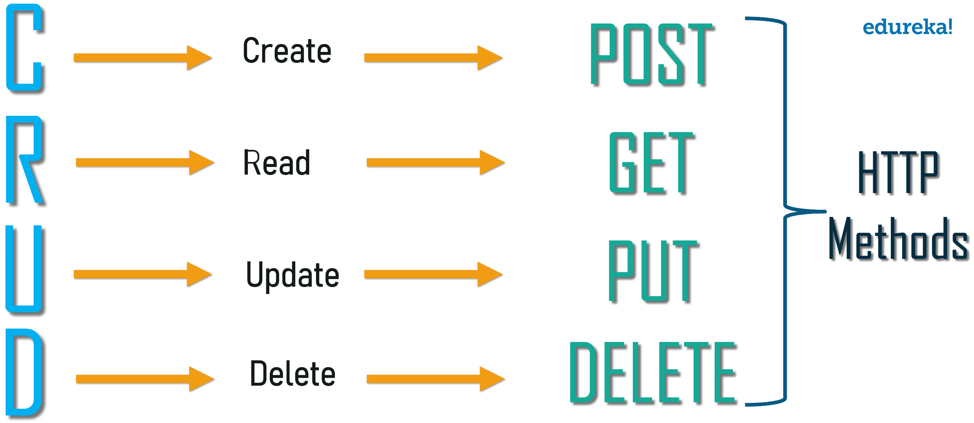
REST Methods

Slide 36
Tmux
Terminal Multiplexer
Within one terminal window you can open multiple windows and split-views (called “panes” in tmux lingo)
Each pane will contain its own, independently running terminal instance. This allows you to have multiple terminal commands and applications running visually next to each other without the need to open multiple terminal emulator windows.
On top of that tmux keeps these windows and panes in a session. You can exit a session at any point. This is called “detaching”. tmux will keep this session alive until you kill the tmux server (e.g. when you reboot)². This is incredibly useful because at any later point in time you can pick that session up exactly from where you left it by simply “attaching” to that session.

Slide 37
Why is it important?
When you lose your ssh connection the tmux session will simply be detached but will keep running on the server in the background including all the processes that run within your session.
To continue your session simply ssh to the server again and attach to the running session.
But tmux is not only helpful when working on a remote machine.
Start a new session for a new task and attach to the old session whenever you want to continue with the old task.
https://www.hamvocke.com/blog/a-quick-and-easy-guide-to-tmux/

Slide 38
Create API from Python
https://medium.com/quick-code/absolute-beginners-guide-to-slaying-apis-using-python-7b380dc82236

Slide 39
Flask
A web service development framework in Python.
It is not the only one in Python, there are a few others as well such as Django, Falcon, Hug, etc.
Flask creates REST API
Flask framework comes with an inbuilt light-weighted web server which needs minimal configuration, and it can be controlled from your Python code. This is one of the reasons why it is so popular.

Slide 40
Essentially …
3 files needed for API
1. Modeling file (Can be Jupyter)
2. Loader file that restores the saved model and makes predictions (cannot be Jupyter)
3. Controller / Predictor file that runs the command from Flask (Cannot be Jupyter)
Default is port 5000. Sometimes the client provides port number to be hosted on.
Integration by front end developer is a must.

Slide 41
Try this…
https://www.datacamp.com/community/tutorials/machine-learning-models-api-python

Slide 42
Questions?
Thank you!

