Slide 1
Time Series II
Time Series → Supervised learning | FB Prophet | Deep Learning

Slide 2
FB Prophet
Classical time series forecasting techniques build on stats models which requires lots of effort to tune models and expect in data and industry.
The person has to tune the parameters of the method with regards to the specific problem when a forecasting model doesn’t perform as expected.
Tuning these methods requires a thorough understanding of how the underlying time series models work.
It’s difficult for some organizations to handling those forecasting without data science teams.
And it might seem doesn’t profitable for an organization to have a bunch of expects on board if there is no need a build a complex forecasting platform or other services.

Slide 3
FB Prophet
Facebook developed an open sourcing Prophet, a forecasting tool available in both Python and R.
It provides intuitive parameters which are easy to tune.
Even someone who lacks deep expertise in time-series forecasting models can use this to generate meaningful predictions for a variety of problems in business scenarios.

Slide 4
FB Prophet
“ Producing high quality forecasts is not an easy problem for either machines or for most analysts. We have observed two main themes in the practice of creating a variety of business forecasts:
Completely automatic forecasting techniques can be brittle and they are often too inflexible to incorporate useful assumptions or heuristics.
Analysts who can product high quality forecasts are quite rare because forecasting is a specialized data science skill requiring substantial experience. ”

Slide 5
Prophet’s Highlights
Very fast, since it’s built in Stan, a programming language for statistical inference written in C++.
An additive regression model where non-linear trends are fit with yearly, weekly, and daily seasonality, plus holiday effects:
1. A piecewise linear or logistic growth curve trend. Prophet automatically detects changes in trends by selecting change points from the data
2. A yearly seasonal component modeled using Fourier series
3. A weekly seasonal component using dummy variables
4. A user-provided list of important holidays.
Robust to missing data and shifts in the trend, and typically handles outliers .
Easy procedure to tweak and adjust forecast while adding domain knowledge or business insights.

Slide 6
Prophet Forecasting Model
The Prophet uses a decomposable time series model with three main model components: trend, seasonality, and holidays. They are combined in the following equation:
y(t)= g(t) + s(t) + h(t) + εt
g(t): piecewise linear or logistic growth curve for modeling non-periodic changes in time series
s(t): periodic changes (e.g. weekly/yearly seasonality)
h(t): effects of holidays (user provided) with irregular schedules
εt: error term accounts for any unusual changes not accommodated by the model

Slide 7
Hands on
https://towardsdatascience.com/a-quick-start-of-time-series-forecasting-with-a-practical-example-using-fb-prophet-31c4447a2274
https://www.digitalocean.com/community/tutorials/a-guide-to-time-series-forecasting-with-prophet-in-python-3

Slide 8
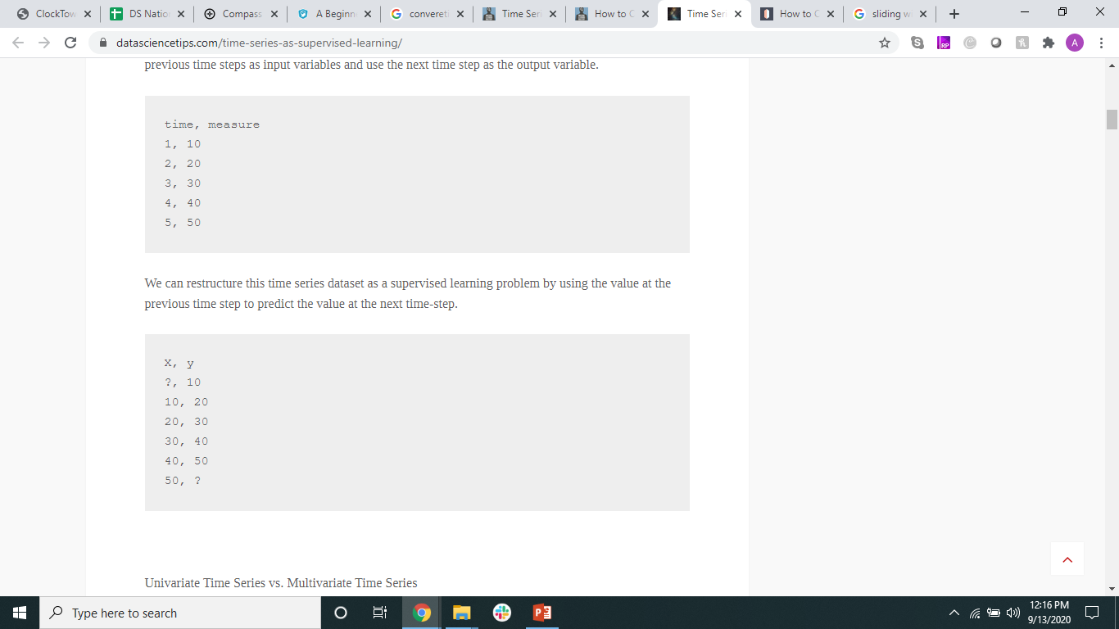
Converting TS to Supervised Learning
Machine learning methods like deep learning can be used for time series forecasting.
Before machine learning can be used, time series forecasting problems must be re-framed as supervised learning problems. From a sequence to pairs of input and output sequences.
Sliding Windows Technique

Slide 9
What?
Given a sequence of numbers for a time series dataset, we can restructure the data to look like a supervised learning problem. We can do this by using previous time steps as input variables and use the next time step as the output variable.
We can restructure this time series dataset as a supervised learning problem by using the value at the previous time step to predict the value at the next time-step.

Slide 10
How?
Pandas Shift function
Given a DataFrame, the shift() function can be used to create copies of columns that are pushed forward (rows of NaN values added to the front) or pulled back (rows of NaN values added to the end).
This is the behavior required to create columns of lag observations as well as columns of forecast observations for a time series dataset in a supervised learning format.

Slide 11
Example
https://machinelearningmastery.com/convert-time-series-supervised-learning-problem-python/#:~:text=A%20key%20function%20to%20help,values%20added%20to%20the%20end).
https://datasciencetips.com/time-series-as-supervised-learning/

Slide 12
Let’s uncomplicate (for ourselves)

Slide 13
Neural Networks
https://www.datacamp.com/community/tutorials/lstm-python-stock-market
https://towardsdatascience.com/lstm-time-series-forecasting-predicting-stock-prices-using-an-lstm-model-6223e9644a2f
https://machinelearningmastery.com/how-to-develop-lstm-models-for-time-series-forecasting/#:~:text=Multi%2DStep%20Output.-,Univariate%20LSTM%20Models,next%20value%20in%20the%20sequence.
https://www.tensorflow.org/tutorials/structured_data/time_series

Slide 14
Questions?
Thank you!

