Slide 1
CS 1330-Introduction to Networks
David Li

Slide 2
Physical Layer
Transports bits across the network media
Accepts a complete frame from the Data Link Layer and encodes it as a series of signals that are transmitted to the local media
This is the last step in the encapsulation process.
The next device in the path to the destination receives the bits and re-encapsulates the frame, then decides what to do with it.

Slide 3
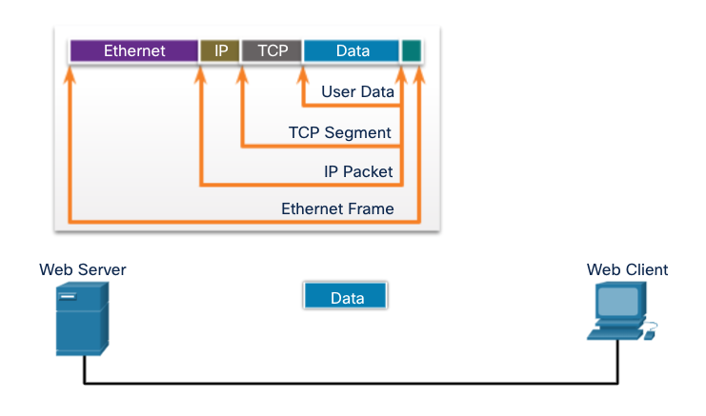
The Physical Layer

Slide 4
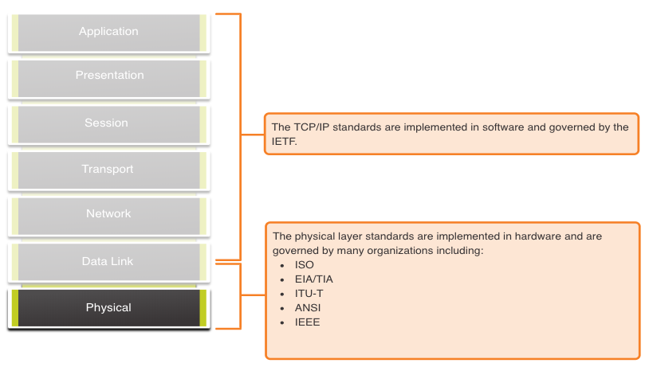
Physical Layer Standards

Slide 5
Physical Components
The Physical Components are the hardware devices, media, and other connectors that transmit the signals that represent the bits.
Hardware components like NICs, interfaces and connectors, cable materials, and cable designs are all specified in standards associated with the physical layer.

Slide 6
Bandwidth
Bandwidth is the capacity at which a medium can carry data.
Unit of Bandwidth | Abbreviation | Equivalence
Bits per second | bps | 1 bps = fundamental unit of bandwidth
Kilobits per second | Kbps | 1 Kbps = 1,000 bps = 10³ bps
Megabits per second | Mbps | 1 Mbps = 1,000,000 bps = 10⁶ bps
Gigabits per second | Gbps | 1 Gbps – 1,000,000,000 bps = 10⁹ bps
Terabits per second | Tbps | 1 Tbps = 1,000,000,000,000 bps = 10¹² bps

Slide 7
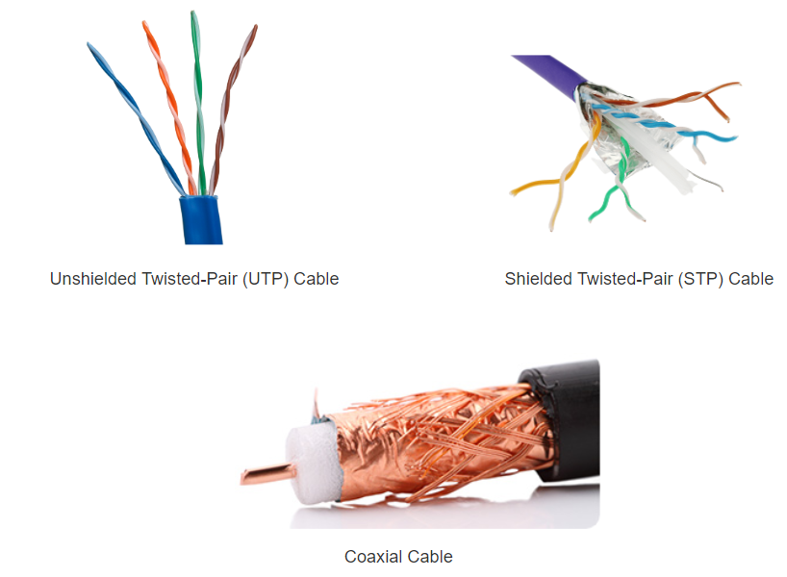
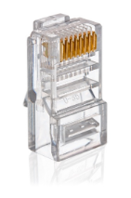
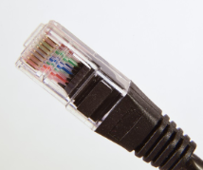
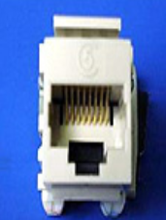
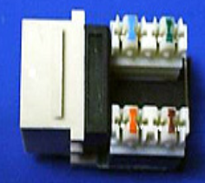
Types of Copper Cabling

Slide 8
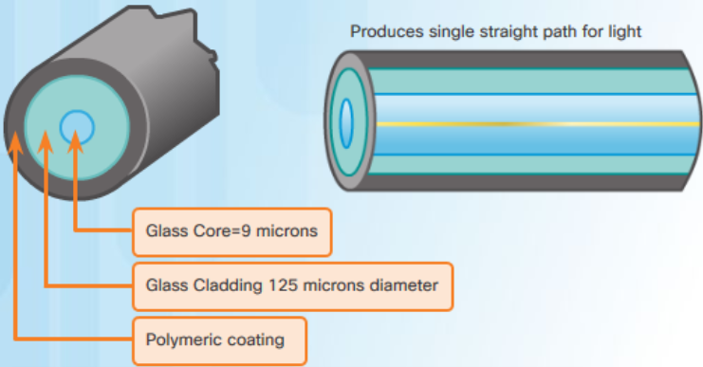
Types of Fiber Media
Single-Mode Fiber
Very small core
Uses expensive lasers
Long-distance applications

Slide 9
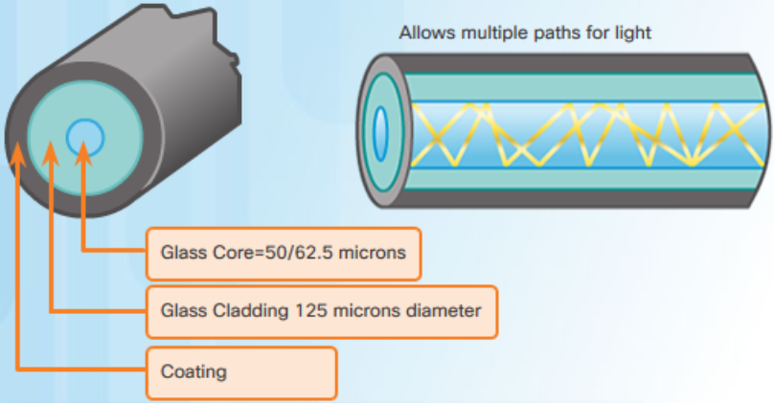
Types of Fiber Media
Multimode Fiber
Larger core
Uses less expensive LEDs
LEDs transmit at different angles
Up to 10 Gbps over 550 meters

Slide 10
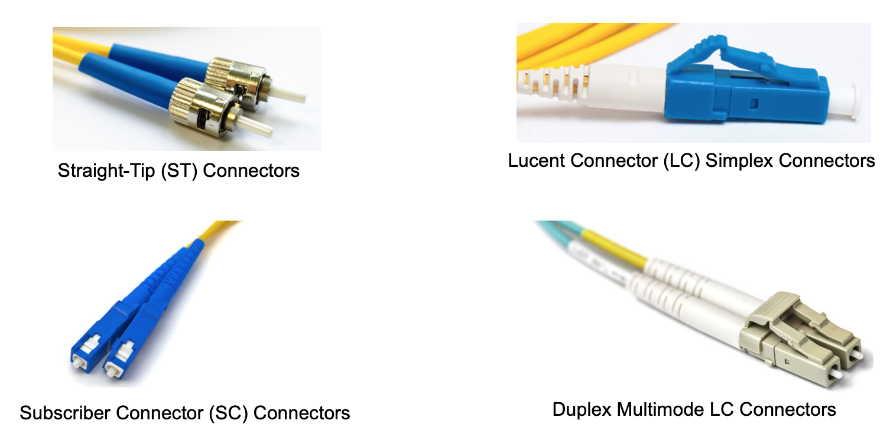
Fiber-Optic Connectors

Slide 11
Wireless Standards:
Wi-Fi (IEEE 802.11) - Wireless LAN (WLAN) technology
Bluetooth (IEEE 802.15) - Wireless Personal Area network (WPAN) standard
WiMAX (IEEE 802.16) - Uses a point-to-multipoint topology to provide broadband wireless access
Zigbee (IEEE 802.15.4) - Low data-rate, low power-consumption communications, primarily for Internet of Things (IoT) applications

Slide 12
Wireless LAN
In general, a Wireless LAN (WLAN) requires the following devices:
Wireless Access Point (AP) - Concentrate wireless signals from users and connect to the existing copper-based network infrastructure
Wireless NIC Adapters - Provide wireless communications capability to network hosts

Slide 13
ICMP Utilities
Internet Control Message Protocol (ICMP) provides feedback about issues related to the processing of IP packets under certain conditions.
Ping: Test Connectivity
Traceroute: Test the Path

Slide 14
ping
Ping 8.8.8.8 (google dns)
Ping google.com (domain name)
Ping 127.0.0.1 (loopback)

Slide 15
Traceroute(tracert)
Test the path between two hosts
Provide a list of hops that were successfully reached along that path.

Slide 16
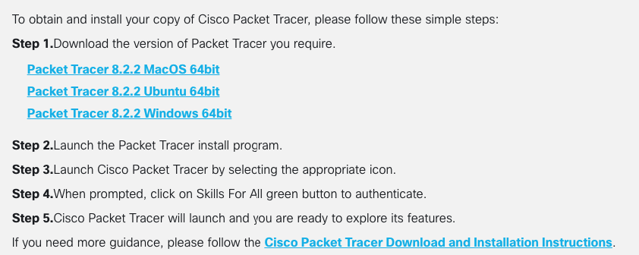
Cisco packet tracer
https://www.netacad.com/resources/lab-downloads?courseLang=en-US
Need to enroll
Getting Started with Cisco Packet Tracer

Slide 17
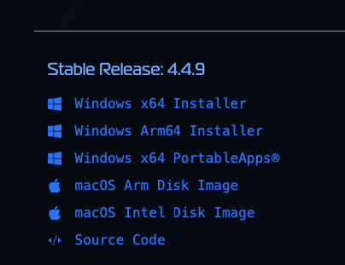
Wireshark
https://www.wireshark.org/download.html

Slide 18
THANK YOU

