Slide 1
Lab 4
Clarifications for HW2

Slide 2
Comparison of RNA measures (QII.3)
The NumReads and Length columns (Salmon output) provide the classical basis for how these metrics are computed
The EffectiveLength column is a concept that is defined by the Salmon that is used to define TPM. This isn’t how TPM was classically defined https://salmon.readthedocs.io/en/latest/file_formats.html

Slide 3
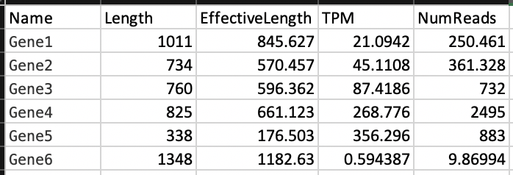
Sample Salmon output (.sf file)

Slide 4
Salmon metrics
Classical definitions of TPM, RPKM, and FPKM are defined here: https://www.rna-seqblog.com/rpkm-fpkm-and-tpm-clearly-explained/
In the setting of single-end reads, FPKM = RPKM because each read corresponds to one fragment. One probably shouldn’t use FPKM

Slide 5
How do I answer QII.3?
Plan to compare at a minimum of four transcript-level statistics (some of which you will have to compute yourself). Don’t worry about aggregating transcript-level features to genes.
There are multiple ‘correct’ answers– the goal is to explore relationships between values and comment on what you observe.

Slide 6
Batch effect adjustments (Problem 3 / Lab 3)
We remove the batch effect using ComBat in one mode of analysis (for cluster visualization, PCA) but use the batch as a covariate in the other (for DESeq2). In short, there are multiple ways to correct for batch effects.
The way that things were done in HW/Lab aren’t necessarily the most parsimonious, but there are other differential expression tools (e.g. moderated t-test from limma-voom) that directly use the batch-corrected matrix as input for differential expression
See discussion of this from Mike Love, author of DESeq2 here: https://support.bioconductor.org/p/121408/

