Slide 1

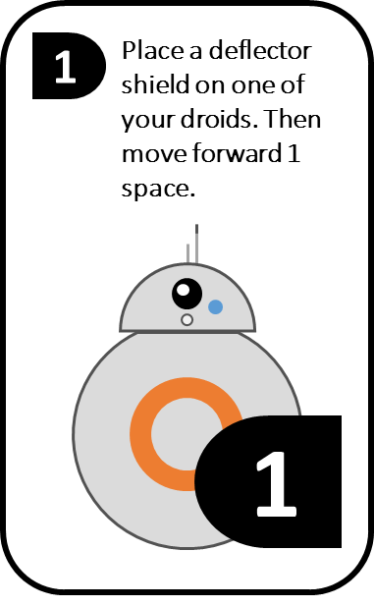

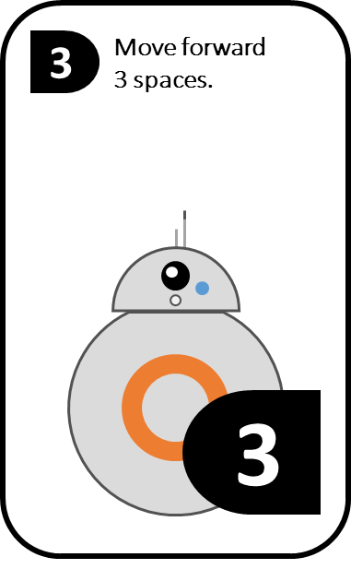
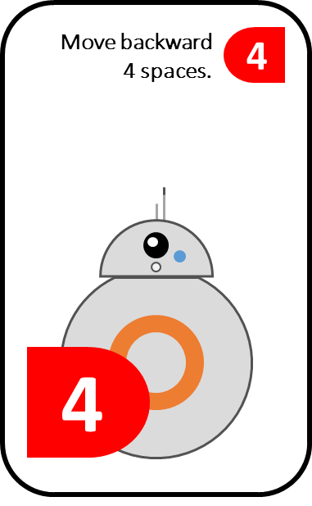



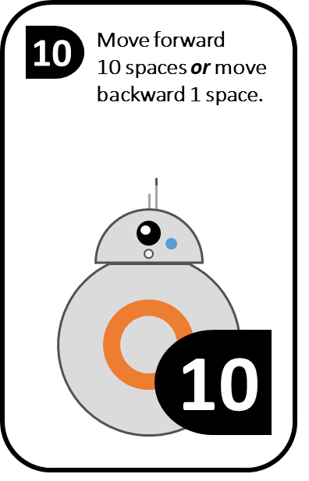
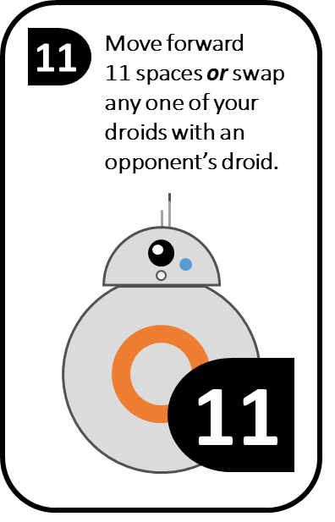
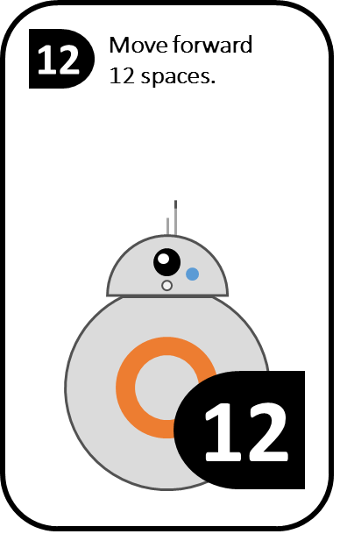



1
Must either start a man out OR move one man forward 1 square.
2
Must either start a man out OR move one man forward 2 squares.
DRAW AGAIN.
3
Must move one man forward 3 squares.
Must move one man backward 4 squares.
4
5
Must move one man forward 5 squares.
7
Must either move one man forward 7 squares OR split the move between any two men.
1
2
3
4
5
7
8
Must move one man forward 8 squares.
10
Must either move one man forward 10 squares or move one man backward 1 square.
11
Move one man forward 11 squares OR any one of your margin men may change places with any margin man of any opponent.
12
Must move one man forward 12 squares.
S
O
R
R
Y
Take one man from your start—place it on a margin square occupied by any opponent and return the opponent’s man to its start.
NOTE: Forfeit move if you do not wish to change places and it is impossible to go forward “11” squares.
NOTE: Forfeit move if no man is on your start OR no opponent’s man is on any margin square.
8
10
11
12
Sorry

