Slide 1


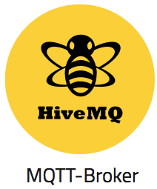


APP client
Http req / reply
Tables
Patient Details
Login Details
Settings / Business rules
For anomaly detection
APP backend / flask
Http req / reply
Amazon
API
Messaging
Module
STAT
Module
SVM
Module
Consider separate servers, virtual or otherwise. Decouple provider failure from aggregator failure
Also may have to rent GPU online to run the SVM module
Http req / reply
publish
Aggregator
http
Tables
Sensor Data
Loc
Beacon ID
SensorID
Val
Time
Sensor Health (SysMons)
Amazon

