Slide 1
Foundations of Computer Science for Researchers

Slide 2
Goals for this lesson
Big picture stuff--what is a programming language? What do programs do?
Differences between programming languages
What are the most commonly used languages?
Why Python?
Programming environments
Compiler versions.
IDEs (integrated development environment).
Reproducibility--GitHub, BitBucket, Atlassian, etc.
Start programming!
Notes:
Intro to programming language
Differences between languages
Programming environments
Other the hardware -> different compiler languages (what is a compiler)
Pycharm is a IDE
Start programming

Slide 3
Class goals
Grasp fundamentals of computer programming
Computational tools
Data structures
Syntax
Apply fundamentals to other programming languages
Ask the right questions for the next steps
Notes:
Always think about the future
Grasp fundamentals
Apply concepts to other langauges

Slide 4
Programming languages
What are they?
Automates and executes algorithms in a structured format.
So what is an algorithm?
A series of instructions constructed to solve a problem.
Examples: instructions on the back of your cake mix, manual for assembling furniture, and so forth.
Some problems cannot be solved using an algorithm--undecidable, unsolvable, intractable problems.
Usually serves as an intermediary between natural languages and assembly language.
Notes:
What is a programming language
They automate and execute algorithms in structured format
Algorithm = set of instructions to solve a problem
Some algorithms that cannot be solved using an algorithm
Undecidable – what to wear tomorrow
Unsolvable – math has produced no solid proof for
Intractable – (our focus) – problem that can be theoretical be solved but may take may too many resources
Get into algorithmic efficiency
Programming languages are intermediary between natural lang and assembly lang

Slide 5
Programming languages
How do they compare to natural languages?
Formally defined syntax and semantics. Will often have a lexicon of keywords.
Unambiguous. Computers cannot resolve ambiguity like humans can.
Must be implementable.
Turing complete
Replicability, predictability, consistency.
For all Turing machines T and input i, there exists a result r, such that all machines T and i will produce the same r.
Arithmetic rules stipulate that 2 + 2 must always yield 4.
Notes:
How does a programming language compare to natural language
Natural language is “human” language (ie English)
PL is defined by syntax and semantics (lexicon of keywords)
PL is unambiguous -> computer unable to understand ambiguity
Implementable
Turing complete **
Named from Allen Turing
A turning machine -> represents a set of finite set of instructions
There exists a result R such that all machines T and I will produce the same i
Ie arithmetic 2 +2 always yield 4

Slide 6
Programming languages
What do programs do?
Almost everything.
“There are more things in heaven and earth, Horatio, than are dreamt of in your philosophy.” (from Shakespeare’s Hamlet). Limitations are set by the extent of your knowledge and imagination.

Slide 7

Programming languages
For each day in month:
print(day)
eat()
exercise()
read()
learn()
Programmer (that’s you)
?
Computational problem
Write a program!
Notes:
Your computer system operates using micro-operating instructions
There is a lot more going on that the programming language guides you through

Slide 8
Types of programming languages
High-level languages
More similar to natural languages than low-level languages.
Handles computational problems designed by programmer.
Constructs represent mathematics.
C++, Java, Python, MATLAB, Javascript, C#.
Low-level languages
Languages which communicate instructions to computer microarchitecture.
Pertains to hardware underlying your software.
Several levels removed from the user.
Assembly language, machine language, and some say C...
Notes:
Types of programming language
High level – more similar to natural lang
Hand computational problems designed by programmer
Constructs represent math
Such as C++, java, python, MATLAB, C# (web devo language), javascript ‘
C++ -> has data structure of high level language/ computational strong and the capabilities to access the low level language
Low level (assembly and machine language that computer hardware uses)
Direct manipulate the hardware and manipulate the micro-architecture comp uses

Slide 9
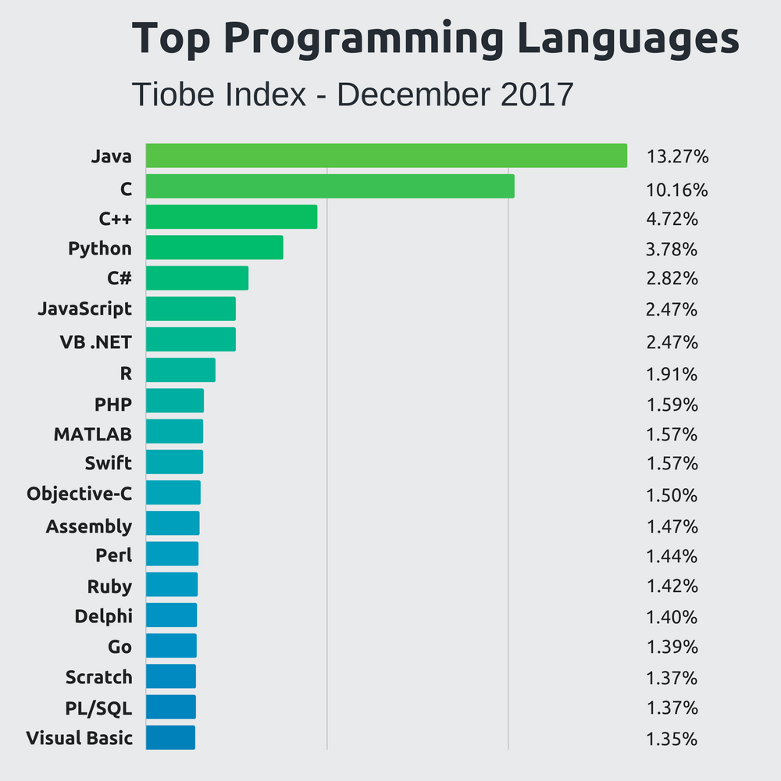
What are common languages out there?
Stackify 2018

Slide 10
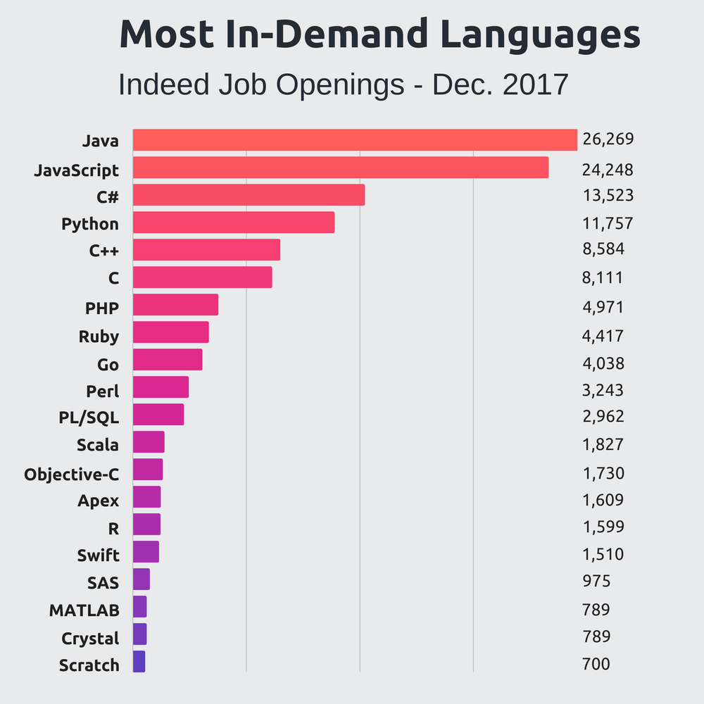
What are common languages out there?
Stackify 2018

Slide 11
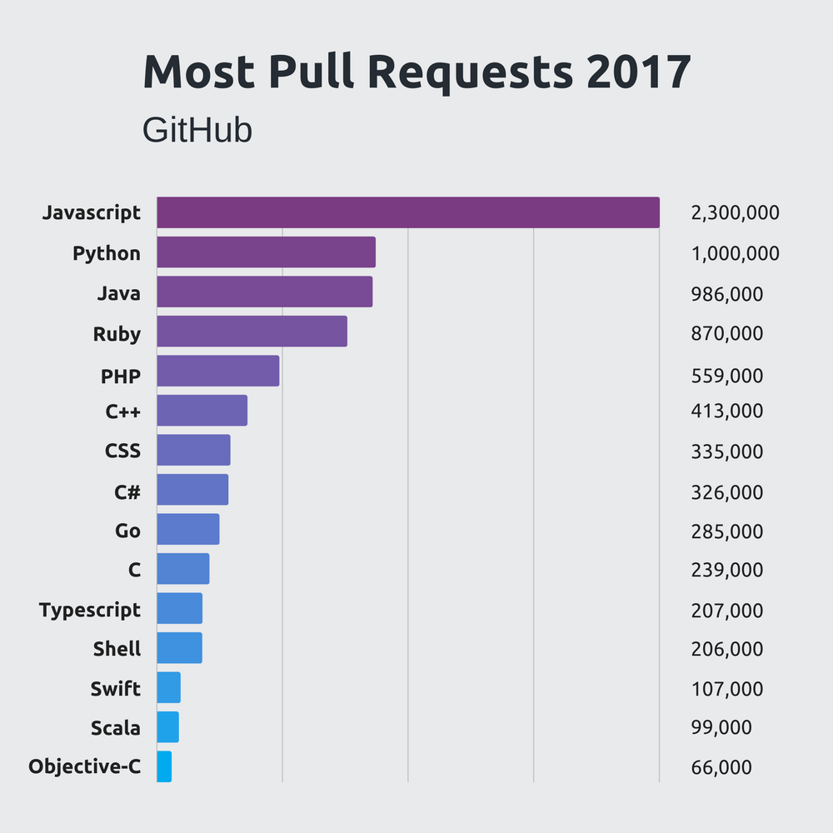
What are common languages out there?
Stackify 2018

Slide 12
Which language should I choose?
Functionality
Data analysis, machine learning → Python, MATLAB
Software development and engineering → Java, C, C++
Hardware manipulation → C
Database management, querying → SQL, MySQL, PostGres
Web development → Javascript, C#
Notes:
Which language should I choose?
Functionality -> what are you going to be using it for
Data analysis, machine learning -> python, Matlab
Software devo and engineering -> java and C++
Hardware manipulation -> C
Database management, query -> SQL, MySQL, PostGres
Web development -> c#, javascript, html (inspect element)

Slide 13
Why Python?
Functionality
Fundamentals of computer science made easier with Python.
Machine learning libraries for data science projects in future.
High demand and usage in academia and industry
Open-source, free of cost
Extensively documented
Important for troubleshooting…
Notes:
Why python
Functionality -> fundamentals of computer science made easier by python
Machine learning libraries for data science projects
Libraries -> are tools that can communicate with your language
You can formfit the functionality of what you are doing with the language to make more specific to what you are doing
High demand, used widely
Open-source, free of cost
Extensively documented
Important for troubleshooting

Slide 14
Programming Environments

Slide 15
IDE (Integrated Development Environment)
Supports only a few select programs per IDE
We will use PyCharm, which only supports Python.
NetBeans and IntelliJ support Java.
Xcode, built for Mac, is for Java, C++, C.
Organization
One project may have more than one program for modularity purposes.
Multiple projects in same IDE.
Debugging
No one writes a perfect program in his/her/their first pass.
Set breakpoints to see which values are being changed as the program executes.
Notes:
IDE – integrated development environment -> support a few select program per IDE
Use pycharm, supports python
Netbeans and intelliJ support java
Xcode built for mac (java, c++)
Organization
One project will often have more than one program for modularity purposes
Multiple projects can be organized in same IDE
Debugging
Most important
No one write perfect program in first pass -> most time spent debugging to understand why what you wrote is not working
Breakpoints: allow you to see which value are beign changed as the program is being executed
IDE VS PLATFORM (TD)
What does it mean for IDE to be on top of Platform

Slide 16
Compilers
Each language has multiple versions of its own compiler
Translates high-level programs into machine-readable format
Checks syntax
Kind of like a spellchecker, they pick up on syntactical errors before programs are executed.
Compiler errors
Throw errors if incorrect syntax is detected.
Usually cannot execute programs with compiler errors.
More on this later...
Notes:
Compiler
Each language will have multiple version of a compiler
Check syntax
Basically a spell checker for you -> makes sure that program is written correctly before you execute/run it
Throws in a compiler error before program is executed
Translates high level programs into machine-readable format

Slide 17
Saving and Reproducing Code
SAVE YOUR CODE
Cloud servers such as the lab DropBox account
Google Drive
There are no excuses for lost code these days….
GitHub
Programmer’s preferred way of storing, sharing, and viewing code from other programmers.
Social media for programmers.
This is how you show off your code.
Get an account for next time.
Notes:
Saving and reproduce code
Always save your code
Cloud serves -> dropbox
Google drive
GitHUb
Programmers preferred way of storing, sharing, and viewing code
Social media for programmers-> show off code
Get an account for next time
Personal Zen is in github
Store images/ snapshots
Will have code and then have snapshots of what user interface show

Slide 18
Open Discussion
Which topics interest you most?
How were the slides?
Would you like to learn about anything I mentioned in more depth?
How should I structure classes to be most conducive to learning how to code?
Is there anything you didn’t understand?
How should we handle homework assignments and readings?

Slide 19
Q & A
What is machine learning?
An important branch of math and computer science, machine learning addresses the theoretical and practical aspects of constructing algorithms which can extract information from input data with little to no human guidance.
Bookmark this concept for future lectures.
We are working towards data analytics and ML application projects.

Slide 20
Q & A
What are similarities and differences between an IDE and platform?
Platforms are underlying organizational structures on which applications are developed, whereas IDEs are specific development environments that are used to modularize and organize code.
Example: your OS is technically a platform. On your OS, you may download whichever IDE you want for your coding projects.
Example: Similarly, your OS is a platform for your applications to be accessed by you, the user, in multiple contexts.
Example: Google Cloud Platform is a platform to host multiple tasks such as billing, database management, etc.
To sum it up, platforms are structures encapsulating specific tools such as IDEs.

Slide 21
Q & A
What are the differences between scripting, coding, and syntaxes?
Syntax, in computer science and linguistics, refers to the structure of a language. In the ER lab, I have heard the term being used as a noun to represent IBM SPSS functions. I believe we are using this term erroneously. However, this assessment is based on my limited experience working with database/querying languages. We use the term syntax to mean a series of commands to calculate standard deviation, summations, etc. In CS, we usually refer to this as a function.
Scripting or coding? While there are myriad opinions about these two terms, a finite distinction between the two is unbeknown to me. I most often use script to describe command line scripts, which we will learn about later, written to move or copy multiple files or to execute one program with multiple files. Coding is programming, which is to execute an algorithm in a high-level language of your choice.

