Slide 1
Foundations of Computer Science for Researchers

Slide 2
Goals for this lesson
Big picture stuff--what is a programming language? What do programs do?
Differences between programming languages
What are the most commonly used languages?
Why Python?
Programming environments
Compiler versions.
IDEs (integrated development environment).
Reproducibility--GitHub, BitBucket, Atlassian, etc.
Start programming!

Slide 3
Class goals
Grasp fundamentals of computer programming
Computational tools
Data structures
Syntax
Apply fundamentals to other programming languages
Ask the right questions for the next steps

Slide 4
Programming languages
What are they?
Automates and executes algorithms in a structured format.
So what is an algorithm?
A series of instructions constructed to solve a problem.
Examples: instructions on the back of your cake mix, manual for assembling furniture, and so forth.
Some problems cannot be solved using an algorithm--undecidable, unsolvable, intractable problems.
Usually serves as an intermediary between natural languages and assembly language.

Slide 5
Programming languages
How do they compare to natural languages?
Formally defined syntax and semantics. Will often have a lexicon of keywords.
Unambiguous. Computers cannot resolve ambiguity like humans can.
Must be implementable.
Turing complete
Replicability, predictability, consistency.
For all Turing machines T and input i, there exists a result r, such that all machines T and i will produce the same r.
Arithmetic rules stipulate that 2 + 2 must always yield 4.

Slide 6
Programming languages
What do programs do?
Almost everything.
“There are more things in heaven and earth, Horatio, than are dreamt of in your philosophy.” (from Shakespeare’s Hamlet). Limitations are set by the extent of your knowledge and imagination.

Slide 7

Programming languages
For each day in month:
print(day)
eat()
exercise()
read()
learn()
Programmer (that’s you)
?
Computational problem
Write a program!

Slide 8
Types of programming languages
High-level languages
More similar to natural languages than low-level languages.
Handles computational problems designed by programmer.
Constructs represent mathematics.
C++, Java, Python, MATLAB, Javascript, C#.
Low-level languages
Languages which communicate instructions to computer microarchitecture.
Pertains to hardware underlying your software.
Several levels removed from the user.
Assembly language, machine language, and some say C...

Slide 9
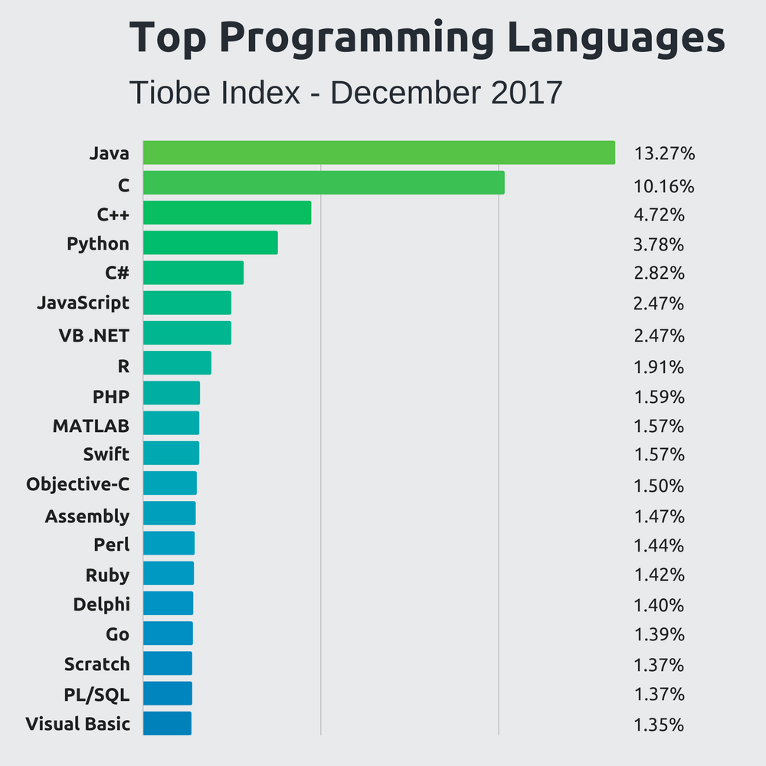
What are common languages out there?
Stackify 2018

Slide 10
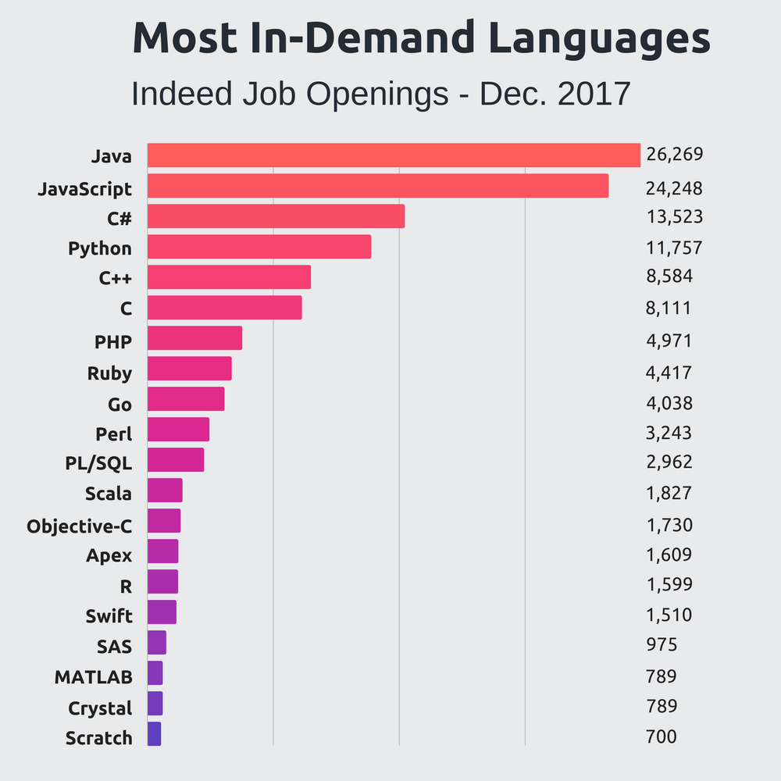
What are common languages out there?
Stackify 2018

Slide 11
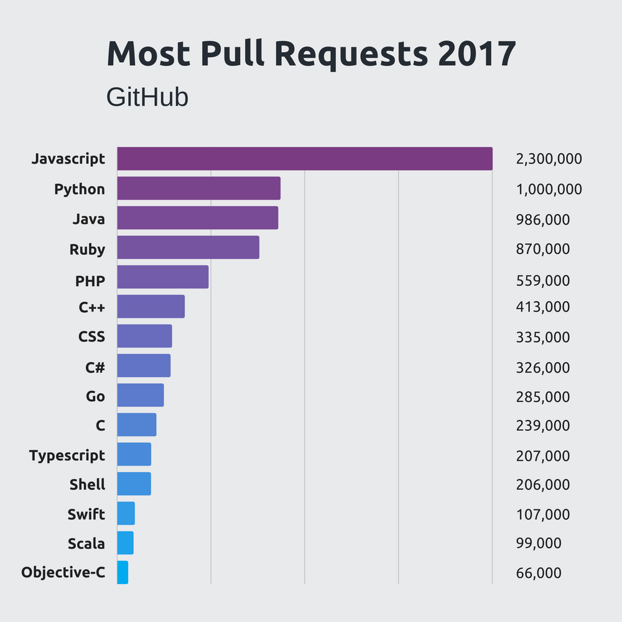
What are common languages out there?
Stackify 2018

Slide 12
Which language should I choose?
Functionality
Data analysis, machine learning → Python, MATLAB
Software development and engineering → Java, C, C++
Hardware manipulation → C
Database management, querying → SQL, MySQL, PostGres
Web development → Javascript, C#

Slide 13
Why Python?
Functionality
Fundamentals of computer science made easier with Python.
Machine learning libraries for data science projects in future.
High demand and usage in academia and industry
Open-source, free of cost
Extensively documented
Important for troubleshooting…

Slide 14
Programming Environments

Slide 15
IDE (Integrated Development Environment)
Supports only a few select programs per IDE
We will use PyCharm, which only supports Python.
NetBeans and IntelliJ support Java.
Xcode, built for Mac, is for Java, C++, C.
Organization
One project may have more than one program for modularity purposes.
Multiple projects in same IDE.
Debugging
No one writes a perfect program in his/her/their first pass.
Set breakpoints to see which values are being changed as the program executes.

Slide 16
Compilers
Each language has multiple versions of its own compiler
Translates high-level programs into machine-readable format
Checks syntax
Kind of like a spellchecker, they pick up on syntactical errors before programs are executed.
Compiler errors
Throw errors if incorrect syntax is detected.
Usually cannot execute programs with compiler errors.
More on this later...

Slide 17
Saving and Reproducing Code
SAVE YOUR CODE
Cloud servers such as the lab DropBox account
Google Drive
There are no excuses for lost code these days….
GitHub
Programmer’s preferred way of storing, sharing, and viewing code from other programmers.
Social media for programmers.
This is how you show off your code.
Get an account for next time.

Slide 18
Open Discussion
Which topics interest you most?
How were the slides?
Would you like to learn about anything I mentioned in more depth?
How should I structure classes to be most conducive to learning how to code?
Is there anything you didn’t understand?
How should we handle homework assignments and readings?

