Slide 1
Figure 1 Processing Flow
DNS Server
SQL Database
CASB
NoSQL Database
Log Parsing
Graph Analytics
Parquet Files
EDR
NGFW
Graph Database

Slide 2
Figure 2 Data Transformation Chain
Log Unstructured Data
Log Structured Data
Graph Data
Graph Embedding Data
Graph Metrics Data

Slide 3
Figure 3 From Primary Signals in Log data to the Short-Term Graph
Log Data
Primary Signals
Graph Elements
Short-Term Graph
user1 login denied device ID1
session created
session terminated
IP session initiated
malicious IP3 detected on user2
OK
teardown IP connection
network ID1 sweep from IP3
rebuild IP connection
starting SSL handshake
port scan from source IP3 device ID2
login allowed
Malicious file at URL1 blocked from IP3
DNS lookup failed
IP10 accessed URL3
IPsec-SA established
IP session initiated
high denied traffic from device ID1 to URL2
user1 login denied device ID1
user1
device ID1
device ID1
malicious IP3 detected on user2
IP3
user2
user1
URL2
network ID1 sweep from IP3
IP3
network ID1
user2
Malicious file at URL1 blocked from IP3
IP3
URL1
IP3
network ID1
high denied traffic from device ID1 to URL2
device ID1
URL2
URL1

Slide 4
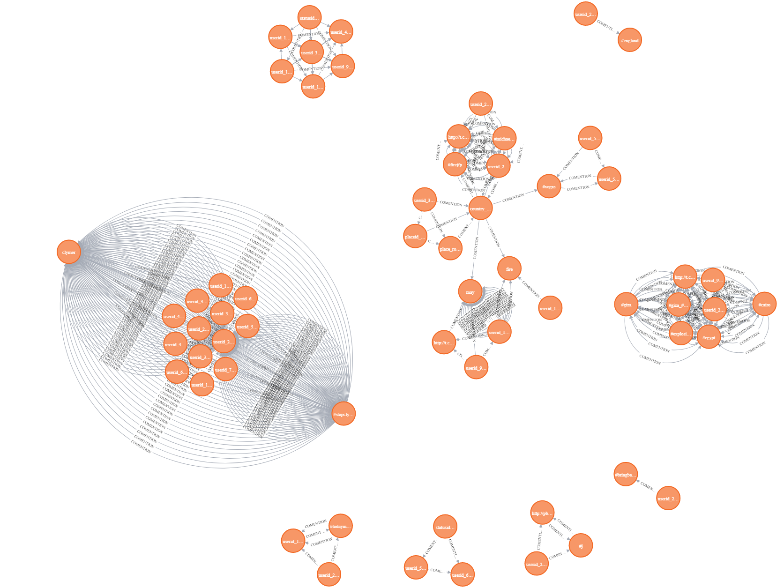
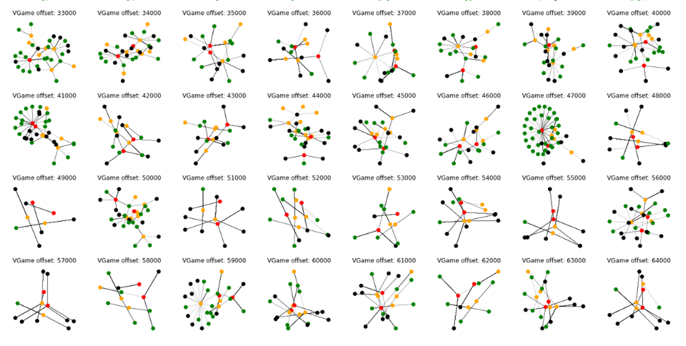
Figure 4 Schematic Graph Processing
Graph Analytics
Graph Embedding
Graph Clustering
Anomaly Detection
Join with the Long-term Graph
Long-term Graph
Graph Database
Short-term Graphs

Slide 5
Figure 5 Anomaly Detection
Short-term Graphs
Betweenness Centrality
Closeness Centrality
Eigenvector Centrality
Edge Connectivity
Node Connectivity
Number of Communities
Communities Size Distribution
Node2vec embeddings
DeepWalk embeddings
DNGR embeddings
Numerical Representation of Graphs
IsolationForest
Autoencoder
Deep Support Vector Data Description
Majority Voting

Slide 6
Figure 6a. Before Merging
Long Term Graph
Short Term Graph
A
B
L
C
D
D
M
Cluster 1
E
E
F
G
G
D, E, G are common nodes
U
V
H
I
Cluster 2
W
X
J
K
Z
Y

Slide 7
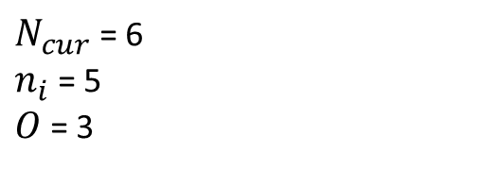
Figure 6b. After Merging
Long Term Graph
A
B
C
L
D
M
Cluster 1
Updated
E
F
G
$N_{cur}$ = 6
$n_{i}$ = 5
$O$ = 3
H
I
Cluster 2
J
K

Slide 8
Figure 7. Evolution of the Long Term Graph
Time frame 1
Time frame 2
Time frame 3
B
A
B
A
B
A
C
C
C
Cluster 1
Pr_anom = 0.7
D
Cluster 1
Pr_anom = 0.7
D
Cluster 1
Pr_anom = 0.85
D
E
F
G
H
H
I
I
Cluster 2
Pr_anom = 0.5
Cluster 2
Pr_anom = 0.6
J
J
Time frame 4
Time frame 5
Time frame 6
B
A
B
A
C
C
L
Cluster 1
Pr_anom = 0.85
D
Cluster 1
Pr_anom = 0.95
D
E
E
F
G
F
G
M
H
H
H
Cluster 2
Pr_anom = 0.7
I
Cluster 2
Pr_anom = 0.7
I
Cluster 2
Pr_anom = 0.7
I
J
J
J
K
K
K

