Slide 1

Boot camp
Exeter
November 2013
Konrad Paszkiewicz – University of Exeter
David Martin – University of Dundee
Christopher Woods – University of Bristol
Notes:
Introduce: Me (Andrew) – organizer, Chris and Karthik (instructors).

Slide 2
Today
Introduction
Using the command line (shell)
Using Python for file handling
Version control using git
Regular expressions

Slide 3
Tomorrow
How (and how much) to test software
R
Graphing in R
Graphing in Python
Pulling everything together

Slide 4
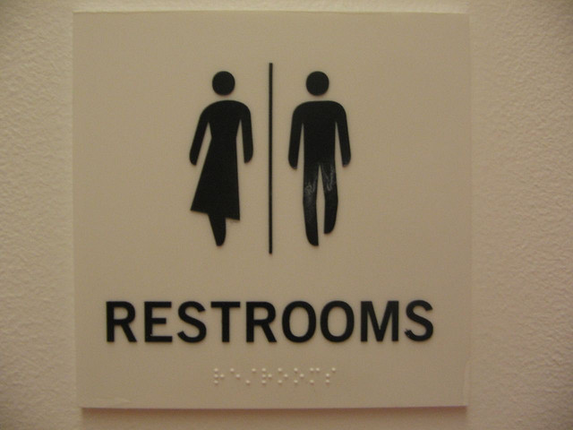
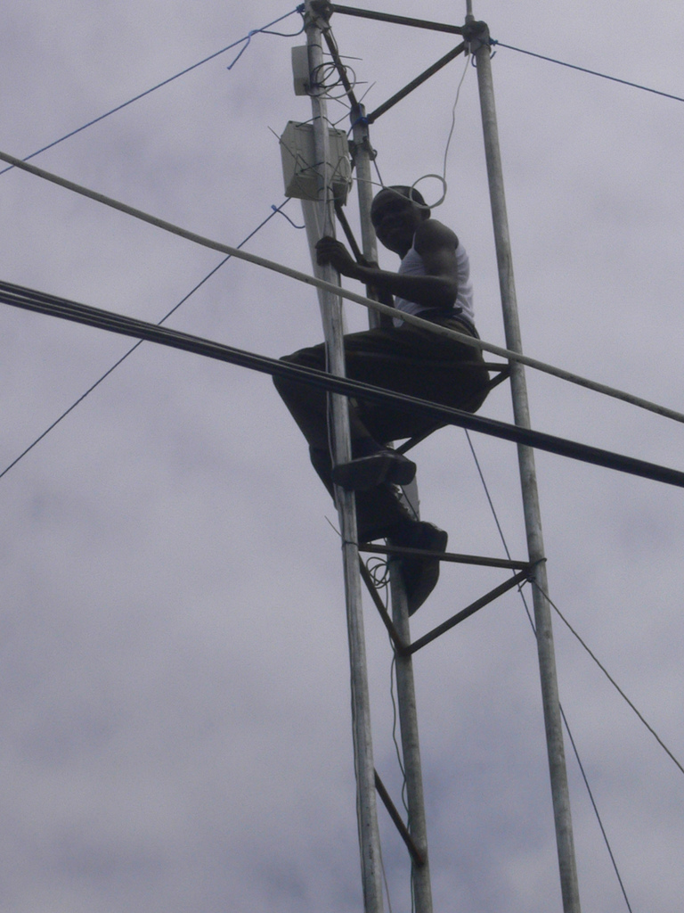
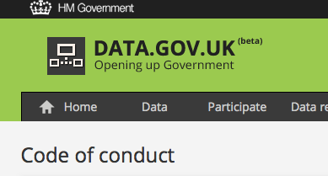


Important stuff
Images courtesy of (clockwise from top-left) oneVillage initiative, Bobbymond, Dajanda, The Government Digital Service, Anton Novojilov
Notes:
Seating OK?
Coffee at 10:30 (like always) – we’re leaving you to fend for yourselves at lunch and the afternoon break
Toilets are back out in the lobby on the right before you reach the street.
Let us know if you are too hot (or cold).
I won’t need to remind you that there is a code of conduct.

Slide 5
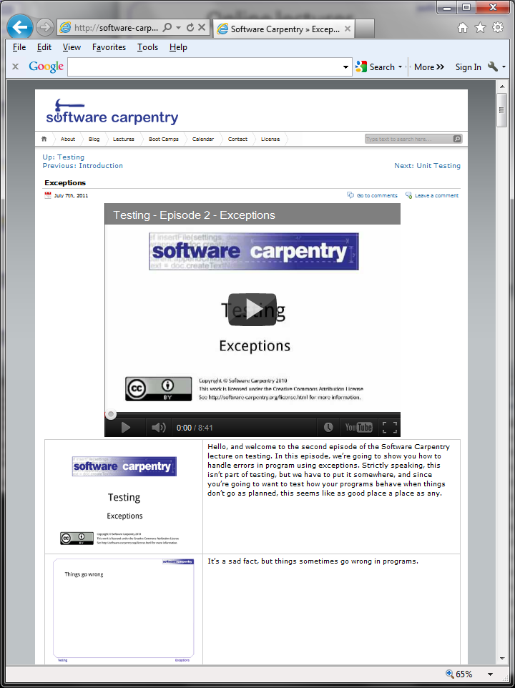
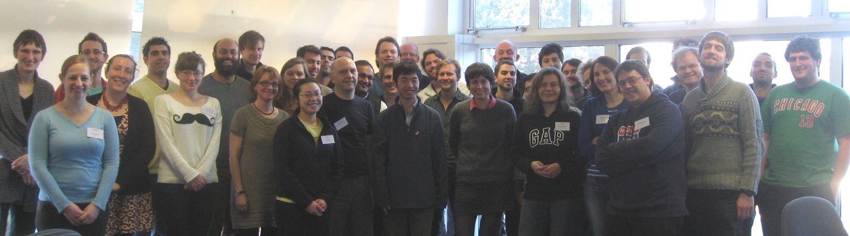
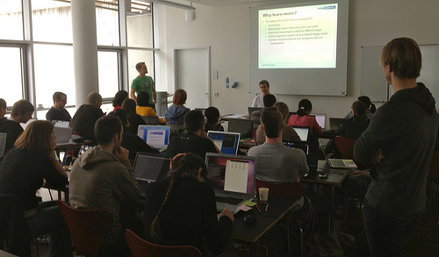
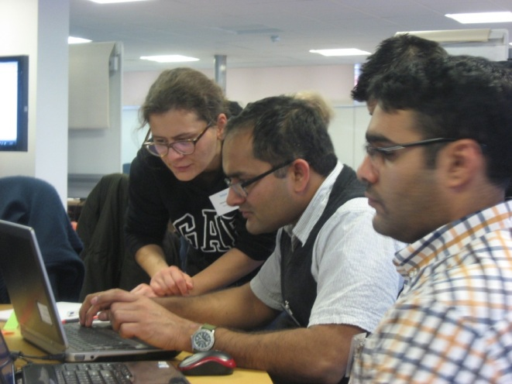
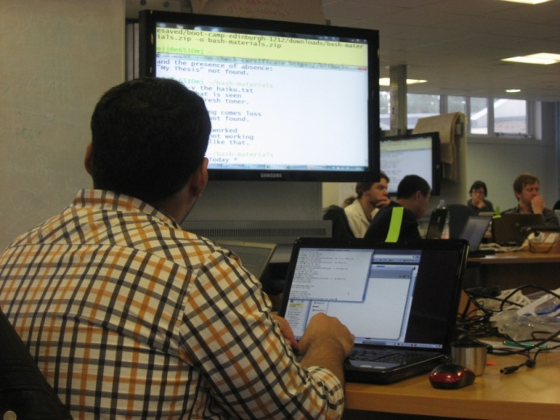

What is Software Carpentry?
Notes:
Founded in 1998.
Teach researchers (post-grads and post-docs) basic software development concepts and skills.
Online lectures and boot camps.
SSI promotes reproducible research through superior software.
Promote software development skills amongst researchers.
UK coordinators of SWC.

Slide 6
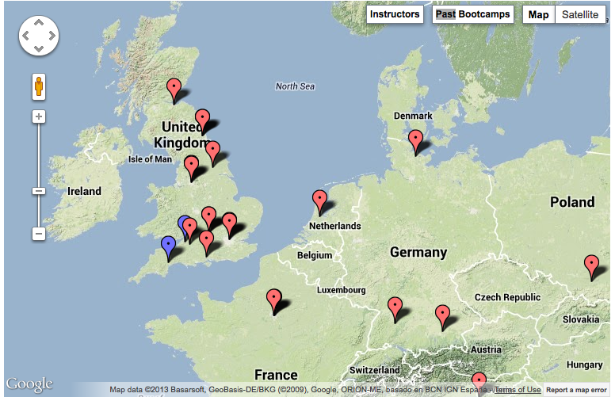



Want to get involved?
Grab us during a break!
admin-uk@software-carpentry.org
http://software-carpentry.org/bootcamps

Slide 7
Meet’n’greet
Your PostIt’s
  Red – I’m stuck, help!
  Green – I’m fine
Your helpers …
  …are there for you!
Browse to http://tinyurl.com/swcexeter
  …and introduce yourself to fellow attendees
Notes:
Get people to put posIts on computer if they have managed to install (green) or not (red)
Introduce helpers – don’t expect them to do everything but hopefully the red tags install
Anna, Matt, David, Phil, Alan (and, I’ll be around).
Point to the website and hand over to Chris.

