Slide 1
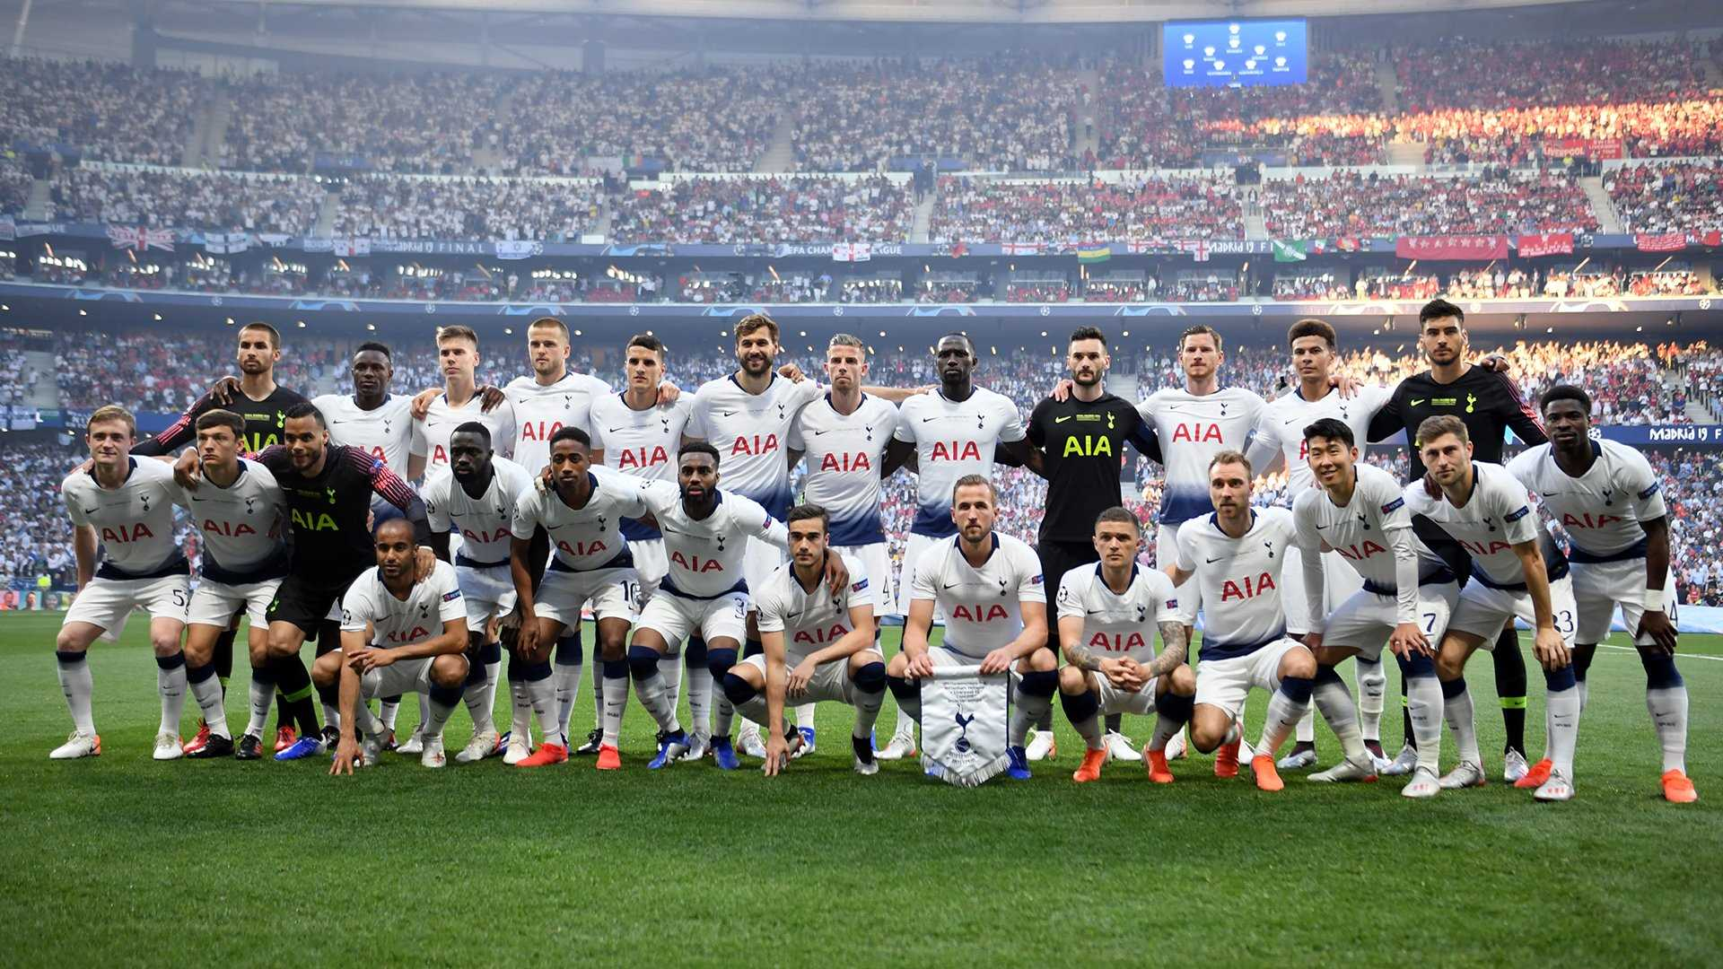

Data-Driven Recruitment Strategy

Slide 2

BUSINESS PROBLEM
Tottenhum Hotspurs needs a data-driven recruitment strategy to identify young, undervalued players who will generate a positive return on investment (ROI) when signed. With financial constraints tightening, it’s imperative to focus not just on player potential but on tangible profitability. Our goal is to develop a classification model that predicts whether signing a player will yield a profitable ROI, thereby reducing the financial risk of signing the wrong player.
Key Issue:
Signing the wrong player can lead to financial losses.
Our Challenge:
Identify young, undervalued players who can be signed cheaply and later resold for a profit.

Slide 3

Business Objectives
Maximize return on investment (ROI) from player signings.
Enhance scouting efficiency by identifying promising regions.
Reduce the risk of costly signings by targeting undervalued talent.

Slide 4
Why Solve This Problem?
1. Financial Efficiency:
Avoid overspending on players whose market values do not reflect their true potential.
2. Competitive Edge:
Secure hidden gems that can drive on-field success and revenue through future transfers.
3.Strategic Scouting:
Focus resources on regions that consistently produce profitable signings.

Slide 5
Our Approach:
Data Utilization:
Leverage the extensive FIFA 18 dataset to inform decision-making.
Analytical Focus:
Use statistical and machine learning models to predict player profitability.
Outcome:
A clear, actionable recommendation on which players to target.

Slide 6
Data Understanding
What’s Included:
In FIFA, Player Attributes are the data and information that determine the quality and the feature of a player’s technical skills, behaviors, and performance on the pitch.
Player attributes such as age, overall rating, potential, skills, and market value.
each player has a collection of attributes rated from 0 to 99 each
2. Why It’s Valuable:
Provides detailed, quantifiable measures of player performance and market trends.
3. Application:
Forms the foundation for our predictive modeling and scouting analysis.

Slide 7
TARGET VARIABLE
Target : Profitability (Yes/No) based on Return on Investment (ROI).
Metric will be Feature engineered into dataset through the formula:
[ROI = (Predicted_Resale_Value - Purchase_Price) / Purchase_Price]
Binary Classification:
1 (Profitable): If the Profitability Ratio is above a certain threshold (e.g., 20% profit).
0 (Not Profitable): This metric not only quantifies potential financial gain but also aligns directly with your club’s objective to avoid costly mistakes.

Slide 8
Why ROI?
Direct Business Relevance:
ROI translates the model’s output into a financial metric, ensuring that recruitment decisions align with the club’s profit goals.
Risk Management:
It minimizes the risk of costly signings by highlighting players who promise significant future returns.
Actionable Insights:
By predicting profitability, the club can prioritize scouting and investment in players who offer the best financial upside.

Slide 9
Predictors (Features) from the FIFA 18 Dataset
1. Age:
Younger players typically have more room for development, thus potentially higher future resale value.
2. Market Value & Wage:
Lower initial market value combined with a promising future (high growth potential) can signal a hidden gem with high ROI.
3. Growth Potential (Engineered Feature):
Indicates the development ceiling and future performance improvement.
4.Key Player Attributes:
Attributes such as pace, dribbling, passing, and finishing will be combined into a Performance Index (a weighted sum) that reflects the player's overall skill set and potential to improve.
5.Regional Data (Optional for Scouting Bases):
Although secondary to the signing decision, knowing the player’s country or region helps identify hotspots for future scouting bases.

Slide 10
Evaluation
1.Primary Model Evaluation Metrics:
Classification Metrics:
Precision: Ensures that when a player is flagged as profitable, they truly are.
Business Impact:
Precision answers: "When we predict a player is high-potential, how often are we right?"*
Why use it : If we misclassify an average player as high-potential (false positive), clubs waste money on bad transfers.
2. Business Impact Metric:
Profitability Ratio (ROI):
Definition: (Predicted Future Value – Purchase Price) / Purchase Price
Why: Directly aligns with our financial goals.

Slide 11
Why Focus on Precision?
Avoiding Costly Mistakes: A false positive—where the model incorrectly flags a player as profitable—can lead to a costly signing. Since each erroneous signing represents a significant financial risk, ensuring that when a player is flagged as profitable they truly are is critical.
Financial Discipline: High precision means we are more confident in our recommendations. The club can then commit resources (both financial and scouting time) to players who are very likely to deliver a good return on investment.
Quality Over Quantity: While missing a few high-ROI players (false negatives) is not ideal, the cost of pursuing a player who turns out to be unprofitable can be much higher. Focusing on precision helps maintain the club’s financial discipline.

Slide 12
The Role of Recall
Capturing Opportunities: Recall measures how many of the truly profitable signings we capture. A high recall ensures that we don’t overlook hidden gems.
Balanced Approach: Although our primary emphasis will be on precision, we don’t want recall to drop too low. We still need a sufficient number of candidates in our shortlist so that potential opportunities aren’t missed entirely.
Overall Model Health: Metrics like the F1-score and ROC-AUC will be monitored to ensure that while we are prioritizing precision, our model still performs well overall. This balance helps in refining the model further.
Precision is prioritized to avoid the significant financial costs associated with unprofitable signings.
Recall is monitored to ensure we capture enough potential opportunities.

Slide 13
Practical Implications for Our Classification Model
Threshold Tuning: We will adjust the classification threshold during model training to favor precision. This means setting a higher confidence level for flagging a player as profitable.
Iterative Refinement: Our model’s performance will be continually evaluated. If the precision is very high but recall falls to an unacceptable level (missing too many opportunities), we’ll iteratively adjust and balance the metrics.
Decision-Making Impact: For the club, this means that while our list of recommended signings might be smaller, each recommendation is backed by a high likelihood of delivering a profitable return, aligning with the club’s risk management strategy.

Slide 14
Feature Engineering – Capturing Undervaluation
Undervaluation: Players whose abilities exceed their current market price.
Value Efficiency Ratio:
[Value_Efficiency_Ratio=Total Attributes Score / Market Value]
Highlights players who offer more quality per investment unit.
Predicted vs. Actual Value Differential:
Measures the gap between what a player should be worth versus their market price.
Growth-Adjusted Undervaluation:
Combines the differential with the player’s expected improvement.
.

Slide 15
Effect of Feature Engineering on Modelling
Enhanced Predictive Power: Incorporating these continuous undervaluation features into our classification model provided a richer, more nuanced view than using raw ratings alone. The model will learn that players with high undervaluation metrics are more likely to yield profitable outcomes.
Risk Mitigation: By highlighting market inefficiencies, the metrics reduce the risk of overpaying for talent. Our logistic classifier can better differentiate between players who look good on paper versus those who offer a hidden value proposition.
Actionable Insights: These metrics translate into clear recommendations for the club. For example, a high Growth-Adjusted Undervaluation score might trigger a “buy” signal, suggesting that scouts should prioritize such players even if their overall rating isn’t the top of the chart.
Integration with ROI Target: When these features are fed into your binary classifier—where the target is defined by whether the predicted ROI exceeds a given threshold—they directly contribute to estimating profitability. In essence, they serve as early indicators that a player’s future resale value (and thus ROI) is likely to be higher than expected.

Slide 16
Modeling Approach
Baseline Model: Logistic Regression
Interpretability: Provides clear insights into how each predictor contributes to the probability of a profitable signing.
Simplicity: A good starting point to understand the relationship between features and ROI-based profitability.
2. Advanced Model: Decision Tree
Non-linear Relationships: Can capture complex interactions among player attributes that linear models might miss.
Robustness: Random forests, in particular, help reduce overfitting while providing a ranking of feature importance.
Ease of Use with Categorical Data: Naturally handle categorical variables like player position without extensive preprocessing.
Benefits:
Improved accuracy and robustness in predictions.

Slide 17
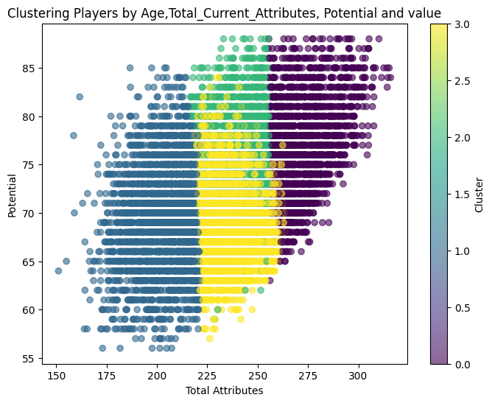
RECOMMENDATIONS
1.SCOUTING:
Cluster 1: Expensive Young Talents
Low total attributes (203), but market value is very high (16.79M). Likely young prospects with hype, big clubs may be overpaying.
Cluster 3: Established, High-Market Players
Surprisingly low potential (68.91) but very high value (23.87M). These might be veterans with brand value or media attention, not necessarily great future performers.
Cluster 2: Hidden Gems?
Higher potential (75.35) but very cheap (1.85M). Could be underpriced future stars, perfect for Brentford-style scouting
Cluster 0: High-Potential, Low-Value Players
Highest attributes (272) and potential (76.63), but surprisingly low market value (3.97M). Might be undervalued elite players due to club situation, scouting bias, or age.

Slide 18
RECOMMENDATIONS
1.Strategic Scouting Insights:
Clustering simplified complex player data into actionable segments. It allowed us to pinpoint hidden gems and elite undervalued players while flagging overhyped, expensive options. By grouping players into clusters based on their age, overall attributes, potential, and market value, we uncover distinct segments that reveal hidden market inefficiencies.
Distinct Player Profiles:
Cluster 2 (Hidden Gems):
These players show high potential and strong attributes but are available at a very low market value. This suggests they are undervalued investments—ideal targets for scouting and further evaluation.
Cluster 0 (Elite Undervalued Players):
Players in this group possess the highest attributes and potential, yet their market value remains low. This could indicate that, despite their elite performance, they are overlooked or mispriced, offering significant upside.
Cluster 1 (Expensive Young Talents):
Here, players command high market values despite lower attributes. They may be overhyped or driven by external factors rather than actual performance, indicating caution should be exercised.
Cluster 3 (Established, High-Market Players):
These are players with moderate potential but very high market value—likely veterans with significant brand or media influence rather than future growth potential.

Slide 19
RECOMMENDATIONS
1.1 Scouting Focus:
a.) Focus on Undervalued Clusters:
By targeting clusters 2 and 0, the club can allocate scouting resources to regions or leagues where undervalued talent is most common, increasing the likelihood of identifying high ROI signings.
b.) Avoid Overpriced Talent:
Clusters 1 and 3 signal that some players may be overvalued, suggesting that pursuing them could result in costly investments with lower future returns.
c.) Setting up Scouting Bases
Setting up Scouting bases in this leagues could prove beneficial because of the high Value-Efficiency, meaning a lot of highly under-valued talents
Liga_NOS
EFL_Championship
Brasileirao_Serie
Eredivisie
LIGA_DO_BRASIL

Slide 20
Thank You!
www.slideegg.com

