Slide 1

Authors: Davide Mascolo, Manuela Petti, Lorenzo Farina
BIBM 2023
IEEE International Conference on Bioinformatics & Biomedicine
Integrating Genomic and Transcriptomic data of checkpoint blockade response in Non-Small Cell Lung Cancer through Multilayer Network Modelling

Slide 2
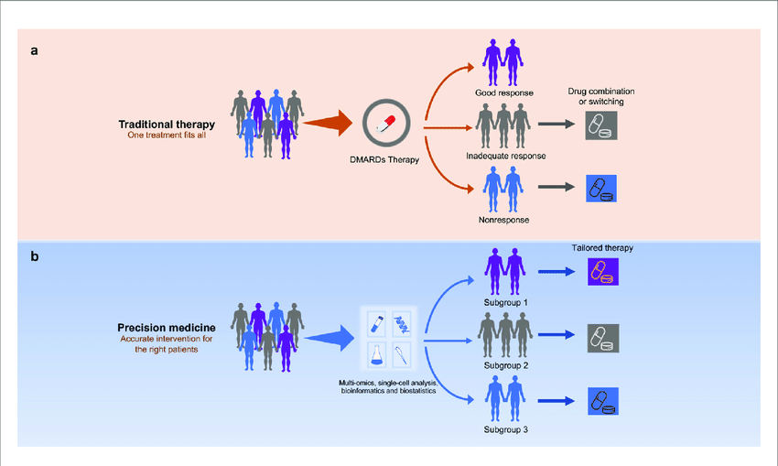
Introduction
Global Impact: Lung cancer as leading cause of cancer-related deaths worldwide.
Personalized Treatment: Shift from a one-size-fits-all approach to personalized treatments.
Targeted Therapy: Biomarkers identification.
Multidata Approach: Not all lung cancers are the same.
Fig. 1: Precision Medicine Approach
Author: Davide Mascolo
Reference: davidemascoloofficial@gmail.com

Slide 3
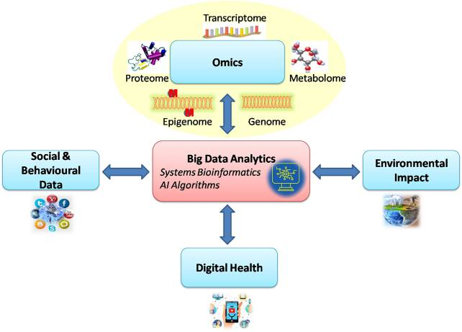
Case study
Inspiration: Project initiated based on Arvind Ravi et co. Genomic and transcriptomic analysis of checkpoint blockade response in advanced non-small cell lung cancer,
Nature Genetics – 06 Apr 2023
Data Types: Genomic and Transcriptomic data.
Cohort Size: 393 NSCLC patients trated with anti-PD-(L)1 immunotherapy.
Objective: Multinetwork approach for patients stratification.
Fig. 2: Multidata Approach
Author: Davide Mascolo
Reference: davidemascoloofficial@gmail.com

Slide 4


Materials
Data
Metadata
Genomic
Transcriptomic
Signatures
Genes Selection with Network Analysis
Curated
Myeloid
Immune
Author: Davide Mascolo
Reference: davidemascoloofficial@gmail.com

Slide 5
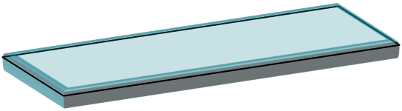

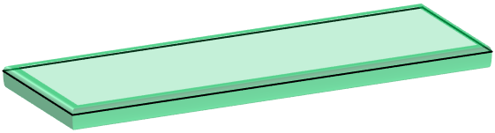

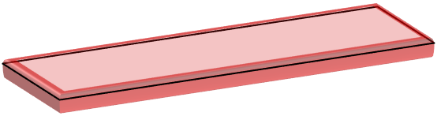




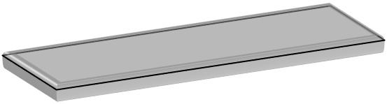
Materials
Multinetwork Approach - Data
Gene B
Gene A
Gene B
Gene A
Curated 2
Curated 1
Myeloid 2
Myeloid 1
Immune 2
Immune 1
Author: Davide Mascolo
Reference: davidemascoloofficial@gmail.com

Slide 6
Methods
DEGs & Network Analysis
Objective: Identify DEGs w.r.t. Resistance condition.
Data:
  RNA Counts filtered by DEGs.
    Response: 52 patients
    Resistance: 84 patients
Differential Co-Expression Network: Capture alterations in connections between nodes across different conditions.
Author: Davide Mascolo
Reference: davidemascoloofficial@gmail.com

Slide 7
Methods
Multinetwork Approach
Data:
  Genomic Data filtered by 10% differential co-expression hubs.
  Transcriptomic Data filtered by 10% differential co-expression hubs.
  Clinical Signatures.
Algorithm: Similarity Network Fusion and Spectral Clustering.
Validation:
  Cox log rank test, with α = 0.05.
  Hypergeometric Test to enrich cluster significance.
Author: Davide Mascolo
Reference: davidemascoloofficial@gmail.com

Slide 8
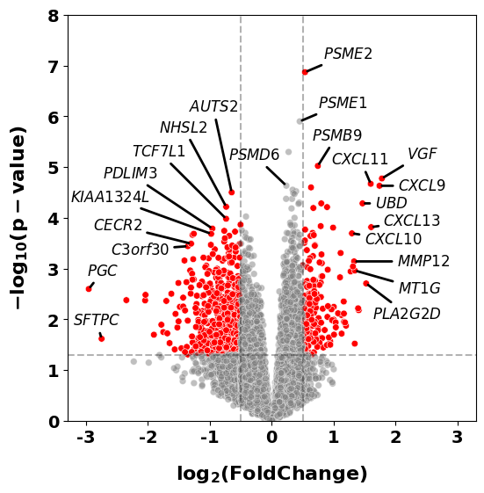
Preliminary Analysis
DEGs Analysis
Key Points:
  fold change ≥ 0.5 and p-value < 0.05.
  False Discovery Rate correction
  DEGs = 857
Relevant Genes:
  SFTPC
  PGC
  CXC Chemokine Family
Fig. 3: DEGs with Volcano Plot
Author: Davide Mascolo
Reference: davidemascoloofficial@gmail.com

Slide 9
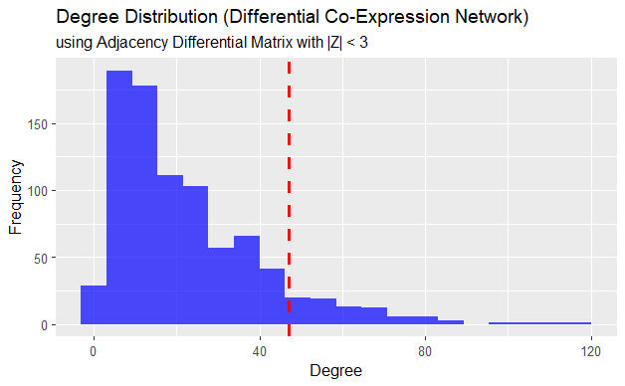
Results
Differential Co-Expression Network
Key Points:
  Quantile 90% (degree ≥ 46)
  10% most connected hubs (N = 89)
Fig. 6: Differential Co-Expression Network
Author: Davide Mascolo
Reference: davidemascoloofficial@gmail.com

Slide 10
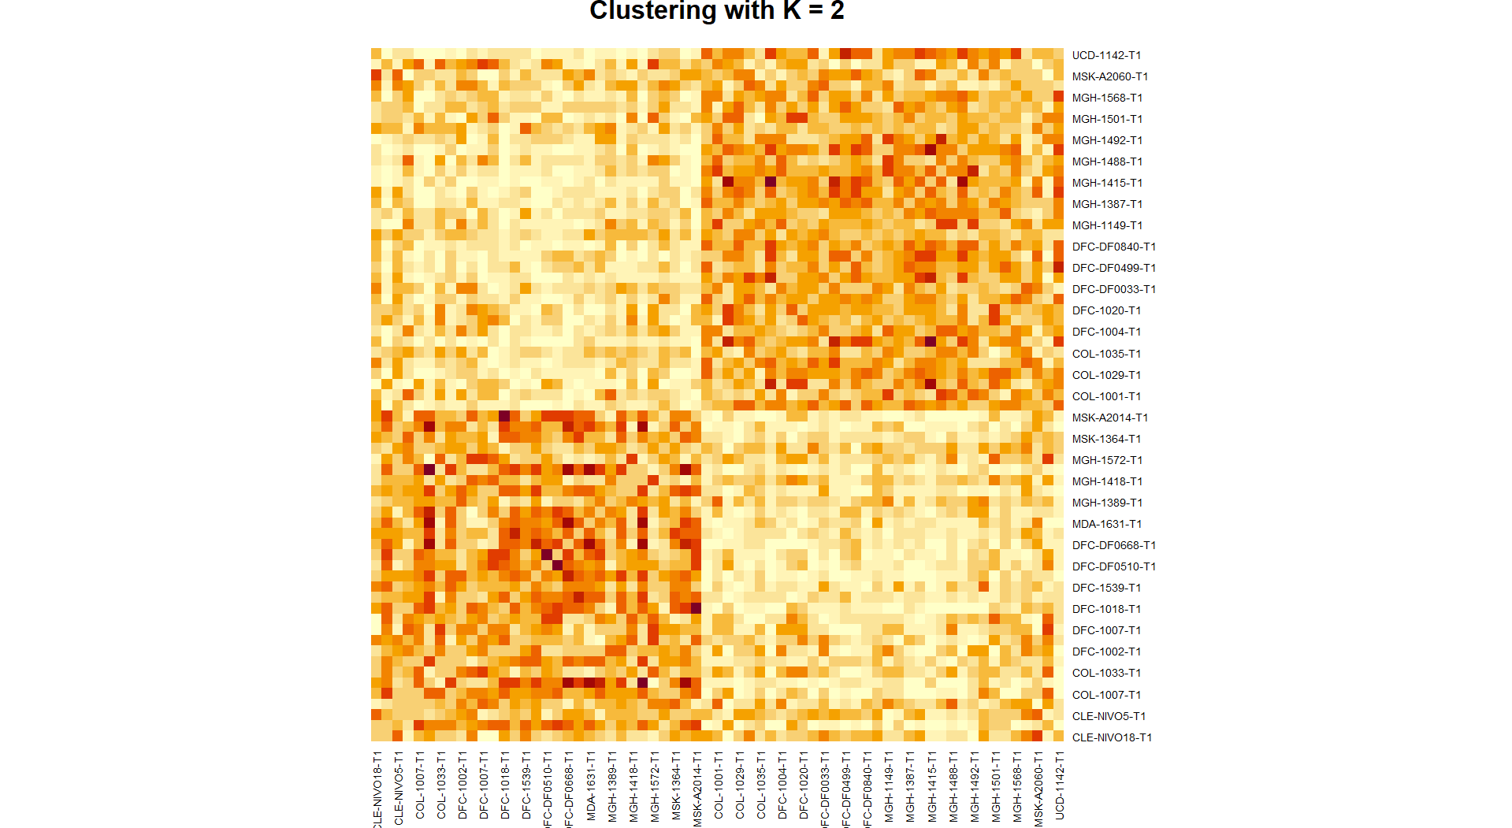
Results
Multinetwork Analysis
Communities: 2
  Resistance
  Response
Community | Hypergeometric Test P-value
01 | 0.0014
02 | 0.0013
Fig. 7: Spectral Clustering with SNF
Author: Davide Mascolo
Reference: davidemascoloofficial@gmail.com

Slide 11
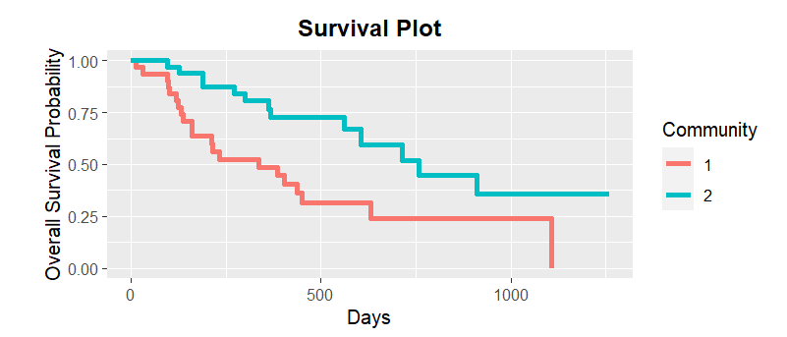
Results
Multinetwork Analysis
Communities: 2
  Resistance
  Response
Fig. 8: Survival Analysis for SNF Clusters
Community | Median Survival Time (Days)
01 | 214
02 | 470
Cox Log Rank Test P-value
0.004
Author: Davide Mascolo
Reference: davidemascoloofficial@gmail.com

Slide 12
Conclusions
Data Integration Significance: Highlight the critical importance of integrating diverse data sources when studying complex and heterogeneous phenomena.
Power of Network Analysis: The study demonstrates how network approaches can reveal hidden information within complex datasets.
Value of Preliminary Analyses: Selection of genes to avoid the information redundancy expressed by the many genes.
Author: Davide Mascolo
Reference: davidemascoloofficial@gmail.com

Slide 13

Authors: Davide Mascolo, Manuela Petti, Lorenzo Farina
BIBM 2023
IEEE International Conference on Bioinformatics & Biomedicine
Reference: davidemascoloofficial@gmail.com
Thank You For Your Attention

