Slide 1
DevOps?
Learn you meteor, webpack secrets, and devops! @ General Assembly
Monday, November 14, 2016
Presented by glenn e. mate

Slide 2
Agenda
Intro
What is DevOps?
Challenges / Current status / Goals
What does Devops look like?
Glimpse into operational tooling to support a day in the life
Let’s do a deploy!
Further education resources

Slide 3

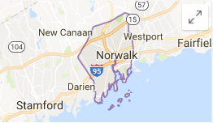
About me
Working in information technology for more than 6 years, passionate about tech for over fifteen years
Cloud Automation Engineer at North American Power (Norwalk, CT)
Drinking the DevOps Kool-Aid!

Slide 4
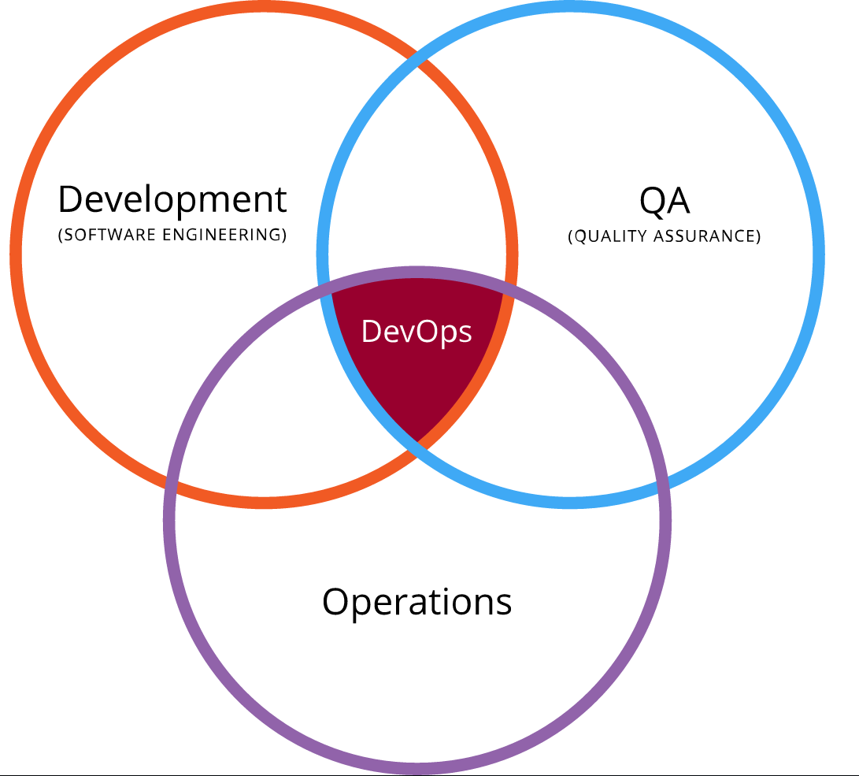
What is DevOps?
“The term “DevOps” typically refers to the emerging professional movement that advocates a collaborative working relationship between Development and IT Operations, resulting in the fast flow of planned work (i.e., high deploy rates) while simultaneously increasing the reliability, stability, resilience and security of the production environment.”
- Gene Kim
Image source: Wikipedia

Slide 5
What is DevOps?
DevOps is born out of many things, influenced by even more
Agile (now that we’re all standing up…)
Lean (manufacturing!)
Deming (Quality = { Result of work efforts / Total Costs } )
Toyota (Kaizen)

Slide 6
Metrics of IT performance
Lead time for changes
Release frequency
Time to restore service
Change fail rate

Slide 7
Predictors of IT performance
Peer-reviewed change approval process
Version control everything
Proactive monitoring
High-trust organizational culture
A win-win relationship between dev and ops

Slide 8
Challenges
Live coding in production
No version control
Complete lack of testing
Manual QA processes

Slide 9
Currently
New Greenfield application, done right from the get-go!
Millions of lines of code in version control (application, infrastructure, services – you name it)
85% code coverage, testing available via automation pipelines and on-demand
Implementing automation around QA for regression and integration testing
Deployments and environment creation daily in a repeatable, stable, continuous fashion

Slide 10
Goals
Continue to refine scripting to interweave many infrastructure and developer components
Implement a functioning continuous deployment to staging model, tune and POC for production
QA automation
Hire more like-minded people!

Slide 11
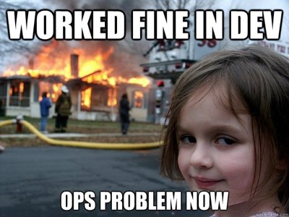
How?
DevOps!

Slide 12
But seriously…
DevOps adoption is not an overnight process.
Requires management and stakeholder buy-in.
Greenfield is waaaaaay easier than applying principles to legacy systems
- Lack of existing testing
- Many manual steps with no native automation baked in (or lack of third party support)
- Change management can be a blocker

Slide 13
But what does it mean?
“DevOps means giving a shit about the job enough to not pass the buck”
“DevOps means giving a shit about your job enough to want to learn all the parts and not just your little world.”
“Developers need to understand infrastructure.”
“Operations people need to understand code.”
- John E. Vincent
Source: John E. Vincent (http://blog.lusis.org/blog/2013/06/04/devops-the-title-match/

Slide 14
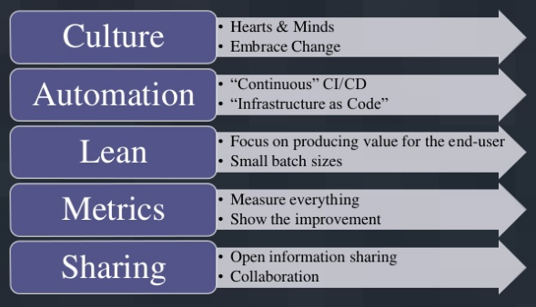
But what does it mean?
CALMS model for DevOps. A lot more than just the tools at use!
Image source: DevOpsGuys BrightTalk Oct 9, 2013; https://www.brighttalk.com/webcast/534/87307/devops-itil-and-anti-fragility-to-protect-or-to-serve

Slide 15
What does it look like?
Version Control and Systems (the foundation)
Git, Subversion, Mercurial – in Github, Bitbucket, etc.
Configuration management (the framing)
Chef, Ansible, Puppet, OpenStack
Testing (the scaffolding)
Unit testing, integration testing, regression testing, smoke testing
Continous Integration / Deployment (the workforce)
Build and deployment pipelines, automated testing and validations, intuitive rollbacks, QA automation
Developers (the architects)
The code, the framework, interaction with Operations

Slide 16
Let’s talk real life
A day in the life as a DevOps guy?
Morning stand-ups
Code before lunch, triage tickets as needed
Team meeting mid-day
Code until late-day, testing and staging the day’s changes
Merge and deploy!
…and putting out fires.

Slide 17
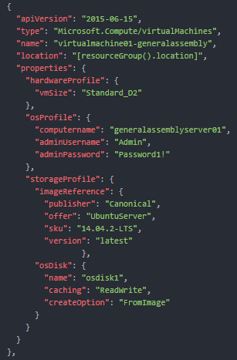
Deploying in Azure
Azure Resource Manager (ARM) templates are static JSON construct files which define the creation of objects in the cloud provider space.
Parameters can be filled in at runtime to manage machine size, public IP address information, or any other value/variable you can image
More than just virtual machines – provision PaaS services such as websites, DNS records, caching, certificates and more
Call your template deployment via a CLI tool, SDK or API – by hand of via automation.

Slide 18
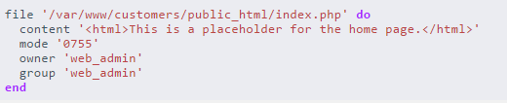
Chef to manage infrastructure
Idempotent, immutable, version controlled infrastructure-as-code. Written in a ruby DSL.
No changes occur without a commit.
Chef resources are aggregated into ruby files, known as ‘recipes’.
Recipes are aggregated by role, application, or need into ‘Cookbooks’
Cookbooks are versioned on the Chef server, pinned by environment (dev, QA, staging, prod, etc.)

Slide 19
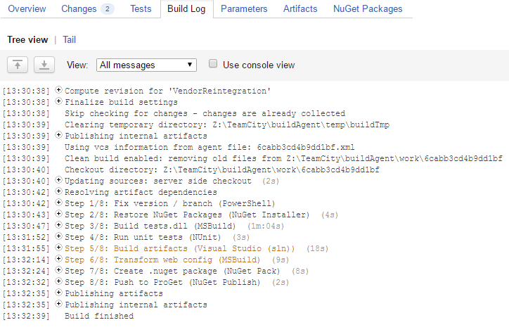
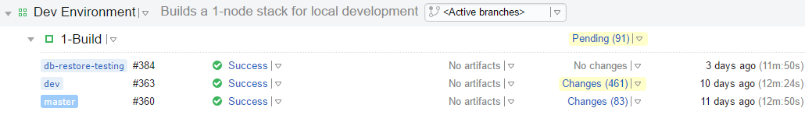
Build your code
TeamCity is a Java-based build management / continuous integration server from JetBrains.
Hook into version control to execute build steps automatically or on-demand
Execute scripts and code – sky is the limit
Run through steps on your branch to execute tests, build artifacts, deploy, or hook into other systems

Slide 20
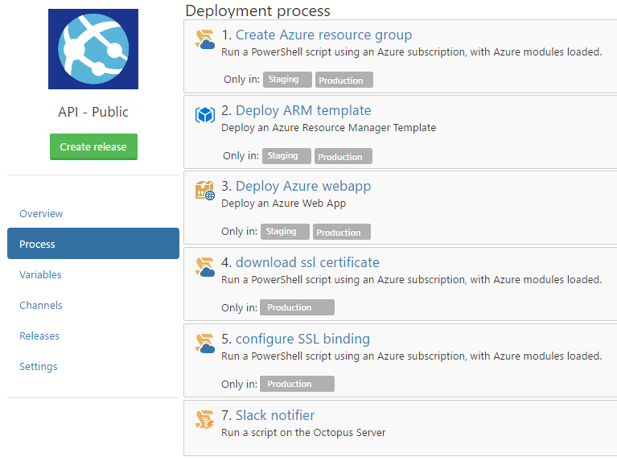
Deploy your artifacts
OctopusDeploy is a deployment automation tool for .NET development
Built for developers, by developers – put the tools in their hands!
Keep it short and simple!

Slide 21
Let’s do a deploy!
Commit a change to a Chef recipe
Watch TeamCity run the commit through the testing / validation Gauntlet
Showcase what a successful build / failed build looks like
Kick off a new development application environment for our website
Show the objects being created in Azure via automation, all from a single click
Showcase a finished build

Slide 22
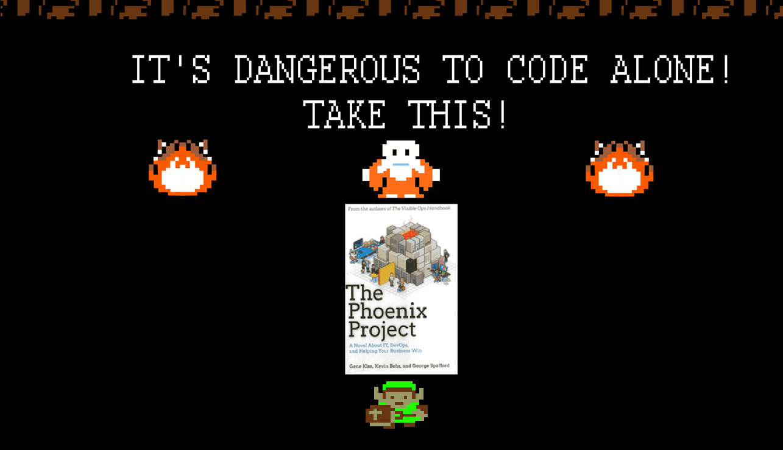

Slide 23
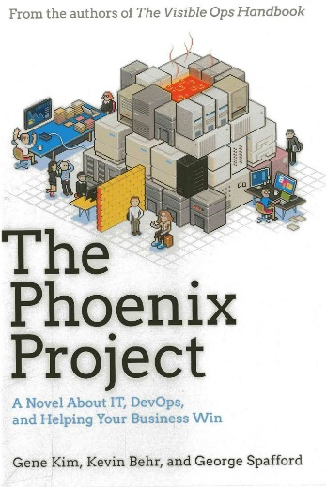
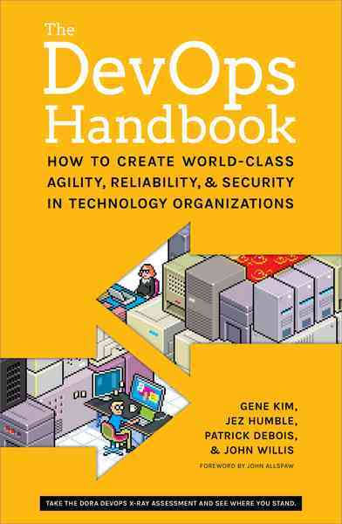
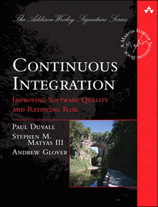
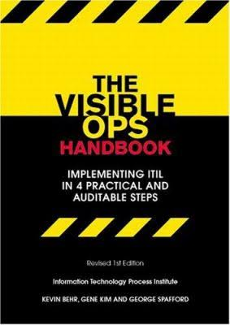
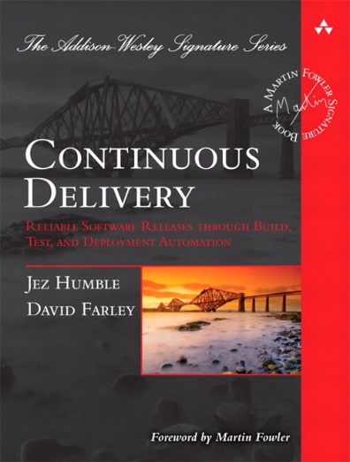
Where can I start to learn? RTFM!
The Phoenix Project
Gene Kim, Kevin Behr, George Spafford
The DevOps Handbook
Gene Kim, Jez Humble, Patrick Debois, John Willis
Continuous Integration
Paul Duvall, Stephen Matyas, Andrew Glover
The Visible Ops Handbook
Kevin Behr, Gene Kim, George Spafford
Continuous Delivery
Jez Humble, David Farley

Slide 24
Where can I start to learn? Talks!
Chef Style DevOps Kungfu (Adam Jacob, CEO – Chef)
https://www.youtube.com/watch?v=_DEToXsgrPc
Injecting Failure at Netflix (Corey Bertram, SRE – Netflix)
https://www.youtube.com/watch?v=ioXV28GtXeo
The Microsoft DevOps Vision (Donovan Brown, Sr. Program Mgr. DevOps – Microsoft)
https://www.youtube.com/watch?v=3WWpx4W-oK8
Radical Ideas Enterprises can Learn from the Cloud (Tom Limoncelli, SRE Manager – Stack Overflow)
https://www.youtube.com/watch?v=4pso_4vfyow
Keynote ChefConf2015 (Jez Humble, Dir. Delivery Architecture – GSA)
https://www.youtube.com/watch?v=L1w2_AY82WY

Slide 25
Thank you
For copies of this slide deck please reach me directly:
glennmate@gmail.com
http://lnkd.in/ZVdpit

