Slide 1
Audio Recognition using CNN
Detecting Audio events for epic-sounds challenge using Overlapping pooling layers and learning rate step decay
Sokolo d. Matsolo

Slide 2

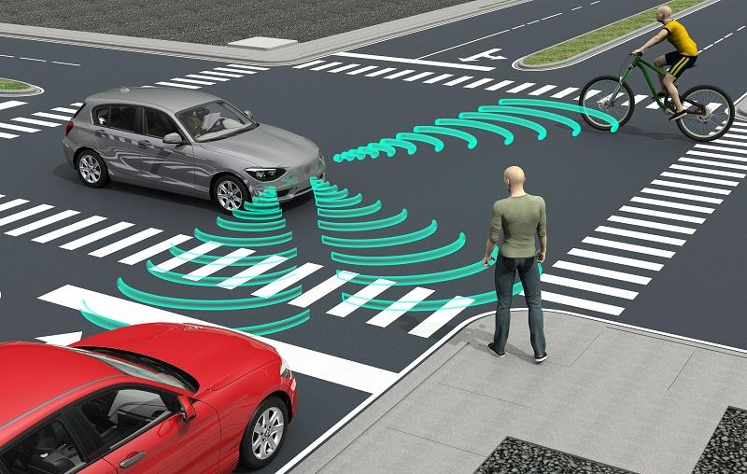

applications
Pedestrian Security
Improve Sound Quality in Electric Cars
Assists Visually impaired
Why?

Slide 3
Similar work
"DCASE 2016 Sound Event Detection System Based on Convolutional Neural Network" by Arseniy Gorin, Nurtas Makhazhanov, and Nickolay Shmyrev.
Sound Event Detection Based on Convolutional Neural Networks with Overlapping Pooling Structure by Hang Zhu and Hongjie Wan 2021
"An automatic learning rate decay strategy for stochastic gradient descent optimization methods in neural networks" by Kang Wang.

Slide 4
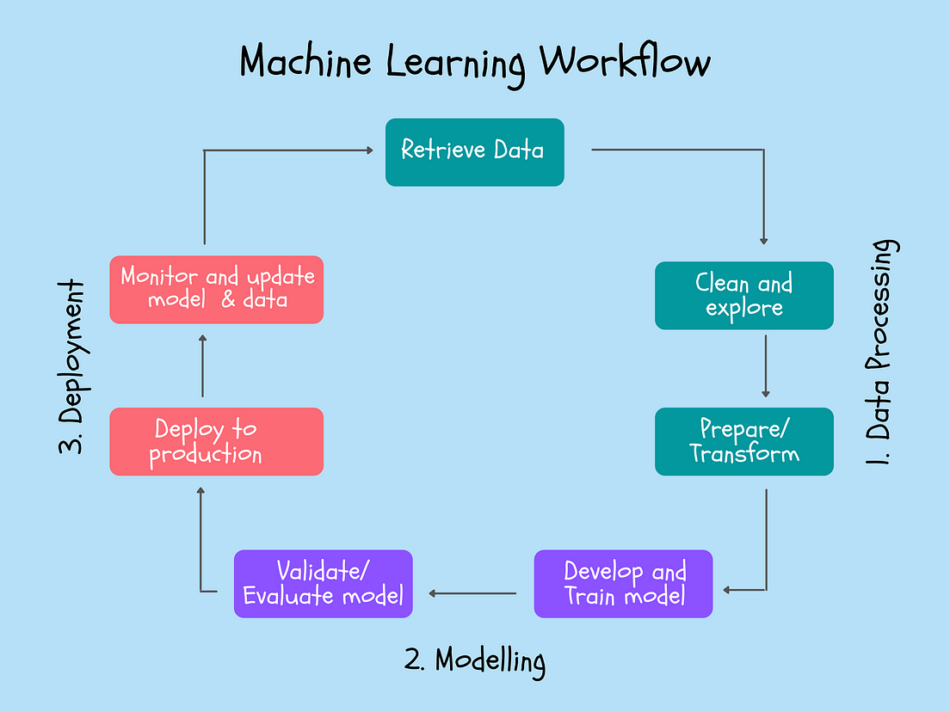
methods
Data Preprocessing
Network Architecture
Hyper-Parameters

Slide 5
Data preprocessing
Use of Log Mel Spectrum to Extract Features
Over-sampling to overcome Data Imbalancing
PCA to Reduce Dimensions
Label encoding on output labels

Slide 6
Model architecture
Conv Laer
Poolimg Layer
Conv Layer
Poolimg Layer
Flatten Layer
Prediction
Full Connection

Slide 7
Hyper-parameters
Filter Size: 35, number of convolutional kernels
Epochs: 100, Determines the number of iterations the model will train
Batch-Size: 32, Default size
Reduction Learning Rate: Provides adaptive learning rate
Reduction factor: 0.5
Minimum Learning Rate: 0.00001
Patience: 5

Slide 8
results
EPOCHS | LOSS | ACC | VAL_LOSS | VAL_ACCURACY
25 | 1.2491 | 0.6013 | 1.4026 | 0.5790
50 | 0.9835 | 0.6824 | 1.1842 | 0.6483
75 | 0.6825 | 0.7766 | 1.0432 | 0.7195
100 | 0.6394 | 0.7912 | 1.0310 | 0.729

Slide 9
conclusion
Limitation
Unbalanced Classes: over-sampled
Building Input Data Pipeline: binary vectors
System Performance
Overfitting
Miscalculation
System Performance
Limitation
Future Work

Slide 10
Thank You

