Slide 1



and : Getting HELP

Slide 2
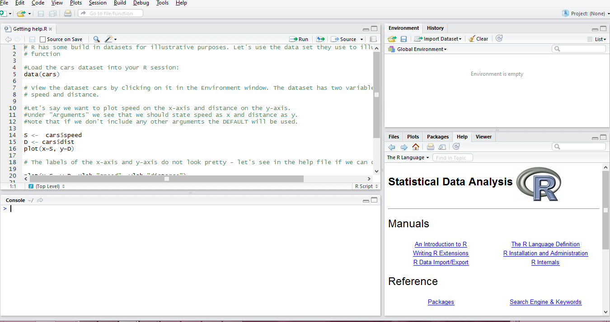
The R help files
Go to the Help window in R Studio

Slide 3
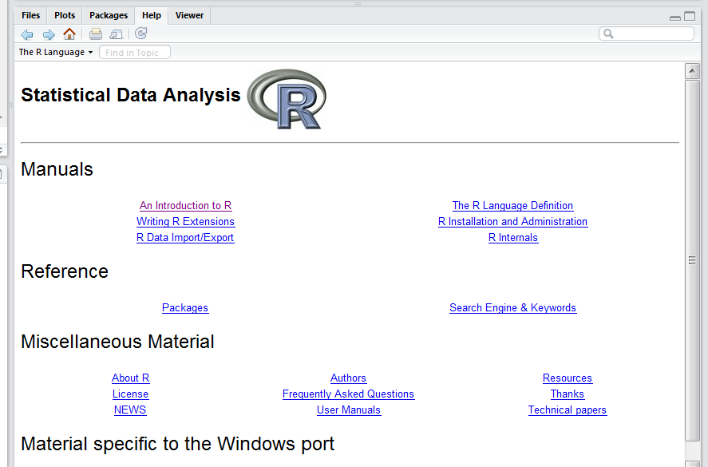

The R help files
Type a keyword in the search block. Say you want to find out how to make a scatter plot:

Slide 4
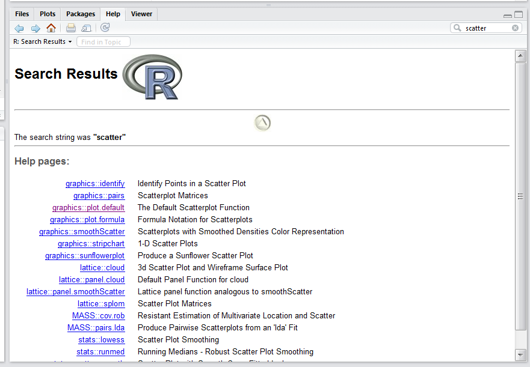
The R help files
This will return a list of all help files that contain the word scatter:

Slide 5
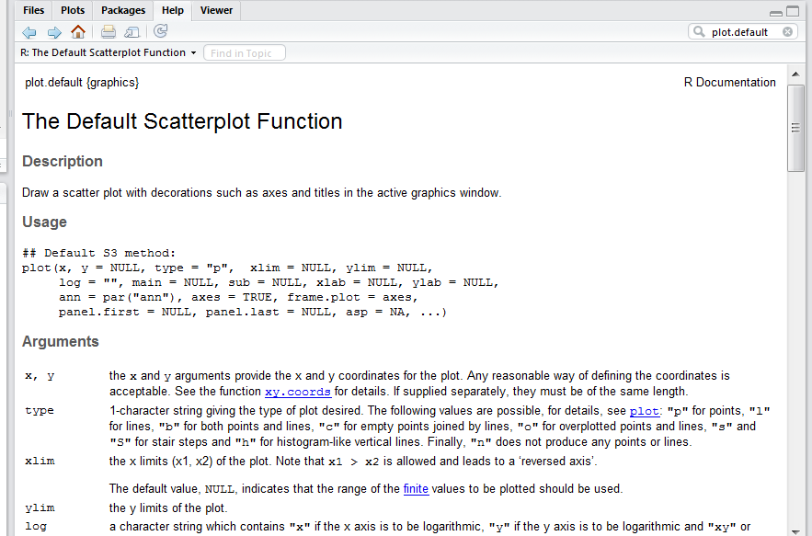
The R help files
To illustrate the navigation of the Help files, I will use the basic scatterplot function.

Slide 6
The “cars” dataset
R has some build in datasets for illustrative purposes. Let's use the data set they use to illustrate the plot() function
Load the cars dataset into your R session:
data(cars)
View the dataset cars by clicking on it in the Environment window. The dataset has two variables called
speed
dist

Slide 7
The plot() function
The arguments of plot()are the values
For the cars dataset, we have
x = speed
y = dist
… = ???
plot(x, y, ...)
x the coordinates of points in the plot. Alternatively, a single plotting structure, function or any R object with a plot method can be provided.
y the y coordinates of points in the plot, optional if x is an appropriate structure.
… Arguments to be passed to methods, such as graphical parameters (see par).

Slide 8
The plot() function
The “…” are additional arguments that we use to complete our graph/plot. These include:
type: the type of plot to be drawn
main: an overall title for the plot
sub: a sub title for the plot
xlab: a title for the x axis
ylab: a title for the y axis
asp: the y/x aspect ratio
For more graphical parameters, search “par”
All the above is found in the help section of plot()

Slide 9
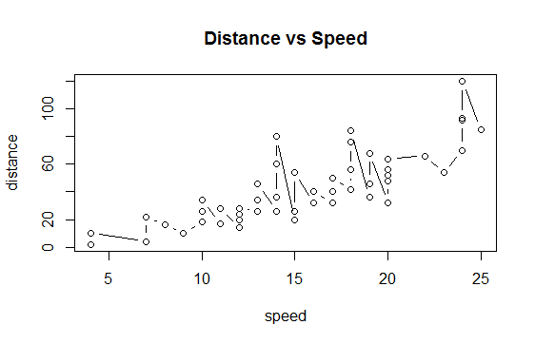
Example of plot() function
Load the cars dataset into your R session:
data(cars)
Plot speed on the x-axis and distance on the y-axis
plot(cars$speed, cars$dist)
Add graphical parameters
plot(x=cars$speed, y=cars$dist,
type = “l”
xlab="speed", ylab="distance“,
main = “Distance vs Speed”)

Slide 10
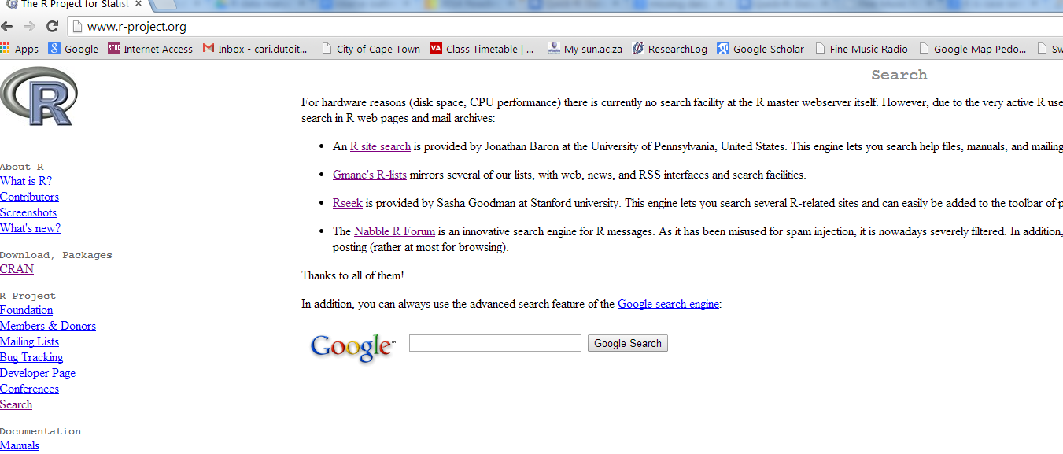
R-project.org
If you cannot find what you are looking for in the help files, go to the R website’s “Search” tab at: http://www.r-project.org/

Slide 11
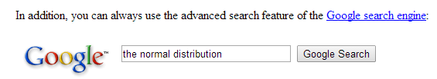
R-project.org
From here you can search in any of the four links provided, or you can perform a Google search.

Slide 12
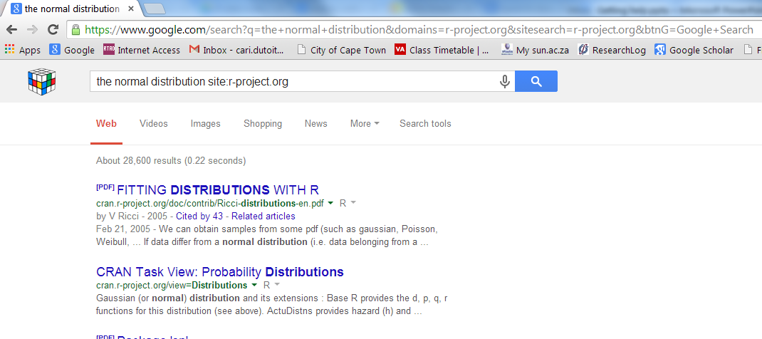
R-project.org
This will do a Google like search within the R-project website

Slide 13
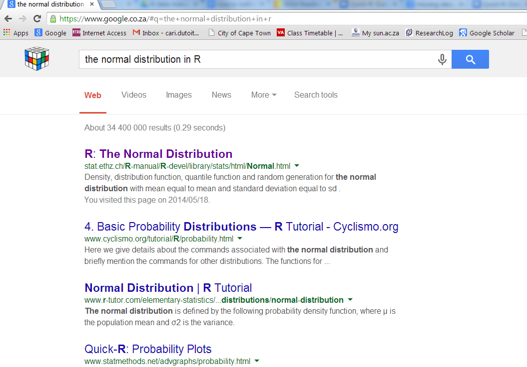
Google Search
You can also be brave and do a Google search, but be sure to add “in R” at the end of what ever you want to search.

Slide 14
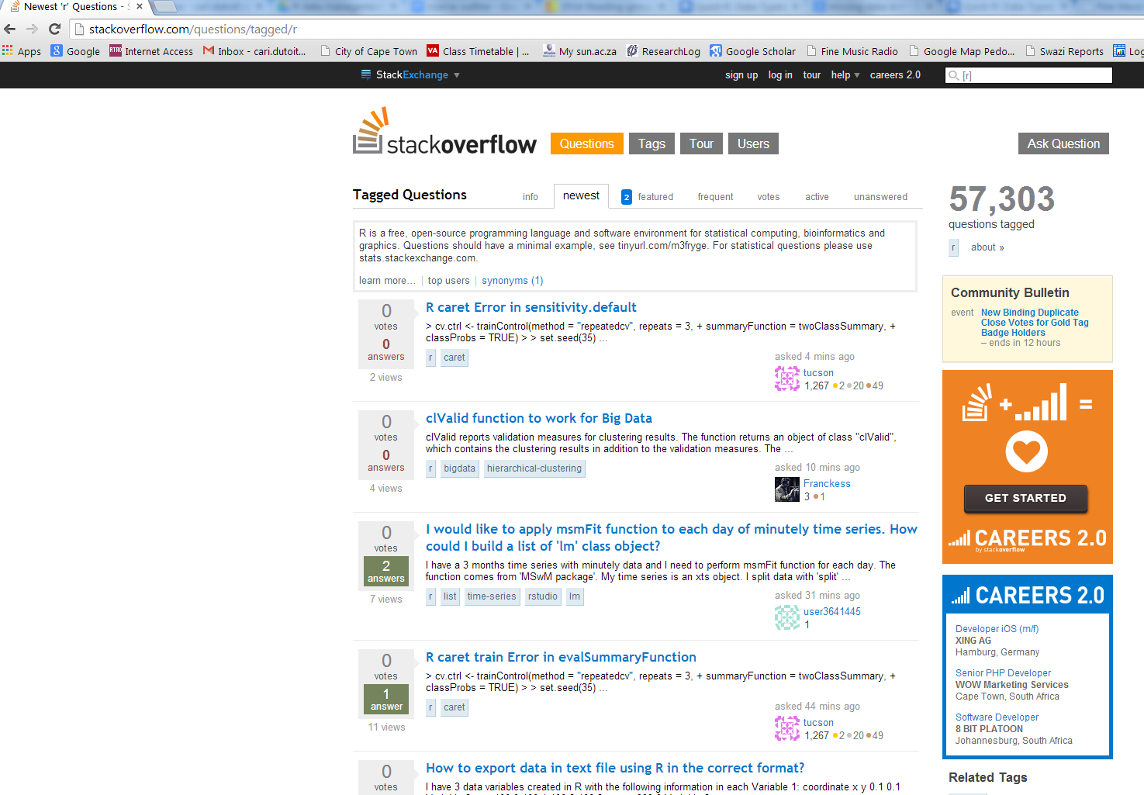
stackoverflow.com
You can search or ask a R related question in the forum www.stackoverflow.com

Slide 15
Vignettes
Some packages come with vignettes. They are essentially additionally documentations.
If we install the package “ape”,
Library(ape)
Then enter:
vignette()
To see a list of all available vignettes on your computer. To view one, enter:
vignette("MoranI", package="ape")

Slide 16
Tutorial
1) Install the following packages:
ggplot2 foreign Hmisc plyr colorspace lubridate ape knitr
MASS

Slide 17
2) Try find help for ggplot2.
2.1 If you cannot find help in R, where else can you look?
2.2 Find help for ggplot2.
2.3 Find the documentation for ggplot2.
3) When was the first version of foreign available on CRAN?
3.1 What is the Title in the help for foreign?
4) For “Hmisc “, what is the description from the help?
5) From the description in the help, what pattern does plyr make use of? And, what does this mean?
6) Besides RGB, give two other sets of colours from colorspace.
7) What does the package “lubridate” deal with?
8) From the help section, what does “ape” stand for?
9) From the help section, what is knitr an alternative to? And, how would you explain what it can be used for to someone else?
10)From the help section, give two datasets, and two functions from the package “MASS”.

Slide 18
answers
1)
2) http://ggplot2.org/ and http://docs.ggplot2.org/current/
3) 17-Dec-1999
3.1) from: library(help="foreign")
“Read Data Stored by Minitab, S, SAS, SPSS, Stata, Systat, Weka, dBase, ...”
4) from: library(help="Hmisc")
“The Hmisc package contains many functions useful for data analysis, high-level graphics, utility operations, functions for computing sample size and power, importing datasets, imputing missing values, advanced table making, variable clustering, character string manipulation, conversion of R objects to LaTeX code, and recoding variables.”
5) the split-apply-combine pattern in R.
6) HLS, HSV, LAB, LUV.
7) Time. “Lubridate provides tools that make it easier to parse and manipulate dates.“
8) Analyses of Phylogenetics and Evolution.
9) alternative tool to Sweave. “The knitr package was designed to be a transparent engine for dynamic report generation with R”
10) library(help="MASS")

