Slide 1



and : Getting HELP

Slide 2
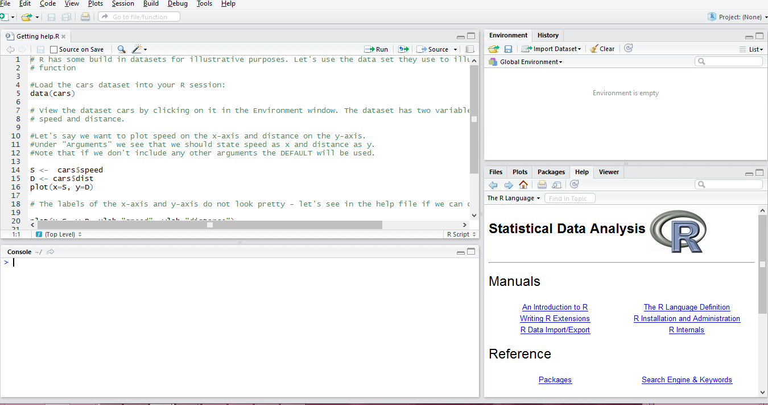
The R help files
Go to the Help window in R Studio

Slide 3
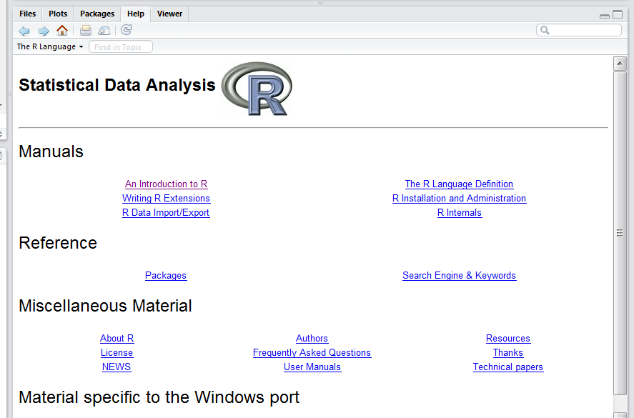

The R help files
Type a keyword in the search block. Say you want to find out how to make a scatter plot:

Slide 4
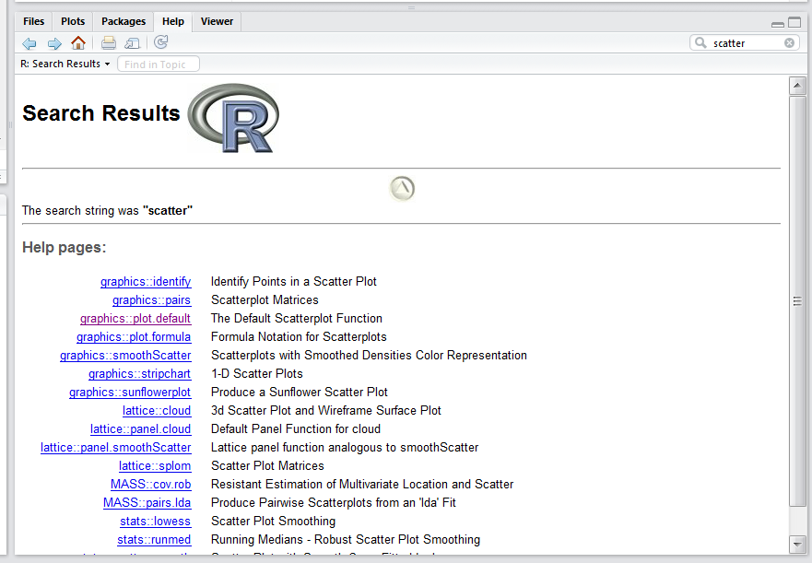
The R help files
This will return a list of all help files that contain the word scatter:

Slide 5
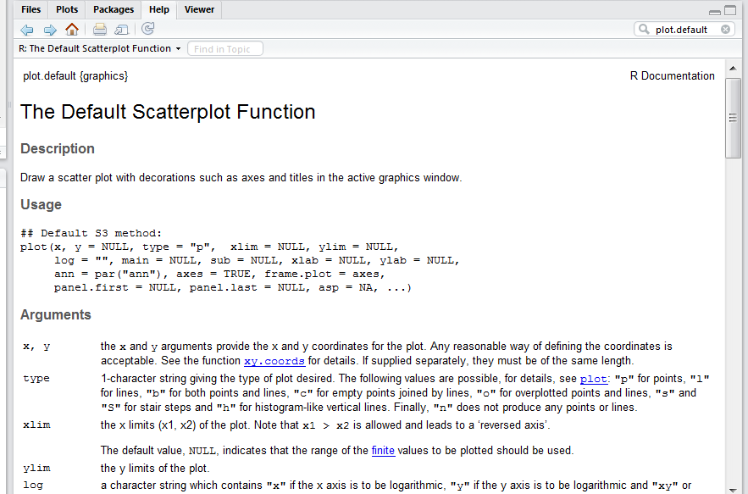
The R help files
To illustrate the navigation of the Help files, I will use the basic scatterplot function.

Slide 6
The “cars” dataset
R has some build in datasets for illustrative purposes. Let's use the data set they use to illustrate the plot() function
Load the cars dataset into your R session:
data(cars)
View the dataset cars by clicking on it in the Environment window. The dataset has two variables called
speed
dist

Slide 7
The plot() function
The arguments of plot()are the values
For the cars dataset, we have
x = speed
y = dist
… = ???
plot(x, y, ...)
x the coordinates of points in the plot. Alternatively, a single plotting structure, function or any R object with a plot method can be provided.
y the y coordinates of points in the plot, optional if x is an appropriate structure.
… Arguments to be passed to methods, such as graphical parameters (see par).

Slide 8
The plot() function
The “…” are additional arguments that we use to complete our graph/plot. These include:
type: the type of plot to be drawn
main: an overall title for the plot
sub: a sub title for the plot
xlab: a title for the x axis
ylab: a title for the y axis
asp: the y/x aspect ratio
For more graphical parameters, search “par”
All the above is found in the help section of plot()

Slide 9
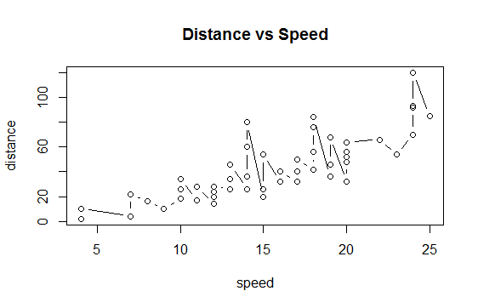
Example of plot() function
Load the cars dataset into your R session:
data(cars)
Plot speed on the x-axis and distance on the y-axis
plot(cars$speed, cars$dist)
Add graphical parameters
plot(x=cars$speed, y=cars$dist,
type = “l”
xlab="speed", ylab="distance“,
main = “Distance vs Speed”)

Slide 10
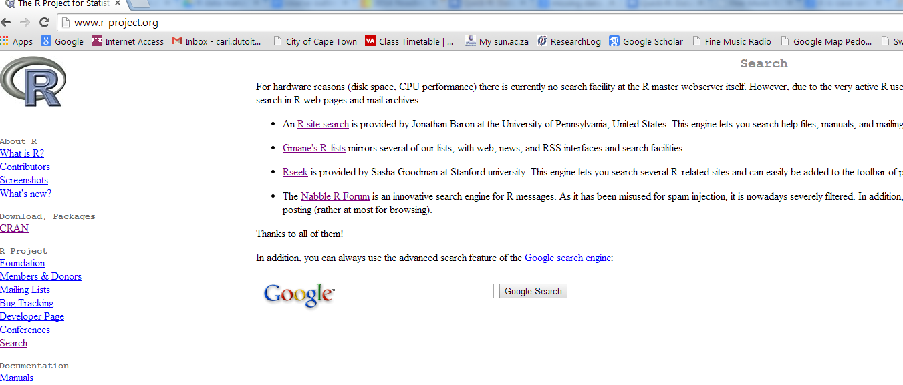
R-project.org
If you cannot find what you are looking for in the help files, go to the R website’s “Search” tab at: http://www.r-project.org/

Slide 11
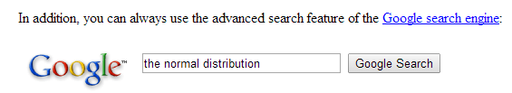
R-project.org
From here you can search in any of the four links provided, or you can perform a Google search.

Slide 12
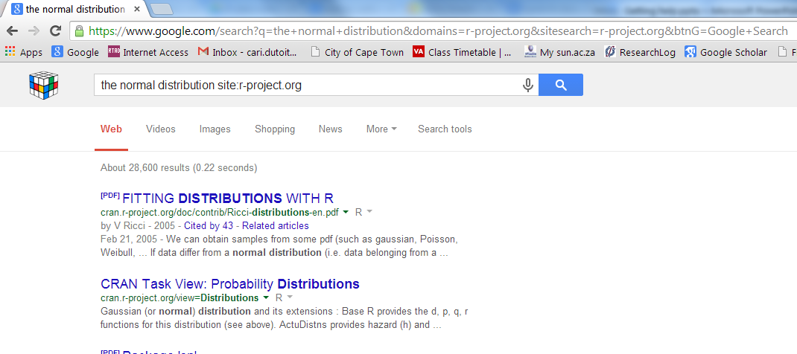
R-project.org
This will do a Google like search within the R-project website

Slide 13
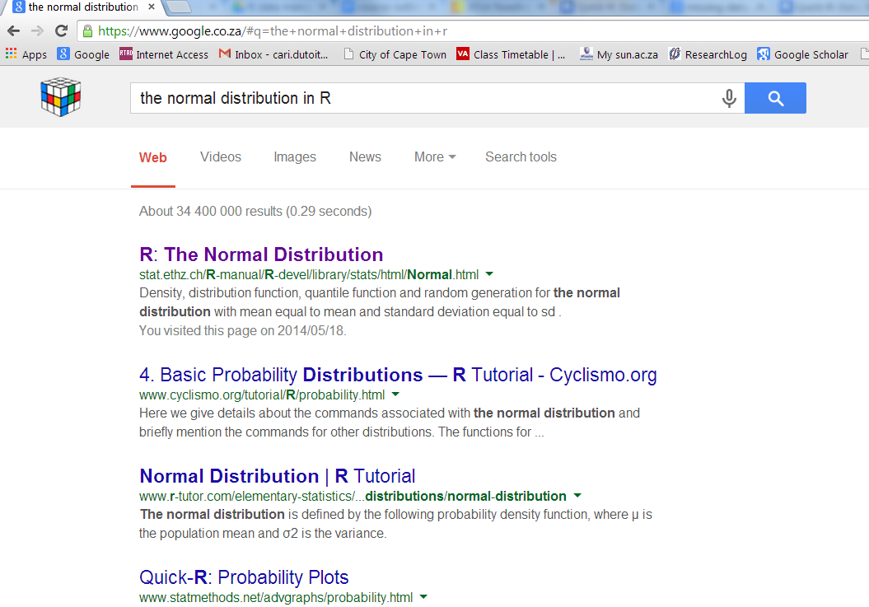
Google Search
You can also be brave and do a Google search, but be sure to add “in R” at the end of what ever you want to search.

Slide 14
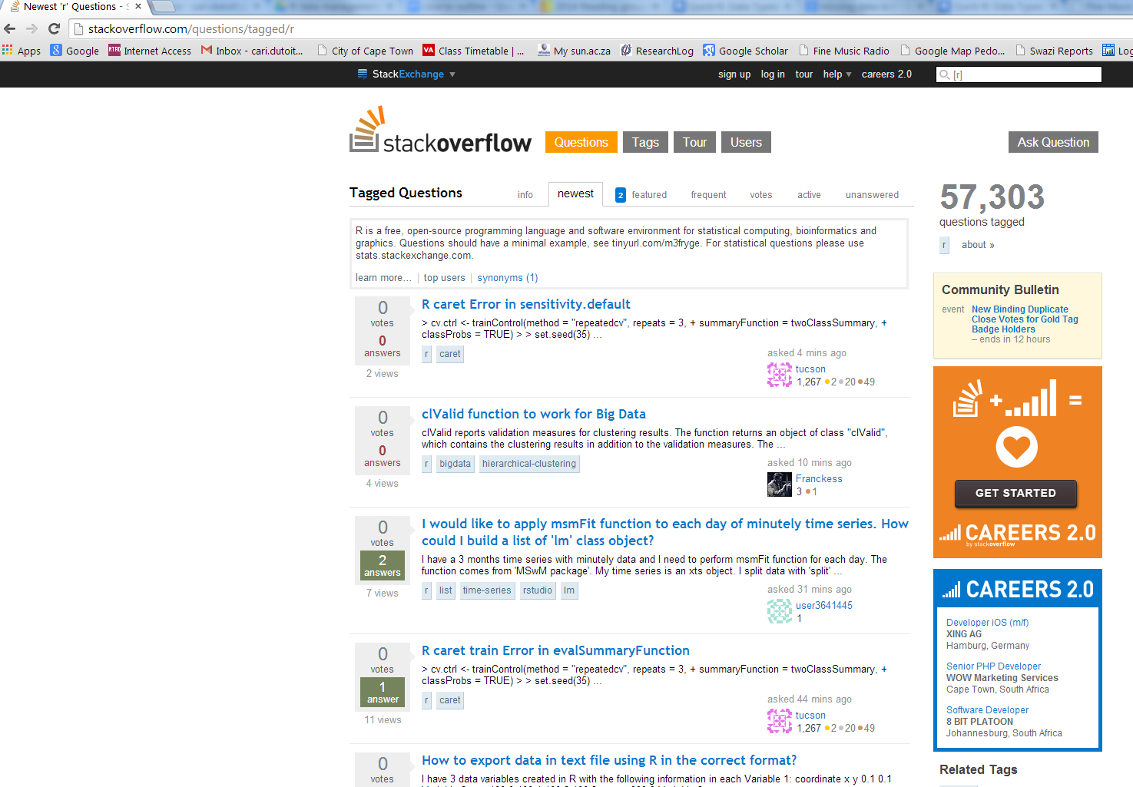
stackoverflow.com
You can search or ask a R related question in the forum www.stackoverflow.com

