Slide 1
The Avocado Story
Presented by
four-cados
Amelin, Andreja, David and Subba

Slide 2
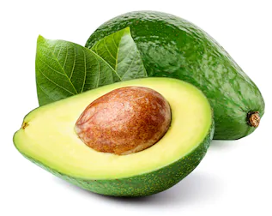
Table of Contents
Project Overview
Our Research
Exploratory Data Analysis
Correlation
Seasonality
Trends
Findings
Predictive Data Analysis
Feature Importances
Machine Learning Models
Conclusion

Slide 3
Project Overview
For the curious and those who would like to get involved into avocado industry as potential growers, sellers, investors or consumers,
we are forecasting avocado prices in various US cities and analysing what features are affecting avocado prices in the US.

Slide 4
Our Research
We research the topic of avocados throughout various forms of raw data, research papers, competitions, even documentaries and gather the following data for our analyses:
avocado sales in US cities
avocado production in the US, Mexico, Peru, Colombia and Chile
avocado market data in the US
climate data in California (biggest producer in the US).
Bonus: import/export data & health benefits of avocados.

Slide 5
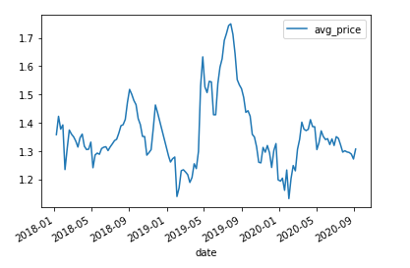
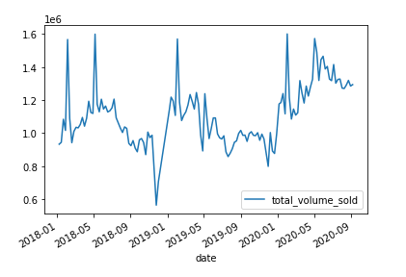
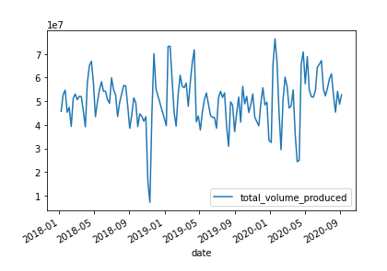
Exploratory Data Analysis
Seasonality in average price, volume sold and production.

Slide 6
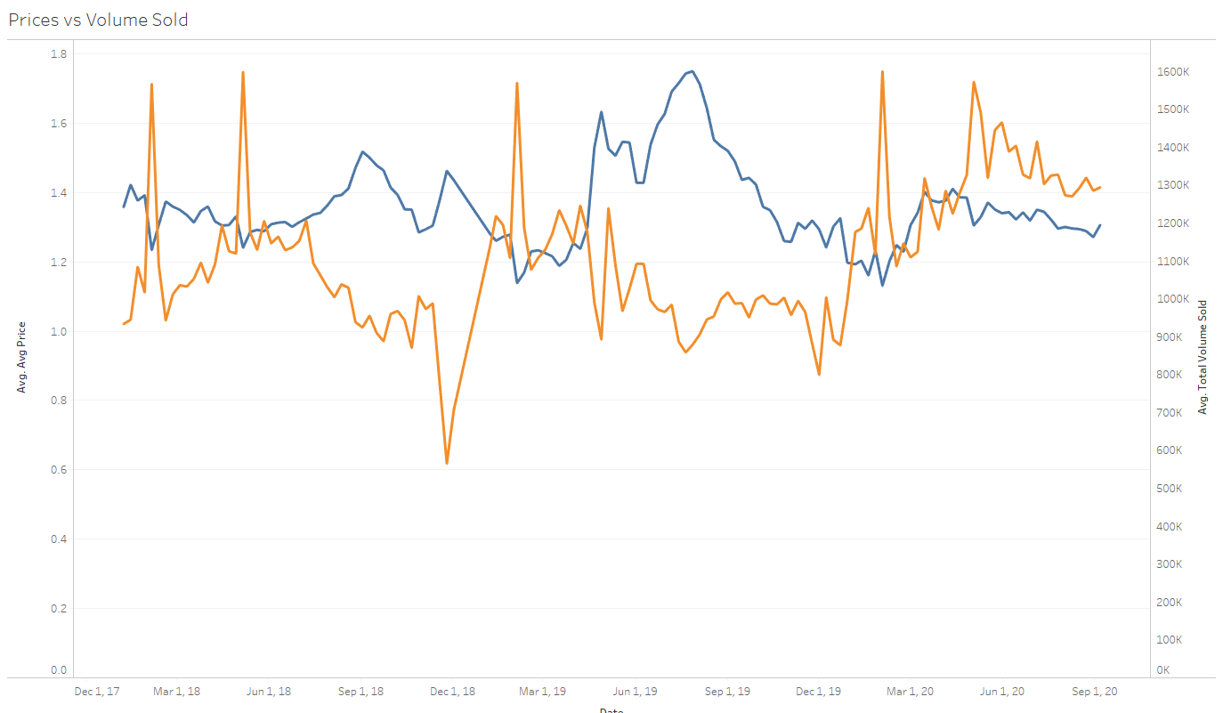
Exploratory Data Analysis
Negative correlation between average price and volume sold.

Slide 7
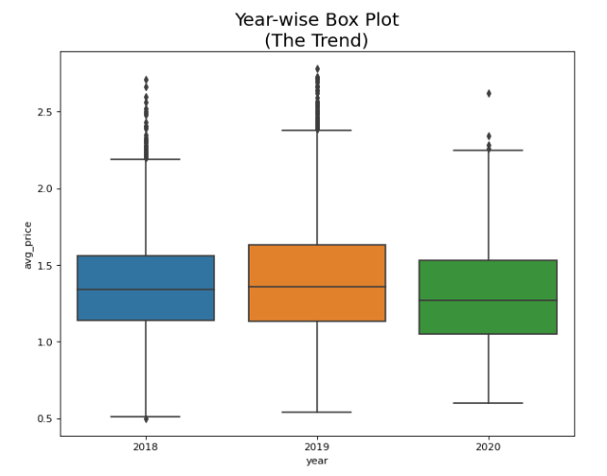
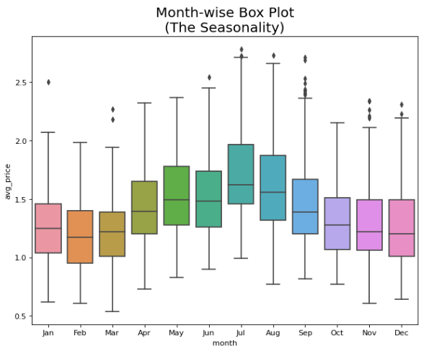
Exploratory Data Analysis
Detecting Outliers and Noise in the Dataset.

Slide 8
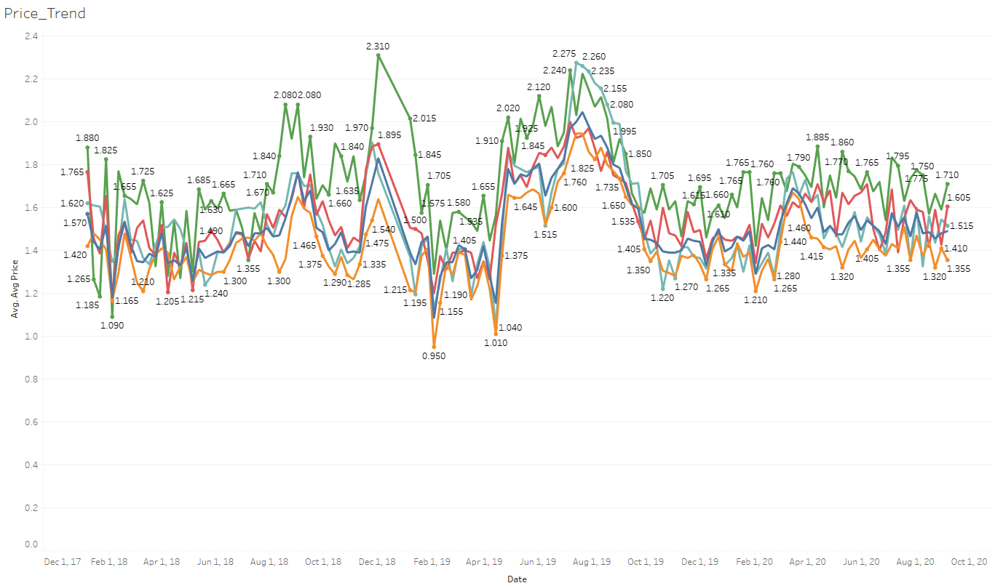
Interactive line chart that shows price trends of US cities and can be filtered by avocado type - organic or conventional and US cities.
Exploratory Data Analysis
Price trends in CA and
other major cities in
the US.
There was xx% increase in
average price from year
2018 to 2019 and xx%
decrease in average price
from 2019 to 2020 in CA.
(Source: Hass Avocado Board)

Slide 9
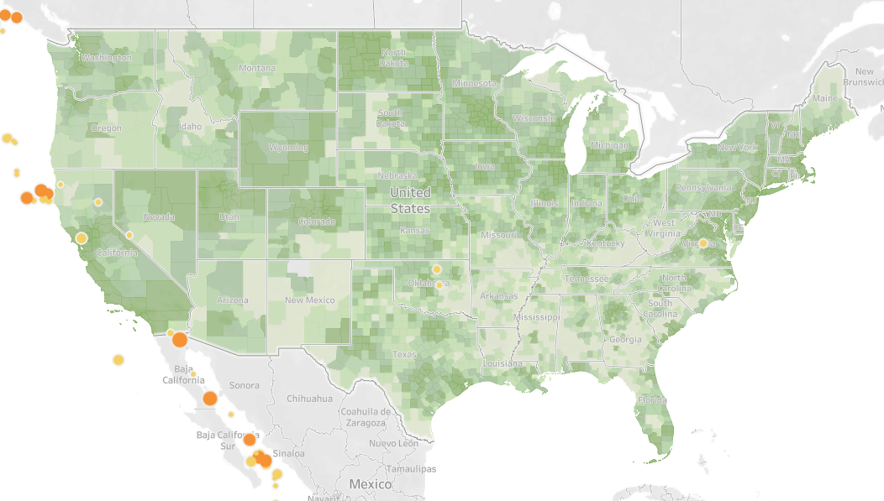
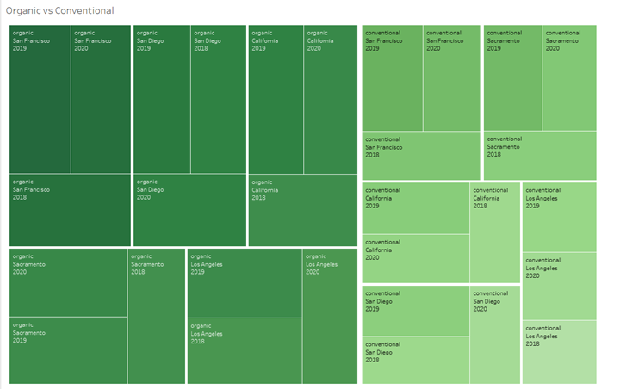
Interactive US map of selected regions that shows what regions have the highest or lowest average price and can be filtered by month.
Interactive chart that shows what cities has the highest/lowest prices of avocados.
Exploratory Data Analysis
US cities with the
highest and the lowest
avocado prices.
San Francisco had the highest
average avocado price in
August 2018 at $2.78. Huston had
the lowest average avocado price in
May 2020 at $0.78.
(Source: Hass Avocado Board)

Slide 10
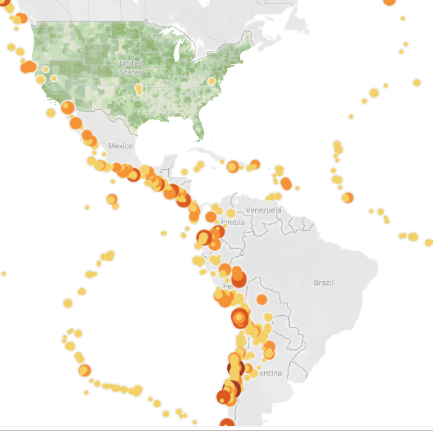
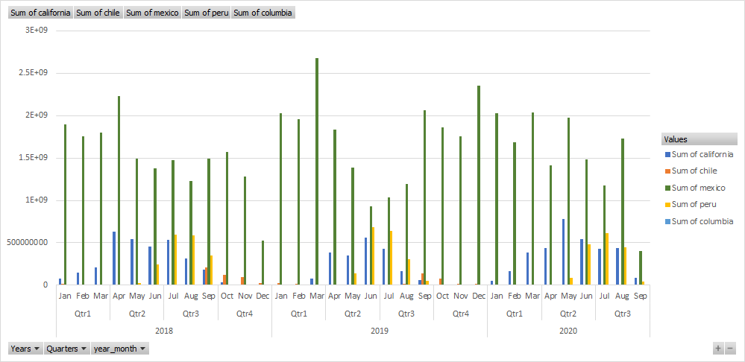
Interactive map of The Americas with production data that shows what countries have the largest production (the larger the circle, the larger production) and can be filtered by year.
Interactive bar chart with production data that can be filtered by country and year.
Exploratory Data Analysis
The largest producers of Avocados in Americas
Mexico is by far the largest producer of avocados in
Americas averaging xxx billion pounds in 2019 alone.
(Source: Hass Avocado Board)

Slide 11
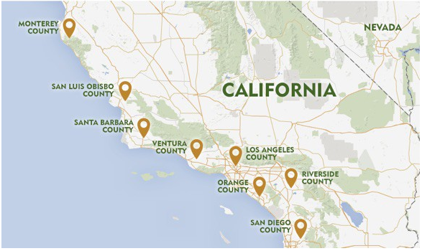
Interactive map of California that shows climate data and production and can be filtered by month.
Exploratory Data Analysis
Climate is affecting production in California.
Correlation between participation and
Avocado production.
(Source: Hass Avocado Board and Climate data)

Slide 12
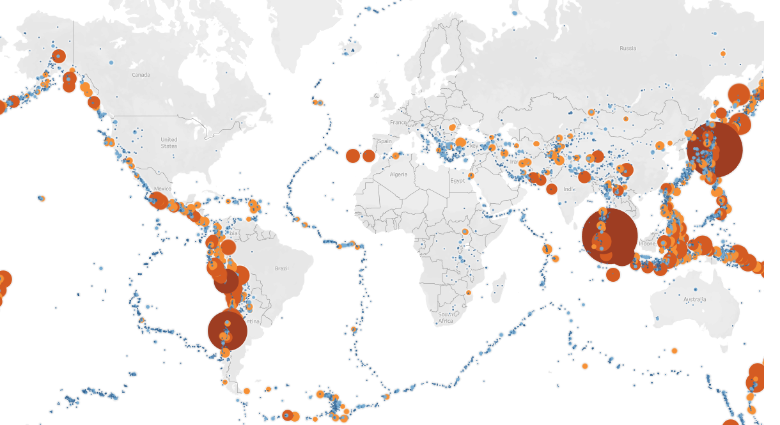
Interactive word map with lines to the countries were US avocados are exported and lines from what countries avocados are imported. The map can be filtered by import/export tradelines.
Exploratory Data Analysis
Where US avocados go?
Where are we getting
avocados from?
Mexico is the largest
importer of avocados in the US,
With 88% share amongst other
importers.
(Source: USDA.gov)

Slide 13
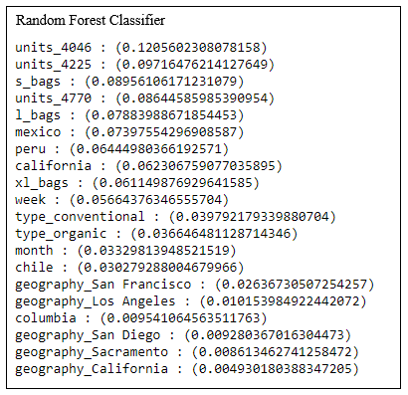
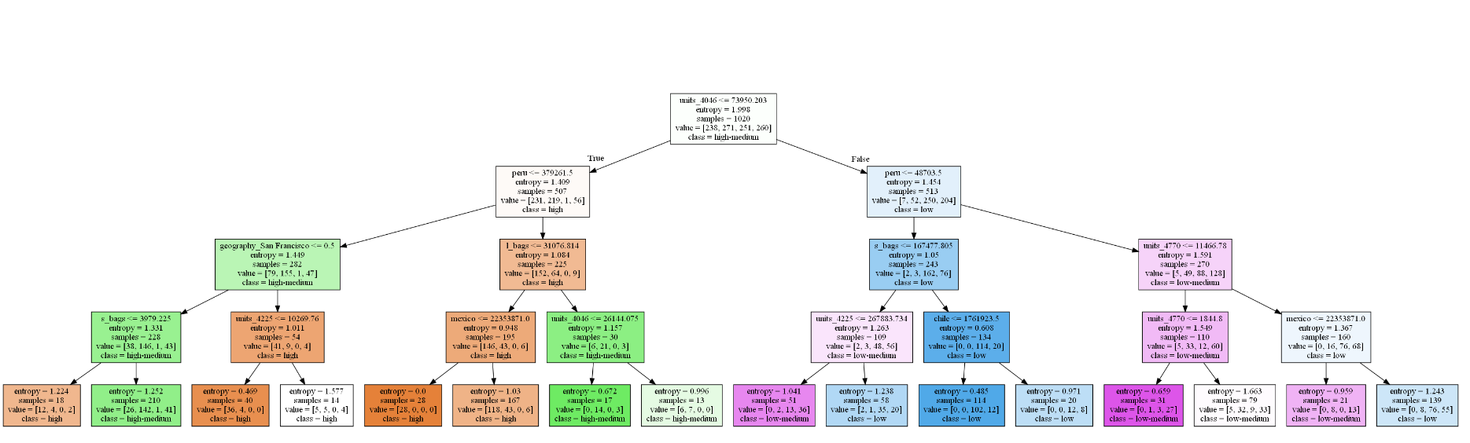
Predictive Data Analysis
What is defining the prices?
What features are important?
Random trees visualizations tells us a story.
Notes:
Which producers are influencing the prices the most. See feature importance list. Peru has the most weight on decision trees as producer. When is the season of avocados in Peru? San Francisco has lots of weight on ML decision as well - can we find connection?

Slide 14
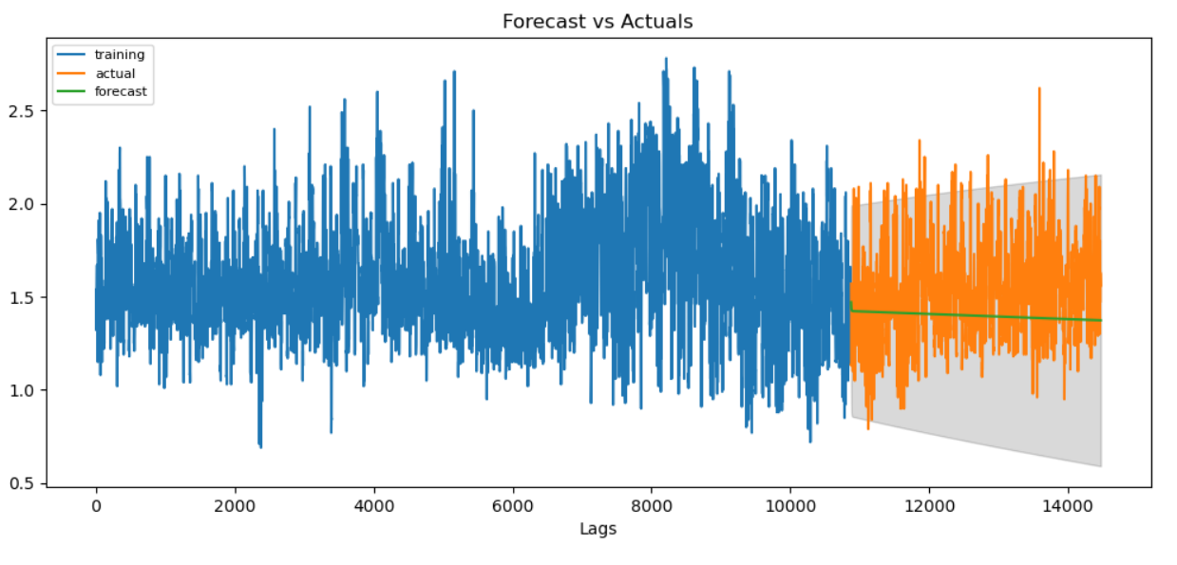
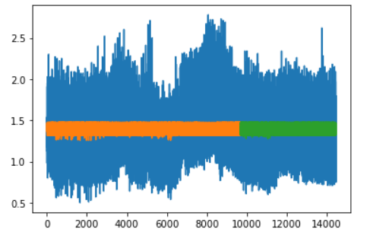
Predictive Data Analysis
ARIMA model accurately predicts avocado prices.
LSTM Forecasting model accurately predicts avocado prices.

Slide 15
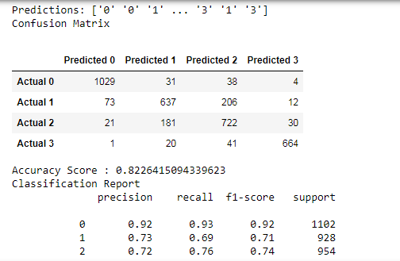
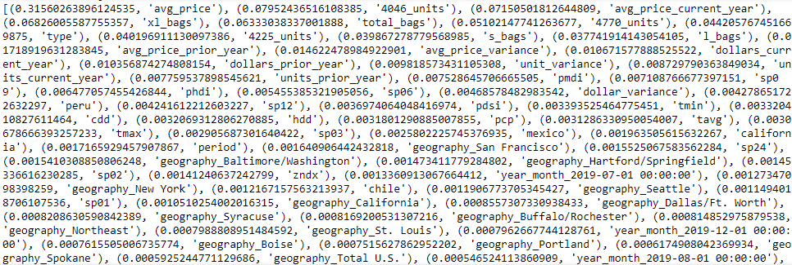
Predictive Data Analysis
Random Forest Classifier with 4 categories of
y-variables showed promising results.
From the list of features we can see the ones that
play the most important role at predicting
avocado prices.

Slide 16
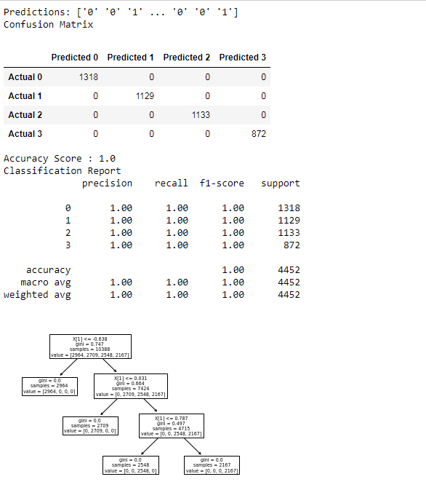
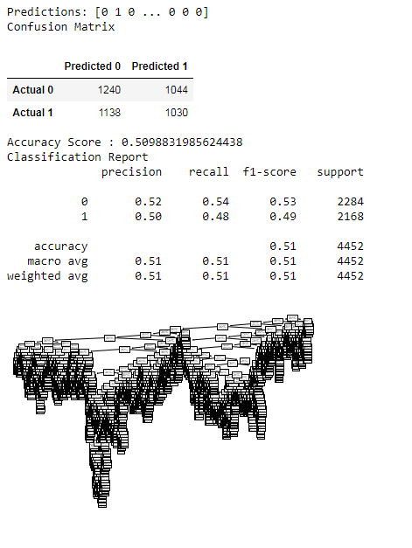
Predictive Data Analysis
Decision Tree Classifier showed different results when categorizing y-variable into 4 or 2 groups.

Slide 17
Conclusion
We as data analysts have ability to influence people and companies around the globe. There is a lot that goes into the price of this precious fruit and we surely could add more features. From long lines of code in Jupyter Notebook, multiple running of ML models and exploring visualizations with Tableau we improve another skill - the power to tell the story.

Slide 18
A blueprint for the dashboard
Storyboard summary
Description of the tool(s) that will be used to create the final dashboard
Description of interactive element(s)
On our dashboard we would like to present findings from our analyses throughout the phases of exploratory data analysis to predictive data analysis.
Our attempt is to build interactive visualizations with Tableau and deploy it via github pages. If time permits we would like to add interactive visualizations with JavaScript as well.
Our data comes in CSV format. In order to use it in JavaScript and libraries such as Plotly and Leaflet, we will need to convert it to JSON and GeoJson format.
A bar chart with production data that can be filtered by country.
Word map with production data that shows what countries have the largest production.
US map of selected regions that shows what regions have the highest or lowest average price and can be filtered by month.
Word map that shows lines where US avocados are exported and from what countries are imported.

Slide 19
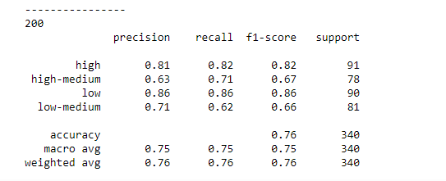
(Page 1 Header) THE AVOCADO STORY
(Context) Forecasting avocado prices in various US cities and analysing what features are affecting avocado prices in the US.
(Header 1) Exploratory Data Analysis
(Header 2) Exploratory Data Analysis with Interactive Elements
(Header 3) Prescriptive Data Analysis
Image 1.
Image 2.
Image 3.
Notes:
PAGE 1: TABLEAUT

Slide 20
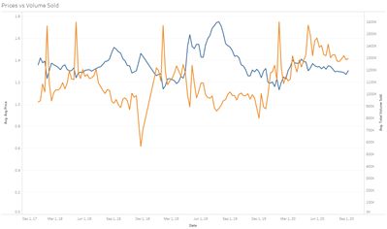
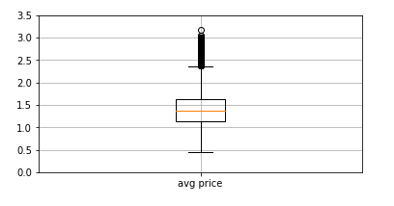
(Article Header) Exploratory Data Analysis
Image from the initial analysis 1.
Image from the initial analysis 2.
Image from the initial analysis 3.
Brief description 1.
Brief description 2.
Brief description 3.
Image from the initial analysis 4.
Image from the initial analysis 5.
Image from the initial analysis 6.
Brief description 4.
Brief description 5.
Brief description 6.
Notes:
PAGE 2: TABLEAU: Exploratory Data Analysis. Images from the initial analysis.

Slide 21
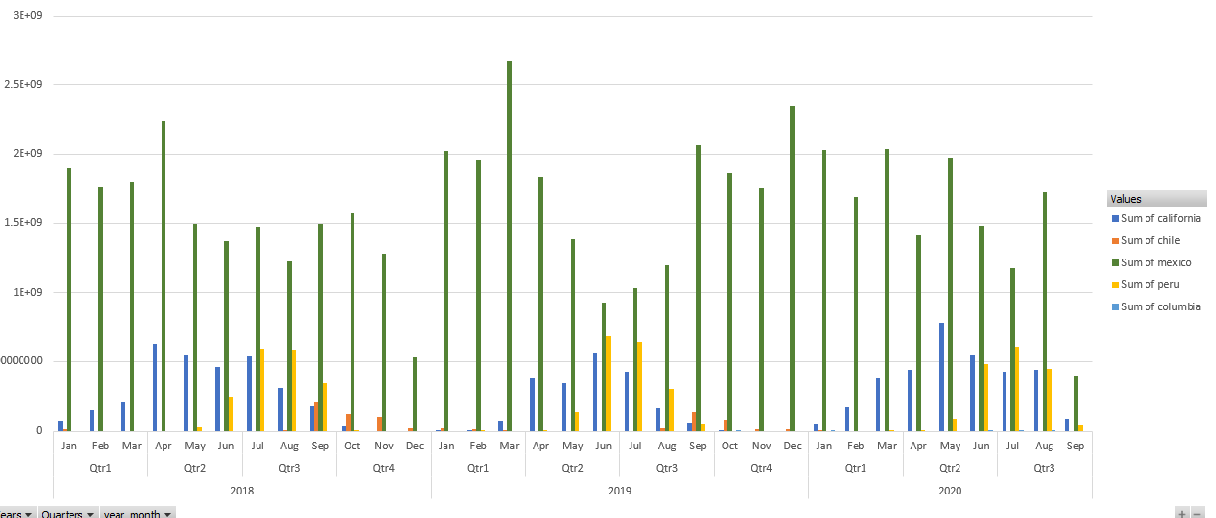
(Page Header) Interactive Elements
Brief description 1.
Brief description 2.
Interactive Map 1.
Interactive Chart 2.
Brief description 3.
Interactive Bar Chart 3
Notes:
PAGE 3: TABLEAU Page with interactive elements

Slide 22
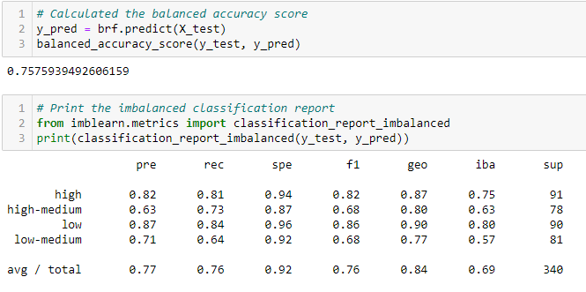
(Article Header) Predictive Data Analysis
Machine Learning Models - Explanation
Images from the ML task 1.
Images from the ML task 2.
Images from the ML task 3.
Report from the ML task 1.
Report from the ML task 2.
Report from the ML task 3.
Notes:
PAGE 4: TABLEAU: Data (images or report) from the machine learning task.

